Slide 1
Managing Difficult Personalities
Catie Kriplean
Professional Development Specialist
State Auditor’s Office
July 20, 2022

Slide 2
-Maya Angelou
“I’ve learned that people will forget what you said, people will forget what you did, but people will never forget how you made them feel.”
Notes:
Story of Beas as mentor making me feel like I could succeed.
Communicating ideas and messages is most effective when you consider their feelings and them as a person.

Slide 3
Work Styles and Communication
Know Yourself and Your Team
Notes:
Start by understanding how others communicate based on their work styles

Slide 4
Objective
Understand how the brain responds to stress in relation to different communication styles:
To effectively work and communicate with all team members
To be inclusive of all people and their work styles
By style flexing to match work types to approach communication differently based on each person’s style.

Slide 5
Benefits of knowing and using work styles
  Avoid miscommunication which leads to more efficiency
  Better conflict resolution
  Develop empathy for co-workers
  Appreciate diversity and cultivate inclusive environment
Notes:
Why should you know your team member’s communication styles?
Knowing and understanding the different personalities has some benefits:
1. Avoid Miscommunication –
When you better understand the people around you, you communicate better, then you will inevitably work better together. With this better understanding of the person, you will be able to avoid miscommunication and speak to your colleagues most effectively. Chambers story
2. Better conflict resolution
If you understand how someone handles conflict and how your personality handles it, you can navigate otherwise sticky situations with newfound ease. While some people prefer a direct, logical approach to working through tension, others prefer to approach conflict gently. Once you understand your personality, you may become more self-aware of how you handle conflict and where you could improve or be more empathetic. Considering differences concerning conflict resolution can help you avoid worsening interpersonal issues and handle challenging situations with care and empathy.
3. Develop empathy for coworkers
Building an empathetic culture starts with your communication with team members. Empathetic communication is a way of adapting your style to communicate with others the way they like, rather than the way you want. By intentionally adjusting your communication in meetings to align with your team’s personality makeup, you’ll improve your team’s productivity and comfort in any discussion. Story of Kevin speaking up in meetings vs. Catalina who needed time to process and perfect what she wanted to say (gave advance notice via email, one on one, etc)
4. Appreciate diversity
Understanding and appreciating that each person may see things differently is helpful because it gives perspective and allows for more inclusivity and less judgment in the workplace. Make differences in work styles work for you, not against you. No one is good at everything --> different work styles supplement your own abilities with strengths of people who are different from you

Slide 6
DISC
Leadership Compass
Personality Profiles
What color is your parachute?
Myers - Brigs
Productivity Style
Strengths-finder
Notes:
Lots of different versions of workstlye tests all based on the same research

Slide 7

Complete Work Style Inventory
Notes:
Scan QR for a digital copy of the work style inventory
Instructions:
Consider each of the following questions separately.
Circle one number (1, 2, 3, or 4) that corresponds to the description that best fits your current work habits.
If you have trouble selecting only one answer, ask yourself which response, at work, would be the most natural or likely for you to make.
There are no right answers to these questions, so base your responses on how you are today, not how you think you should be or would like to be in the future.

Slide 8

Calculate Results
Circle the letter that responds to each question from your quiz.
Count up the responses to the four specific working styles: driver, expressive, amiable, and analytical.
Record at the bottom of this sheet

Slide 9
Results Meaning
Facts and Results;
Thinking and Task Oriented
Analytical
Driver
Slow/Patient
Introverted
Fast/ Impatient
Extroverted
Amiable
Expressive
People and Emotions;
Feelings and Relationships
Notes:
Explain chart
No one is all one style because we are all complex. This is a continuum.
I had 7 Analytical and 4 in Driver and Expressive.

Slide 10

Analytical
Facts and Results;
Thinking and Task Oriented
Behaviors
Wants excellence and quality
Needs to comply with standards
Avoids uncertainty
Strengths: accuracy and precision
Weakness: poor improviser
Slow/Patient
Introverted
Fast/ Impatient
Extroverted
People and Emotions;
Feelings and Relationships
Notes:
THEY ASK HOW?
THEY FEAR BEING EMBARRASSED
IN THEIR OFFICE/CUBICLE: Business related, degree, no pictures or flowers, functional, each corner has a purpose

Slide 11

Amiable
Behaviors
Facts and Results;
Thinking and Task Oriented
Wants harmony and peace
Needs to serve others
Avoids confrontation, conflict and change
Strengths: team player, loyal and patient
Weakness: taking a stand (perceived as indecisive)
Slow/Patient
Introverted
Fast/ Impatient
Extroverted
People and Emotions;
Feelings and Relationships
Notes:
THEY ASK How does this affect the way it is done? → change is outside their comfort zone
THEY FEAR losing trust and having disagreements.
IN THEIR OFFICE/CUBICLE: pictures, usually candid, colorful decorations, neater as not to offend anyone

Slide 12

Driver
Behaviors
Facts and Results;
Thinking and Task Oriented
Wants action and better results
Needs to control and to win
Avoids wasted time and energy
Strengths: decisive, task and goal oriented
Weakness: insensitive to others
Slow/Patient
Introverted
Fast/ Impatient
Extroverted
People and Emotions;
Feelings and Relationships
Notes:
THEY ASK WHAT?
THEY FEAR LOSING CONTROL or becoming emotional at work
IN THEIR OFFICE/CUBICLE, they like a corner, posed family portraits, properly decorated, feels polished

Slide 13

Expressive
Facts and Results;
Thinking and Task Oriented
Behaviors
Wants feedback, to be liked, social recognition
Needs to interact and verbalize
Avoids boredom
Strengths: interaction skills and persuasion
Weakness: impulsive
Slow/Patient
Introverted
Fast/ Impatient
Extroverted
People and Emotions;
Feelings and Relationships
Notes:
THEY ASK WHO?
THEY FEAR rejection
IN THEIR OFFICE/CUBICLE, it’s a mess, sayings on the wall, dead flowers, bright, cheerful feeling

Slide 14
Reflect and Discuss
  How accurate do you feel the results are?
  How will this knowledge impact your communication at work?
Notes:
Remember, this is not black and white, this is a continuum and you will have traits of more than one workstyle

Slide 15
Leading Your Team
with Neuroscience and Empathy
Notes:
Let’s take the knowledge of work styles to lead the team using neuroscience and empathy

Slide 16
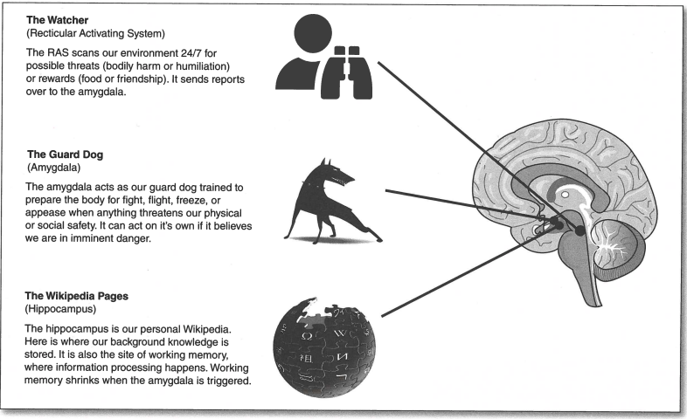
Brain Structure
Notes:
Start with neuroscience: explain brain structure
When someone is stressed, they no longer are using their prefrontal cortex, but the amygdala is taking over and reacting. They’re no longer in a logical or rational state of mind. This is when others are seen as “difficult.”
We want to avoid reaching this stage by using our knowledge of workstyles to make others feel comfortable.
Image from Culturally Responsive Teaching and the Brain by Zaretta Hammond

Slide 17
How does this translate to work styles?
Behavior Under Stress (page 11)
Facts and Results;
Thinking and Task Oriented
Avoiding
Autocratic
Analytical
Driver
Slow/Patient
Introverted
Fast/ Impatient
Extroverted
Amiable
Expressive
Acquiescing
People and Emotions;
Feelings and Relationships
Attacking
Notes:
Each workstyle tends to react differently when stressed. Explain diagram.
Refer to page 11. Has what suggestions of what that person may “need” to de-escalate and move out of the Amygdala
So how do we avoid reaching this stressed stage (next slide)

Slide 18
Start Implementation
Whole team completes work style inventory
Discuss communication preferences and change practice based on team member’s style
Color coded names/badges
Assign tasks/project based on work style strengths
Check in on style
Notes:
You can start with:
Whole team completes work style inventory
Discuss communication preferences and change practice based on team member’s style (when working in new team like SAO has new teams often for different projects. Discuss at the beginning of projects)
Color coded or symbol on names/badges/offices
Assign tasks/project based on work style strengths
Check in on style → when I started working professionally vs. now because my personal values have shifted from focusing solely on work to work and building relationships

Slide 19
Style Flex
What it is:
Tailoring your behavior so the way you communicate fits better with the other person's style
Presenting your ideas in way that is comfortable to the other person
What it ISN’T:
Manipulation
Conformity
Notes:
What it is:
Tailoring your behavior so the way you work fits better with the other person's style
Presenting your ideas in way that is comfortable to the other person
Like a baseball player choosing to swing differently at a fastball, slider, or curve ball
Style flexing is choosing how to communicate to best get your message to the intended
What it ISN’T:
Not manipulation or conformity
Manipulation: Being nice at their expense
Style flexing is choosing how to communicate to best get your message to the intended
You aren't conforming your ideas, you are choosing the process (how) you communicate, also seen as adapting to another's process

Slide 20
How to style flex
Identify your style and the other person’s style
Plan
Implement: monitor
  Is it making the other person feel more comfortable?
  Are you more productive?
Evaluate
  What went well?
  What was a miss?
Notes:
To identify look at work habits you’ve observed or share work styles within the team
Plan: Adjust body language and/or the way you say things to the other’s preferred style to make them feel comfortable. Change only a few things (3-4).
Implement: as you flex your style, monitor the changes for positive or negative effects
Is it making the other person feel more comfortable?
Are you more productive?
If yes → great, you know for the future interactions
If no → make adaptions to improve
There will be trial and error, you can modify your plan and behavior
4. Evaluate: after the fact, look at the results
What went well:
What specifically did they respond positively to?
Which change had the most impact?
Could you do this more often with this person?
Would you want to do this with others of the same style?
What was a disappointment:
What specifically did they NOT enhance the interaction?
Was it do
to misidentification of the person’s style?
Poor planning
Ineffective implementation?

Slide 21
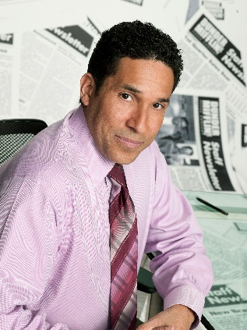
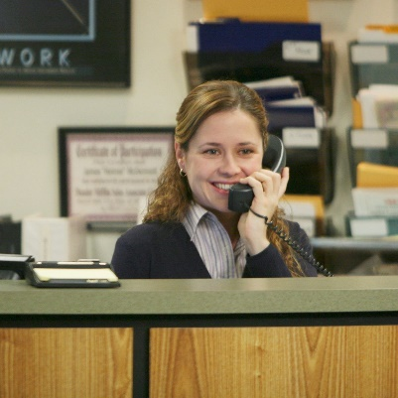




  Check accuracy
  Give them the time and space to make a decision
  Be straight forward
  Be prepared at all times
  Be personable
  Show interest in them as a person
  Be informal in conversation, but keep on task
  If you disagree, expect hurt feelings
  Be non-threatening (focus on work)
  Tie facts to results
  Focus on the win-win
  Make an effort to be efficient
  When done, depart graciously
  Allow time for small talk
  Ask for their opinions
  Lay out the important, put the support in an addendum
  Provide testimonials from people they see as important.
Analytical
Amiable
Driver
Expressive
General Strategies by Behavior Type (page 9)
Plan Your Style Flex

Slide 22
When to Style Flex
Temporary → not all the time
At the beginning of a conversation
When something important is at stake
When the other person seems to be under considerable amount of stress
When the person you are communicating with is especially rigid i.e. difficult
Notes:
When should you style flex?
Temporary
At the beginning of a conversation
When something important is at stake
When the other person seems to be under considerable amount of stress
When the person you are communicating with is especially rigid i.e. difficult

Slide 23
Providing Feedback
Be empathetic by style flexing
Managing by Style page 10 has different suggestions based on feedback type
Motivate
Compliment
Counsel
Correct
Delegate
Notes:
Providing feedback is one of the most challenging aspects of leading a team. Style flexing can help avoid causing stress or “difficult” people from reacting negatively.

Slide 24
Atul Gawande, Director of USAID Global Health, Surgeon, and Author of Better: A Surgeon’s Notes on Performance
“Better is possible. It does not take genius. It takes diligence. It takes moral clarity. It takes ingenuity. And above all, it takes a willingness to try.”
Notes:
Emphasize they are leaders who need to take the first step. Others will reciprocate

Slide 25
Thanks
Thanks
Do you have any questions?
Catie.kriplean@sao.texas.gov
512-936-6906
https://sao.texas.gov/Training/
Please keep this slide for attribution

Slide 26
Sources
Crystal Knows - 5 Benefits of Understanding Personalities in the Workplace
People Styles at Work...And Beyond: Making Bad Relationships Good and Good Relationships Better: Bolton, Robert, Bolton, Dorothy Grover
Work Styles Handout https://qrco.de/bdAGIx
Culturally Responsive Teaching and The Brain: Promoting Authentic Engagement and Rigor Among Culturally and Linguistically Diverse Students: Hammond, Zaretta L.
Handout: Work Style Inventory

