Slide 1
Audit ready! Strategies for Success
TSABAA Conference
July 20, 2022

Slide 2
Overview
Setting the Stage
Our Story
How to Work with Internal Auditors
How to Work with External Auditors

Slide 3
Setting the stage

Slide 4
Background / intro

Slide 5
Notes:
By a show of hands, how many of you have been audited or encountered an auditor in your work? And by “audit” or “auditor”, I mean someone outside your section that has come to review your work, your team’s work, your agency’s work…. Maybe they didn’t call themselves an “auditor”. Maybe it was termed a “review”. Walks like, talks like, quacks like…..
Auditors/reviewers come from both the state level (name examples)
And from the federal level….. (name examples)

Slide 6
Our story

Slide 7
Single Audit FY2012 Results:
Current Year Findings |  | Prior Year Findings |  | TOTAL FINDINGS | Total Questioned Costs
 | Material Weakness or MW and MNC |  | Reissued as Current Year Findings
19 | (9) | 12 | (9) | 22 | $1.248 M

Slide 8
What We Tried:
Audit *More*
Audit *Better*
Audit *Less*
Advise

Slide 9
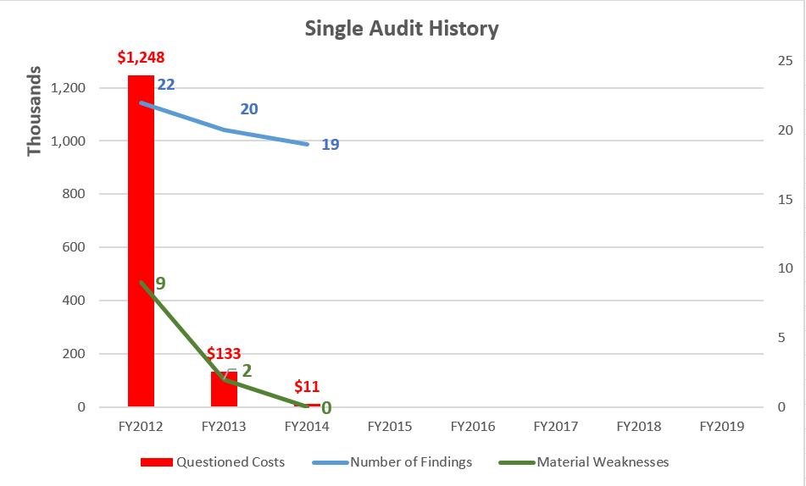

Slide 10
What Finally Helped
Focusing on
AUDIT
READINESS

Slide 12
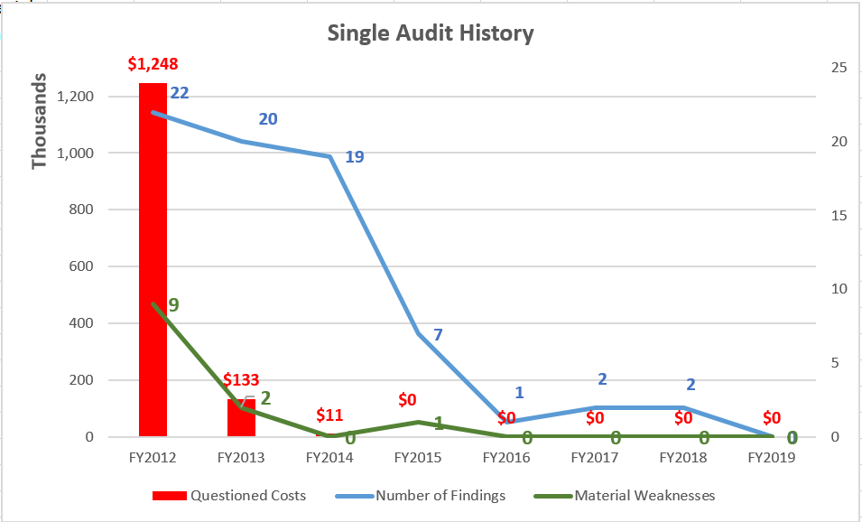
Notes:
Note especially the audits of Fiscal years 2017 and 2018.
Who remembers a major event requiring significant federal funds that occurred August/September 2017?
Hurricane Harvey made landfall along the Texas coast near Port Aransas around 10:00 p.m. on August 25th as a cat 4 hurricane.
However, because the rule of two years @ “low risk”, Hurricane Harvey federal disaster dollars were actually not audited at DPS in FY2018.

Slide 13
Mission of Internal Auditing
“To enhance and protect organizational value by providing risk-based and objective assurance, advice, and insight.”
The Institute of Internal Auditors
Notes:
From the official “Mission of Internal Auditing” as promulgated by our professional standards board….
To close the story – we saw our role in helping our agency through this challenge, by not just auditing them, but by providing insight on how to be better prepared for audits…..

Slide 14
How to Work With Internal Auditors
Strategies for Success
What Internal Auditors Wish Management Knew…..
Notes:
SUSAN

Slide 15
There is a Difference….
EXTERNAL AUDIT | INTERNAL AUDIT
Focus on Historical Events | Focus on the Future
Compliance | Goals and Objectives of the Organization
Typically, Cannot Perform Consulting Services | The Definition of Internal Auditing – “Assurance and Consulting Activity”
They Leave | Ongoing Relationship
Independent of the Organization | Independent of Management, but NOT Independent of the Organization
Provide Assurance to Third Parties | Provide Assurance to the Board and to Senior Management
Scope is Often Prescribed | *Risk* Driven
Compliance Driven | Process and Controls Driven (Economy, Efficiency, Effectiveness, and Excellence)
Notes:
SUSAN
First – let’s distinguish internal from external auditors. Maybe you think an auditor is an auditor is an auditor…. Not so.

Slide 16
Develop Your Relationship
Strategies for Success – Internal Audits
Internal Audit as “Partner”
Internal Audit as “Trusted Advisor”
Internal Audit on your side
Notes:
SUSAN

Slide 17
Bring Your Internal Auditor in Early
Strategies for Success – Internal Audits
Most value in providing services on the front end
Preventive vs. Detective
Advantage of Advisory Services (vs. Assurance Services)
Notes:
SUSAN

Slide 18
Identify Issues Up Front
Strategies for Success – Internal Audits
Internal Audit is on your team – be straight, don’t hide anything
Auditors will likely find anyway
Allows auditor to spend more time on developing the recommendation – i.e., solution-oriented.
Notes:
SUSAN

Slide 19
How to Work With External Auditors
Strategies for Success
Preparing for an Audit
and
During an Audit
Notes:
SUSAN

Slide 20
Have a Strategy
Strategies for Success – External Audits
Notify Internal Audit – let them act as your liaison
Hold Pre-Entrance and Pre-Exit Strategy Meetings with IA
Identify/establish POCs for the audit
When to escalate to IA
Ensure story is transparent, accurate, and complete
Identify and Resolve Concerns/Issues Early – Don’t Wait (no news is not good news)
Communicate Above and Below – keep your team informed and be sure to keep your chain of command informed.
Take Corrective Actions During the Audit (if possible)
Notes:
SUSAN

Slide 21
Housekeeping
Strategies for Success – External Audits
PLAN FOR AUDITS
Ensure written policies/procedures up to date
Identify key requirements and restraints – statutes, rules, regulations, budget limitations
Self-audit prior to audit
Know where you stand on any prior audit findings
Identify known issues and planned corrective actions – better for you to have identified them, allows the auditor to focus more on the corrective actions
Be very organized – Present your best self
Notes:
SUSAN

Slide 22
Communication
Strategies for Success – External Audits
Discuss schedules and any upcoming events that might impact the audit
Seek to understand the auditor’s objectives. Rather than just answering the question asked or providing the document requested, seek to understand what the auditor is trying to determine. This will help ensure:
Better understanding
Accuracy
Completeness
Request status meetings with the auditors periodically throughout the audit.
Identify and resolve differences with auditors early
Take corrective actions during the audit
Always be Pleasant, Courteous, Accommodating
Refrain from arguing with the auditors (let IA or GC do this, if necessary)
Do not be afraid to suggest language.
After receiving draft report, 1) identify any inaccuracies, and 2) identify unnecessarily inflammatory or confusing language. Remember, usually a short window to do this.
Notes:
SUSAN

Slide 23
Example: Communicating Management Actions Taken
Added 3 FTEs
Updated Policy & Procedures Manual
Reorganized Functional Responsibilities
CONNECT THE DOTS – Tell the “for why?” and the “impact” if possible
as dedicated resources to reduce existing backlog, resulting in a 29 day drop in travel payment processing time.
to reflect new processes over approvals and authorizations for card transactions, ensuring greater understanding of and adherence to compliance requirements.
to achieve greater efficiencies and improved customer service through incorporating dedicated points of contact to deepen business acumen of Finance liaisons. Standing monthly meetings with dedicated Finance liaisons have resulted in early identification of potential issues.

Slide 24
Shared Objectives
ACCURACY
FAIRNESS

Slide 25
Questions?
Catherine A. Melvin, CPA, CIA, CLEA
Chief Auditor
Texas Department of Public Safety
Office: 512-424-7573
Email: catherine.melvin@dps.texas.gov
Susan Oballe, CIA, CGAP
Assistant Chief Auditor
Texas Department of Public Safety
Office: 512-424-2158
Email: susan.Oballe@dps.Texas.gov
We are a strategic partner within DPS that is committed to continuous improvement. We are dedicated to building positive business relationships and strive to add value as our internal partners seek our assistance.

