Slide 1
Leading Multiple Generations
Denise Messina
Senior Professional Development Specialist
July 21, 2022

Slide 2
40%
Percentage of workplace conflict that stems from generational differences.

Slide 3
You’re working on an project with team members who vary in age from 22 to 65.
You send out an email at 3:00 p.m. that says, “The information we’ve been waiting on is here. We need all team members to change focus and wrap this portion up ASAP.”
What responses do
you receive?
Notes:
At your table – you can turn around if you like to form a bigger team. Read the case study and come up with a couple of answers.
I work 8-4 and I have a gym class at 4:30. Can I come back later?
I need to pick up my kids, can we meet earlier?
If everyone else is staying, I’ll stay. Should we order in?
No problem, I’ll start on it now.
What is ASAP and what do you mean when you say it?
Why the differences in response?
Work time and definitions around work ethic is just one area where we see generational differences or more generally age differences. Where else could we see differences?
Work-life balance, loyalty, dress code (tattoos/piercings, hair color/cut), communication.
Let’s watch a video and see this in action.

Slide 4


Slide 5
Today’s Workforce
Traditionalists
1930-1945
2%
Millennials
1981-2000
35%
Gen Zers
1991 –
5%
Baby Boomers
1946-1964 25%
Gen Xers
1965-1980 33%

Slide 6
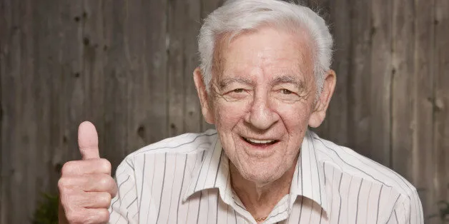
Traditionalists – Born 1930-1945
Dependable | Straightforward | Tactful | Loyal
Events: Great Depression, WW ll, GI Bill, Communication
Motivated by: Respect, Recognition, Long-term Value to Company
Communication Style: Formal Tone, Letters, Phone, In-Person
Insight: Needs work that is satisfying and meaningful. Wants stability.

Slide 7


Baby Boomers – Born 1946-1964
Optimistic | Competitive | Workaholic | Team
65% Plan to work beyond retirement age.
Events: Vietnam War, Robust Economy, Watergate, Civil Rights
Motivated by: Status, Process and Procedure, Chain of Command
Communication Style: Less Formal, Phone Calls, Face-to-Face
Insight: Great in Mentor Roles, Work best with Goals and Deadlines.
10,000 Reach retirement age every day

Slide 8

Generation X – Born 1965-1980
Flexible | Informal | Skeptical | Independent
55% of Startups are Gen Xers – the highest %
Events: Divorce/Latch Key, 23% Interest, Fall Berlin Wall, AIDS Crisis
Motivated by: Work to live, Efficiency, Flexibility, Personal Interests
Communication Style: Informal, Whatever is Efficient
Insight: Feedback, Flexible Work arrangements, Personal Development.
By 2028 will outnumber Baby Boomers

Slide 9

Millennials (Y’s) – Born 1981-2000
Competitive | Civic Minded | Achievement Focus
55% of Global Workforce by 2025
Events: School Shootings, 9/11, Technology
Motivated by: Responsibility, Quality Manager, Unique Work Exp.
Communication Style: Instant/Brief/Technology– own language
Insight: Manage by Results, Flexible Schedule and Work Assignments
15% of ages
25-35 living at home with parents

Slide 10

Gen Z – Born 2001-2020
Global | Entrepreneurial | Practical | Authenticity
65% more digital communicationthan in person
Events: Global Terrorism, Covid 19, Digital Natives
Motivated by: Diversity, Personalization, Individuality, Creativity
Communication Style: Technology, Not talking on phone
Insight: Multiple Projects, Self-Directed and Independent, W/L Balance
45% self-report they are online almost constantly

Slide 11
Quick Glance at Generalizations
“I paid my dues along the way. Is it too much to ask for young people to make an occasional sacrifice?”
Values: Optimism, freedom, idealistic, and defining themselves through their work
“I have a family life…so sue me.”
Values: Skepticism, informality, self-reliance, independence, and multitasking
“I’d be happy to share some of the wisdom it’s take me years to accumulate. But nobody asks me!”
Values: Respect for authority, disciplined, duty before pleasure, hard work and sacrifice
“What do you mean, I am not qualified for the Vice-president position? I have a college degree and I was President of my University’s student body association.”
Values: Diversity, teamwork, community commitment, and technology
“I can work as effectively on a report at home; I don’t have to drive through rush hour traffic to sit at my desk and get it done.”
Values: Diversity, social, expressive, socially conscience, and on-the-job training

Slide 12
Case Study
A team leader of a group of 15 employees spanning all four generations comes to you with a problem. Some of the older workers are complaining that the younger employees are playing computer games over lunch. They feel this is inappropriate behavior on the job; the younger generations say that it is relaxing to them, and who cares what they do for their lunch time?
What are the sources of disagreement?
What filters are the various generations using when addressing this problem?
What else do we need to know before addressing?

Slide 13
Tips for Avoiding Generational Misunderstandings
Approach generational differences with interest, not fear or stereotyping.
Be aware of your own assumptions.
Empathize with their values.
Avoid generational jargon.
Remember that most items are a matter of preference, not a rule.
Practice active listening.
Appreciate the benefits of a multi-generational workforce.

Slide 14
Successfully Leading
Multi-Generational Teams
Focus on the mission and goals and help team members define how their talents and expertise make an impact.
Create communications systems that provide information and resources to each person, all the time.
Customize incentives that recognize, reward and drive high performance.
Notes:
.

Slide 15
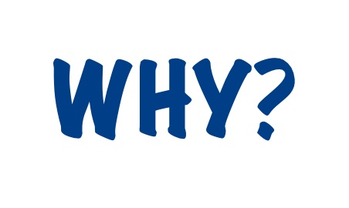

Focus on the mission and goals and help team members define how their talents and expertise make an impact.

Slide 16

Create communications systems that provide information and resources to each person, all the time.
Are there generational implications?
What information is best transferred with this method?

Slide 17

Customize incentives that recognize, reward and drive high performance.
Employer-employee relationship
Scheduling assignments
Incentives
Training
Tracks for advancement
Work hours
Autonomy
Office equipment
Meeting environment

Slide 18
Thank you!
Make it a
great day!
Jo dale Guzman
Jodale.guzman@sao.texas.gov
Notes:
Session Description: Leading multiple generations, even in a small work group, has quickly become a core competency for everyone. Each generation has distinct perspectives, values, and communication styles. The differences between generations isn’t new to the workplace, what is new is the speed at which cultural change happens and how that has resulted in micro-generations and an even greater divide between distinct generations. This session will discuss how to create a work environment that meets the needs of all generations.

