Slide 1
Tools to Attract and Retain Employees: BENEFITS!
Texas State Agency Business Administrators’ Association
July 21, 2022

Slide 2
Employees Earn Valuable Benefits

Slide 3
Benefits include
Health coverage
100% premiums paid for eligible full-time employees
50% health premiums paid for eligible spouses and children of full-time employees
ERS Retirement plan (if applicable)
Valuable benefits make up about one-third of the average State of Texas compensation package
More pay and vacation time as rewards for longevity
Notes:
When is the last time you reviewed your benefits? Did you enroll when you were first employed and haven’t reviewed them since?
Well, whether you’ve been working for the state for one year or twenty, we recommend you review your benefits at least once a year to make sure you’re enrolled in the best benefit options for you and your dependents. Then, we recommend you learn about how to get the most value from your benefits.
Let’s do a quick overview of benefits offered through ERS to state and higher educations employees:
health coverage;
dental coverage;
State of Texas Vision;
Optional Term Life Insurance;
Dependent Term Life Insurance;
Voluntary Accidental Death & Dismemberment (AD&D);
Texas Income Protection Plan (TIPP);
TexFlex;
Texa$aver (if applicable) and
the ERS retirement plan (if applicable).
We’ll go into more detail about each one in the next few slides.

Slide 4
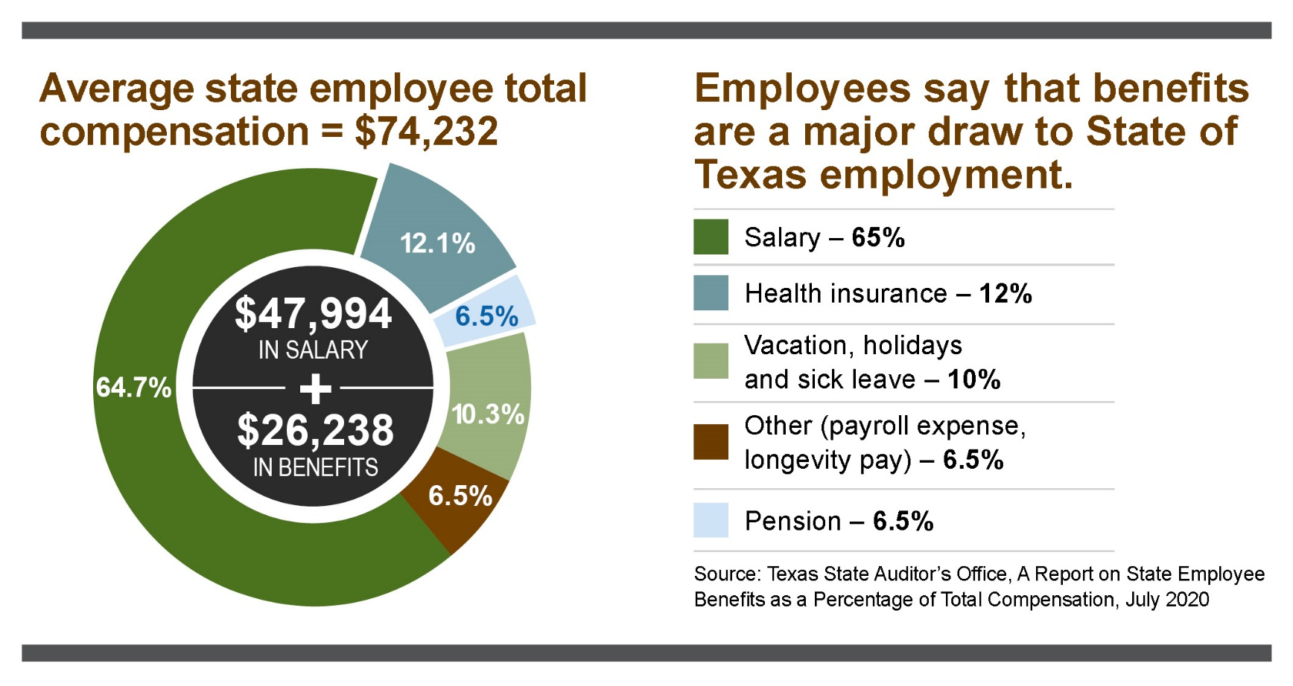
Benefits breakdown

Slide 5
ERS website: ers.texas.gov Benefits information for new employees and recruits
Overviews of and details on:
Health and other insurance benefits
State of Texas Retirement and Texa$averSM 401(k)s and 457s
Dependent eligibility and coverage

Slide 6
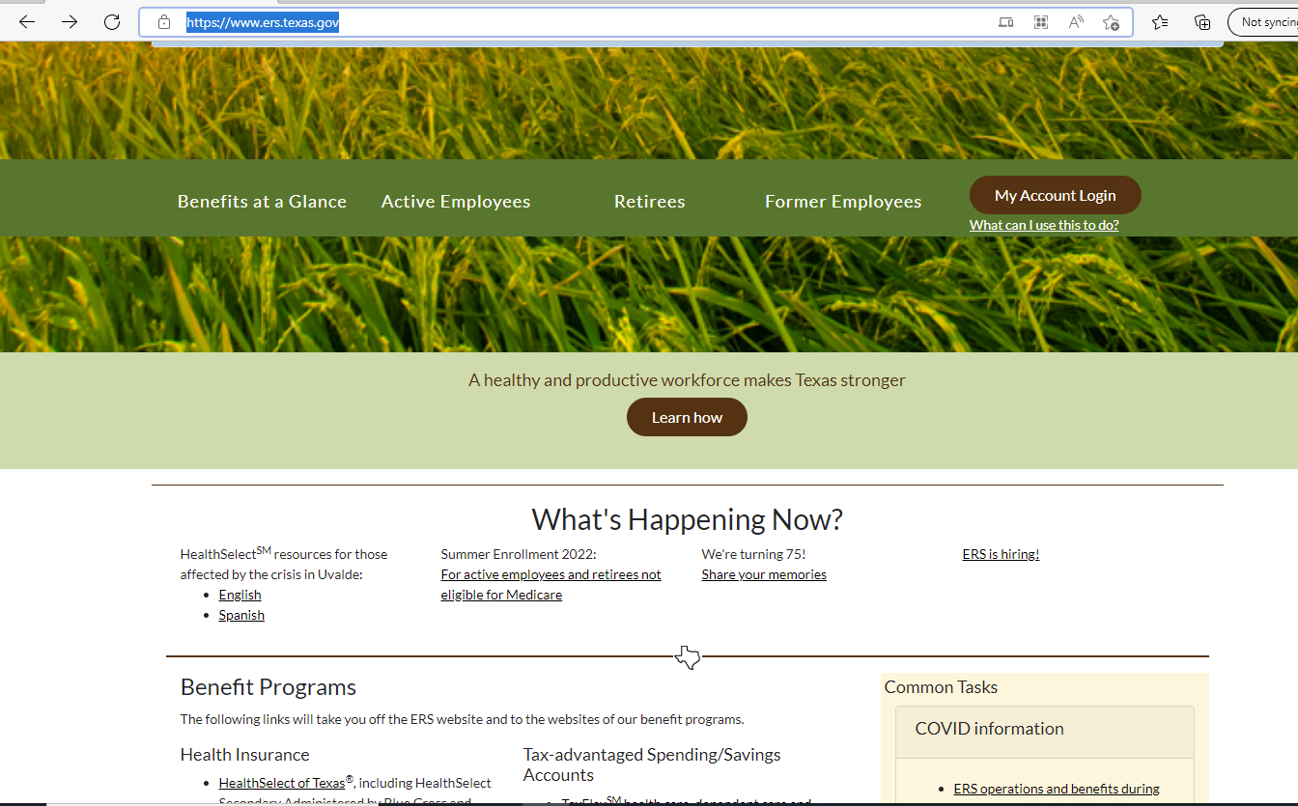
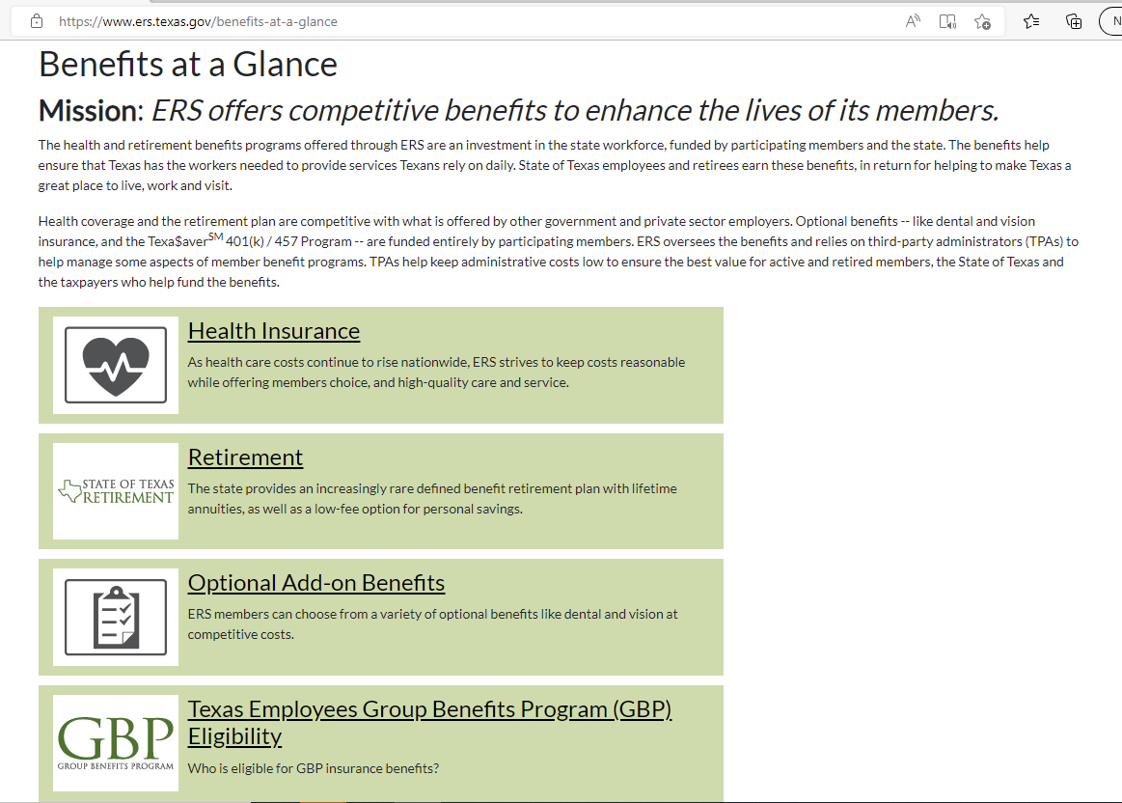
Overview for Recruits: Benefits at a Glance
Notes:
This slide has two builds:
First click brings the red circle
Second click brings the Benefits at a Glance page screenshot

Slide 7
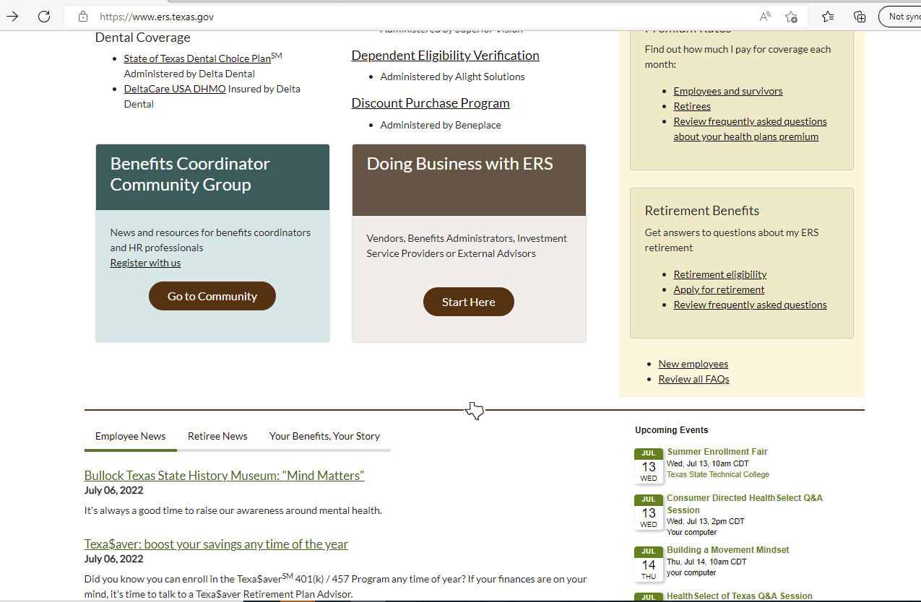
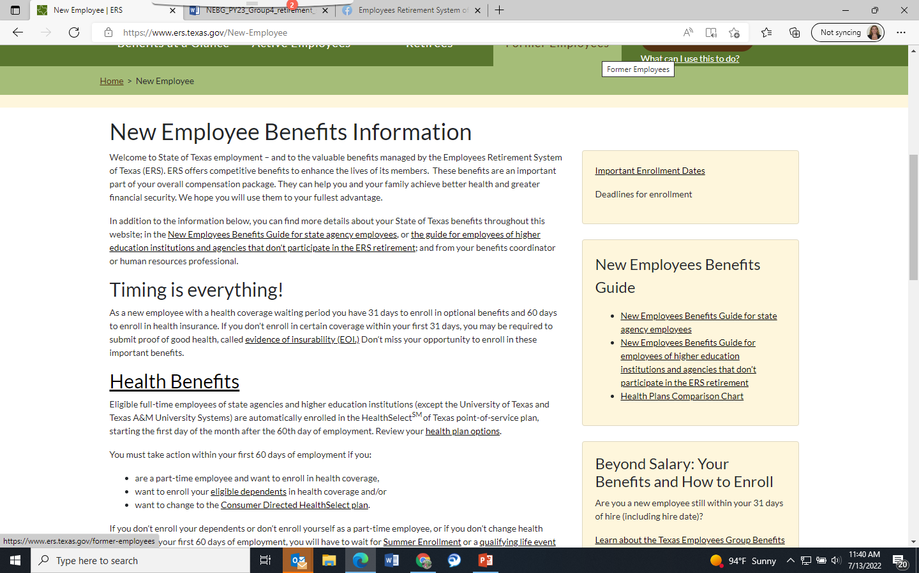
Information for New Employees
Notes:
This slide has four builds:
First click brings the red circle on the homepage
Second click brings the new employees page screenshot
Third click brings the red circle for the NEBG
Fourth click brings the red circle for the Beyond Salary link

Slide 8
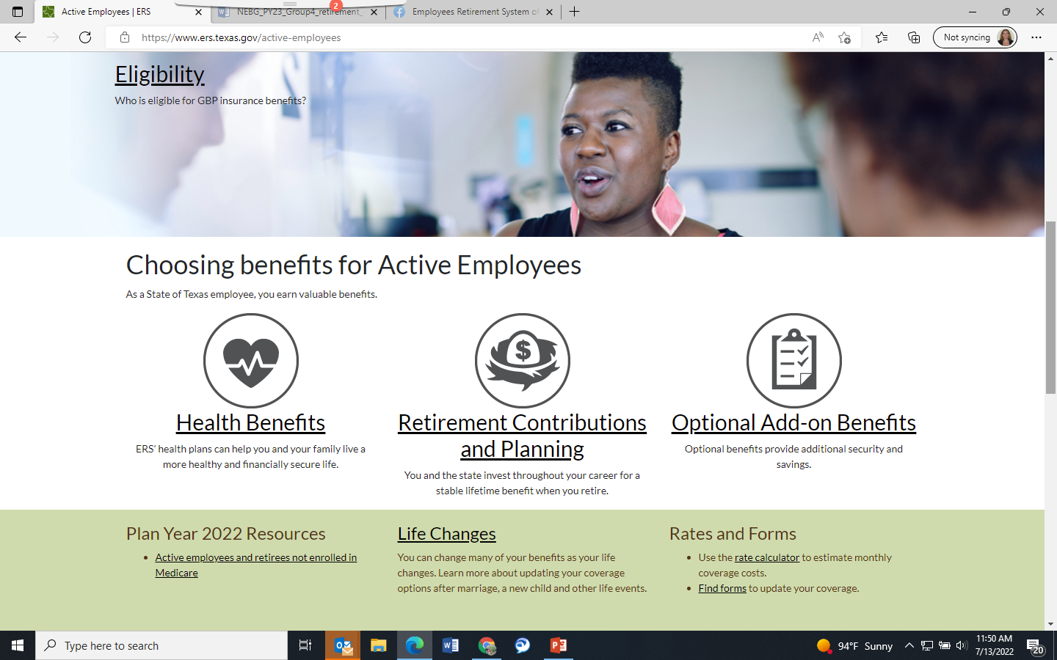
More Details
Notes:
This slide has two builds:
First click brings the red circle
Second click brings the active employee landing page screenshot

Slide 9
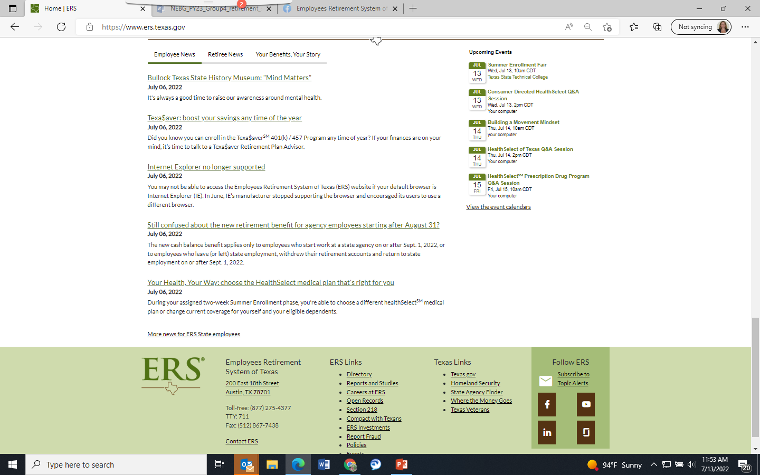
Ongoing Information and Education
Notes:
This slide has three builds:
First click brings the red circle over “Employee News”
Second click brings the red circle over the subscription link
Third click brings the red circle over events

Slide 10
Benefits – ERS Defined Benefit Plan
Defined benefit retirement plan offers lifetime retirement payments after just 10 years of state service (five years for employees starting on or after Sept. 1, 2022)
Employees earn insurance benefits* in retirement after 10 years of state service.
Optional 401(k) / 457 plans with affordable minimum contributions and low fees can help boost retirement income.
*Health and other insurance benefits for employees and retirees are subject to change based on available state funding. You should confirm the benefits available as of your proposed hire date with the agency’s human resources department.
Notes:
This slide only applies to employees who participate in the ERS retirement plan.
The State of Texas retirement plan is a defined benefit plan, or commonly known as a pension. This plan pays eligible retirees a set monthly annuity that is calculated using a formula defined by state law and based on factors like your salary and years of service. The Texas Legislature also determines contribution rates for the plan. Currently, 9.5% is deducted from your pre-tax earnings and deposited into your ERS retirement account. This contribution cannot be changed or waived. The state contributes 9.5% of payroll and your agency contributes .5%. The state and agency amounts are deposited into the ERS Retirement Trust Fund.
Every month you contribute to the plan, you get one month of service credit. This includes earned and purchased service credit . The amount of service credit you have plus your age determines when you’ll be eligible to retire. Eligible retirees meeting the necessary criteria receive a lifetime monthly annuity and can be eligible for GBP retiree insurance benefits.
You can’t take out loans against your ERS retirement account. If you leave state employment, you can request a refund of your retirement contributions, (but not the state and agency contribution), and any interest earned on the contributions. Be aware that funds paid out directly to you are taxed and depending on your age, you could have an additional penalty when you file your taxes the following year. If you withdraw your contributions, you lose the earned service credit. This means you will not be eligible for the retirement benefit unless you start working and contributing to your state retirement plan again.

Slide 11
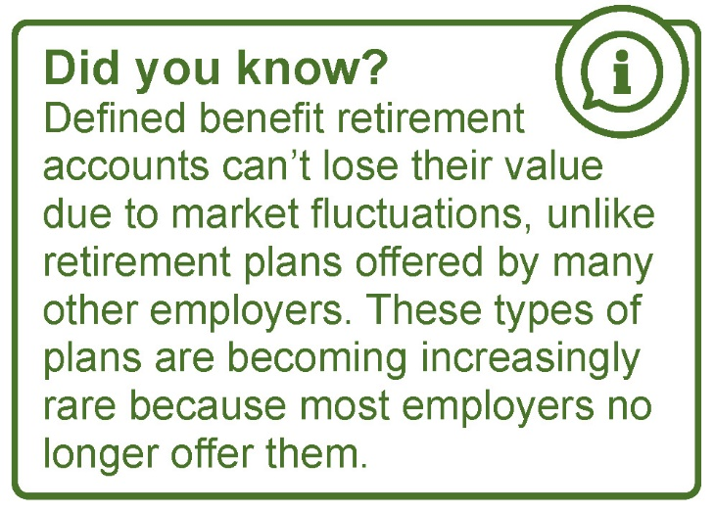
Benefits - Retirement

Slide 12
Lifetime Retirement Benefits Group 4

Slide 13
SB 321 maintained a defined benefit pension plan for all state employees
Group 4 is NOT a 401(k) plan
Group 4 benefits are a defined benefit pension:
☑
investments are pooled together and professionally managed
☑
members qualify for a retirement benefit after working for a certain period of time (vesting period)
☑
members must reach a certain age to meet retirement eligibility
☑
retirees are paid a guaranteed income (annuity) for life
Notes:
Talking Points:
Pooled Investments is one way not a 401(k) – in those types of plans, employees get contributions but are “on their own” in investing and planning for retirement
Annuity – This is the key factor on how not a 401(k) – the state ensures employees have a guaranteed lifetime payment in retirement just like for Groups 1, 2 and 3.
The state offers an optional 401(k) and 457 personal savings plan for employees. That will still be an option for Group 4 employees to enhance their retirement planning
Legislature ensured that all current participants benefits are maintained with the provisions of SB 321
Group 4 benefits ARE NOT 401(k) or defined contribution style benefits.
Group 4 absolutely continues to be a defined benefit pension
The state has not lost the recruitment tool of a offered a pension plan – just a different style
Nearly all Texas county employees and a large number of city employees across the state have similar style of pension benefits as is Group 4

Slide 14
Group 4 – How it Works
Employee contributions:
Group 4 employees contribute 6% of pay into an individual retirement account
Investment earnings and gain sharing:
Guaranteed Annual Interest - individual account balance is guaranteed to increase in value each year by 4%
Notes:
During your career with the state, you will contribute 6% of your salary to your retirement account each month. Your contributions will come out of your monthly salary before taxes, helping to lower the amount you pay in income taxes.
Your contributions will go into your personal account. Your account will grow by a guaranteed 4% interest each year. In years when the five-year average of ERS’ total Trust Fund investment returns exceeds 4%, your account will also get half of the excess return percent as a percentage increase to your account balance—up to 3% additional per year.

Slide 15
Group 4 – How it Works
State match:
The state will match 150% of your account balance (including the interest earned and any gain sharing) throughout your career.
Lifetime annuity payments with opportunities for increases:
Group 4 standard lifetime monthly annuity is calculated based on the total cash balance amount and age at retirement
Group 4 annuities are expected to increase in retirement
Notes:
You cannot withdraw the state’s match, but you will receive it as part of your monthly annuity in retirement.
When you reach retirement eligibility and decide to retire, ERS will add up the money in your account plus the state’s final match to determine how much you have in your account at the time of retirement.

Slide 16
Group 4 Cash Balance Lifetime annuity calculation for regular state employees
A Group 4 standard lifetime monthly annuity is calculation example
+
=
$204,629
Member Account Balance
$306,943
150% State Match
$511,572
Cash Balance
$511,572
Cash Balance
$2,795
Starting Standard Monthly Annuity at Age 62
=
Annuity Factor
Member starting at age 32 with $35,000 starting salary assuming 2% annual salary increases throughout career.
Notes:
This step is a key factor that makes Group 4 a defined benefit and NOT a 401(k)
401(k) plans do not provide a lifetime annuity but leave employees to manage/invest the $511,572 on their own without a guaranteed lifetime annuity
Just like the benefits in Group 1,2 and 3 – a formula is used to calculate the final lifetime annuity – this is just a different type of formula
Special feature of Group 4 is these retirees will have annuities that increase in retirement because they get to share in those positive investment years as well.

Slide 17
Group 4 – How it Works
Vesting and retirement eligibility:
You will be fully vested in your retirement account after contributing to it for five years while you work for a participating state agency.
To be eligible to retire and start getting an annuity, you must either:
meet the Rule of 80, when your age (in years and months) plus your years and months of service credit equal 80, or
be age 65 and have at least five years of service credit.

Slide 18
Group 4 – Other benefits in retirement
Health insurance - if you retire with at least 10 years of state service in a benefits-eligible position.
Group dental insurance
Vision benefits
Term life insurance
Notes:
It’s important to know that insurance benefits are funded biannually by the Texas Legislature, and the state’s contribution for health premiums is not guaranteed.

Slide 19
401(k) or 457 Program
Pre-tax contribution
Automatically enrolled at 1% (ERS contributing state agency employees only)
Transfer funds
Employees can make changes
A 457 account may be available for some higher education institutions.
Retirees no longer make contributions but still have access to their accounts
Notes:
As a an active employee, you can boost your retirement savings through the Texa$aver 401(k) /457 Program, a voluntary retirement savings program administered by Empower Retirement.
Because it’s so important to save for retirement, new employees are automatically enrolled in the Texa$aver 401(k) plan. One percent of your salary is set aside pre-tax in this savings account. You can increase, decrease or stop your contributions at any time, and change how your funds are invested.
You can transfer money from a qualified retirement account from a previous employer to maximize your savings with Texa$aver.
Please Note: Program availability may differ for some higher education institutions.
If you are a retiree, you no longer make contributions into your Texa$aver account. Once you retire, you want to reach out to Texa$aver to get information on what happens with your account balance.
To learn more about managing your Texa$aver account you can view one of the presentations available through the Texa$aver website or contact Empower directly at (800) 634-5091.

Slide 20
Benefits - Insurance
Health insurance premiums for eligible full-time employees paid at 100% for you and 50% for dependents. For eligible part-time employees, premiums paid at 50% for you and 25% for dependents
No deductibles for in-network, in-area services in HealthSelect of Texas
Low-cost doctor visits and low- or no-cost virtual visits

Slide 21
Benefits - Insurance
Preventive care and physicals covered at 100%
Full prescription drug coverage with a mail-order service
State contribution to HSA for high-deductible health plan members
Notes:
HealthSelect of Texas®, a point-of-service plan or Consumer Directed HealthSelectSM, a high-deductible plan with tax-free health savings account (HSA)

Slide 22
Know your optional benefits

Slide 23
Health Care FSA | Limited-purpose FSA | Dependent Care FSA
Can be used towards eligible medical, dental, vision and prescription drugs Can pledge from $180 to $2,850 Debit card can be used | Can be used towards dental and vision only Can pledge from $180 to $2,850 Debit card can be used | Can be used towards dependent care expenses Can pledge from $180 to $5,000 There is no debit card There is no carryover but there is a grace period
Notes:
ERS also offers TexFlex which is a tax savings program regulated by the IRS and available to active employees. It lets you set aside money from your paycheck before taxes to use towards eligible out-of-pocket expenses. So, you save money on taxes!
We offer a Health Care FSA, Limited-purpose FSA and a Dependent Care FSA.
Enrolling in the health care FSA allows you and your dependents to use the funds towards eligible expenses such as medical, dental, vision and prescription drugs.
You can elect to contribute a minimum of $180 up to $2,850 annually. Your contributions are deducted pre-tax from your monthly paycheck. Your entire contribution is available your first day in the program even though you haven’t contributed all of the funds in your account.
Next, if you decide to enroll in Consumer Directed HealthSelect, you can use your HSA to pay for eligible medical expenses so you won’t be eligible to enroll in the Health Care FSA. However, you do have the option to enroll in the limited-purpose FSA.
The limited-purpose FSA works exactly the same as the HealthCare FSA, but you can only use the funds towards eligible dental and vision expenses.
Remember, the limited-purpose FSA is only available to Consumer Directed HealthSelect participants.
The carryover amount for health care and limited-purpose FSAs is increasing. If you have a health care or limited-purpose FSA in Plan Year 2023, you can carry over up to $570 from Plan Year 2023 (ending Aug. 31, 2023) to Plan Year 2024 (starting Sept. 1, 2023).
There are three ways to claim money:
Pay for expenses using the TexFlex debit card at the time of purchase.
Pay out-of-pocket at the provider and upload claims through the TexFlex website or mobile app after incurring the expense.
Pay out-of-pocket at the provider and submit a claim by fax or mail after incurring the expense.
Remember to save all receipts. Even when using the debit card, the purchase may not be automatically verified as an eligible expense. PayFlex is required by the IRS to validate every purchase as an eligible expense. If they are unable to verify the purchase, they will ask you to provide a receipt to confirm the purchase was eligible.
Finally, let’s look at the Dependent Care FSA.
You can enroll and submit eligible dependent care (includes children and adults) claims for reimbursement.
You can elect to contribute a minimum of $180 up to $5,000 annually per household into the account. Your entire contribution amount is not available up front. Much like a checking account, the money must be in the account before you can use it.
The Dependent Care FSA is a reimbursement program. The cost of services has to be incurred and the services received before a claim can be filed. If a claim is filed prior to receipt of services, the claim will be denied and need to be resubmitted. Reimbursements can only be received up to the amount available in the account. Once money is available in the account again, you’ll be reimbursed for any remaining amount of a claim.
There is no carryover. However, available funds not used by the end of the plan year (August 31) can be used during the grace period from September 1 through November 15. December 31 is the last day to submit claims incurred through the end of the grace period. Funds not used by November 15 will be forfeited.
There are two ways to claim money:
Upload claims through the TexFlex website or mobile app after incurring the expense.
Submit a claim form by fax or mail after incurring the expense.

Slide 24
Dental Insurance
Primary Care Dentist | No* | Yes – make sure there is a PCD in your area
Deductible | Yes** | No
Copays/Coinsurance | Yes** | Yes – they vary by service
Maximum Calendar Year Benefits | $2,000 (includes routine extractions) | Unlimited
*The plan pays more if you an in-network dentist.
**Amount differs for in-network and out-of-network dentist
Notes:
There are two dental plans available:
State of Texas Dental Choice Plan
DeltaCare USA DHMO
Each dental plan works differently.
The State of Texas Dental Choice Plan is a PPO dental insurance plan. You’re not required to designate a primary care dentist (PCD) and can see any dentist that takes PPO dental plans.
The amount of the deductible, copay, and coinsurance varies depending on whether you use an in-network or out-of-network dentist.
The plan has two networks designed to save you money.
Delta Dental PPO network
Delta Premier network
Both networks offer board certified dentists. The difference between the networks is how much you pay. If you choose a Delta Dental PPO dentist, you will likely pay less out of pocket. If you choose a Delta Premier dentist, you’ll still receive network benefits, but will likely pay more for services.
There is a maximum calendar year benefit of $2,000 for basic and major services, which includes routine extractions. Once the maximum calendar year benefit is met, the plan pays 40% of allowable in-network dental services. Diagnostic and preventive services don’t count toward the calendar year maximum.
There is a $2,000 lifetime maximum benefit towards orthodontia for children and adults.
This plan is available outside of Texas, so if you have a dependent living out of state you’ll want to consider enrolling in this plan.
DeltaCare USA DHMO is a dental health maintenance organization (DHMO) insurance plan. It requires selecting and designating a PCD from a list of approved providers. If you access services from a dentist who is not on the list of approved providers and is not designated as your PCD, the plan will not cover the cost.
There is no deductible with this plan. There are specific copays and the cost varies depending on the type of service provided. There is no calendar year maximum or claims. You can find a Schedule of Benefits with copay amounts on the plan website.
The DHMO is not available outside of Texas. Before you enroll, make sure you have located a dentist in the DHMO network near your home or place of employment, and make sure that they are accepting new patients. If you enroll and are not able to find a suitable local dentist, you can’t change dental plans unless you have a QLE or during Summer Enrollment.

Slide 25
Lower cost for routine eye exam
$200
Allowance toward frames or contacts
Providers available in all 50 states
Save money using in-network providers
Participating retailers:
LensCrafters
Pearle Vision
Target Optical
VisionWorks
1-800 Contacts
Walmart Vision Center
Sam’s Club Optical
Costco Optical
Apply your benefits to your order
Notes:
State of Texas Vision, administered by Superior Vision Services Inc., is available to employees and retirees and their eligible dependents.
You must be enrolled in the plan in order to enroll your eligible dependents.
The plan includes a $15 copay for a routine eye exam when using an in-network or contracted provider. There is a $200 retail allowance towards frames or contacts depending on your preference for in-network providers. Additional plan benefits including contact lens exams and standard single vision lenses are covered when using an in-network provider based on a copay.
Superior Vision has a large, nationwide network with some participating retailers including:
LensCrafters
Pearle Vision
Target Optical
VisionWorks
Walmart Vision Center
Sam’s Club Optical
Costco Optical
Online retailers include: 1800CONTACTS, Glasses.com, Befitting and ContactsDirect

Slide 26
Texas Income Protection Plan (TIPP)
Short-term disability insurance
Pays up to 66% of your monthly salary
Up to five months
Long-term disability insurance
Pays up to 60% of your monthly salary – pay period depends on your age at the time of disability
Pre-existing conditions subject to certain exclusions.
Notes:
Did you know that according to the Texas State Government Effectiveness and Efficiency Report, almost one-third of U.S. workers become disabled for at least three months in their lifetime?
Many U.S. workers don’t have enough savings to cover three months of living expenses. It’s important to be prepared for these unforeseen circumstances. So, consider enrolling in disability insurance through the Texas Income Protection Plan (TIPP).
There are two plans available through TIPP:
Short-term disability and
Long-term disability.
Short-term disability:
covers up to 66% of your monthly salary (capped at $6,600 per month for individuals making more than $10,000 monthly)
for up to five months.
Long-term disability:
covers up to 60% of your monthly salary (capped at $6,000 per month for individuals making more than $10,000 monthly)
for a period ranging from 12 months to full Social Security retirement age, depending on how old you are at the time of disability.
Evidence of Insurability (EOI) is not required if you enroll within your first 31 days of employment. After your first 31 days of employment, you can apply through EOI if you have a qualifying life event (QLE) such as a birth or marriage or during Summer Enrollment.
Premium amounts vary based on age, salary, and the level of coverage you purchase. Lastly, this coverage isn’t available to family members.
Remember, you must use all available sick leave including extended sick leave, sick leave pool, and/ or donated sick leave or complete the 30-day waiting period, whichever is longer, before the benefit will be paid.
Please Note: Pre-existing conditions are subject to certain exclusions. There is a six-month pre-existing clause. If you’ve gone to the doctor or you’re receiving treatment for a medical condition during the three-month period prior to the date coverage begins, disability benefits for that specific condition will not be covered for the first six months.

Slide 27
Discount Purchase Program
Ready to Save?
Shop online for discounted prices.
No membership fee.
Just shop and save!
https://ers.savings.beneplace.com/

Slide 28
ERS supports the state workforce by offering competitive benefits at a reasonable cost.

