Slide 1
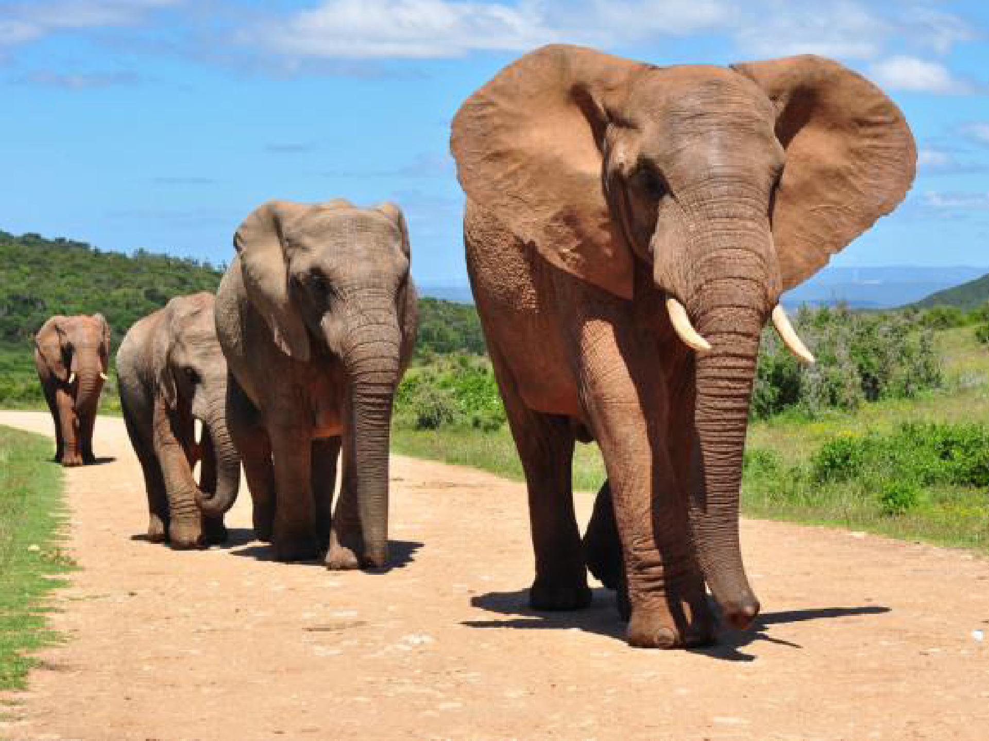
Wellness Starts with Leadership
Alexis Schminke Texas DPS

Slide 2
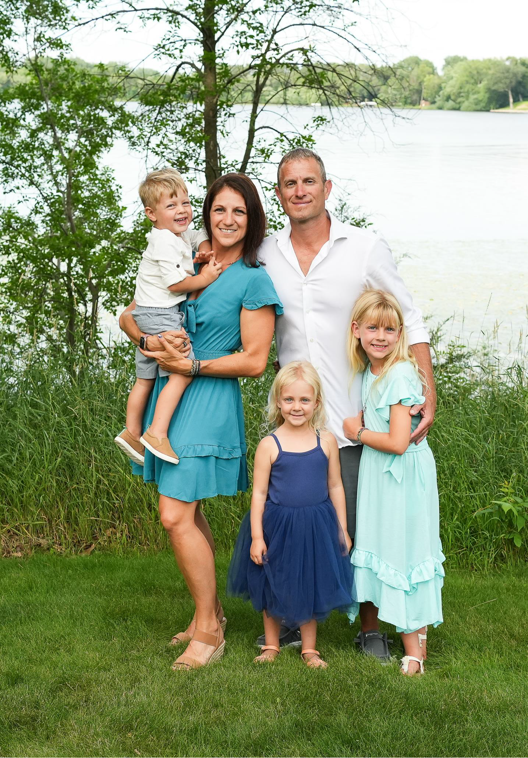

Slide 3
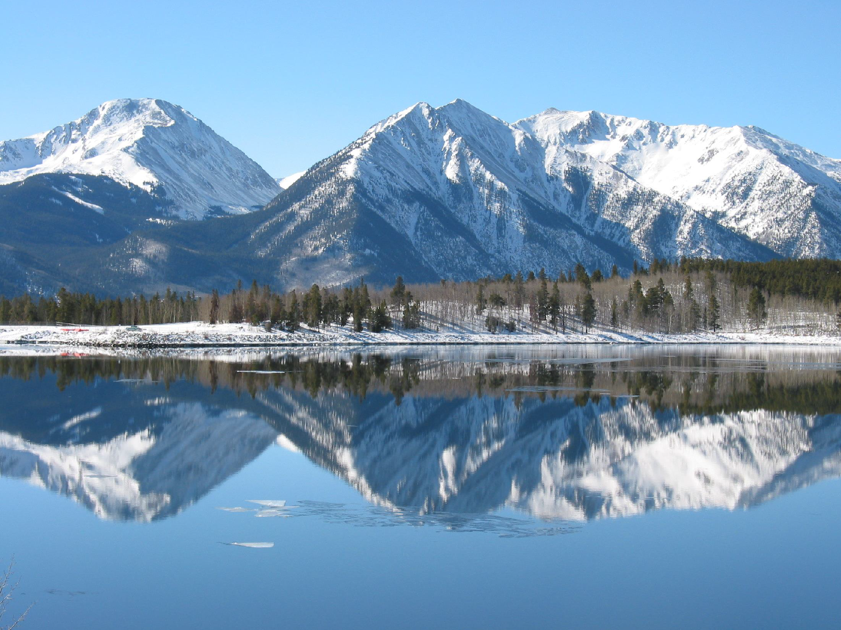
Born and Raised

Slide 4
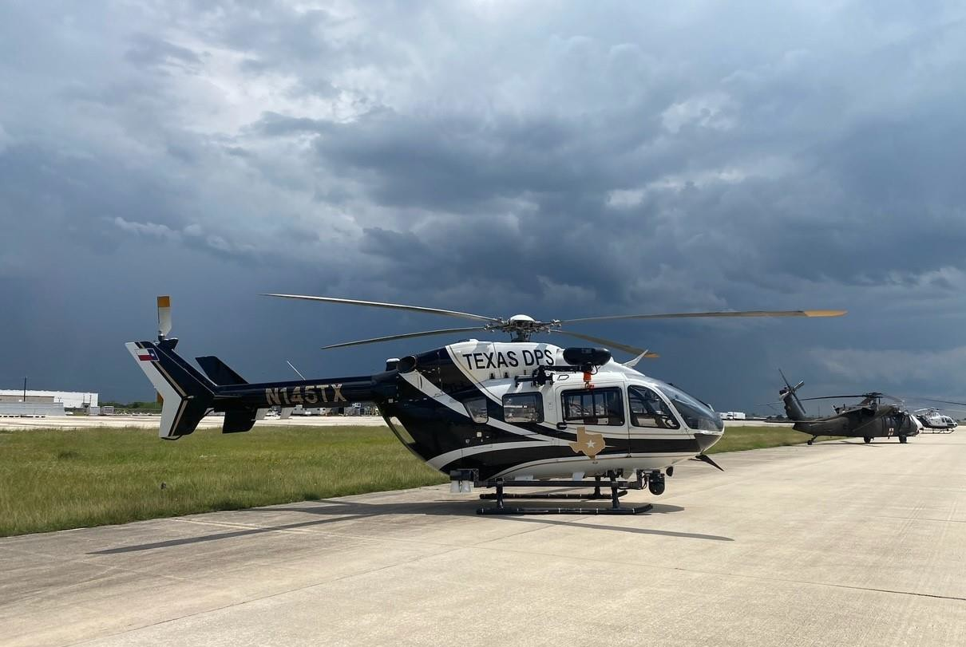

Slide 5
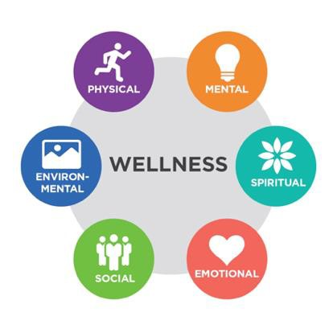
What is wellness?

Slide 6
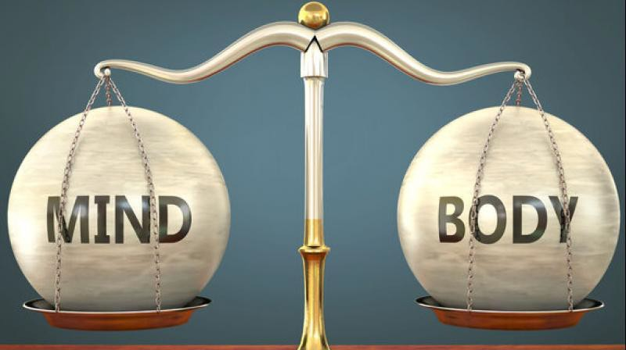
Mind and body are connected

Slide 7
What do you do for
your personal wellness?

Slide 8
Why is employee
wellness important?

Slide 9
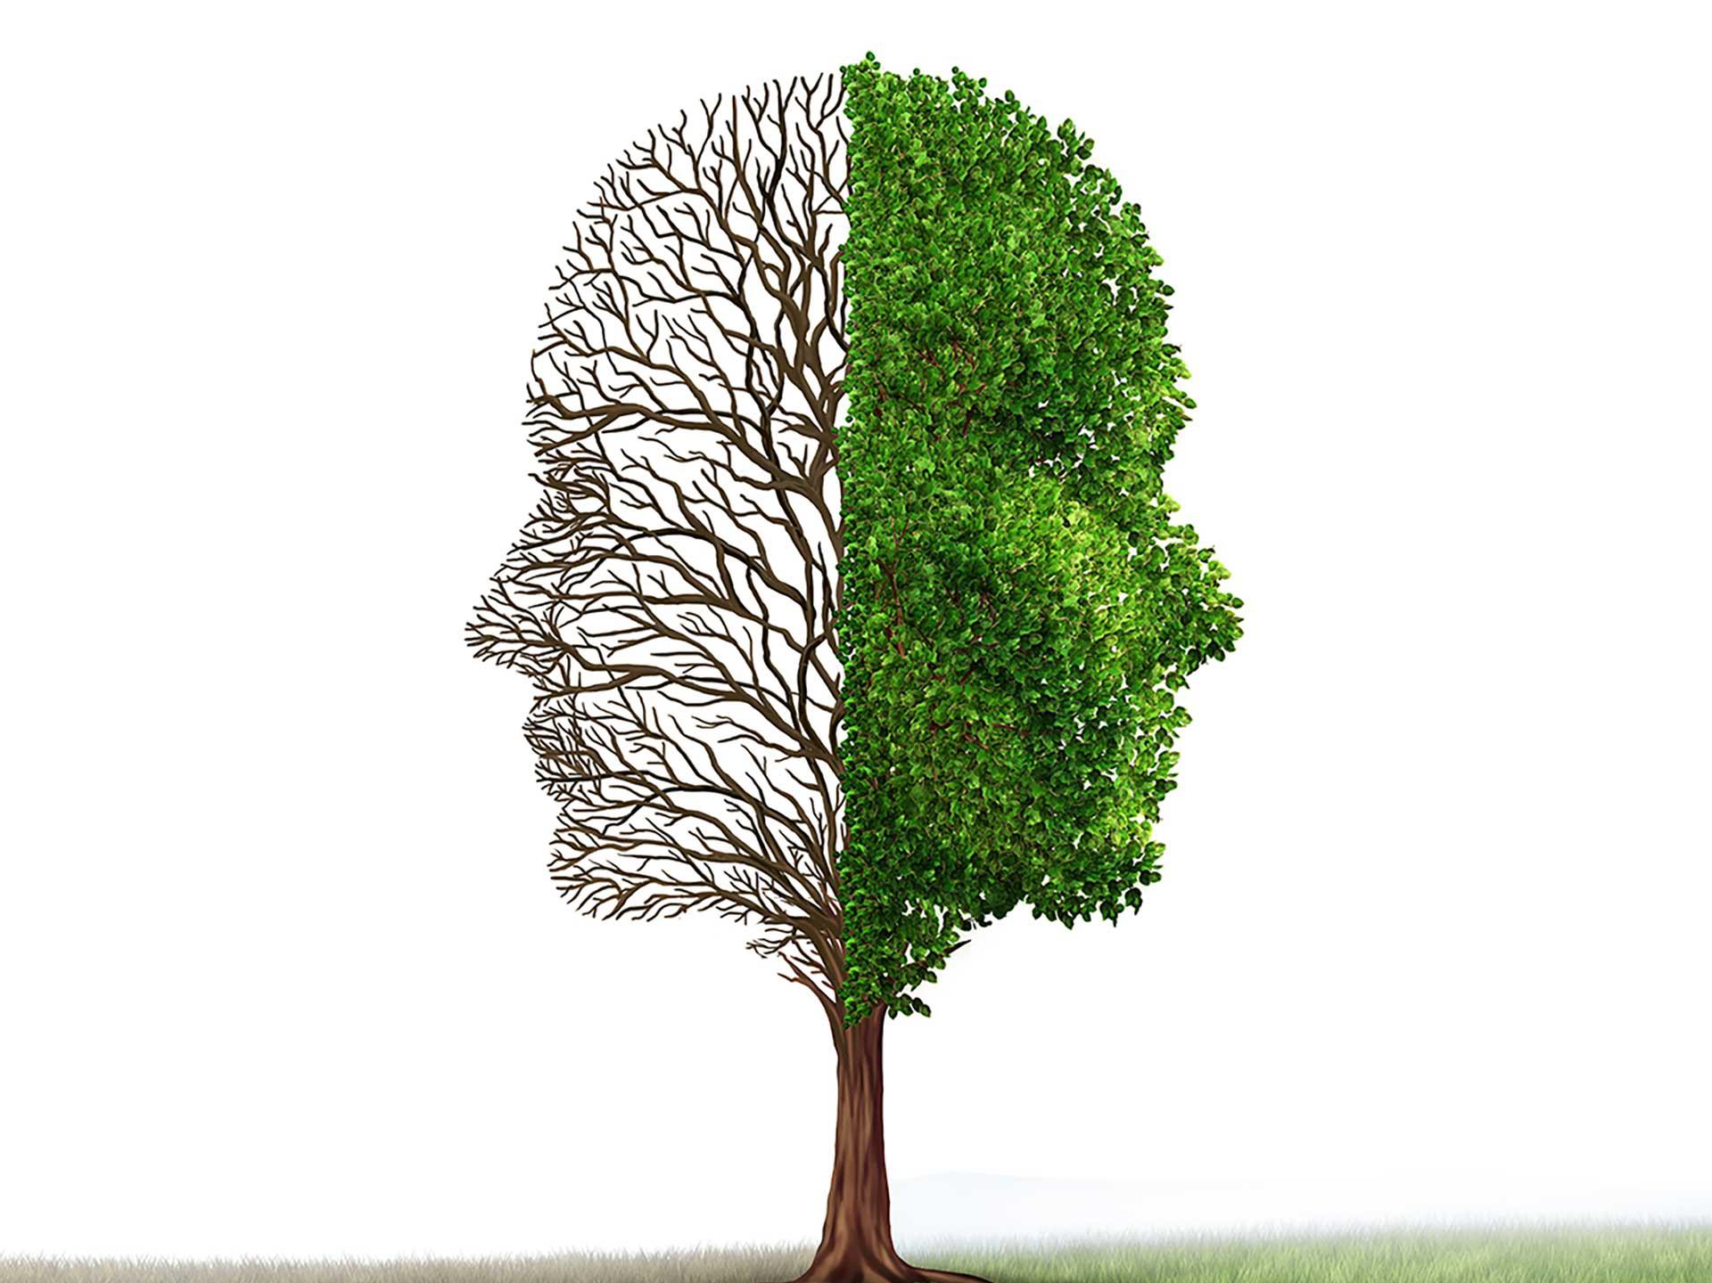
Mindset

Slide 10
Wellness Pyramid
Choices
Will Power
Conscious
Habits
Subconscious
Beliefs, Values, Life Experiences

Slide 11
What is beneath the surface?
Conscious
Subconscious Values Upbringing Advertising Experiences

Slide 12
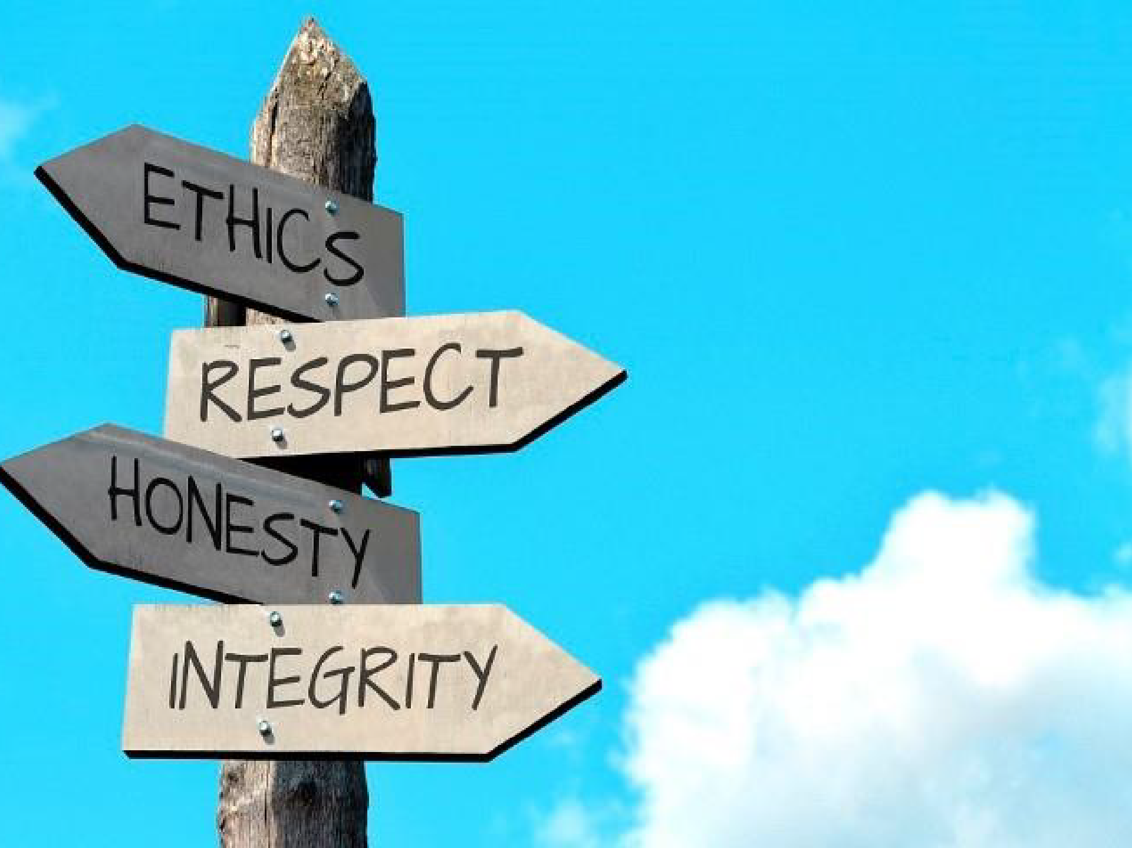
CONNECT TO VALUES

Slide 13
Values drive behavior
Why you think what you think
Filter in the brain
Drives healthy and unhealthy behavior and habits

Slide 14
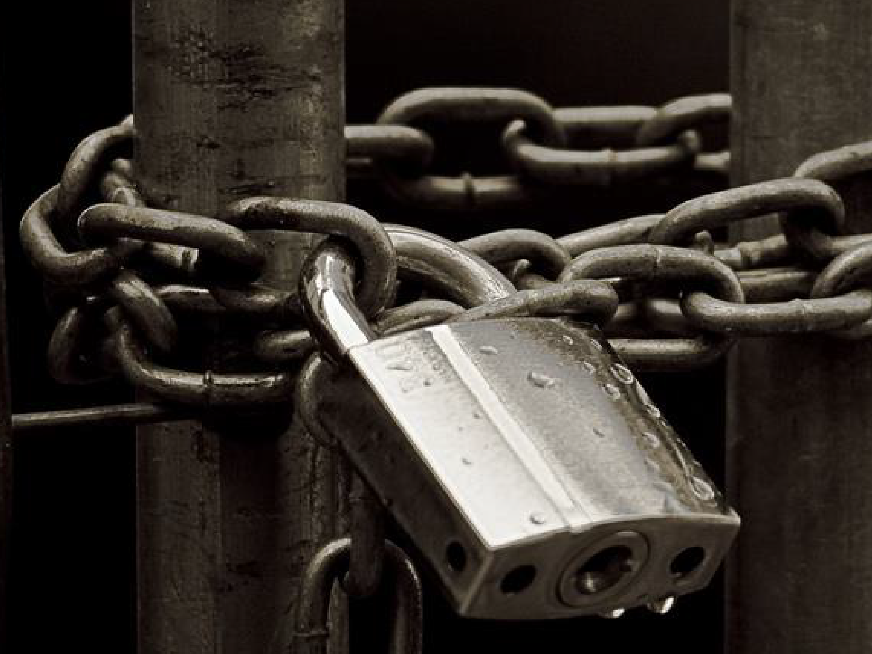
Fixed Mindset

Slide 15
I’m not good at this
I give up
It’s good enough
I can’t make this any better
This is too hard
I made a mistake
I just can’t do this
I’ll never be that smart
Plan A didn’t work
My friend can do it

Slide 16
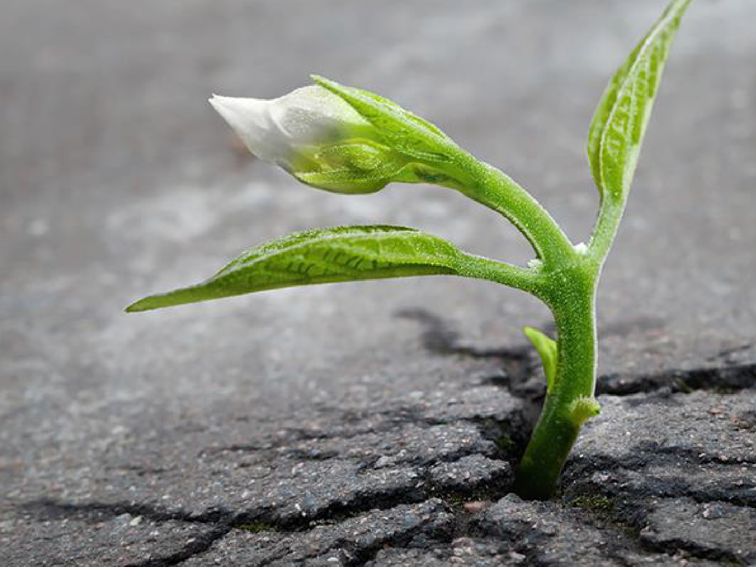
Growth Mindset

Slide 17
Growth Mindset- Intelligence can be developed

Slide 18
Fixed | Growth
I’m not good at this | What am I missing
I give up | I’ll use a different strategy
It’s good enough | Is this really my best work?
I can’t make this any better | I can always improve
This is too hard | This may take some time
I made a mistake | Mistakes help me to learn
I just can’t do this | I am going to train my brain
I’ll never be that smart | I will learn how to do this
Plan A didn’t work | There’s always Plan B
My friend can do it | I will learn from them

Slide 19
Embrace
Challenge!

Slide 20
Fixed | Growth
It is impossible to eat healthy. | I will eat healthy by being prepared.
I don’t like to exercise. | I am going to find a way to be active that I enjoy.
I do not have time to prepare food. | I will take the time to prepare healthy food.
I can’t sleep because of my schedule. | I am going to work on my sleep habits, I know I can improve.
Fitness programs are being implemented to get rid of people. | Programs are being implemented to help people.
I am a wonderful communicator. Everyone else is wrong. | I can work on my communication style to more effectively reach people.
I am so stressed. | Stress makes me stronger.

Slide 21
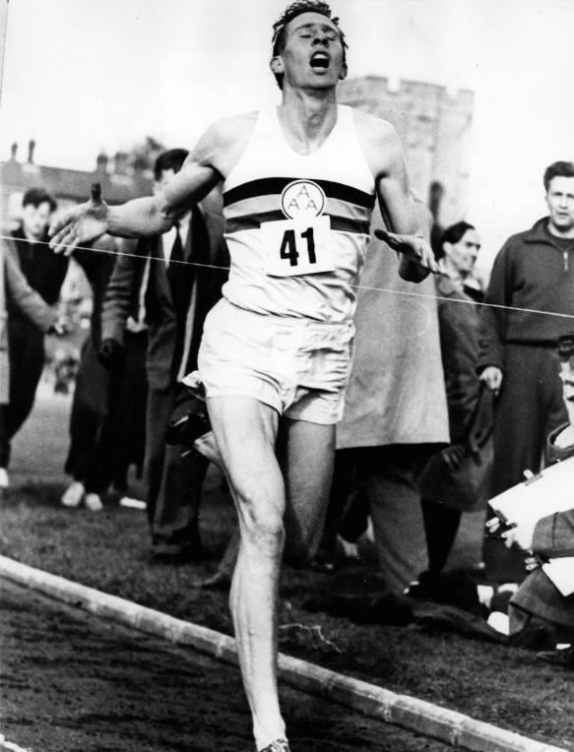
Self Limiting Beliefs

Slide 22
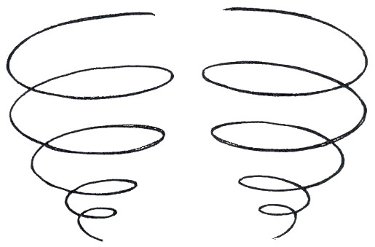
Broaden and Build Theory
Three Ways to Fail at Life:
Complain about everything.
Blame others for your problems.
Never be grateful.

Slide 23
How Leaders impact employee wellness

Slide 24
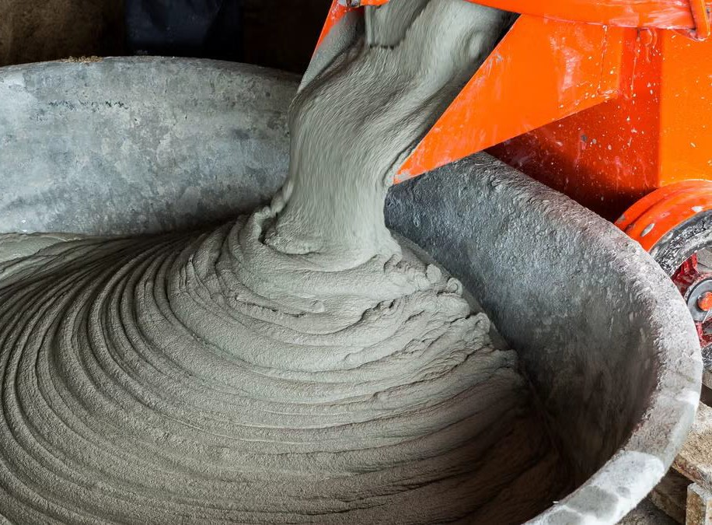
Leaders’ actions
cement the culture

Slide 25
Positive

Slide 26
Negative

Slide 27
Actions speak louder than words

Slide 28
Why promote wellness?

Slide 29
Absenteeism

Slide 30
Presenteeism

Slide 31
Increased morale

Slide 32
Job Satisfaction

Slide 33
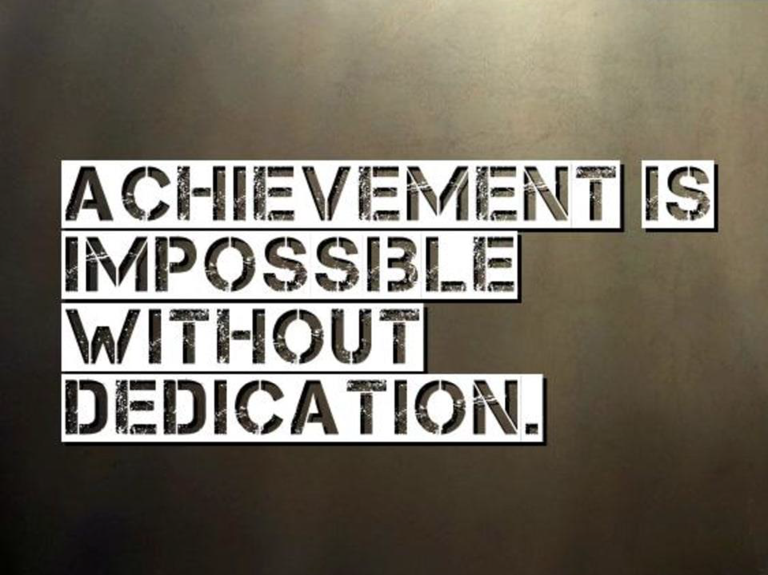
Dedication to the job

Slide 34
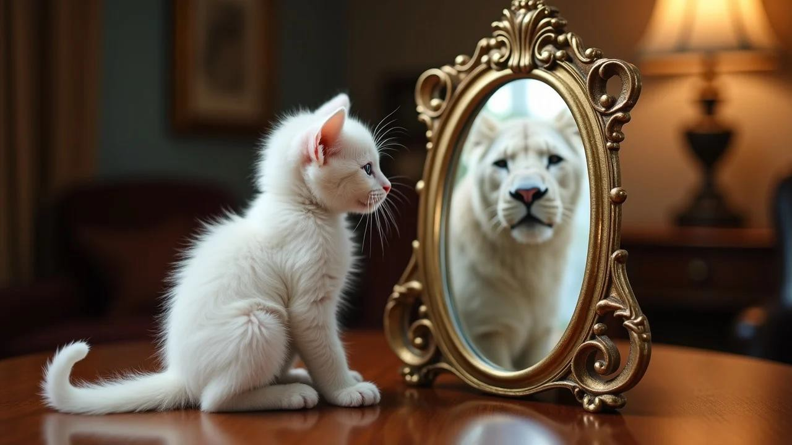
Confidence

Slide 35
Team cohesion

Slide 36
Willingness to go above and beyond

Slide 37
Increased productivity

Slide 38
How to promote wellness

Slide 39
Work/life balance

Slide 40
Challenges

Slide 41
Prioritize mental health

Slide 42
Healthy food available

Slide 43
Encourage breaks

Slide 44
We know what to do to be healthy

Slide 46
Desire

Slide 47
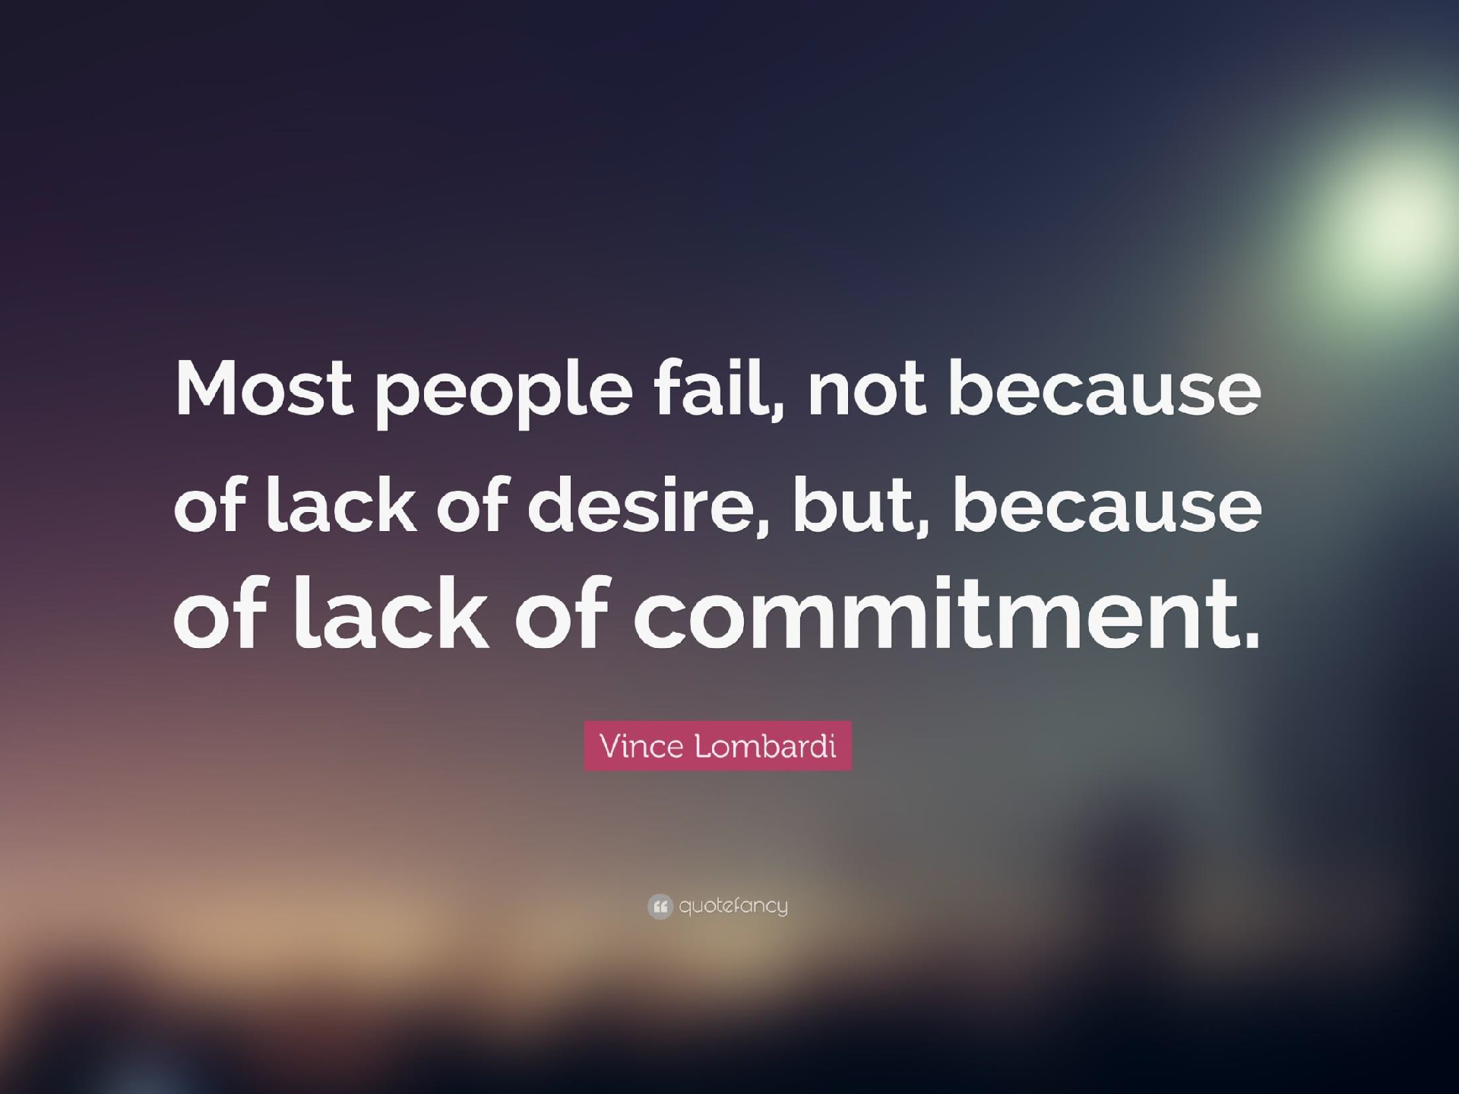
Commit

Slide 48
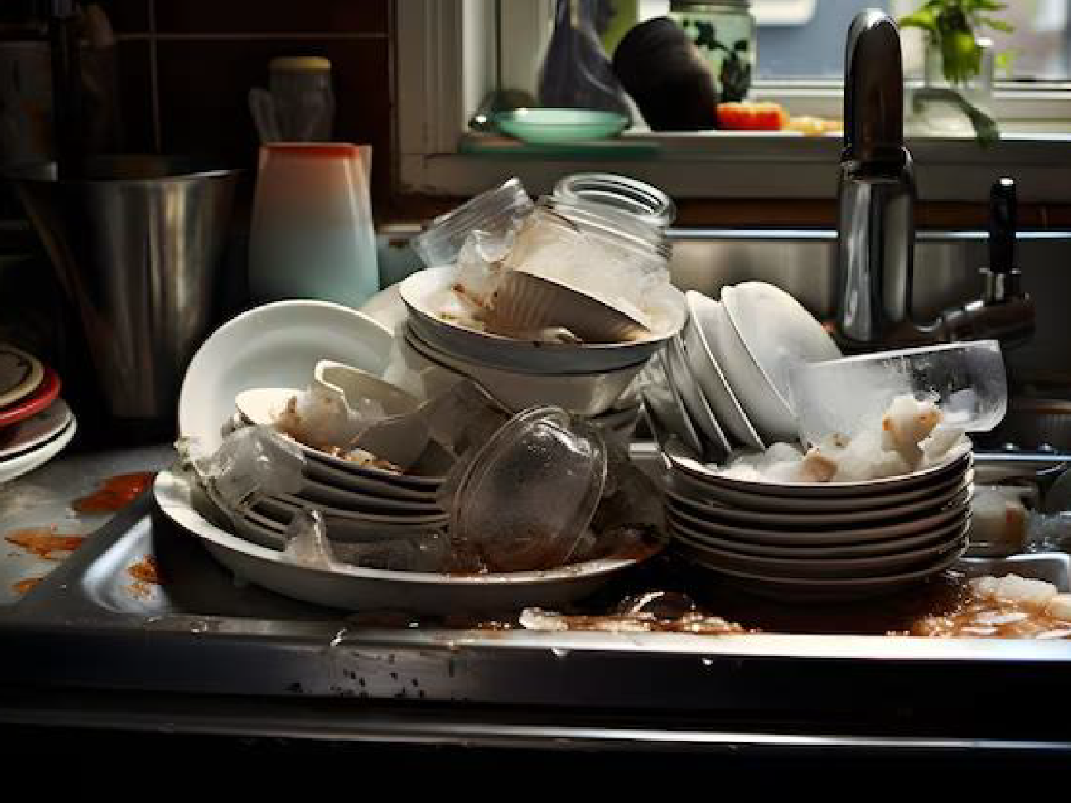
Effort

Slide 49
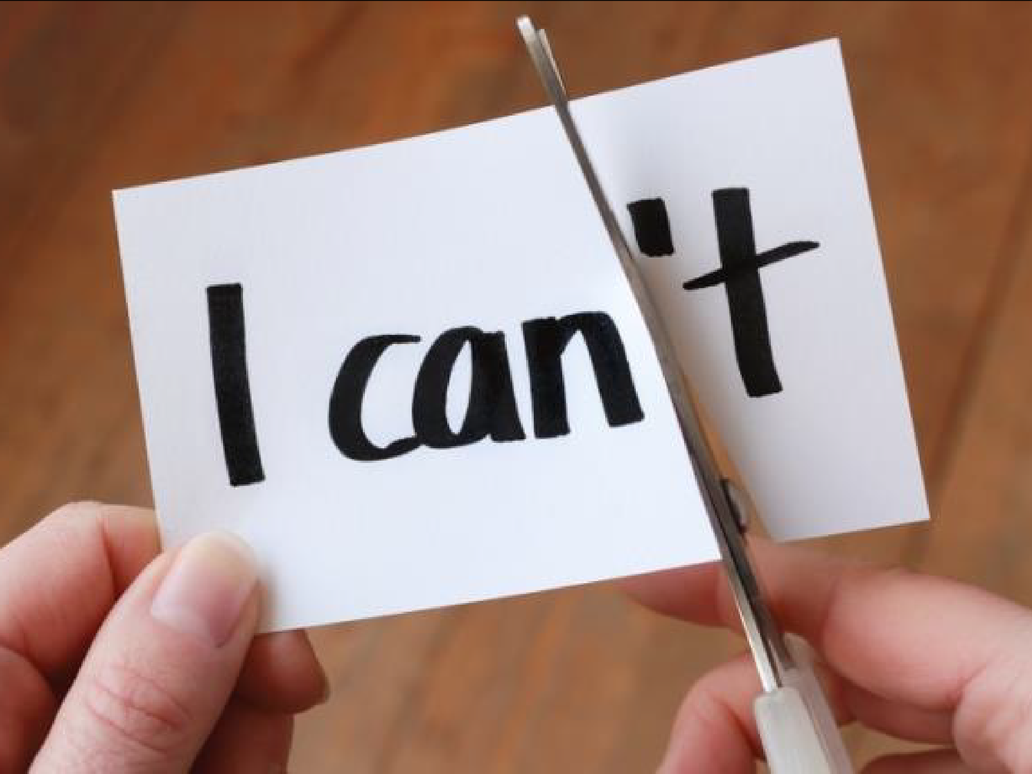

Slide 50
Recap

Slide 51
Mindset

Slide 52
How Leaders impact employee wellness

Slide 53
Why promote wellness?

Slide 54
What is one thing
you will work on
for self/employee wellness?

Slide 55
Thank you!
Alexis.Schminke@dps.Texas.gov

