Slide 1
Introduction to Fiscal Notes for State Agencies
PRESENTED TO TEXAS STATE AGENCY BUSINESS ADMINISTRATORS’ ASSOCIATION
LEGISLATIVE BUDGET BOARD STAFF DECEMBER 2024

Slide 2
What are fiscal notes
Fiscal notes are written estimates of the fiscal impact that may result from the implementation of a bill or joint resolution.
They serve as a tool to help legislators better understand how proposed legislation might impact the state budget, state agencies, and, if applicable, local governments.
Fiscal notes can reflect:
Costs
Savings
Revenue Gains
Revenue Losses

Slide 3
Types of fiscal notes
Fiscal Implication
Proposed legislation may result in a cost or savings or impact state revenue.
No Fiscal Implication (NFI)
Implementing proposed legislation will not require any additional resources, nor produce any savings, nor create any state revenue impact.
No Significant Fiscal Implication (NSFI)
Any change in resources to implement proposed legislation is insignificant relative to the budget of an affected agency and could be absorbed with existing resources.
Cannot Be Determined (CBD)
The fiscal impact cannot be determined due to a lack of necessary data or some other special circumstance.
Hybrids
Combination of types, e.g., the cost posed by certain bill provisions can be determined while others cannot.

Slide 4
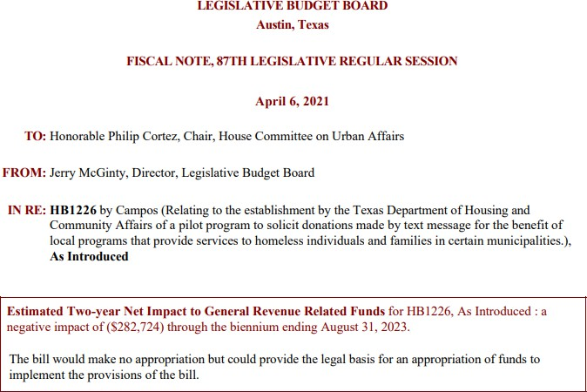
Fiscal note example – fiscal implication
Heading
The “top box”
Biennial net impact to GR-Related Funds

Slide 5
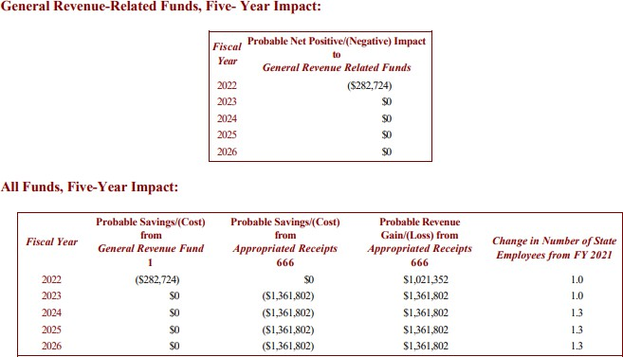
Fiscal implication, cont’d
Fund 1 – GR
Fund 2 – Available School Fund
Fund 3 – State Tech and Instructional Materials
GR Account 193 – Foundation School Program
GR Account 5040 – Tobacco Settlement
Includes any changes in FTEs

Slide 6
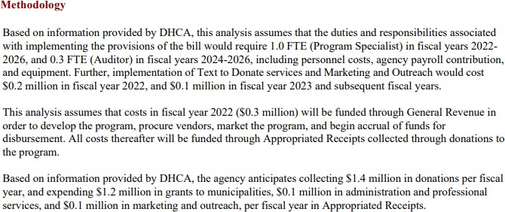
Fiscal implication, cont’d
Summarizes provisions that create the fiscal impact
Explains assumptions used in calculating fiscal impact and how they were applied

Slide 7
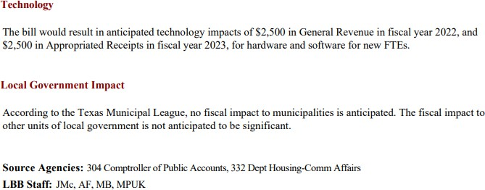
Fiscal implication, cont’d
Identifies the portions of any administrative costs attributable to technology
Identifies any fiscal impact on units of local government
Agencies assigned to the fiscal note that provided a response
LBB staff assigned to the fiscal note

Slide 8
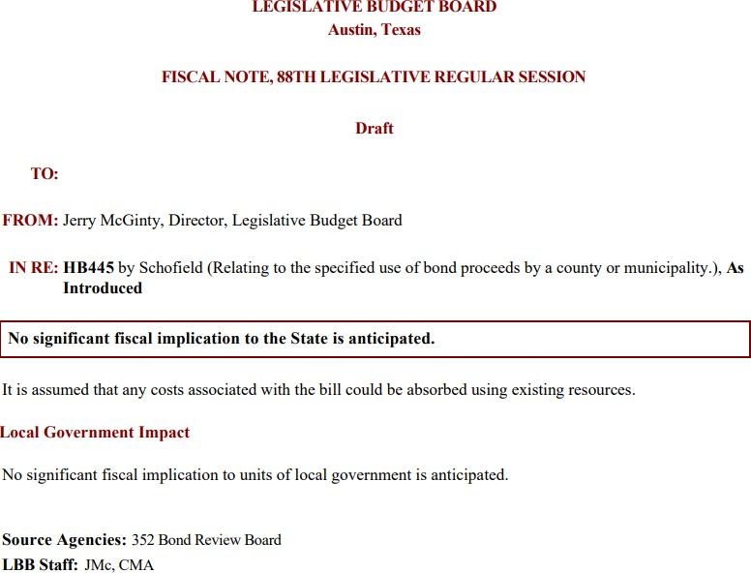
Fiscal note example - NSFI
Heading
Top box summary statement
General comments
Local government impact

Slide 9
Who is involved in producing fiscal notes
Short answer: LBB and agency staff
LBB fiscal note coordinators assess which state agencies are affected by proposed legislation and assign to affected agencies and appropriate LBB analysts.
Agency staff are asked to submit an estimate of the proposed legislation’s fiscal impact on the agency, under deadlines if applicable, via an LBB web application called the Fiscal Notes System.
LBB analysts consider that estimate and other resources and consult other LBB staff in writing the fiscal note, which is reviewed prior to delivery to legislative committee, legislative author and sponsor, and source agencies.
Chris Mattsson and Scott Dudley manage the process.

Slide 10
Fiscal note process (for bill heard in cmte)
Bill referred to committee by House Speaker/Lieutenant Governor
Possibility of fiscal implication determined by LBB fiscal note coordinator.
Fiscal note requested by committee clerk.
If bill has probable fiscal implications, fiscal note coordinator assigns bill to affected agencies and LBB analyst.
If the bill does not have fiscal implications, fiscal note coordinator prepares fiscal note.
Data provided by agencies and other sources.
Completed fiscal note sent to committee clerk, bill author, sponsor, and source agencies.
Fiscal note draft prepared by LBB analyst.
Fiscal note reviewed and approved by LBB management.
Fiscal note reviewed and finalized by fiscal
note coordinator.

Slide 11
When are fiscal notes produced
Assignments are made in advance of and during legislative sessions; fiscal notes are delivered once committees start hearing bills.
89th Legislative Session – important dates
Monday, November 11, 2024 – Bill prefiling opened.
Tuesday, January 14, 2025 – 89th Legislature convenes.
Friday, March 14, 2025 – 60-day deadline for bill filing.
Committees typically organize and begin hearing proposed legislation in late January-February.

Slide 12
Agency estimate deadlines
Deadlines for agency estimates are informed by committee activity.
LBB staff are notified of that activity directly by committee staff or by publicly posted notice.
Senate committees must post notice of a meeting at least 24 hours
before the meeting.
House committees must comply with the following notice requirements, unless the rule is suspended by floor vote:
for a public hearing held during a regular legislative session, notice must be posted at least five calendar days before the hearing;
for a public hearing held during a special session, notice must be posted at least 24 hours before the hearing; and
for a formal meeting or a work session, written notice must be posted and transmitted to each member of the committee two hours in advance of the meeting, or an announcement must be read in the house while in session.

Slide 13
Agency estimate deadlines, cont’d
Typical agency deadlines:
For introduced and engrossed versions of bills and joint resolutions heard in public hearings: 24–72-hours
For amended bills and joint resolutions, committee substitutes, bills and joint resolutions that have passed the second chamber, and conference committee report versions of bills and joint resolutions: 24 hours or less
Deadlines are not limited to business hours.
Committee amendments and substitutes are available to affected agencies via the Fiscal Notes System.

Slide 14
Agency estimate deadlines, cont’d
Bill versions | Typical deadline for agency estimates
Introduced bills Engrossed bills | 24-72 hours from the time the bill is posted for hearing.
Bills as amended / substituted Bills as passed the second house/chamber | 12-24 hours from when the fiscal note is requested.
Conference committee reports (CCRs) | 12 hours or less; warp speed on the final Saturday of session.
House simple resolutions to go “outside the bounds” on CCRs | 12 hours or less; warp speed on the final Sunday of session.

Slide 15
How to estimate fiscal impact
Determine what the proposed legislation would do – take note of the effective date, any temporary provisions, repeals of existing law, etc.
Make any necessary assumptions regarding how proposed legislation would be implemented.
Identify fiscal issues, e.g., if a bill requires a new agency program:
How many FTE positions and what types of positions would it take to launch and operate the program?
Would costs be spread evenly over time? What factors might change costs from year-to-year?
Would there be one-time start-up costs?
What would demand for the program be? Would it change over time?
How many people or entities would be subject to the program?
Would there be a time lag before the program’s full effects are felt?
Would provisions of the legislation raise revenue or save money?
Would the agency be able to absorb any added workload requirements and expenditures?

Slide 16
Preparing a fiscal estimate
Fiscal estimates are submitted via the Fiscal Notes System; components resemble those of the fiscal note:
Fiscal Analysis – Brief statement about the parts of the proposed legislation that would have fiscal implication to the state or units of local government as compared with the current law regardless of other legislation that has passed or is under consideration.
Fiscal Impact – Estimate of the fiscal impact the proposed legislation would have on the state. The estimate should cover at least a five-year period, beginning with the implementation date of the bill.
Methodology – Assumptions, data, and methods used to develop an estimate.
Technology Impact – If proposed legislation is likely to create costs, the portion of those costs attributable to an agency’s technology budget, including capital needs.
Local Government – Explanation of what actions local governments would have to take to implement provisions of the bill and estimates of the resulting costs or savings and increased or decreased revenue from state aid or local sources.

Slide 17
Agency estimate reminders
Agency estimates should exclude costs due to inflation.
Agency estimates should only include direct impacts; secondary impacts are excluded from fiscal note estimates.
If an agency resubmits information that differs substantially from its original submission, the LBB will evaluate that information and use whichever submission is determined to be most accurate and reliable.
The LBB is not obligated to use agency estimates of costs, impacts, caseloads, etc.

Slide 18
Agency estimate reminders, cont’d
When in doubt, include dollar amounts of any costs or savings in your estimate, no matter how small.
If identifying a bill as NSFI in your estimate (i.e., not including dollar amounts), make sure your NSFI criteria is understood by your LBB analyst.
Feel free to share spreadsheets used for estimate calculations with your LBB analyst.

Slide 19
General reminders
Fiscal note coordinators aren’t perfect; consider tracking bills that affect your agency and getting in touch if a bill hasn’t been assigned to your agency after a reasonable amount of time.
If you have the capacity, consider preparing if not submitting estimates prior to proposed legislation being scheduled for hearing.
Consider lending some thought to your internal process for preparing and reviewing estimates before having to use that process.
If you don’t understand why your agency was assigned a particular bill, reach out to the fiscal note coordinator who made the assignment or Chris Mattsson.

Slide 20
Frequently asked questions
Is there an impact if a bill authorizes but does not require a program to be implemented?
For estimates of impact to the state, the LBB treats “shall” and “may” in the same way and assumes full implementation. This provides the legislature with information regarding the potential costs of the proposed legislation and a specific dollar amount that the legislature can use when deciding how much, if any, of the program costs to fund through the appropriation process.
What if a mistake is made when submitting an estimate? Can the submissions be edited?
Estimates can be resubmitted. Contact the fiscal note coordinator who assigned the proposed legislation.
How are fiscal notes distributed, and are copies available for agencies?
Fiscal notes are delivered electronically directly to the requesting committee, the bill author/sponsor, and source agencies. Copies of fiscal notes are also available on Texas Legislature Online once the bill has been heard in committee.
Who is available to assist our agency with fiscal notes?
The LBB has a technical support team to assist with any issues relating to the Fiscal Note System. LBB analysts, fiscal note coordinators, Chris Mattsson, and Scott Dudley are available to answer questions relating to fiscal notes and the fiscal note process.

Slide 21
Contact the LBB
lbb.texas.gov 512-463-1200
Guide to Fiscal Notes Instructions for Texas State Agencies
Fiscal Notes System Support 512-936-4033

