Slide 1
The 5 Languages of Appreciation For Leaders
Becky Beachy
Audit Manager
Serra Tamur
Managing Sr. Auditor
Texas State Auditor’s Office
December 5, 2024

Slide 2
Notes:
Why is feeling appreciated so important in a work setting? Employee recognition programs proliferate, but job satisfaction and employee engagement decline. (12) Each of us wants to know that what we are doing matters. Without a sense of being valued by supervisors and colleagues, workers start to feel like a machine or a commodity. If no one notices a person’s commitment to doing the job well, that person’s motivation tends to wane over time.
Stephen R. Covey . . . 7 Habits
Feels so strongly about appreciation he stated:

Slide 3
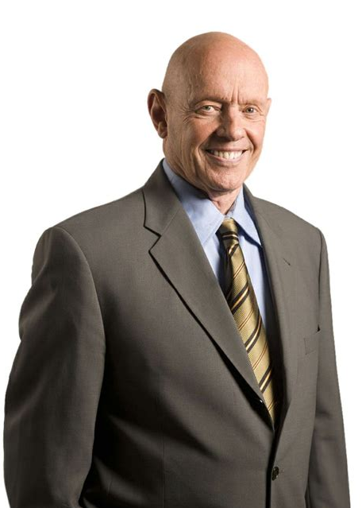
Stephen R. Covey
“Next to physical survival, the greatest need of a human being is psychological survival, to be understood, to be affirmed, to be validated, to be appreciated.”
Notes:
My heart says . . .that rings true for me.
Let’s take a look at some facts:

Slide 4
What we know
80% of employees work harder for a boss who appreciates them.
50% of employees said they would stay longer at their company if they felt more appreciation from their boss.
Notes:
Recent research shows the following:

Slide 5
What we know
51% of mangers believe they do a good job of showing appreciation for their staff.
17% of employees (of the same managers above) believe their managers do a good job of recognizing and appreciating their achievements.
Notes:
Society of Human Resource Management

Slide 6
What we know
64% of Americans who leave their jobs say they do so because they don’t feel appreciated.
14% of organizations provide the tools for employee rewards and recognition.

Slide 7
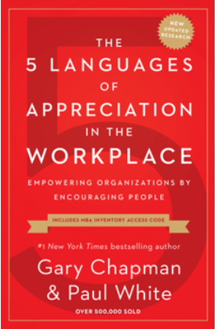
GaRy Chapman and Paul White
Notes:
Recognition or Appreciation, as we’ll be referring to it today – is vital to the health of an organization and it is something everyone on the team can do regardless of where they sit on the organizational chart.
Gary Chapman and Paul White were so convinced by the evidence they saw in studies and in their own consulting practices, that they wrote this book – which is what this presentation is based on.
How many of you are familiar with Gary Chapman’s previous work, The 5 Love Languages? This is based on a similar premise, only geared to the work world.
So this seems fairly simple – appreciate people for the things they do. And yet, we don’t do it, or don’t do it effectively.
As a matter of fact, appreciating other people at work sometimes feels like this . . .

Slide 8
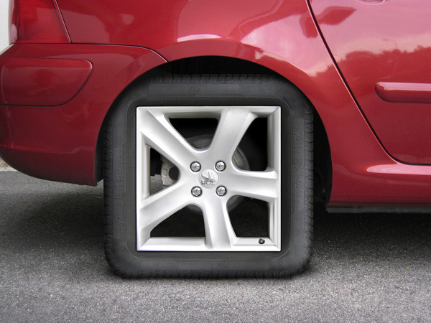
It’s a great idea, but the implementation is wrong!
Notes:
You’ve got the basic idea, it’s the implementation that is wrong.
Each person has a unique way they like to be appreciated. When we give recognition, we often give it in the way we like to receive it because, if we like it, other people will too.
Birdhouses/Theatre story
To be effective you have to be willing to try something different.
You need to commit to speaking a different language.

Slide 9
5 Languages of Appreciation
Words of Affirmation
Quality Time
Act of Service
Tangible Gifts
Physical Touch
Notes:
Knowing the languages of those we work with allows us to have more meaningful interactions and provide recognition that feeds the soul.

Slide 10
Assessment
Circle the letter from each pair that you feel is most important to you.
Go with your first impulse. Don’t agonize - pick one!
Score yourself on the second page.

Slide 11
Informal Survey
What language do you speak?
Notes:
Two-fold: get an idea of the language mix in the room AND pick 5 volunteers for each language.
As a volunteer, you will share with the whole group how you like to receive appreciation in your own unique language. I will be explaining each language and giving ideas on how to use the language effectively. After your primary language has been explained, you will share your preferred method of appreciation with the whole group.
Show of hands:
How many of you have ____ as your top language?
Words of Affirmation
Quality Time
Act of Service
Tangible Gifts

Slide 12
Words of Affirmation
This language of appreciation uses words to communicate a positive message to another person.
Notes:
When you speak this language, you are verbally affirming a positive characteristic about a person.
Let’s look at some examples.

Slide 13
Sounds like
“I like the way you answered the phone in a cheerful tone and offered to help the customer resolve their concern.”
Notes:
Accomplishments – specific – not “Good job with the customers this morning
Character – perseverance, patience
Personality – optimistic, planner

Slide 14
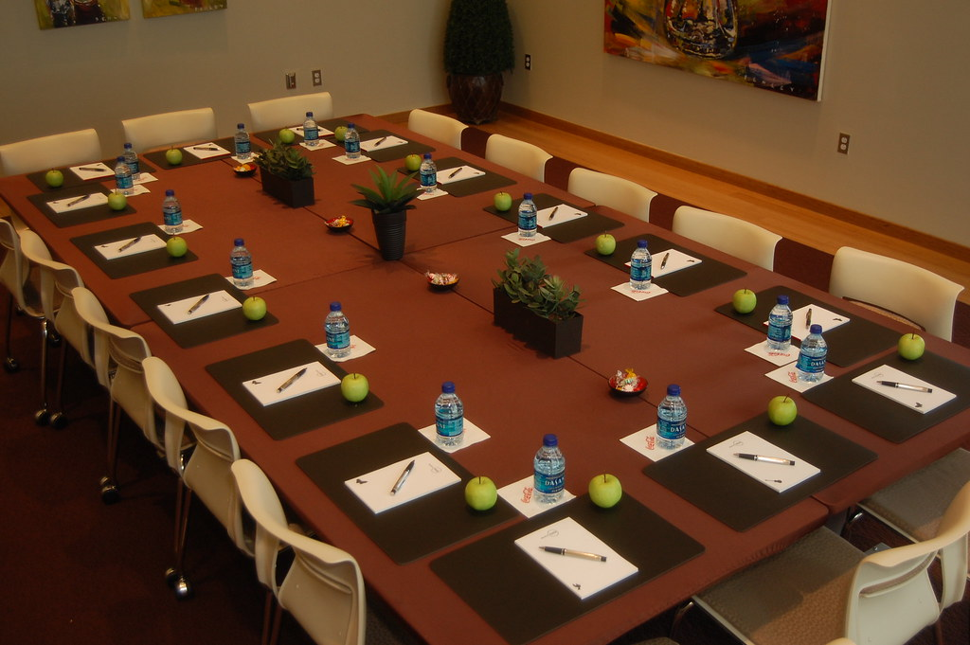
Sounds like
“Thanks for showing up early and making sure we were ready to go when the employees arrived.”

Slide 15
When and where
Personal
In front of others
Written
Public
Notes:
Personal – A private conversation
In front of others – (not public) just in front of people who are important to them – in front of their supervisor or perhaps colleagues
Written – the power of a note – a lot of mileage
Public – in a meeting –On a state website -make sure this is ok!

Slide 16
Quality Time
The language of quality time means giving others your focused attention.
(Not to be confused with proximity)
Notes:
Not to be confused with proximity instead think personal attention

Slide 17
Looks like
Sit down in my office to see how things are going.
Have an off-site retreat for staff.
Notes:
Some ideas from folks who have Quality time as their primary language of appreciation.

Slide 18
Looks Like
Go to lunch together to talk about business.
Go to lunch together just for fun.
Notes:
Quiz
How many of you would see going to lunch and talking business as a Negative deposit in the time bank? How about positive? Why?
How about lunch together for fun? Negative or Positive?

Slide 19
When and where
Quality conversation
Shared experiences
Small group dialogue
Notes:
Quality Conversation: This can sound like words of affirmation – which focuses on what we are saying.
Quality conversation focuses more on what we are hearing. It means that when we are speaking with each other, it is a safe environment to share honest emotions with a genuine desire to understand each other. This can occur one on one, but be mindful that some individuals may be intimidated in this context. In that case consider: 1:1 coaching – “Wow, this is intense!”
Shared Experiences: For some employees, sharing experiences with their colleagues is an important way for them to feel connected and encouraged. - For example, attending a conference together, working on a fun project or attending an event.
Small group dialogue: For someone who prefers small group dialogue, having a chance to have shared experiences in a small group versus an “everyone” meeting or event may feel more comfortable and increase the quality of the time spent together for that person.
Close proximity: Some folks just enjoy the chance to work along side each other. Everyone can be doing something different, but the camaraderie of the group fills the need for quality time. Think of a time when you’ve enjoyed an outdoor concert – you don’t even have to know the people around you, the shared experience is what matters.

Slide 20
Acts of Service
This language means demonstrating appreciation by providing acts of service.
“Don’t tell me you care, show me.”

Slide 21
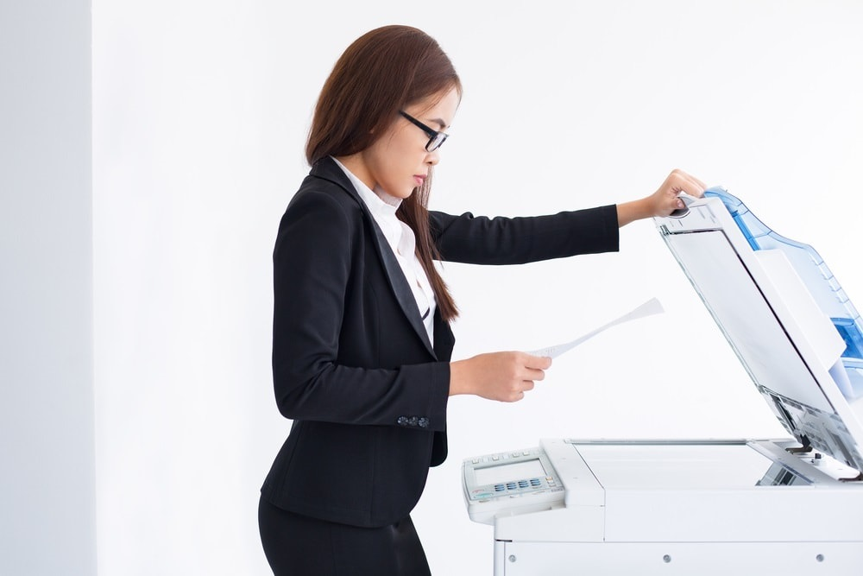
Looks like
Offer to do a routine task
Technology assistance
Assist with end of event clean up
Provide food or sodas
Notes:
Examples from real employees
Offer to do a menial task that will allow me to focus on higher priorities. (double check numbers on a report, photo copies)
Help me get my computer to work more efficiently.
Assist me in cleaning up at the end of an event or end of the day.
Provide some food or sodas when we’ve been working hard on a project.

Slide 22
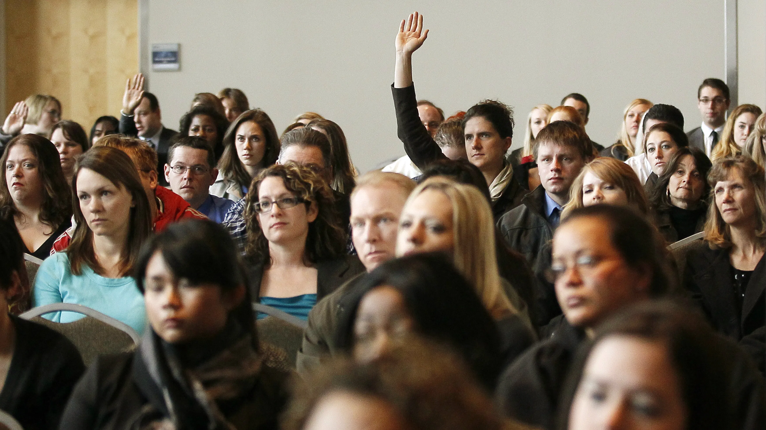
Serving effectively
Ask before you help
Serve voluntarily
Do it their way
Complete what you start
Notes:
There may be some things the person wants to do themselves. Even if you know this is their primary language – ASK or you could create an uncomfortable situation. “You’ve done a terrific job advertising for the art show, is there anything I do to help with the event?”
For an act of service to be encouraging serve voluntarily - not an act of duty or compliance. “Susan said you’re running around like a chicken with her head cut off, what do you need?”
Clarify how they want the task done and then do it! “Did you have a plan for how you would like the vendor table set up?”
A job ½ done is often more work than a job not done at all –(Gary and the books) if you have a time constraint be sure let the person know – they can customize the task for the time allotted.

Slide 23
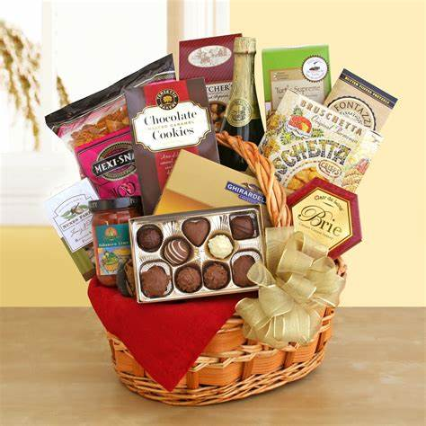
Tangible Gifts
Showing appreciation through tangible gifts that have personal value.
Notes:
The challenge of giving the correct gift to the right person is a primary reason why many employers no longer give gifts for birthdays or holidays.
So how can we make gift giving more meaningful for the people in our lives you speak this language?

Slide 24
Two important considerations
The gift must be something the person values.
The gift should be personal, and fact oriented.
Notes:
Two tickets to a slap-stick comedy hour may not be appreciated by the employee who enjoys a subtle, dry wit.
Likewise, the gift should personal and based on facts – Lesvia – baby shower gift for her niece (NEPHEW).

Slide 25
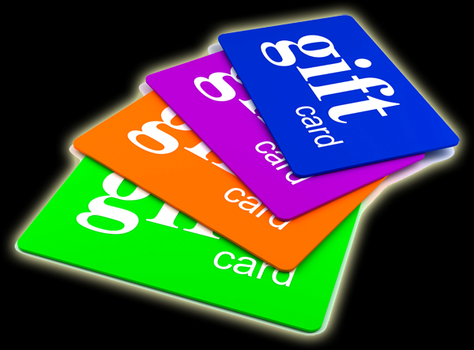
Looks like
Gift cards
Personal time off
Time to attend a conference
Treats
Tickets for an event
Notes:
Last one – TWC at Christmas time – performances at lunch at the Capital – time off to go see.

Slide 26
Physical Touch
Hmmm, this seems a bit weird for work.
Notes:
So hard to use this language at work – you may have noticed that it was not even part of the assessment that you took. This is a very touchy subject – and should be approached with caution. When I started working professionally in 1999 – class in appropriate hugging – I still have the handout. You wouldn’t find that now days!

Slide 27
A few ideas
Firm handshake
Cheerful high-five
Fist bump
Notes:
Friendly nod, twinkly eyes.
Reaching out virtually . . . .

Slide 29
Thank You
Becky Beachy
Audit Manager
becky.beachy@sao.texas.gov
Serra Tamur
Managing Sr. Auditor
serra.tamur@sao.texas.gov
Texas State Auditor’s Office

