Slide 1
Learning the Art of Legislative Empowerment
By:
Ann Bishop, Executive Director
Cathy Tilton, Member Relations Manager

Slide 2
Introductions
Notes:
Give a little intro of yourself and your background.
Ann – share your extensive knowledge working for the state.
Cathy – share how your mom worked for the state and retired from the state.

Slide 3
Learn the Basics
Know
the Legislative Process
Know
the Players
Know
the Rules
Notes:
Start with a question. Ask about their knowledge about the Legislative process.
If you don’t already know the basic rules of the game, learn them, whether from the LBB, Texas Legislative Council website or Google.
Ann – talk about the importance of knowing some of the basic information about the Legislative process.

Slide 4
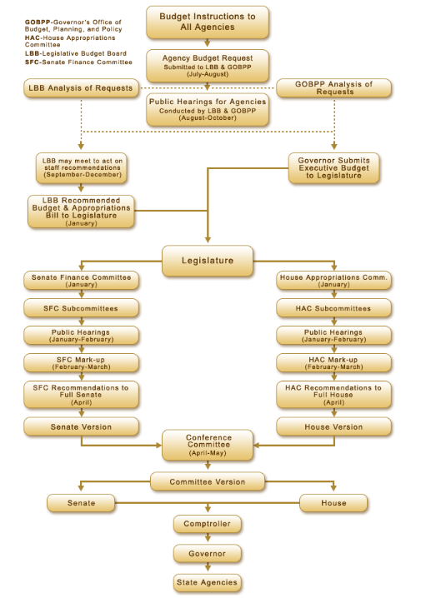
Know the Process

Slide 5
Know The Legislative Players
Learn more about the committees that legislative members serve on
Found on the House and Senate websites
Notes:
Start with a question. Ask about their knowledge about the Legislative process.
If you don’t already know the basic rules of the game, learn them, whether from the LBB, Texas Legislative Council website or Google.
Ann – talk about the importance of knowing some of the basic information about the Legislative process.

Slide 6
Know The Rules
Notes:
Start with a question. Ask about their knowledge about the Legislative process.
If you don’t already know the basic rules of the game, learn them, whether from the LBB, Texas Legislative Council website or Google.
Ann – talk about the importance of knowing some of the basic information about the Legislative process.

Slide 7
Resources
Reports
Guidelines
Statistics
Notes:
Ask another question?
Ann can talk about:
Where to find some of the data within agencies
What to look for within the reports
How to show the statistics for ex: pay raises.
The State Classification Team produces several reports and guides on various compensation, classification, and workforce issues. Reports include:
Benefits as a Percent of Total Compensation
Classification Compliance Reviews and Audits
Compensation and Classification
Employee Turnover
Full-Time Equivalent (FTE) Employees
Human Resources Management Statutes Inventory
Legislative Workforce Summaries
Comptroller of Public Accounts- Fiscal Notes
LBB- Fiscal Size Up
Policy area reports

Slide 8
State Employee Rights
Notes:
Even if you know the basic rules and process, sometimes things happen. Share the example this year of the two LAR instructions.
Ideas, suggestions and specific proposals for bills may come from several sources.
There are other resources available, but you do need to know your rights as a state employee.

Slide 9
Permissible Political Activities
HHS employees are entitled to participate in the political process to the extent that such participation does not violate applicable laws and agency policy. For example, employees may participate, on their own time and without the use of agency resources, in the following political activities:
Assisting in voter registration drives
Expressing opinions about candidates and issues
Wearing or displaying political badges, buttons, or stickers
Attending, organizing, or managing political rallies and meetings
Joining a political club or party
Signing or circulating nominating petitions
Campaigning for or against referendum questions, such as constitutional amendments or municipal ordinances
Collecting contributions or selling tickets to political fundraising functions
Distributing campaign materials in a partisan election outside of the workplace and subject to the preceding conditions
Notes:
Even if you know the basic rules and process, sometimes things happen. Share the example this year of the two LAR instructions.
Ideas, suggestions and specific proposals for bills may come from several sources.
There are other resources available, but you do need to know your rights as a state employee.

Slide 10
Employee Political Activity
A TDCJ employee is encouraged to exercise the employee’s rights and responsibilities as a citizen in the political process through various activities. These activities may include voting, participating as a voter registrar, contributing personal money to the employee’s preferred candidates or political parties, and actively engaging in campaigning or fundraising and endorsements. However, TDCJ employee political activities shall comply with the provisions within this directive.
Notes:
Even if you know the basic rules and process, sometimes things happen. Share the example this year of the two LAR instructions.
Ideas, suggestions and specific proposals for bills may come from several sources.
There are other resources available, but you do need to know your rights as a state employee.

Slide 11
Resources outside of Agencies
Special Interest Groups
Think Tanks
Not-for-profits
Association
Unions
Notes:
Who are the groups?
How do they help you?
Talk about the different groups.
Ask the question of testimonies?

Slide 12
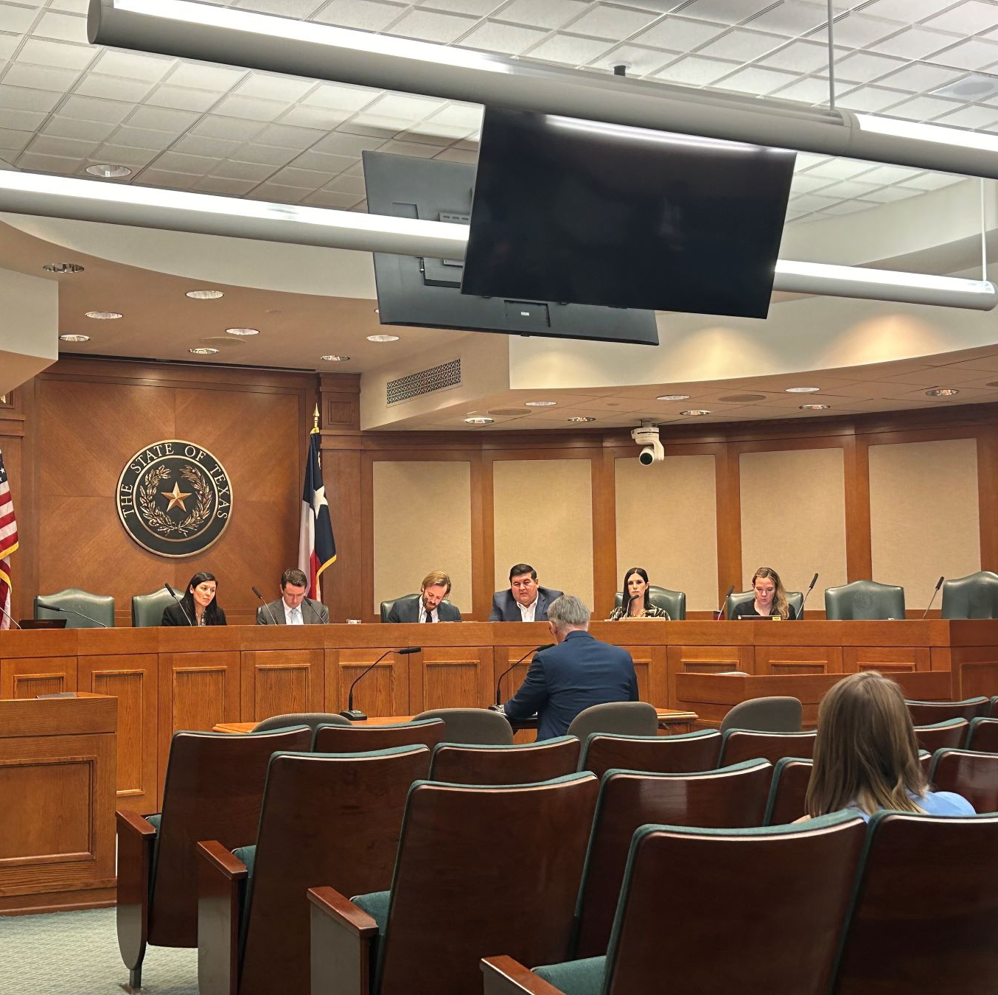
Behind the Scenes
Letter to State Agency Directors- If you don’t ask, we can’t ask.
Judiciary-wide inflation relief and staff retention and recruitment - The OCA is grateful for the increased funding received in the 88th Legislative Session that provided much-needed relief for maintaining and recruiting staff for our agency.
Board of Reviews
Pre-session workgroups
Notes:
Talk about Ann’s letter to agency directors
Come together for everyone for the raises

Slide 13
Using The Cycle To Educate and Empower Yourself and Your Team
Notes:
With that being said, we’re going to end it with a little more information about us and how we can help.
Knowledge = Power
TPEA can help provide that knowledge!
Leaders at state agencies have the opportunity to educate employees about the legislative process, and empower them to advocate for what they need.
Being able to speak for yourself/your team in terms of LARs, exceptional item requests, and budget hearings adds weight to your request and demonstrates your knowledge.
Advocacy: Before and during the session, everyone can reach out to their lawmakers to let their thoughts and needs be known.

Slide 14
Your friend at the Capitol
Our Mission
At TPEA, our mission is not just a statement but a commitment to actively preserve and enhance the salaries, benefits, and pensions of state employees and retirees.
Our Vision
State employees and retirees are respected and properly compensated for their dedicated service.
Notes:
Evolution of TPEA’s work
Pension
Benefits
Pay/Salary
Remote work
Parental leave

Slide 15
Who We Are
TPEA was established in 1946
Advocate for current and retired state employees
Instrumental in creating the ERS pension fund
Only non-profit, non-union, non-partisan advocacy group
Notes:
CT: Share the history of TPEA and notable successes

Slide 16
TPEA is More Than Your Advocate
Keeping members informed and up to date on legislation that affects state of Texas employees
Exclusive discounts on everyday purchases, travel, home and more
*Administrative Hearing
Rider Coverage through a licensed Attorney
Exclusive discounts on supplemental insurance benefits
*TPEA Members can enjoy additional coverage through Texas Legal at a discounted price not provided to other organizations. The plans offer a wide range of legal coverages or you and your family, ensuring protection in every situation. You can customize the level of coverage that suits you and include your spouse, dependent children under the age of 26, and disabled children over the age of 26 on your plan as well.
Notes:
TPEA membership includes:
Advocacy at legislative hearings to protect and improve your pay and benefits, so they are not diminished during a Legislative session.
Added value - legal services via with separate Texas Legal membership for you and your family (includes rider for administrative hearings).
Access to informed & knowledgeable resources about Legislative bills and documents relating to state employees & retirees.
Exclusive member discounts on supplemental insurance benefits.
Exclusive discounts on purchases, travel, home and more.

Slide 17
THANK YOU
CONTACT US
888.367.8732
membership@tpea.org
tpea.org
10815 Ranch Rd. 2222, Bldg. 3B-100, Austin, TX 78730

