Slide 1
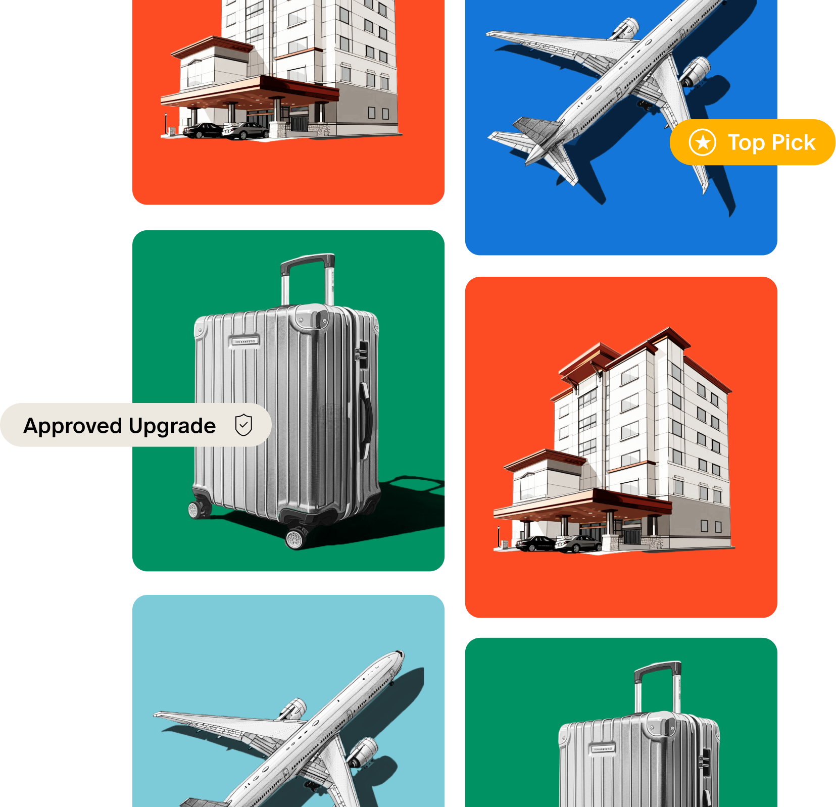
Booking Made Easy
Confidential
Q3 2024

Slide 2
Marketing Deep Dive
Agenda
1. A Word From Our CEO
2. Meet the Team
3. Engine
4. Inventory
5. Benefits
6. Booking on Engine
7. Q&A
Confidential
Q3 2024

Slide 4
Meet the Team
Your Government Team
Neha Bhakta
Government Team Lead
Yessenia Cornejo
Government Success Manager
Elise German
Government Group Sales Manager
Logan Bala
Government Groups Specialist
Confidential
Q3 2024

Slide 5
Engine
Who are we?
We are a booking platform that connects State of Texas travelers to Government Rates across all hotel brands helping streamline business.
Engine is the contracted hotel vendor for the State of Texas.
Current Contract Term
October 1, 2023 - August 25, 2025
Confidential
Q3 2024
Notes:
Engine, previously Hotel Engine is your contracted hotel vendor since 2019. We are a private booking platform dedicated to making business travel easy for all with access to government rates across all brands in one place.

Slide 6
Engine
Hotel Engine is now Engine
Hotel Engine Rebrands to Engine, Secures $140M at $2.1 B Valuation
Confidential
Q3 2024
Notes:
Hotel Engine was established in 2015 and over the years we have experienced significant growth. Thanks to our clients such as yourself and our highly skilled, and customer obsessed team, we culminated a substantial $140 million Series C funding. Bringing Engine’s valuation from 1.3 billion in 2021 to 2.1 billion in 2024. With our new investment we broadened our services to flights and cars and on October 6 Hotel Engine announced its rebrand to Engine.
Now currently we are only offering hotels to our state travelers but hope to expand those offerings in the future.

Slide 7
Inventory
33K
Hotels across the U.S offering GSA or lower
4.5K+
Hotels in Texas
3K+
State of Texas Partnered Hotels
Confidential
Q3 2024
Notes:
At Engine, your travelers can choose from 33,000 hotels nationwide selling at GSA rates or lower. This includes 4,500 hotels in Texas and 3,000 state-partnered properties. And we’re not stopping there. Our team is expanding beyond Texas to increase inventory for government travelers and those needing to book accommodations outside the state.

Slide 8
Benefits
Benefits
HE DIRECT
The state of Texas' exclusive negotiated rates with hotel partners. There are over 3,000 hotels across Texas partnered with us to offer GSA rates, flexible cancellation policies, and refunds for unused nights.
HOTEL LOYALTY
Connect your favorite loyalty reward programs and continue to earn points on eligible travel. We are partnered with your favorite loyalty programs so you can earn from both Engine and our partners.
VISIBILITY
View all bookings made at your agency, along with access to your trends tab. Get a deeper insight into your spending, and filter by department or city.
Confidential
Q3 2024
Notes:
So why use Engine? Besides the contractual obligation... There’s benefits! We offer HE Direct rates, we reach out to thousands of hotels asking to participate in our Government Program with more and more hotels reaching out to join us every year to offer you competitive rates.
Hotel Loyalty: Earn points for your stay at your favorite hotel brands. While personal travel bookings aren't available through Engine, syncing your loyalty number allows you to accumulate points for those well-deserved vacations off the clock!
Visibility: Monitor your agency's spending to ensure you're staying within budget. Identify areas with higher rates compared to previous years and use this data to determine the optimal dates for meetings or project scheduling.

Slide 9
Booking
Confidential
Q3 2024

Slide 10
Billing
Confidential
Q3 2024

Slide 11
Trends
Confidential
Q3 2024

Slide 12
Thank You
Q&A
Get in touch:
Name Yessenia Cornejo
Yessenia.Cornejo@engine.com
Confidential
Q3 2024

