Slide 1
TSABAA Presentation
PRESENTED TO TEXAS STATE AGENCY
BUSINESS ADMINISTRATORS’ ASSOCIATION
JULY 2025

Slide 2
Presentation Outline
Overview of LBB Responsibilities & Functions
Observations from the 89th TX Legislature
Leadership Development Discussion

Slide 3
Legislative Budget Board
Created in 1949 by Senate Bill 387, the Legislative Budget Board (LBB) is a permanent joint committee of the Texas Legislature.
LBB MEMBERS
Lieutenant Governor, Joint Chair Speaker of the House, Joint Chair Dan Patrick Dustin Burrows
Senate Finance Committee Chair House Appropriations Committee Chair
Joan Huffman Greg Bonnen
Appointed Member House Ways and Means Committee Chair
Brandon Creighton Morgan Meyer
Appointed Member Appointed Member
Lois Kolkhorst Mary E. Gonzalez
Appointed Member Appointed Member
Charles Schwertner Armando Walle

Slide 4
Legislative Budget Board
LBB MISSION STATEMENT -
The mission of the Legislative Budget Board (LBB) staff is to provide the Texas Legislature quality and objective budget and fiscal analyses, and information about budget and operational needs, trends, and developments, through a range of services and deliverables.
LBB CORE VALUES –
PRIDE – PRofessionalism, Integrity, Dependability, Excellence
LEGISLATIVE BUDGET BOARD ID: 9307

Slide 5
LBB Primary Statutory Responsibilities
Adopt limits on tax spending & consolidated GR appropriations
Section 316.002, Government Code;
Article 8, Section 22, Texas Constitution
Prepare a General Appropriations Bill draft
Section 322.008(a), Government Code
Prepare a budget estimates document
Section 322.008(c), Government Code
Conduct biennial Strategic Fiscal Reviews
Section 322.0175, Government Code
Conduct comprehensive school district reviews
Section 322.016, Government Code
Guide, review, and finalize agency strategic plans
Chapter 2056, Government Code
Prepare fiscal notes and impact statements on proposed legislation
Chapter 314, Government Code
Maintain and provide public online access to state contract database
Section 322.020, Government Code

Slide 6
Budget Analysis
Teams Primarily Organized by Government Functions
General Government and Info Technology
Health and Human Services
Higher Education
Federal Funds
Public Education
Natural Resources and Judiciary
Public Safety and Criminal Justice
Business and Economic Development
Scope includes all state agencies and institutions
Primary work products include:
General Appropriation Bills and Legislative Budget Estimates
Primers, Summaries, Reports, and other Research/Publications
Fiscal Size-Up
Other Duties include:
Criminal justice population projections, cost reports, and recidivism studies
Health and Human Services caseload and cost projections
School finance modeling and projections
Higher education formula funding analysis
LEGISLATIVE BUDGET BOARD ID: 9307

Slide 7
Reviews & Estimates
Fiscal & Performance Review Coordination
Responsible for coordinating the preparation of fiscal notes and impact statements on proposed legislation and the production of the strategic fiscal review of state agencies
Contracts Oversight
Monitors and analyzes state contracts to ensure adherence to procurement rules and best practices and to minimize the state’s contracting risk
School Performance Review
Review the effectiveness and efficiency of the operations of school districts
Estimates & Revenue Analysis
Track biennial revenues and national/state economic indicators
Monitor general appropriations bill costing and spending limit capacities throughout the legislative session, and develop Tax Equity Notes and associated impact statements
LEGISLATIVE BUDGET BOARD ID: 9307

Slide 8
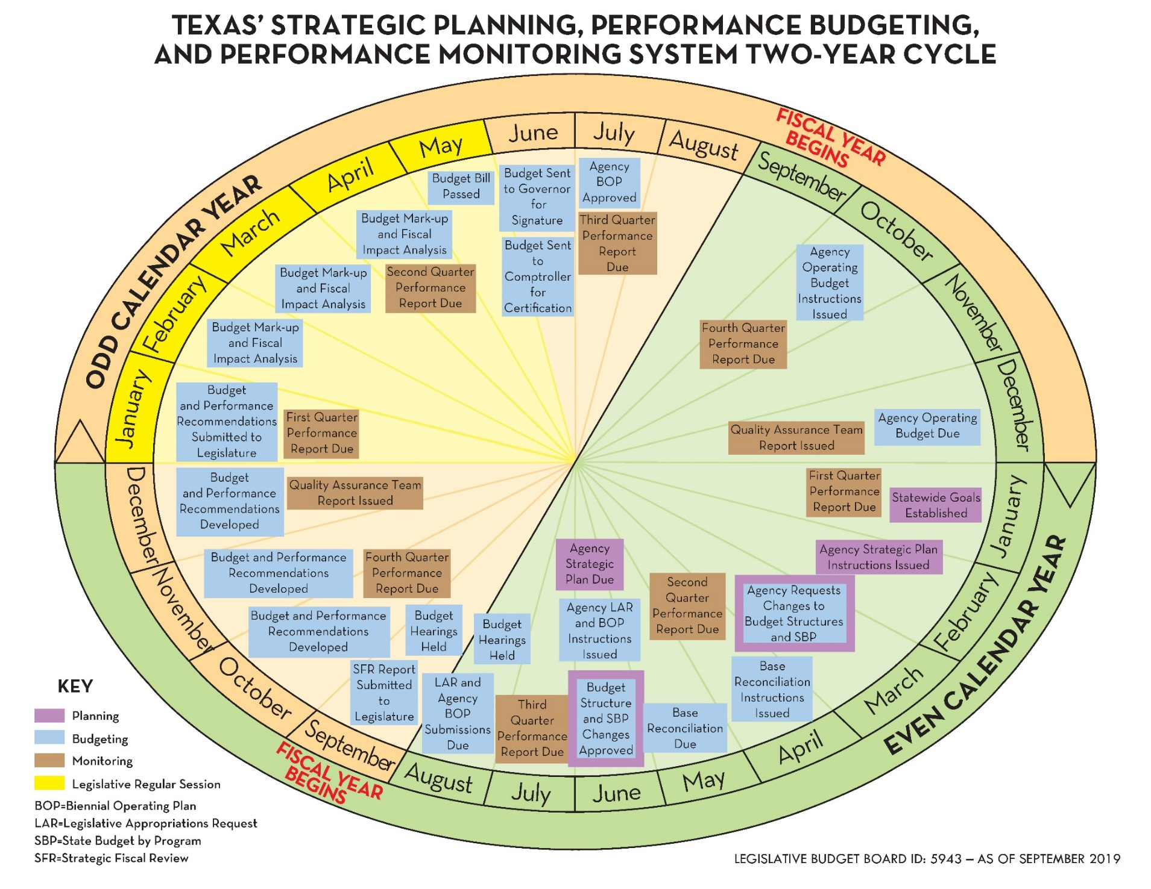

Slide 9
Observations from the 89th TX Legislature
[ Regular Session ]

Slide 10
Observations from the 89th TX Leg
2026-27 GAA ~ $337.9 Billion
2025 Supplemental Appro ~ $12.6 Billion
Property Tax Relief, Public Education
Water Funding Dedication
Add’l Electricity Capacity
Medicaid Caseload Growth
Add’l Correctional Beds at TDCJ
Border Security
LEGISLATIVE BUDGET BOARD ID: 9307

Slide 11
Observations from the 89th TX Leg
LEGISLATIVE BUDGET BOARD ID: 9307

Slide 12
Observations from the 89th TX Leg
$140K homestead exemption for homeowners under 65, $200K homestead exemption for homeowners 65+ yrs
Increased tax relief for business personal property
Statewide school choice program
Teacher pay increases and additional school funding, prayer and Ten Commandments in public schools
Committing $ billions for water needs in future years
Dementia Prevention and Research Institute of Texas
Film and moving image industry incentive funding
Functions of the Lottery Commission moved to TDLR
LEGISLATIVE BUDGET BOARD ID: 9307

Slide 13
Observations from the 89th TX Leg
What Next?
Reminders –
Build Relationships with the Leadership Staff
Communicate, Communicate, Communicate
Conversations before Pushing Paper
LEGISLATIVE BUDGET BOARD ID: 9307

Slide 14
Leadership Development Discussion Jan 2024: Mission-Minded Leaders Dec 2024: Identifying and Growing Leaders

Slide 15
Leadership Development Discussion
As individuals, we have an obligation to develop ourselves as leaders to the fullest possible extent.
As leaders within Texas state government, we all have an obligation to identify and develop future leaders to the fullest possible extent.

Slide 16
Mission-Minded Leaders
HHSC Mission Statement:
Improving the health, safety and well-being of Texans with good stewardship of public resources.
TEA Mission Statement:
The Texas Education Agency will improve outcomes for all public school students in the state by providing leadership, guidance, and support to school systems.
TxDOT Mission Statement:
Connecting You with Texas
TDCJ Mission Statement:
The mission of the Texas Department of Criminal Justice is to provide public safety, promote positive change in offender behavior, reintegrate offenders into society, and assist victims of crime.
TPWD Mission Statement:
To manage and conserve the natural and cultural resources of Texas and to provide hunting, fishing and outdoor recreation opportunities for the use and enjoyment of present and future generations.
DIR Mission Statement:
The mission of the Texas Department of Information Resources is to serve Texas government by leading the state's technology strategy, protecting state technology infrastructure, and offering innovative and cost-effective solutions for all levels of government.
TDLR Mission Statement:
To earn the trust of Texans every day by providing innovative regulatory solutions for our licensees and those they serve.

Slide 17
Mission-Minded Leaders
Do you agree with your agency mission; does it accurately reflect what you do?
Who benefits when these missions are met?
How do you share this with other employees so that they understand how their work impacts accomplishing the mission?
How do we develop leaders? [Experiences / Mentors / Training / Other Ways]
PUBLIC SERVICE: Why did you choose public service as a career?
Remember that public service is a privilege; we choose to be public servants and in doing so, ask for the public’s trust.

Slide 18
Leadership Development Discussion
Identifying and Growing Leaders

Slide 19
“Those who hold the public trust must adhere to the highest ethical standards there are. The job requires it, and the public must demand it.” – Barbara Jordan
“Leadership requires belief in the mission and unyielding perseverance to achieve victory.” - Jocko Willink
THANK YOU FOR WHAT YOU DO!!
www.lbb.texas.gov
512.463.1200
"Leadership is a potent combination of strategy and character. But if you must be without one, be without the strategy.” – Norman Schwarzkopf
"Leaders aren't born, they are made. And they are made just like anything else, through hard work. And that's the price we'll have to pay to achieve that goal, or any goal." – Vince Lombardi

