Slide 1

LEADING BY CONNECTION
PEOPLE, PROCESS & PURPOSE
PATRICK FORTNER
Red Mike Messages

Slide 2

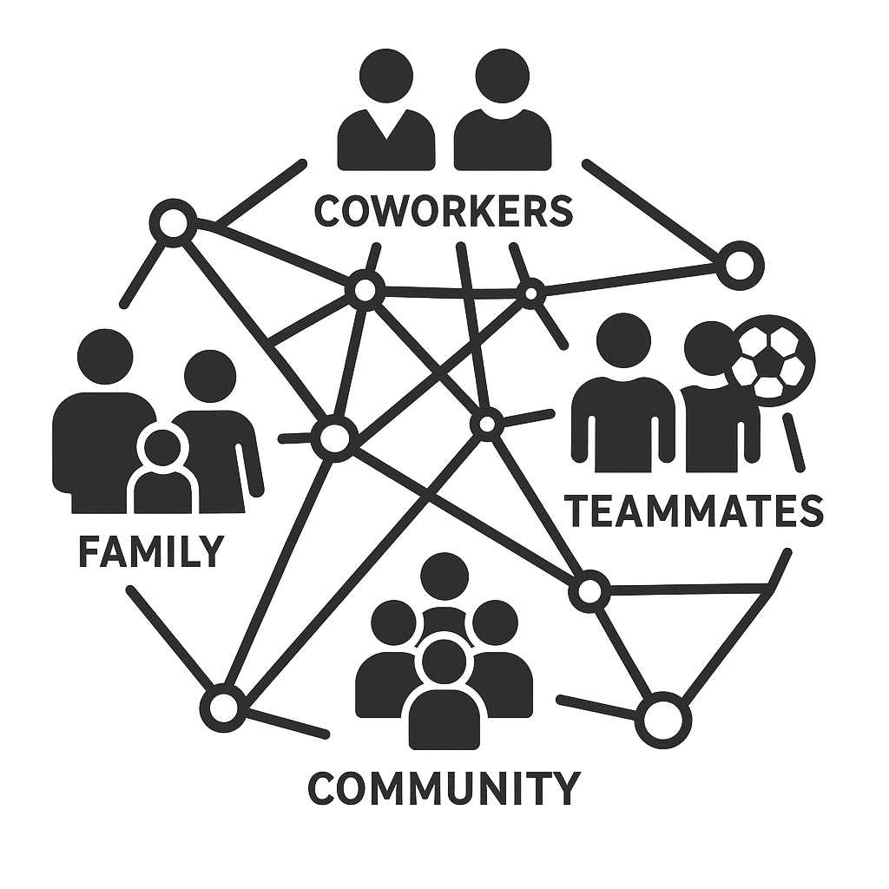
Who are
you connected to?

Slide 3

People, process & purpose.

Slide 4

Command Without Ego
Trust beats volume.

Slide 5

Quiet consistency leaves the longest impression.

Slide 6

Not above the team - WITH the team.

Slide 7

You’re the last line. No excuses. Just defense.

Slide 8


You Can’t Wing It and Win It.

Slide 9

Don’t wait. Problems don’t age well.

Slide 10
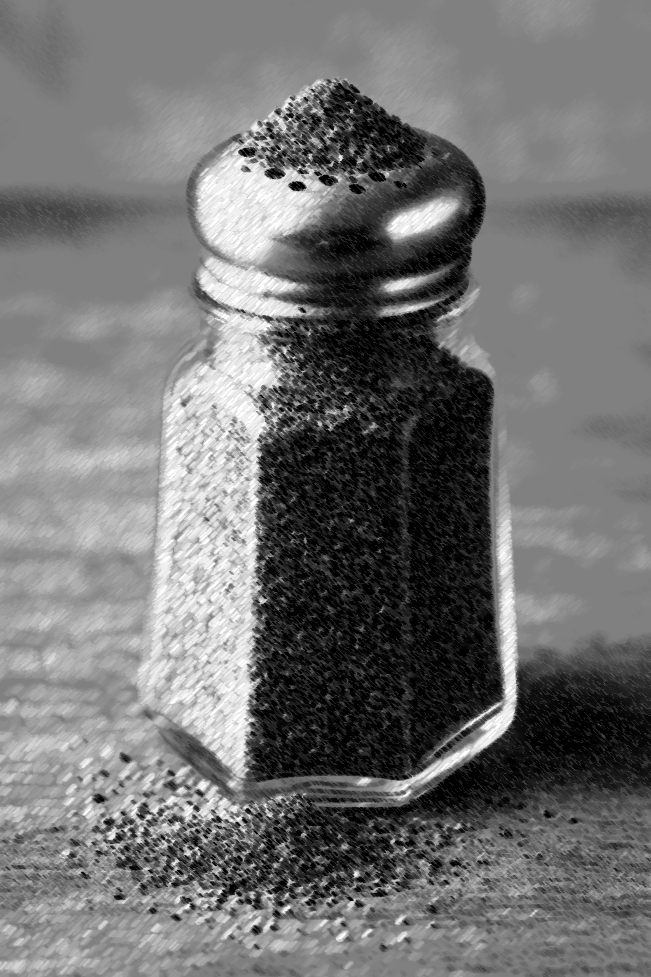
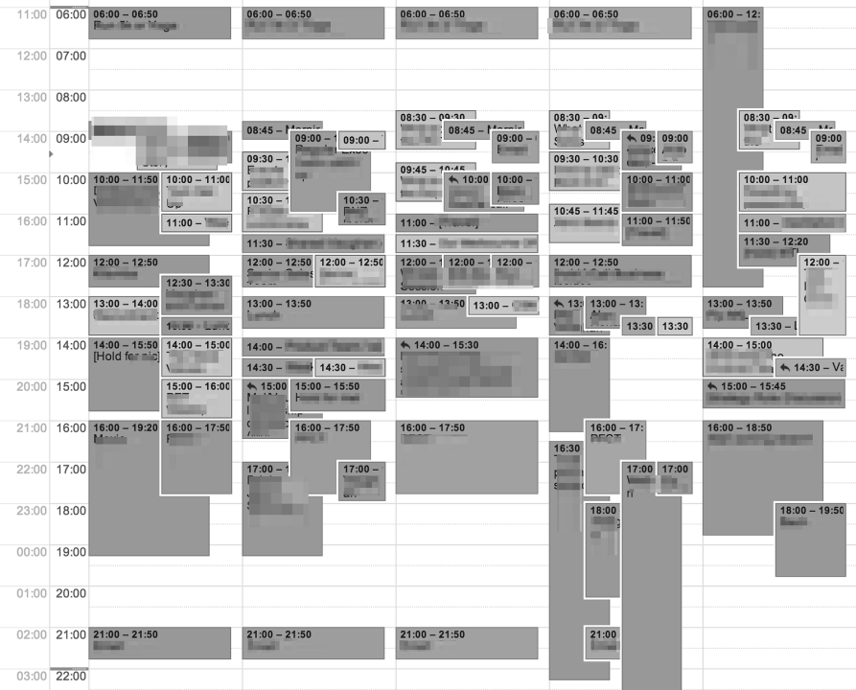
Overfilled systems can’t deliver.

Slide 11


Process without intention is just clutter.

Slide 12
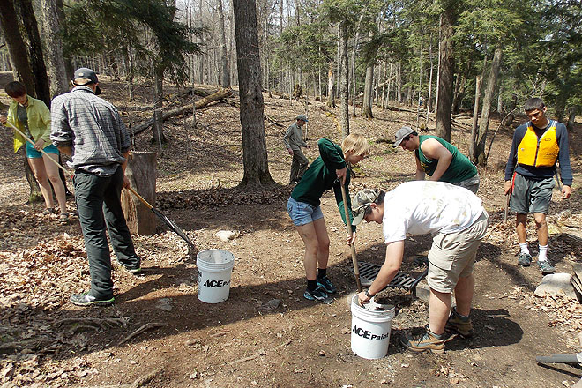
The only question is: Did you leave it better than you found it?

Slide 13


Same ladder, different rungs

Slide 14

Purpose isn’t the glory play. It’s the right play.

Slide 15


No applause. Just purpose.

Slide 16


Leadership starts with sacrifice.

Slide 17

Purpose gives you something to hold

Slide 18

Final thoughts
Ask the hard questions
Contemplate the answers
Life is Short. Drink the Bourbon.

Slide 19
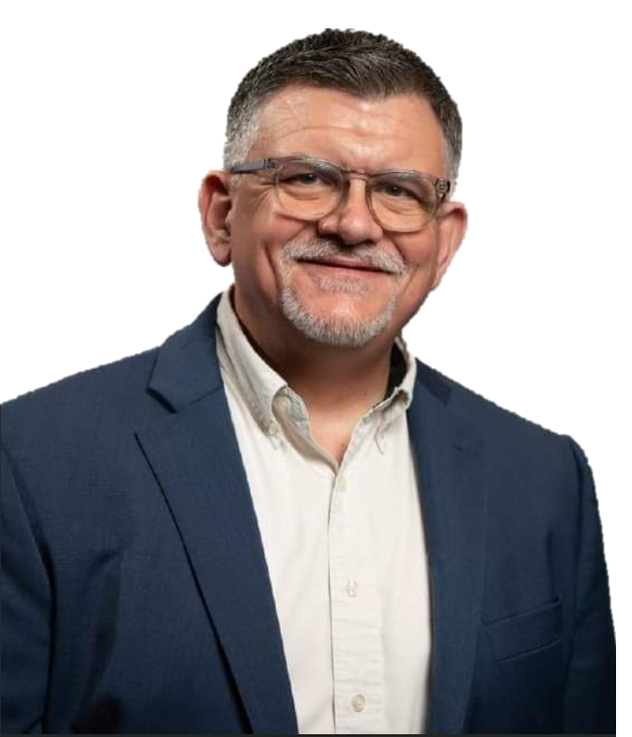
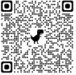
Questions
PATRICK FORTNER
RedMikeMessages@gmail.com (512) 947-9226

