Slide 1

“Why Connection Drives Success: The Human Side of Professional Growth.”
Leyna Nguyen

Slide 2
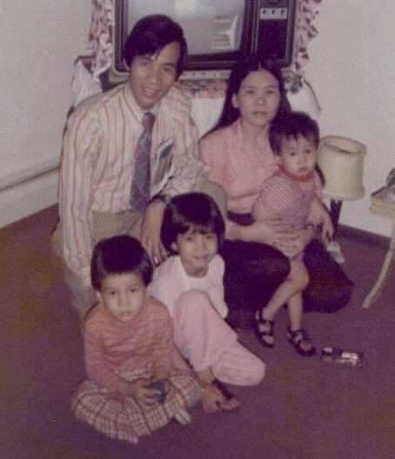
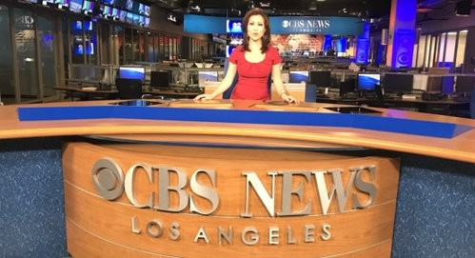


Slide 3
“People donʼt leave jobs — they leave people.”
75% of people who quit do so because of their manager (Gallup )
#1 reason for quitting is not pay — it's feeling undervalued (McKinsey)

Slide 4

Connection Is the New Currency
Connection creates engagement. Disconnection breeds resentment.
A disconnected team member is 3x more likely to be actively disengaged
(Gallup )
You donʼt have to be best friends — but people need to feel heard and valued.

Slide 5

Take Responsibility for the Culture You Create
Culture is not a poster. Itʼs what people whisper about when leadership leaves the room.
No matter your position, you influence culture.
Leaders: You donʼt have to fix everything — just start listening.

Slide 6

You Donʼt Need a Title to Lead
Leadership is not a position. It's a decision.
The best team members take ownership, act with integrity, and lift others — no title required.
Quiet influence > loud authority

Slide 7
Make People Feel Like They
Matter
52% of employees say they donʼt feel recognized at work
(Workhuman survey)
Employees who feel appreciated are 5x more likely to stay.

Slide 8
KEY ACTIONS
Call out contributions in real time.
Celebrate small wins.
Ask for input — and mean it.
Remove the phrase “Just doing my job.”
→ Replace with: “What I do matters.”

Slide 9

The Human Side Is the Winning Side
“The best leaders arenʼt the loudest, richest, or smartest. Theyʼre the ones who made people feel like they belonged.”

Slide 10

What happiness looks like

