Slide 1
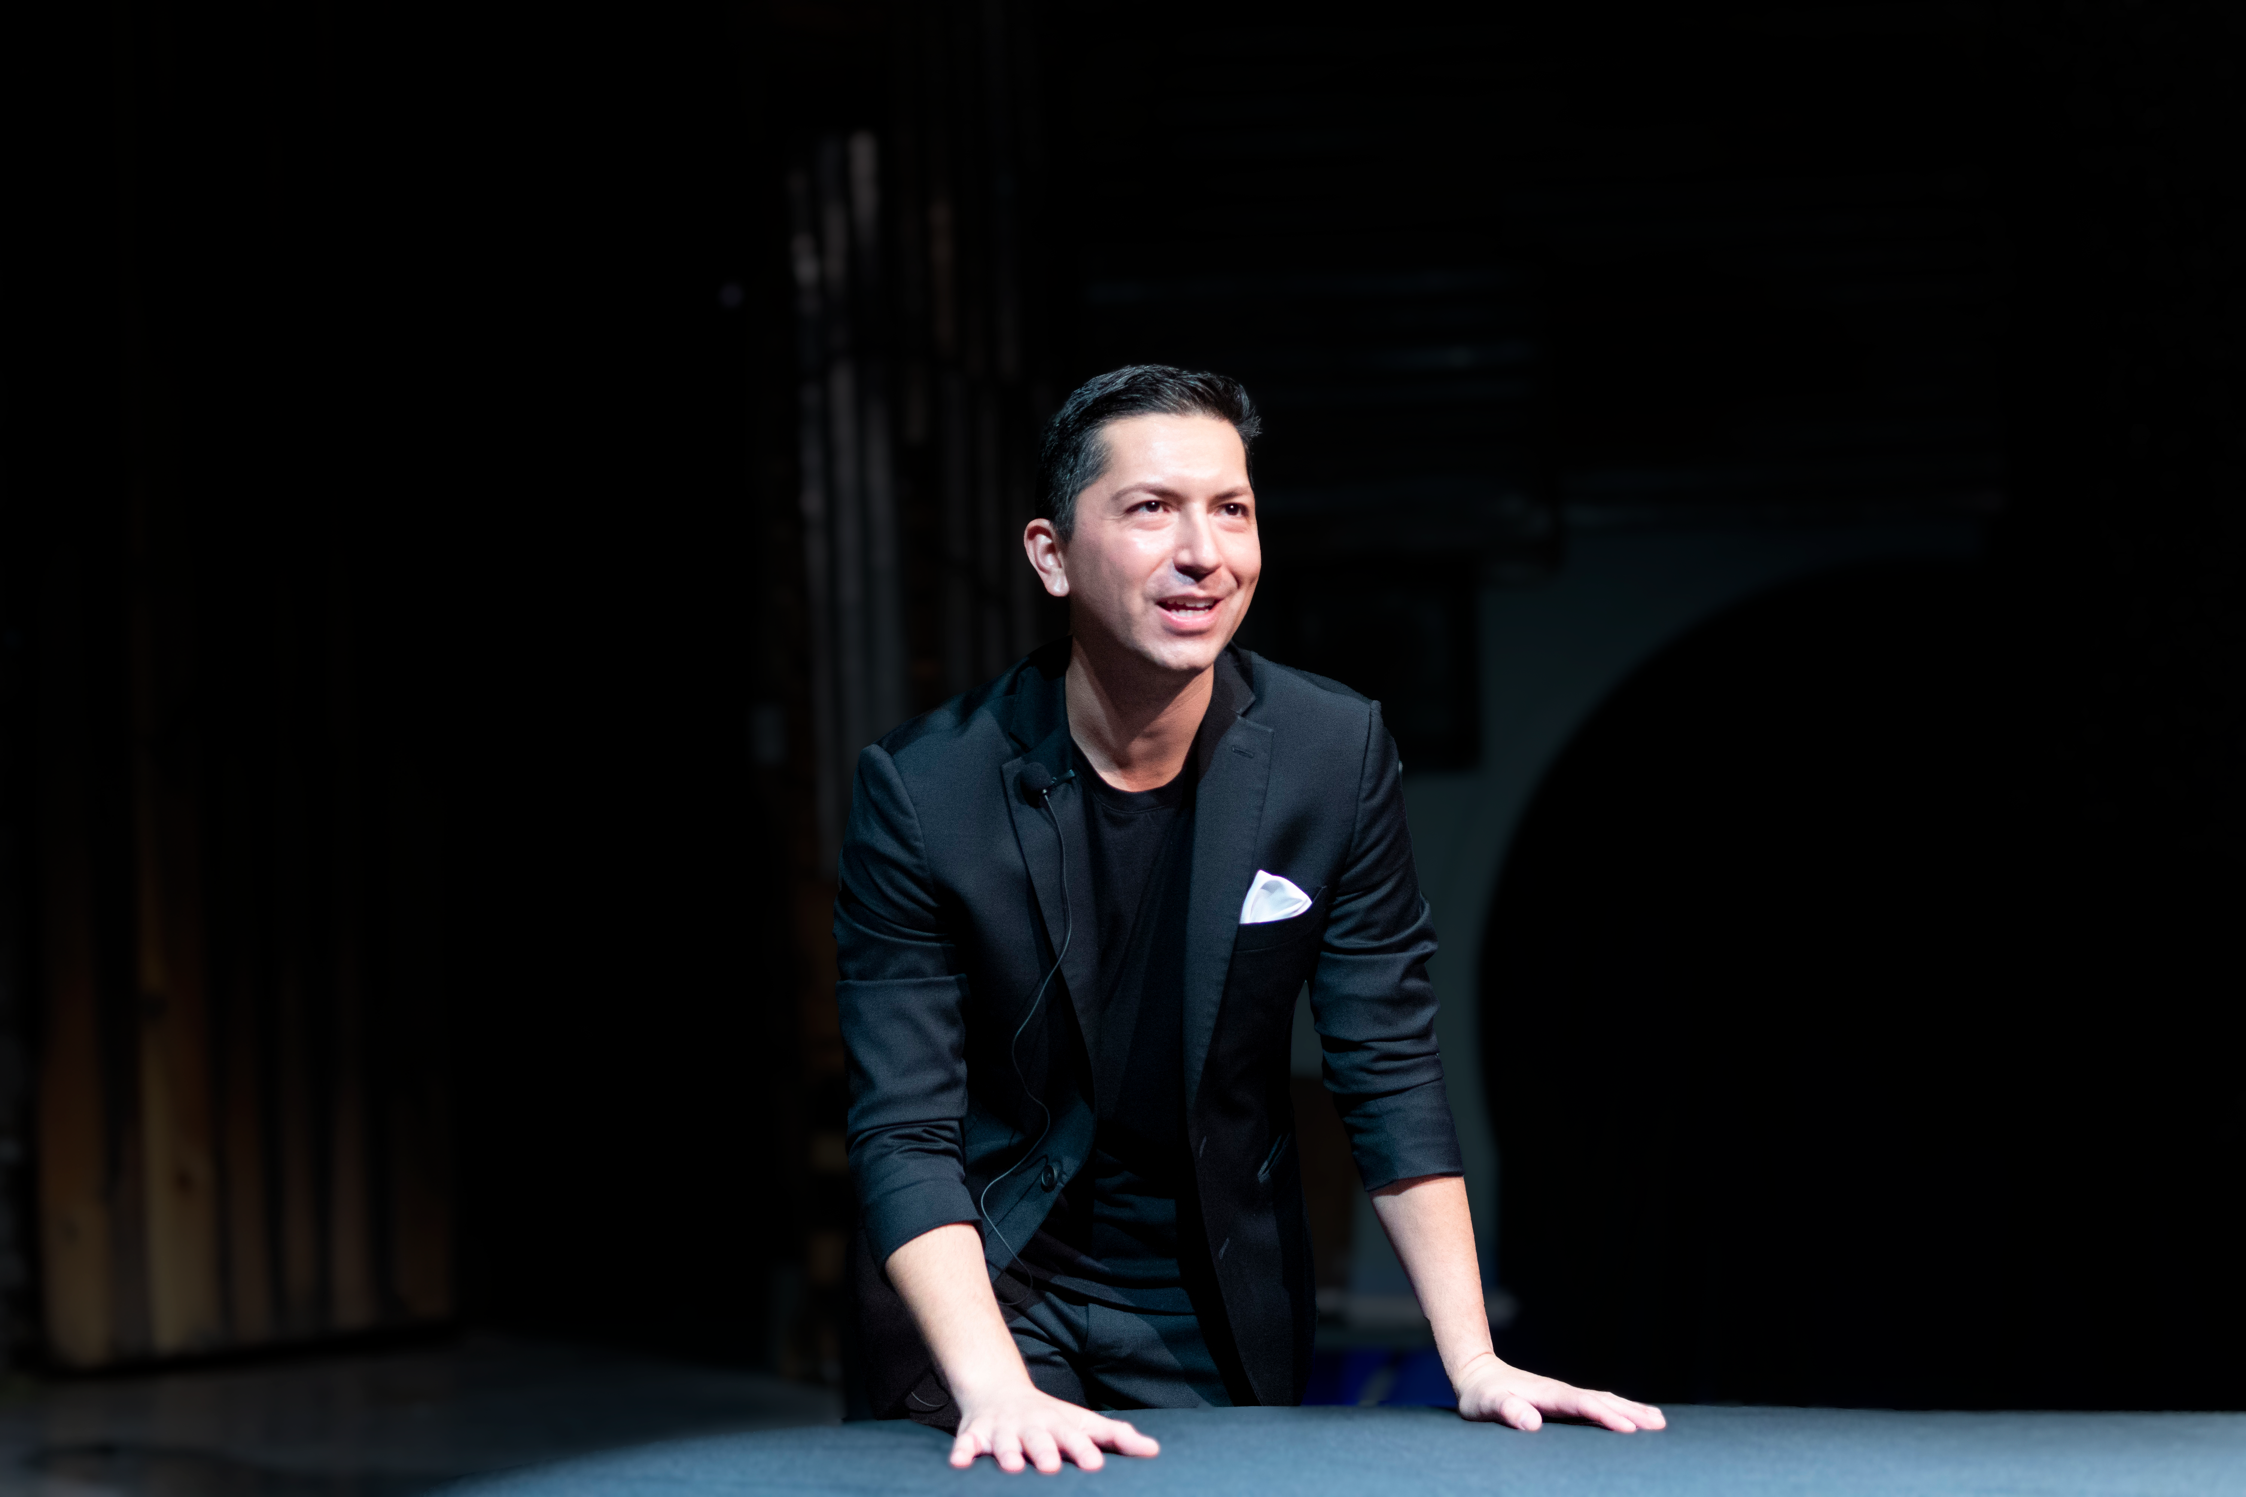
The Magic of Communication Rudy Reynoso
Speaking Strategist & Magician
www.RudyReynoso.com
@RudyisMagic – Instagram
@RisewithRudy - TikTok

