Slide 1
CAPPS ERP Update
TSABAA
July 2025

Slide 2
Current Maintenance & Upgrades

Slide 3
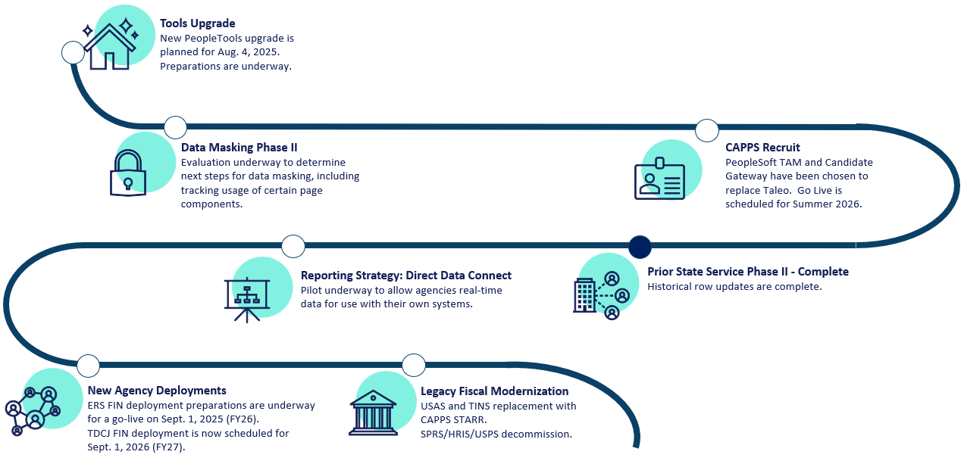
CAPPS Roadmap

Slide 4
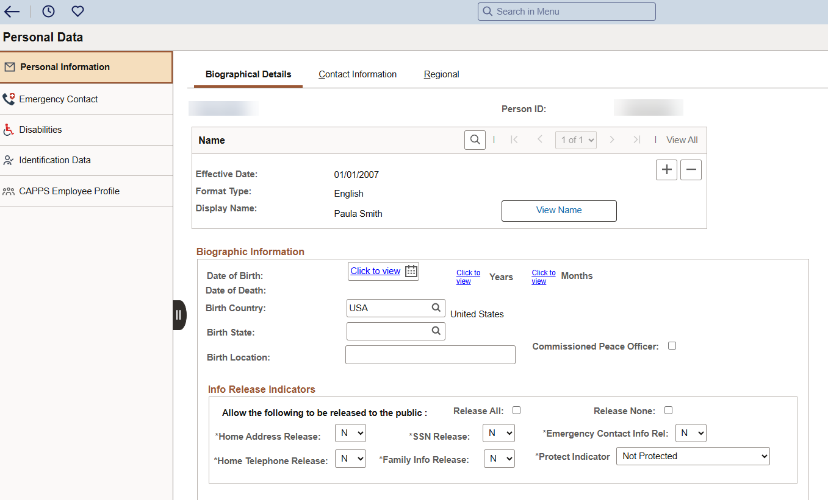
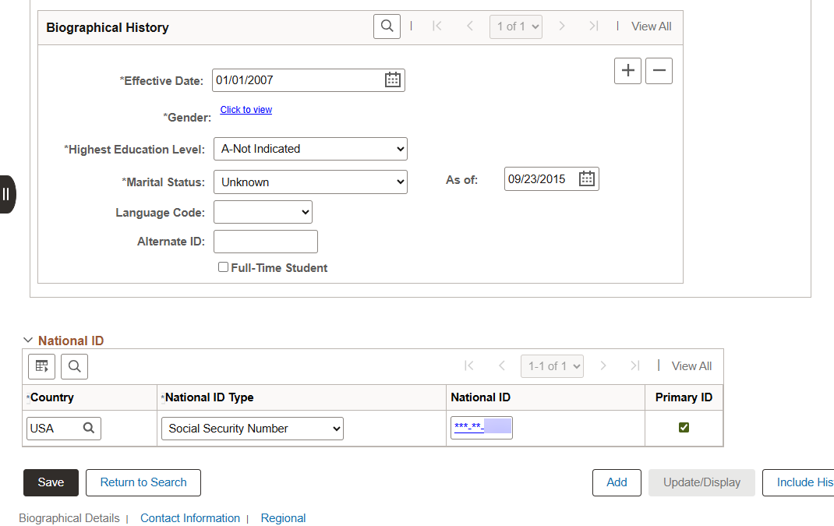
Data Masking Phase II

Slide 5
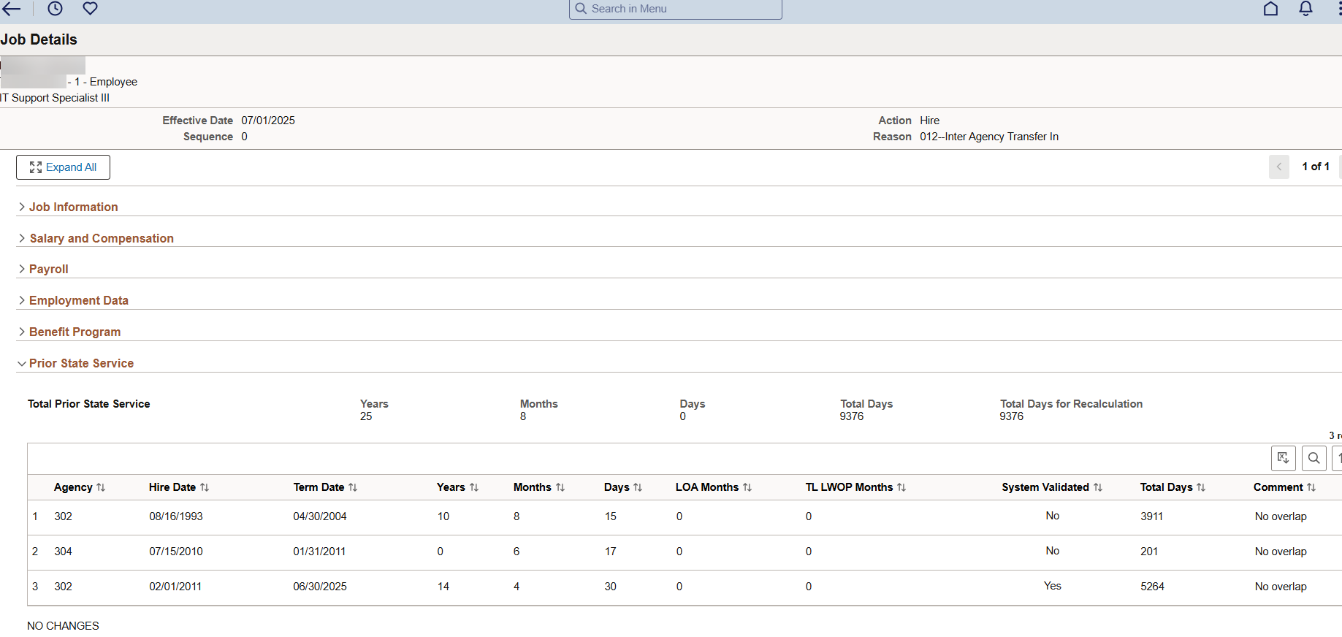
Prior State Service Phase II

Slide 6
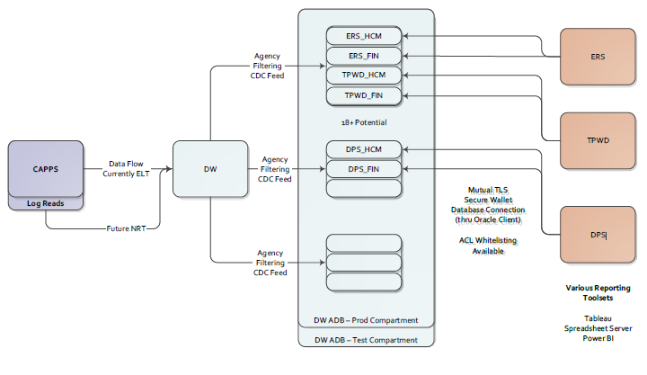
Agency Direct Data Access - ADDA

Slide 7
CAPPS STARR Update

Slide 8
CPA Fiscal Management CAPPS ERP Vision
CAPPS is already more than Peoplesoft. It is the name for the Comptroller's ERP systems. The procured solution and its functionality will be part of the larger ERP.
The goal is to implement a solution that provides the usability and comprehensive functionality required to perform all required functions with limited customizations.
CPA solicited for a SaaS solution:
SaaS stands for software as a service, which means software is hosted by a third-party provider and delivered to customers over the internet as a service.
The SaaS delivery model is enabled by a multitenant architecture, where a service provider can distribute multiple versions of the same software from a single physical server.
Each user has its own version of the application, with the associated customizations, data, and access controls, but from a shared code base that is patched, updated, and maintained centrally.

Slide 9
CPA Fiscal Management CAPPS ERP Vision
The Statewide Fiscal Systems (SFS) and Statewide Fiscal Oversight (SFO) Departments of CPA’s Fiscal Management division partnered to reach the best business choices to secure our systems, ensure the integrity of our data, and provide the best user experience possible.
The original ERP legislative mandate is in full effect. Any solution chosen does not deviate from the goal of “a single set of books”.
The expectation is that transactions flow seamlessly regardless of how many behind the scene products are required to accomplish all requirements.

Slide 10
CAPPS STARR Timeline & Accomplishments
CAPPS STARR RFO released: April 24, 2024
Vendor down selection announced: January 3, 2025
Vendor presentations: January 29 - February 14, 2025
Final vendor selection: Late March 2025
Contract negotiations: April - June 2025
Contract signed June 30, 2025
Project initiation: September 2025 (FY26)
Anticipated go-live dates
USAS/TINS Replacement: September 2027 (FY28)
SPA Replacement: March 2028 (FY28)

Slide 11
CAPPS STARR Vendor
CGI is an IT and business consulting firm with more then 45 years of public sector experience. CGI implements its own proprietary government financial solution, CGI Advantage.
CGI Advantage is a web-based ERP system designed specifically for government operations. The financial management module promotes accountability and offers real-time budget tracking functionality. It also provides the capability to deliver reports that comply with GAAP and GASB requirements.

Slide 12
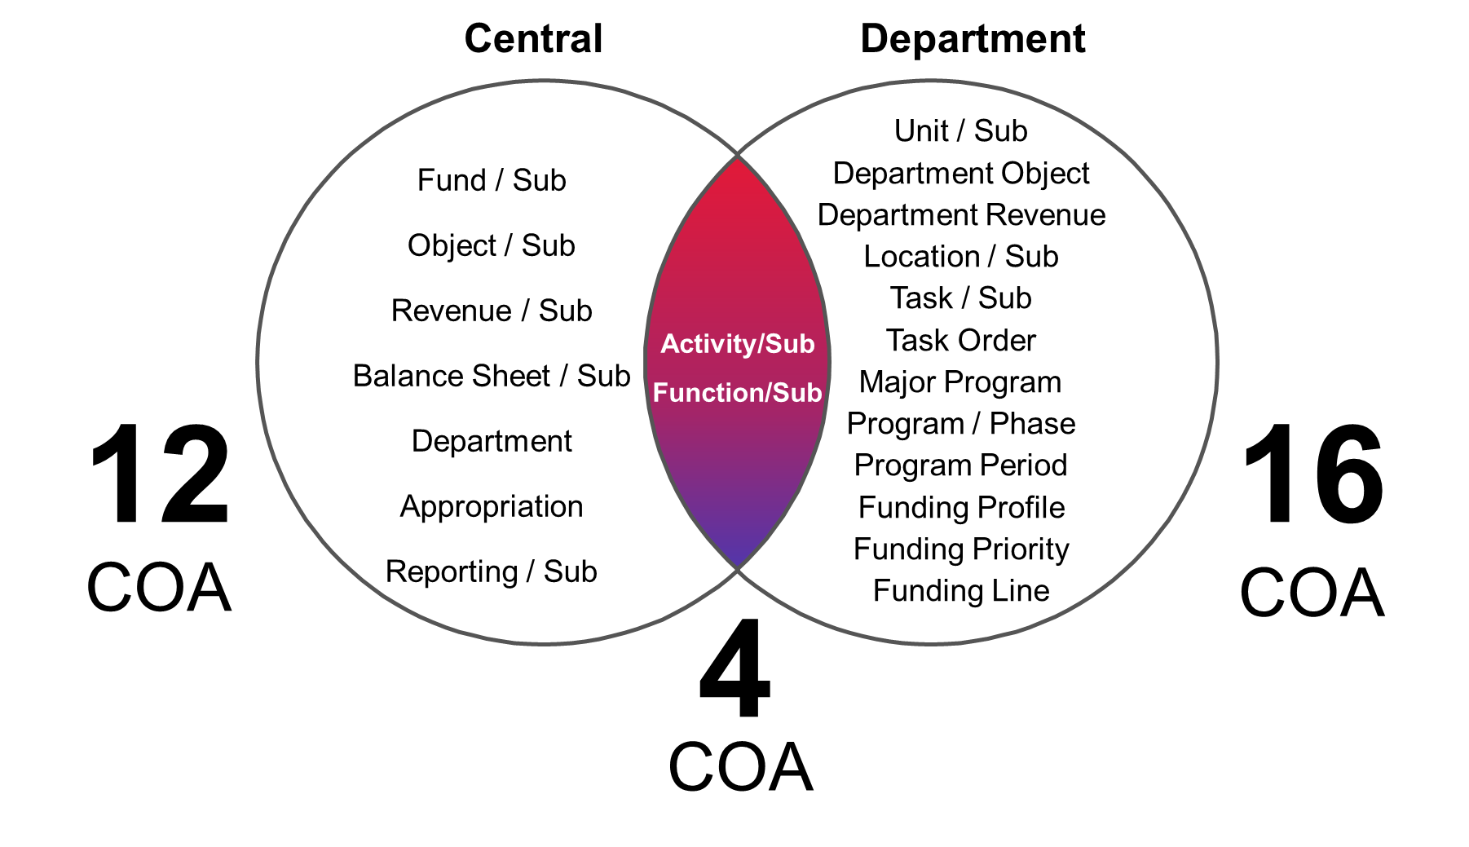
CGI Advantage – Core Financial Functions
General Accounting
Budget
Control
Accounts Payable and Receivable
Offsets
Cash Management
Financial
Management
Cost
Accounting
Inventory Management
Asset Management
Travel & Expense Management
Grant Lifecycle Management
Robust COA designed for government accounting
Delivered for GAAP and GASB
Dedicated ACFR roll-ups
Configurable budget control and cash control
Flexible and configurable journals and ledgers

Slide 13
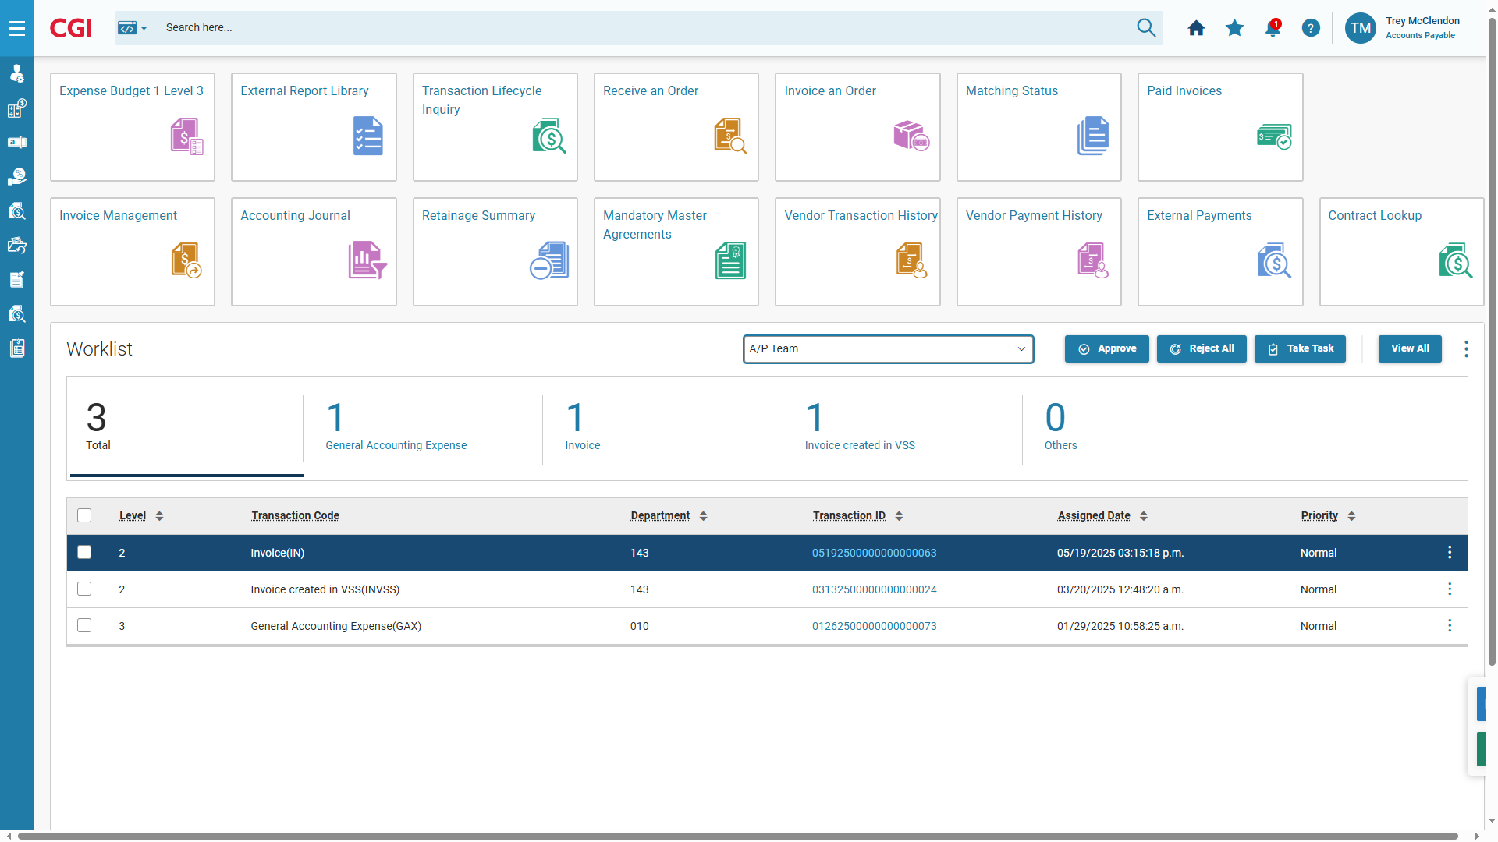
Modern, Intuitive User Experience
Intuitive Homepages
All-in-One View: Key info, tasks, and metrics in one place.
Role-Based & Configurable: Tailors content and layout to each user’s role and preferences
Fast & Intuitive: Designed for quick access to critical workflows and data, helping users easily find what they need

Slide 14
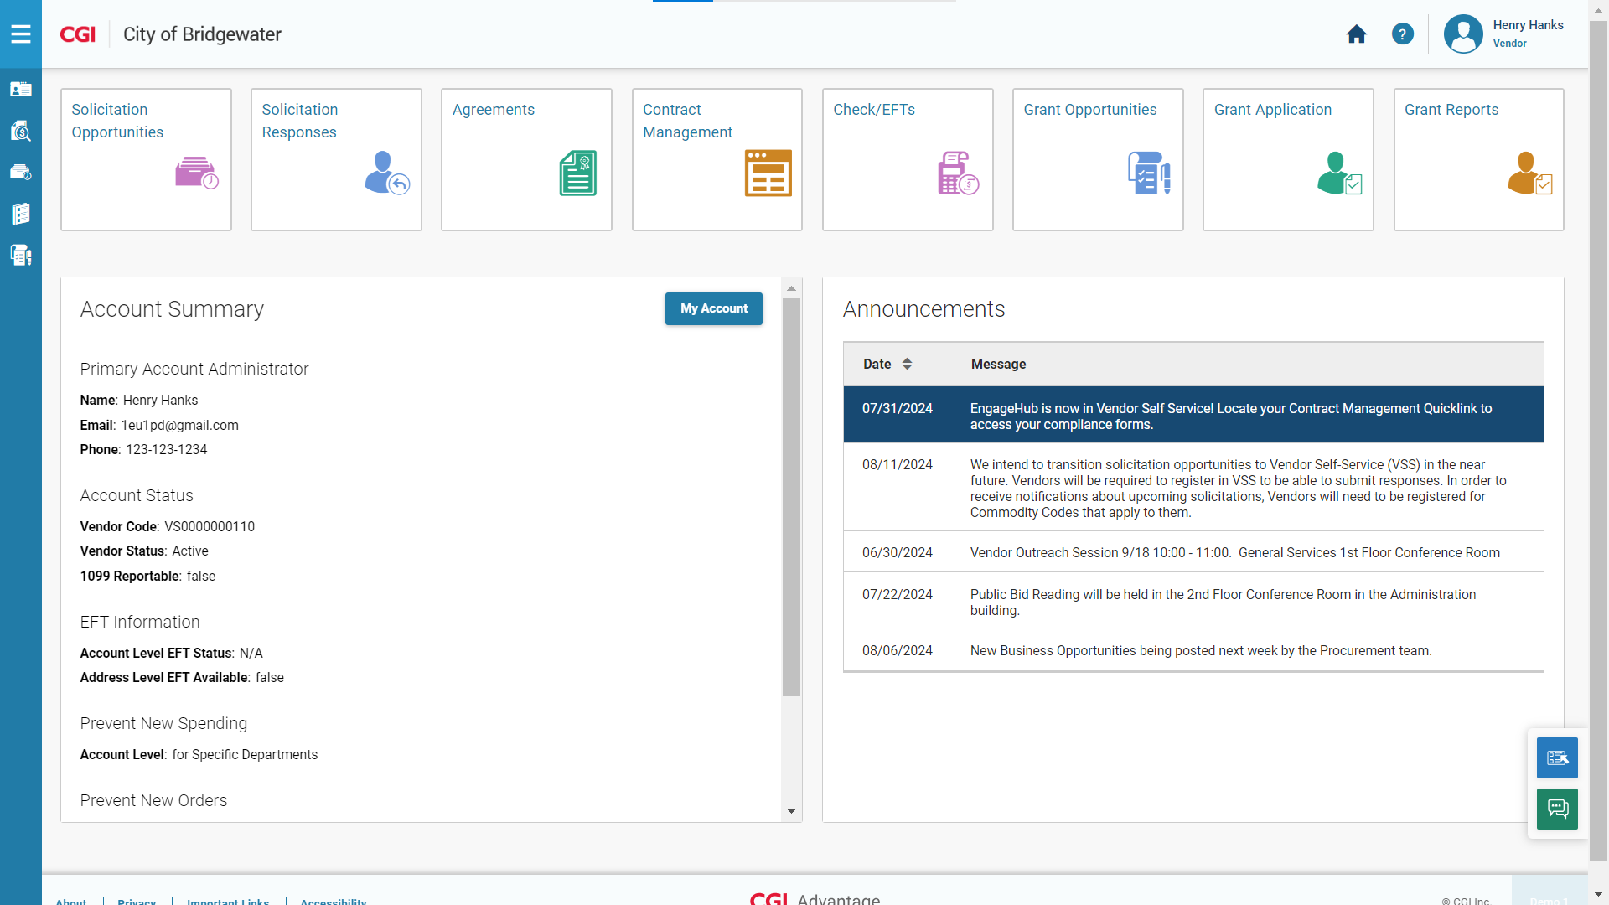
Modern, Intuitive User Experience
Sample Vendor Homepage

Slide 15
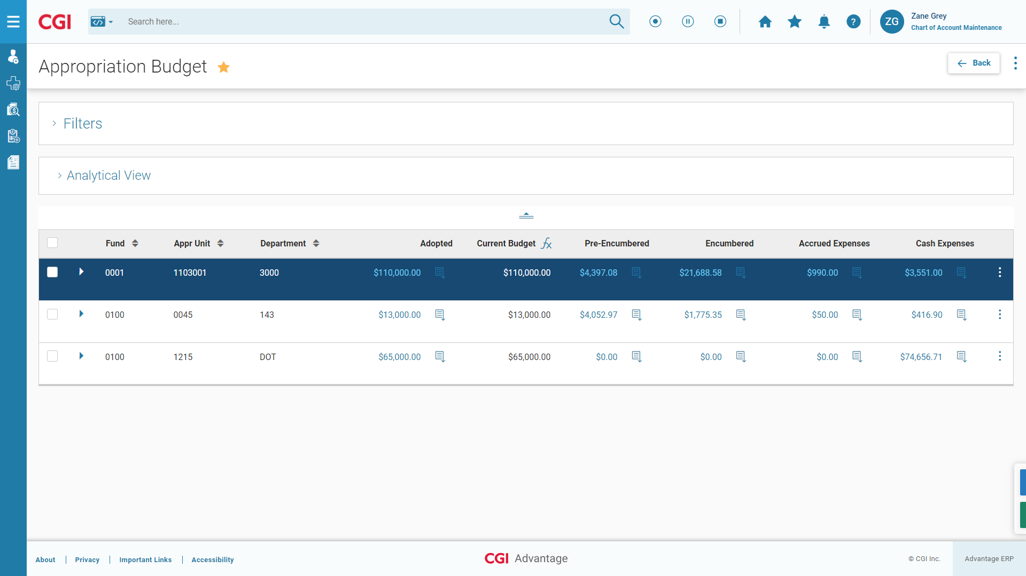
Modern, Intuitive User Experience
Responsive, mobile-first design
Role-based approach with integrated workflow
Real-time data and configurable inquiries

Slide 16
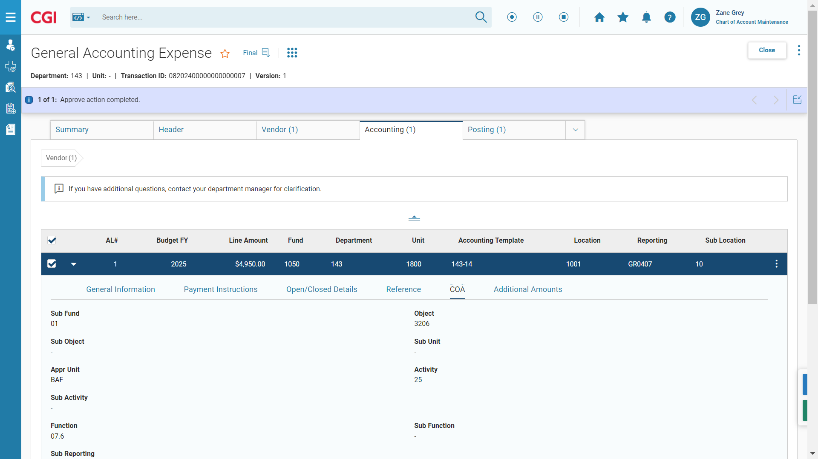
Modern, Intuitive User Experience
Sample General Expenditure Transaction

Slide 17
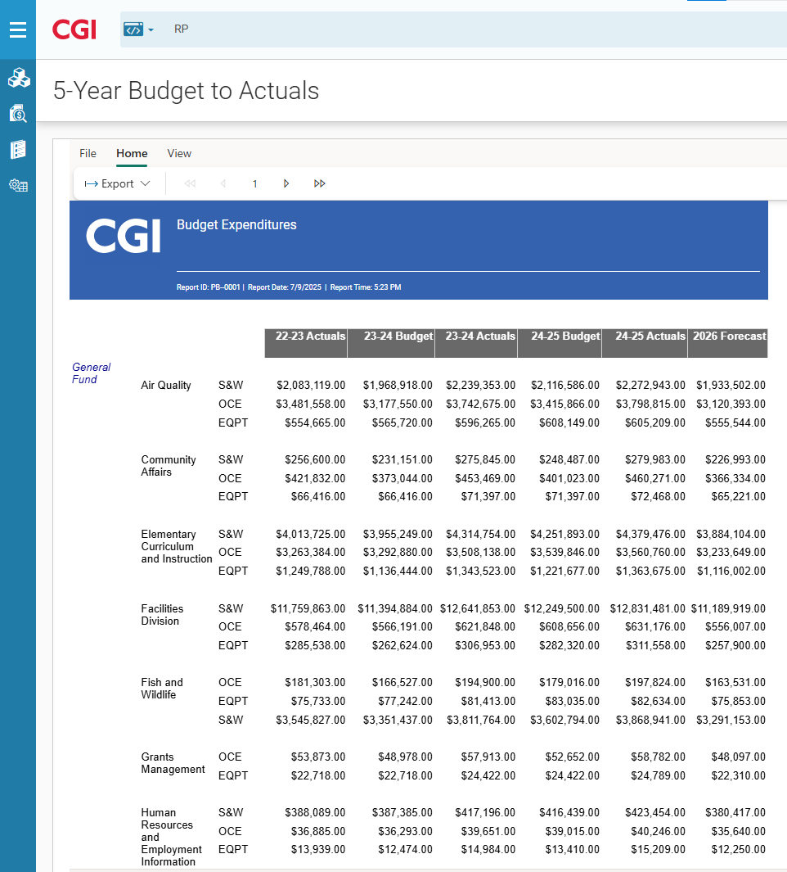
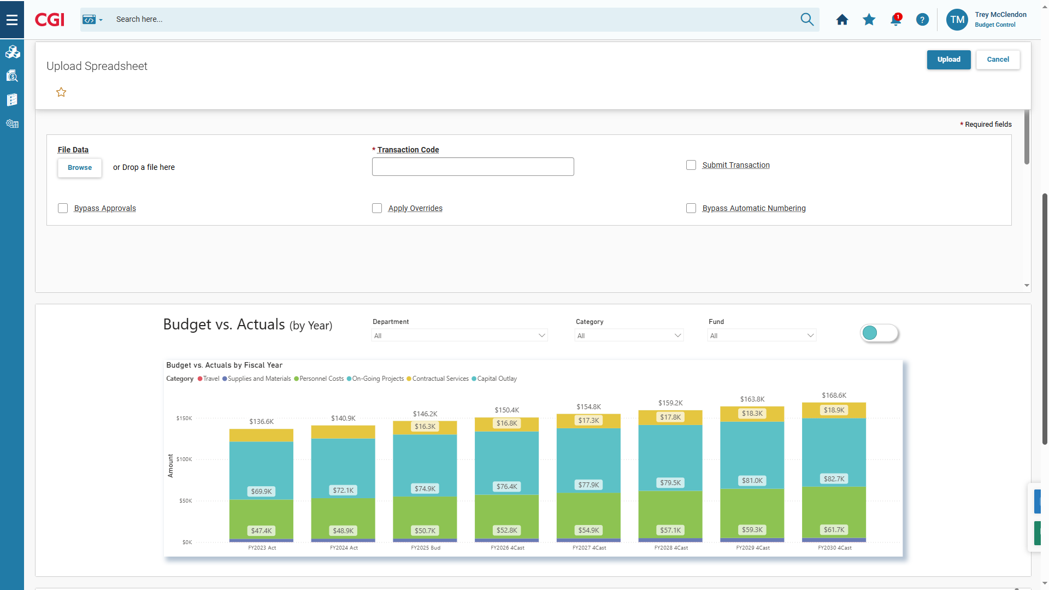
Modern, Intuitive User Experience
Embedded reports and analytics
Real-Time Insights: data at your fingertips
Contextual Analytics: reports embedded where work happens
Interactive & Visual: drill-downs and dashboards for deeper understanding

Slide 18
Implementation Approach
Phased implementation starting with core USAS/TINS functionality
Support for existing interfaces alongside development of APIs for modern system integration
Comprehensive testing and security protocols
Vendor-provided technical training and support
Service Level Agreements for ongoing maintenance
Post Implementation Vision
Ongoing Training Opportunities
Communication
Support Structure

Slide 19
Thank You!
Chelsa Vinklarek Chelsa.Vinklarek@cpa.texas.gov
Clarisse Roquemore Clarisse.Roquemore@cpa.texas.gov

