Slide 1

The Power Of Connection: Enhancing Collaboration for Better Results
TSABAA Summer Conference
July 2025
Notes:
1. Introduction (5 minutes)
Opening statement:
Connection is at the heart of effective governance and public service. As public servants, we are tasked with delivering results to citizens, and to do so effectively, we must break down silos and work together.
Personal connection to the theme:
Briefly share your experience as an internal auditor and how you've seen the impact of strong connections between departments versus the lack of them.
** Poll group – large vs. small agency -- mgmt. vs. line staff -- how many with less than 2 years in state government **

Slide 2
Overview of what we will cover
Why connections matter
The consequences of disconnected systems
Strategies for building strong connections across departments
Notes:
Overview of what we will cover:
Why connection matters
The consequences of disconnected systems
Strategies for building strong connections across departments

Slide 3

Why Connect?
Notes:
2. Why Connect? (10 minutes)
Connection is about collaboration:
Collaboration is the foundation of innovation, efficiency, and problem-solving. When we connect, we tap into collective knowledge, expertise, and resources.
"Why do we want to connect?" – The ultimate goal is to align our daily work with the mission of the agency and improve outcomes for the public.
Connecting work to the agency’s mission:
Every department, from procurement to human resources, plays a role in fulfilling the agency's mission. Understanding how individual contributions tie into the larger goal enhances engagement and impact.
The need to connect legislative intent to action:
Often, there’s a disconnect between legislative intent and agency implementation. Connecting these dots ensures that the work done at the ground level aligns with the broader legislative goals and public needs.
Building a connected system:
Systems must connect: Think of the agency as a network of interconnected systems. Procurement, accounting, HR, and program departments must share information and collaborate seamlessly.

Slide 4
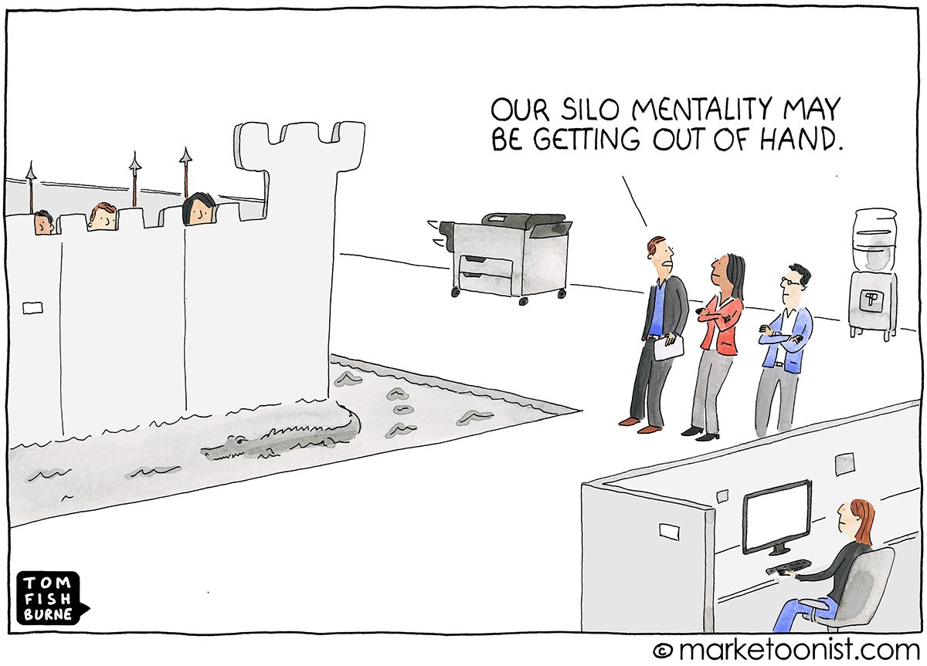
What Happens When We Don’t Connect?
Notes:
What Happens When We Don’t Connect? (10 minutes)
Silos:
Without connection, we create silos – isolated departments that don’t share information or collaborate. This can lead to inefficiency and missed opportunities.
Example: Procurement unaware of a HR need, leading to delays or mismatched hires.
Waste and redundancies:
Unconnected departments often duplicate efforts, wasting time and resources. An easy example: multiple departments creating their own reports instead of collaborating on a unified system.
Example: Two departments purchasing similar software or services without coordination.
Being reactive instead of strategic:
When we don’t connect, we tend to be reactive, responding to problems rather than anticipating and addressing them in a proactive, strategic manner.
Example: Reactive auditing due to poor communication versus strategic, forward-thinking auditing based on connected systems.

Slide 5

The Benefits of Connection
Notes:
The Benefits of Connection (10 minutes)
Increased efficiency:
Connecting departments leads to streamlined processes, fewer redundancies, and better resource allocation.
Example: Shared data across departments can eliminate the need for duplicate data entry, reducing errors and delays.
Improved outcomes:
When departments align, they create more effective solutions and achieve better results. Agencies can fulfill their mission with greater accuracy and impact.
Informed decision-making:
Connection allows for better decision-making, as decision-makers have access to complete, relevant data from all departments.
A more strategic approach:
When systems are connected, departments can focus on long-term strategic goals rather than short-term issues.

Slide 6
Building Strong Connections
Fostering a culture of collaboration
Integrating systems and processes
Promoting connection
Training and development
Notes:
. Building Strong Connections (15 minutes)
Fostering a culture of collaboration:
Encouraging open communication, trust, and shared goals across departments.
Example: Cross-functional teams working together on projects or initiatives.
Promote regular inter-departmental meetings or workshops to foster relationships and improve understanding of each department’s role.
Integrating systems and processes:
Implementing technology and processes that promote seamless data-sharing and coordination across departments.
Example: Creating an integrated project management system or database that allows all departments to see the status of projects in real time.
Leadership's role in promoting connection:
Leaders must model collaborative behavior and incentivize cross-departmental cooperation.
Example: Department heads regularly meeting to discuss goals and resolve issues.
Training and development:
Offering training programs that help employees understand other departments' functions and challenges, leading to greater empathy and better collaboration.
Example: Workshops on procurement processes for non-procurement staff or HR policies for department managers.

Slide 7

CONNECT!
Connection is critical for fostering collaboration, reducing waste, improving decision-making, and achieving the agency's mission effectively
Without connection, we face inefficiencies, redundancies, and reactive management
Connection is an ongoing effort. It’s about creating a culture where departments understand the importance of collaboration and are equipped to work together
Notes:
Conclusion & Call to Action (5 minutes)
Summary of key points:
Connection is critical for fostering collaboration, reducing waste, improving decision-making, and achieving the agency's mission effectively.
Without connection, we face inefficiencies, redundancies, and reactive management.
Final thought:
Emphasize that connection is an ongoing effort. It’s about creating a culture where departments understand the importance of collaboration and are equipped to work together.

Slide 8

Think about one area in your agency where connections can be improved
Take actionable steps toward fostering collaboration
Notes:
Call to action:
Encourage attendees to think about one area in their agency where connections can be improved and take actionable steps toward fostering collaboration

Slide 9
Connection Action Plan
Identify departments that you are connecting with or want to improve connection with (e.g., Procurement, Accounting, HR, etc.).
Assess your current strengths and challenges in communication, collaboration, systems integration, and data sharing.
Outline clear, actionable steps to improve those connections, assign responsibility, and set a realistic timeline for action.
Define success indicators so that you can measure whether the changes are making a positive impact (e.g., reduced processing time, better alignment, or improved decision-making).
Notes:
Tool for self-assessment

Slide 10
Contact Information
Susan Oballe Vanessa Mayo
Assistant Chief Auditor Assistant Chief, Regulatory Services
Texas Department of Public Safety Texas Department of Public Safety
Susan.Oballe@dps.Texas.gov Vanessa.Mayo@dps.texas.gov
512-424-2158 512-424-3251

