Slide 1

Audit Ready
Why Standardization Matters: The Connection Between Process and Performance
2025 TSABAA Summer Conference

Slide 2

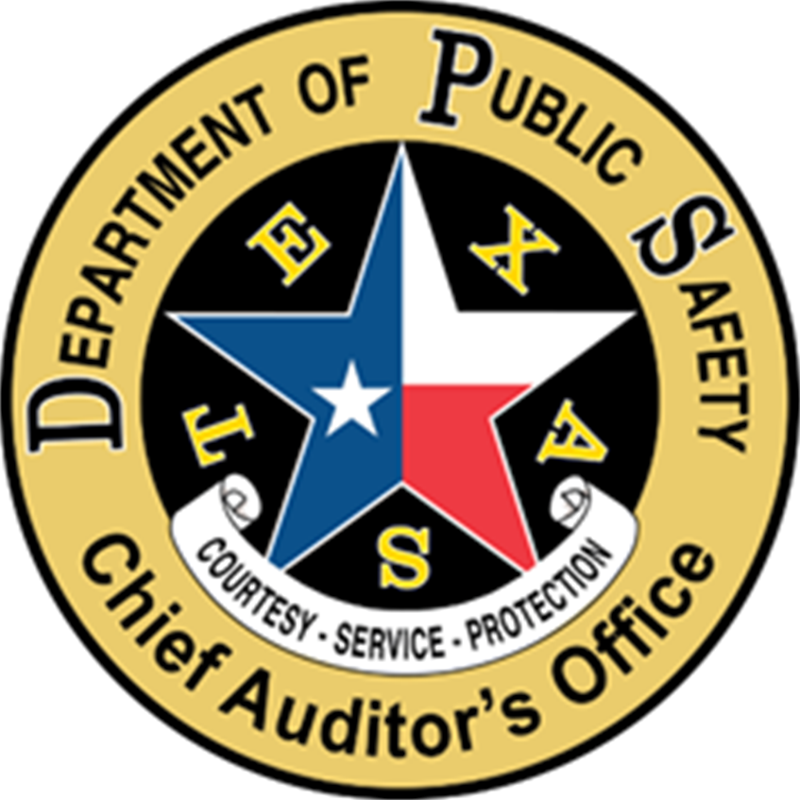
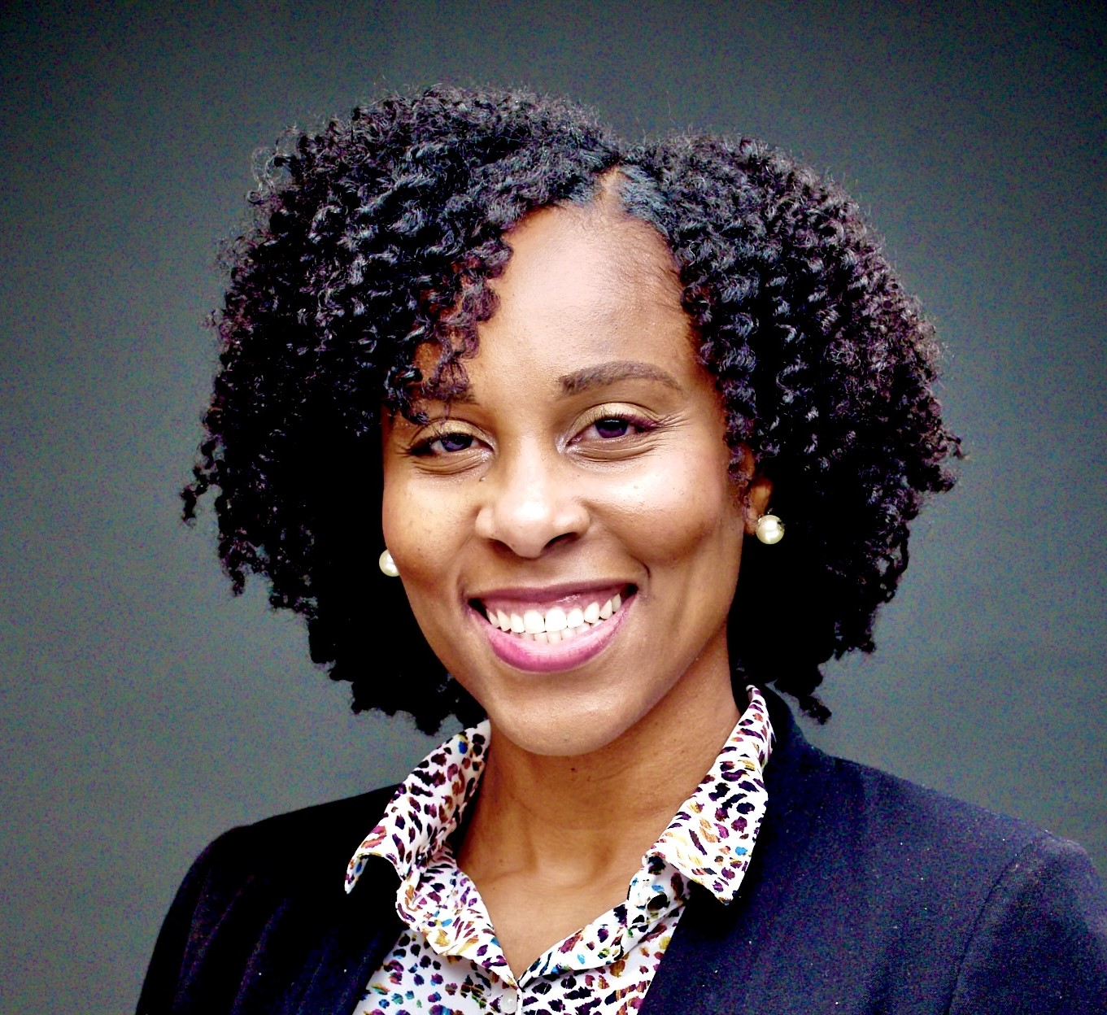

Presenters
Tammara West, CIA, CISA, CGAP
Senior Audit Manager
Chief Auditor's Office
Niko Alexander, SSGB
Senior Process Improvement Analyst
Chief Auditor's Office

Slide 3


Objectives
Understand the Importance of Standardization
Understand the Connection Between Standardization and Audit Readiness
Identify Key Steps in Creating Standardized Processes

Slide 4
The Importance of Standardization

Slide 5
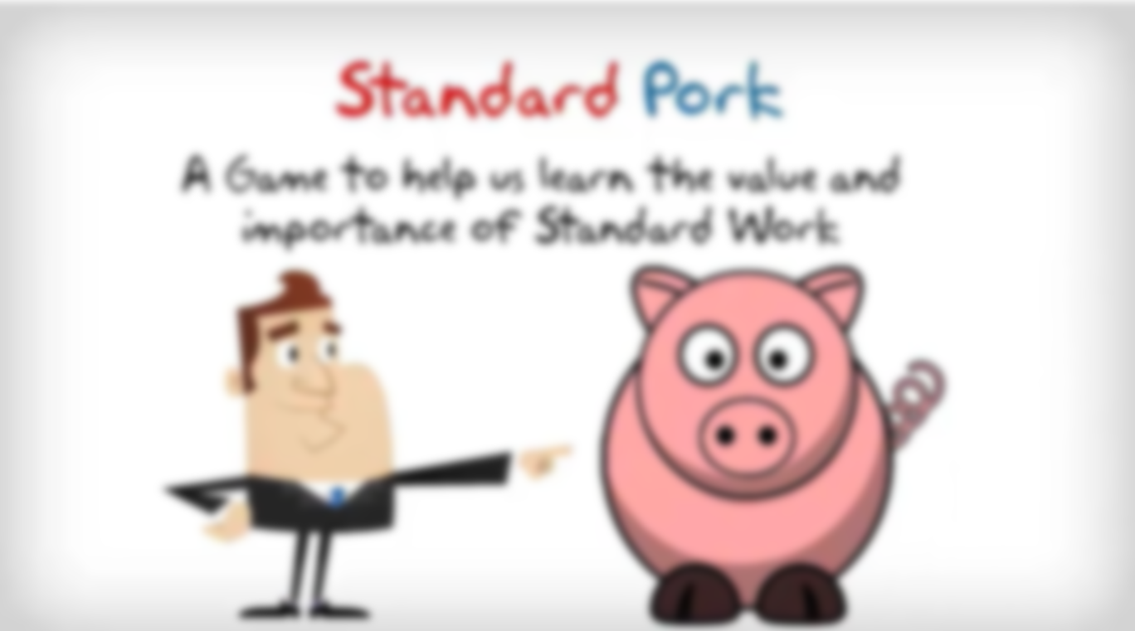
Exercise

Slide 6


Slide 7


Slide 8


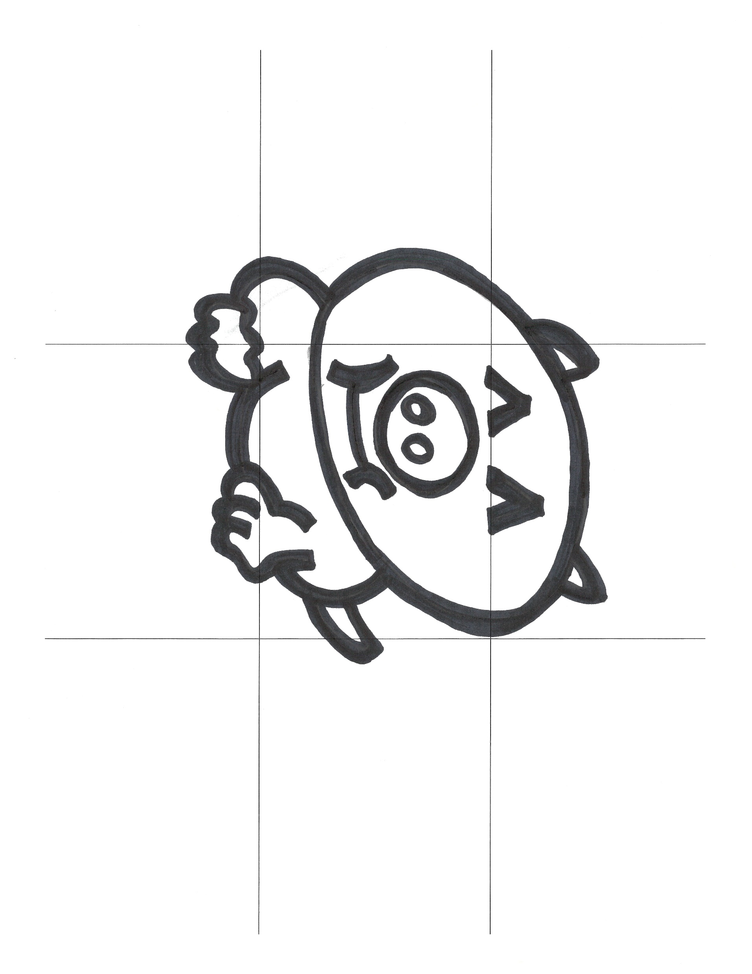

Which One
Is Correct?

Slide 9
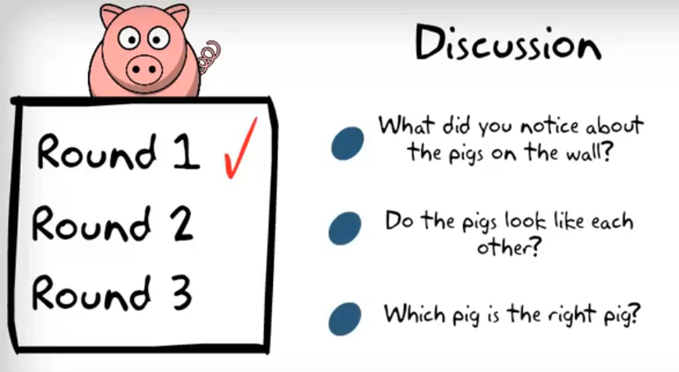

Slide 10
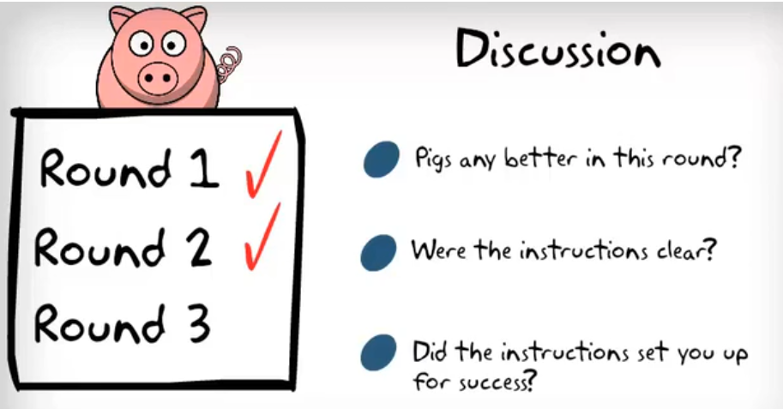
Follow all the instructions
Draw the pig in the exact sequence as stated
Draw each step as it appears

Slide 11
Draw a letter M at the top left intersection. Bottom center of M touches the intersection.
Draw the letter W at the bottom left intersection. Top center of W touches the intersection.
Draw the letter W at the bottom right intersection. Top center of W touches the intersection.
Draw an arc from the letter M to the top right intersection.
Draw another arc from the top right intersection to the bottom right W.
Draw an arc between the two bottom Ws.
Draw the letter O in the center left box.
Draw an arc from the letter M to the tangent of the circle.
Draw an arc from the left W to the tangent of the circle.
Draw an arc for the eye. Halfway between M and circle.
Draw an arc for the mouth. Halfway between W and circle. Must be a happy pig!!
Draw the cursive letter e near the top of arc on the right.
And finally draw two dots in the middle of the circle for the pig's nose.
Put your pen down and hang up your pig.

Slide 12
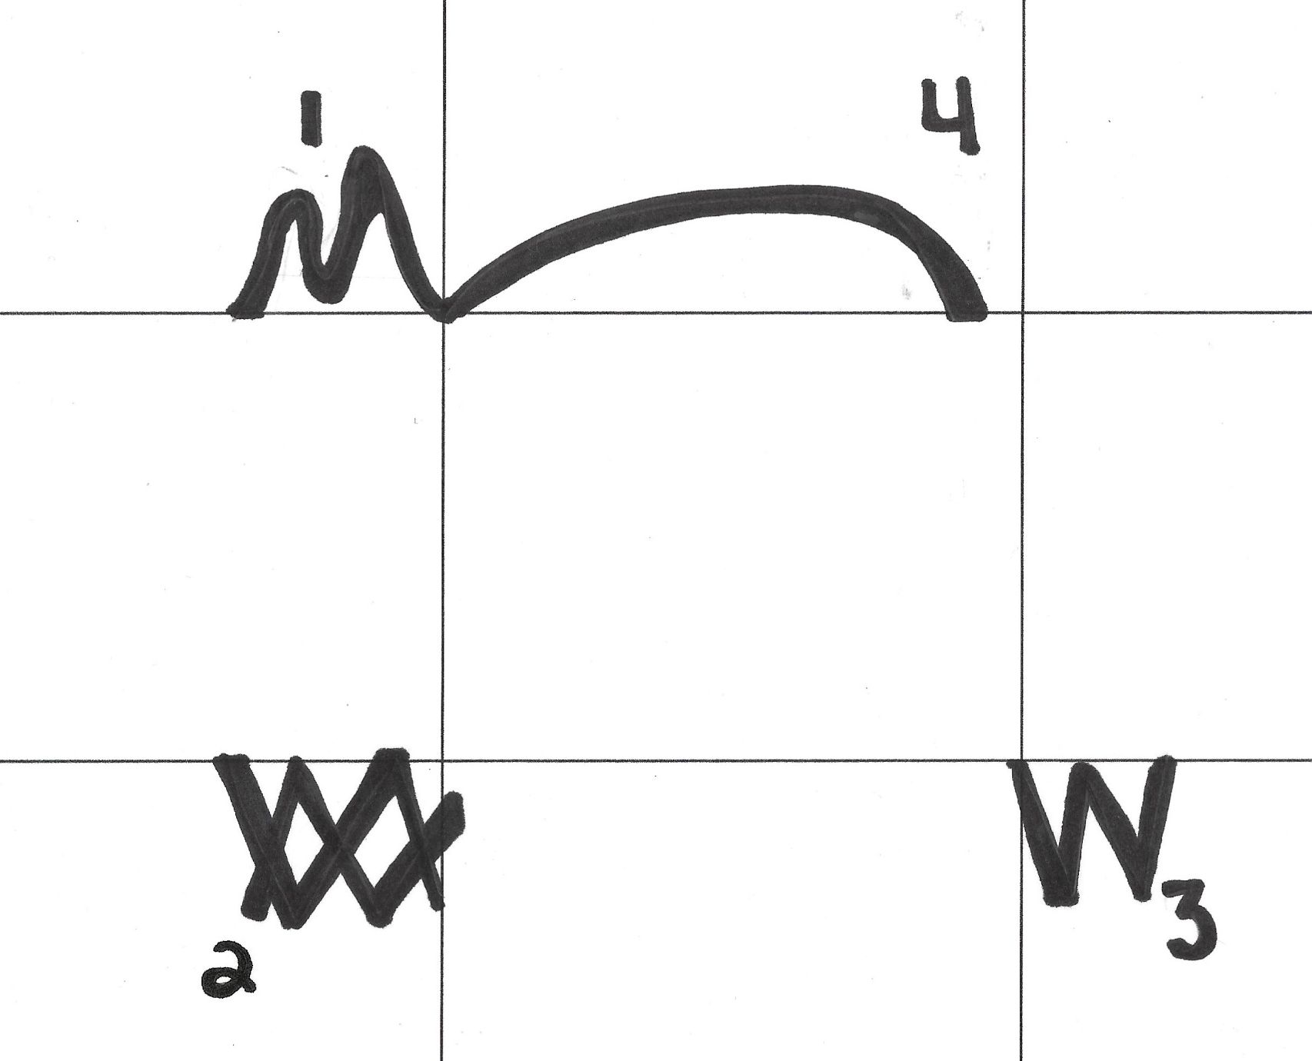
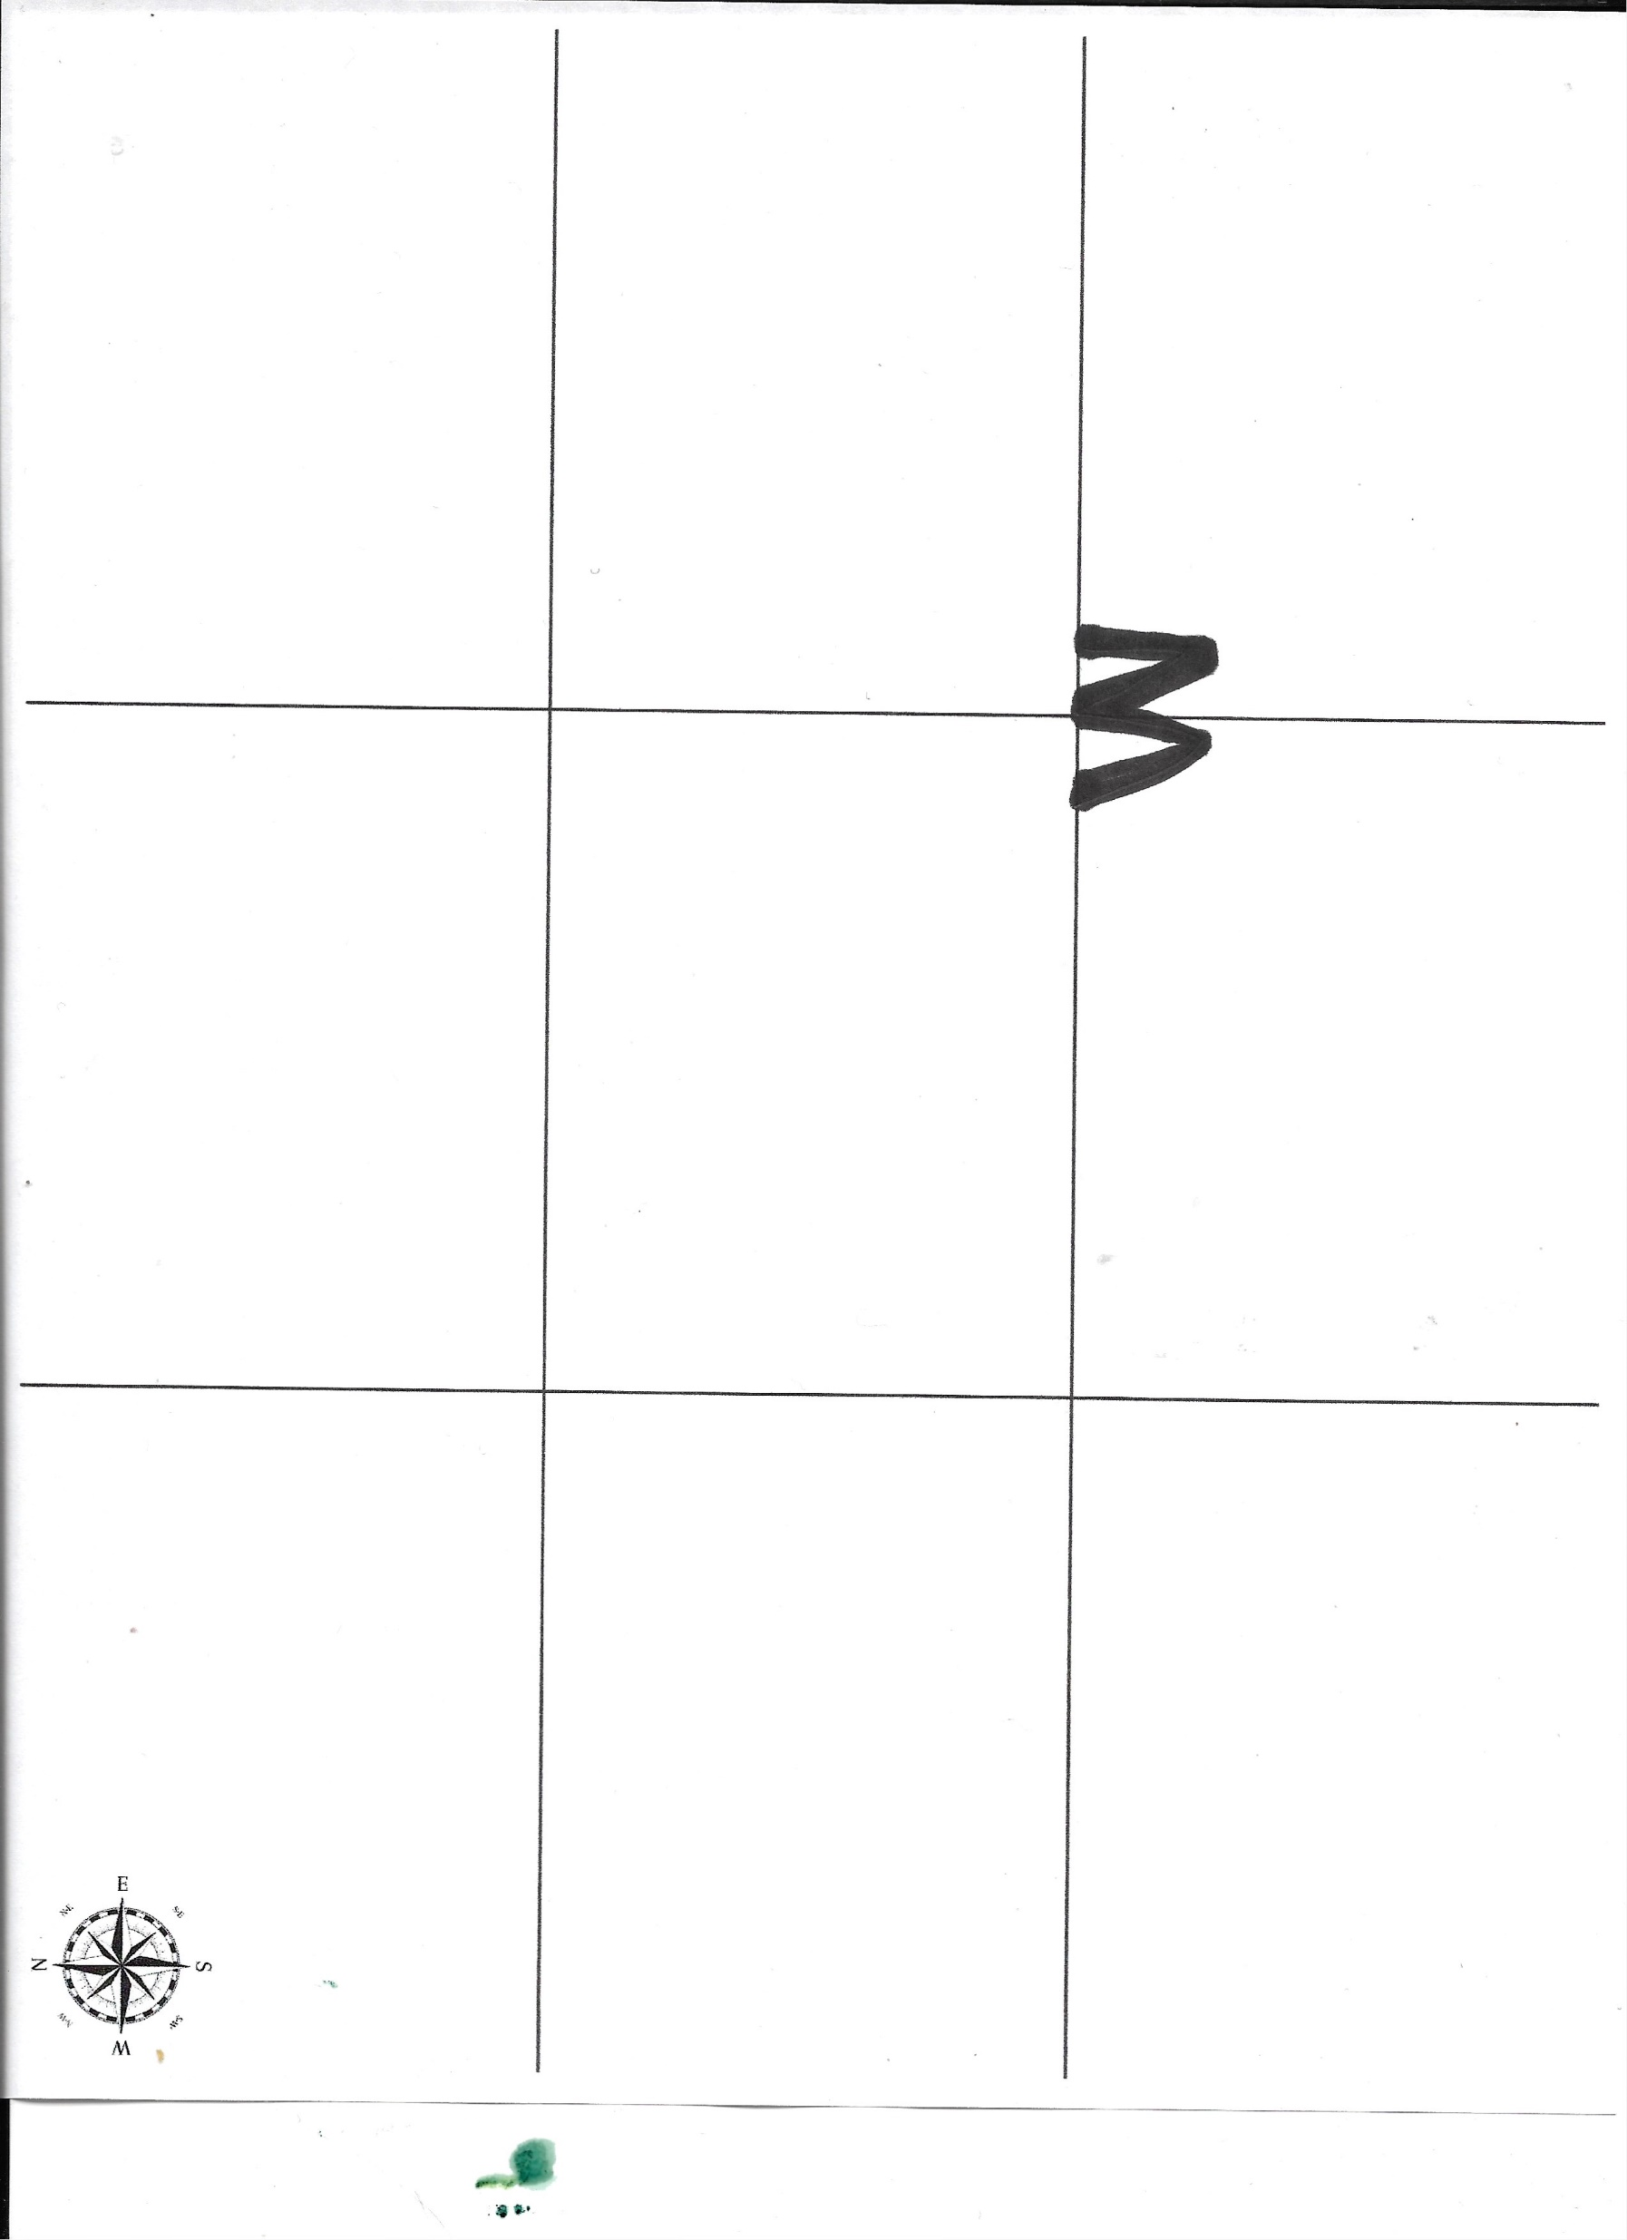
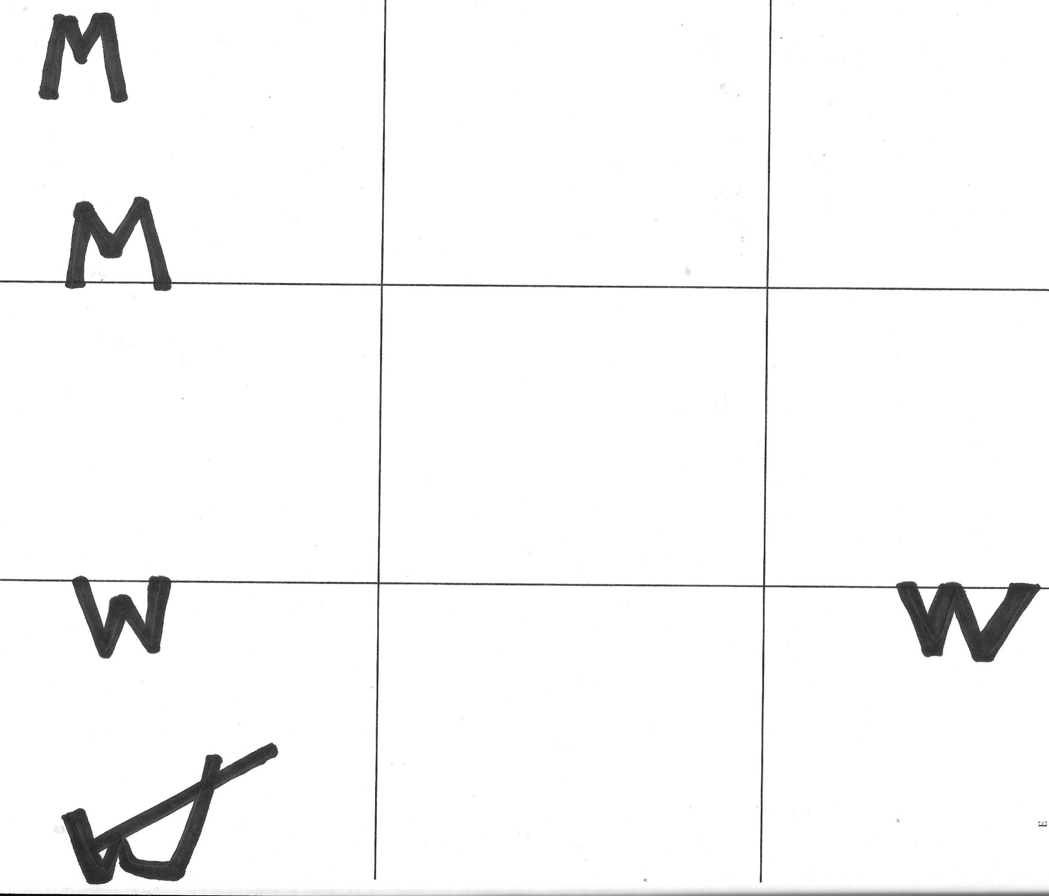
Which One
Is Correct?

Slide 14
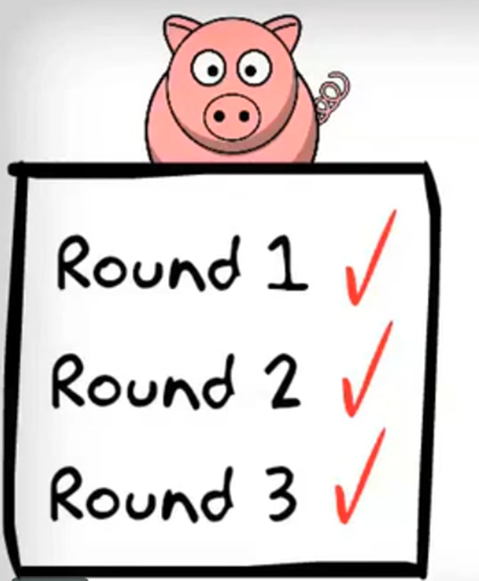
Follow all the instructions
Draw each step as it appears

Slide 15
1
4
8
12
10
7
5
11
13
9
6
2
3

Slide 16

This One Is Correct!!

Slide 17
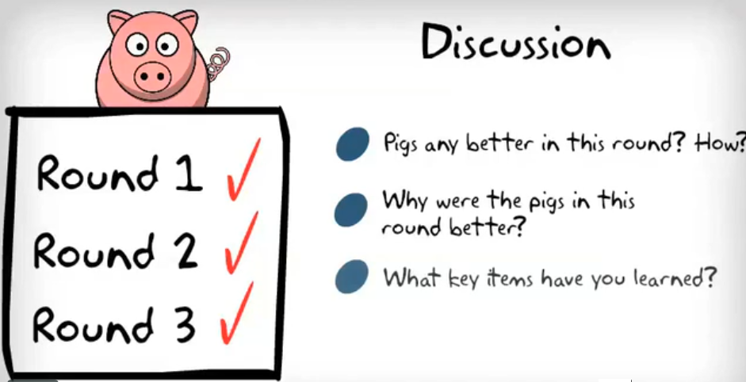

Slide 18
The Connection Between Standardization and Audit Readiness

Slide 19
Standardization and Business Readiness
Improves Efficiency – Standardized procedures reduce errors, streamline workflows, and eliminate unnecessary complexity, saving time and resources.
Enhances Quality Control – Uniform standards help maintain consistent product and service quality, ensuring customer satisfaction and regulatory compliance.
Boosts Collaboration & Communication – Clear, standardized procedures improve teamwork by ensuring everyone follows the same guidelines, reducing confusion and misunderstandings.

Slide 20
Standardization and Business Readiness
Reduces Costs – When businesses follow standardized processes, they minimize waste, optimize resource utilization, and cut operational expenses.
Facilitates Scalability – Standardization allows businesses to expand or replicate their operations more easily, whether it’s opening new locations or integrating with partners.
Strengthens Compliance & Risk Management – Adhering to industry regulations and standardized protocols reduces legal risks and enhances security measures.

Slide 21
Standardization and Audit Readiness
Process Documentation – Well-documented, repeatable processes are easier for auditors to test, validate, and rely on as evidence of control effectiveness.
Naming & Version Control – Standard file names and version practices reduce confusion, minimize duplication, and save time during evidence gathering.
Role Clarity – Clearly defined responsibilities make it easier to trace approvals, handoffs, and ownership throughout the process lifecycle.

Slide 22
Standardization and Audit Readiness
Documentation Consistency – Standard forms, templates, and checklists help ensure required information is consistently captured, reducing the risk of missing or incomplete documentation.
Compliance Clarity – Clear, repeatable workflows make it easier to demonstrate alignment with laws, policies, and internal procedures during an audit.
Reduced Audit Stress – When processes are standardized, audit preparation becomes routine—not reactive—resulting in smoother audits and stronger outcomes.

Slide 23
Common Pitfalls Auditors See
Processes vary by person or team—no single version of “correct.”
Key steps are undocumented or dependent on one employee.
Old versions of forms or procedures still in circulation.
Lack of training or reinforcement leads to drift from the standard.
“If it’s not documented, it didn’t happen.” – a phrase we live by in audit

Slide 24
Key Steps in Creating Standardized Processes

Slide 25
How to Standardize Processes
Identify Key Processes – Determine which workflows need standardization based on their impact on efficiency and quality.
    Repetitive tasks
    Create bottlenecks, backlogs, or delays
    Involve compliance with regulations or standards
    Consume excessive time or resources

Slide 26
How to Standardize Processes
Understanding the Process –
    Review all available documentation
    Conduct interviews
    Perform Process walk also referred to as Gemba walk
    Facilitated sessions

Slide 27
How to Standardize Processes
Use Process Mapping – Visualize workflows with flowcharts or diagrams to ensure clarity.
    SIPOC Diagrams
    Flow Charts
    Swimlane Diagrams
    Value Stream Maps

Slide 28
How to Standardize Processes
Implement Best Practices – Adopt industry standards and proven methodologies.
    Six Sigma
    Lean
    PDCA (Plan-Do-Check-Act)
    TQM (Total Quality Management)
    TOC (Theory of Constraints)
Notes:
Six Sigma, Lean, Deming PDCA, TQM, TOC, etc…

Slide 29
How to Standardize Processes
Document Procedures – Create clear Standard Operating Procedures (SOPs) outlining each step in the process.
    Visual aids
    Checklists
    Manuals

Slide 30
How to Standardize Processes
Train Employees – Ensure staff understands and follows standardized procedures.
Leverage Automation – Use software tools to streamline repetitive tasks and enforce consistency.
Monitor & Improve – Regularly review processes, gather feedback, and refine them for continuous improvement.

Slide 31
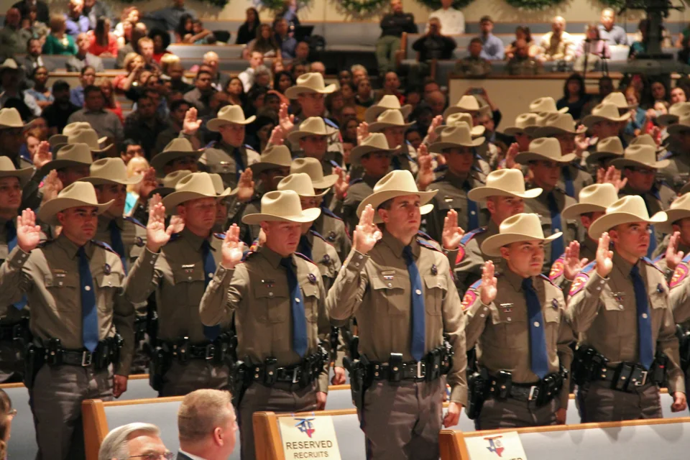
Case Study
Improve the law enforcement recruiting process to ensure better outcomes and enhance efficiency and effectiveness

Slide 32
Ready for an Audit vs Audit Ready - Lessons Learned
Finalize and Share Policy Clearly - Moving from draft to distributed policy helps to ensure shared expectations and alignment across teams.
Create a Culture of Expected Learning - When training is expected and supported, staff are empowered to act with clarity and consistency.
Build Confidence Through Consistency - Standard practices across teams eliminate guesswork and strengthen trust in processes and outcomes.
Standardize the Process and the Oversight - Embedding monitoring into the process ensures it stays active, effective, and aligned with intent.
Make Audit Readiness a Daily Habit - Readiness isn’t about preparing under pressure—it’s the result of everyday habits and intentional design.

Slide 33

Questions?
Tammara West
Sr. Audit Manager​
DPS Chief Auditor's Office​
Tammara.West@dps.texas.gov
512.424.7624
Niko Alexander
Sr. Process Improvement Analyst
DPS Chief Auditor's Office
Nikolaos.Alexander@dps.texas.gov
512.424.2124

