Slide 1
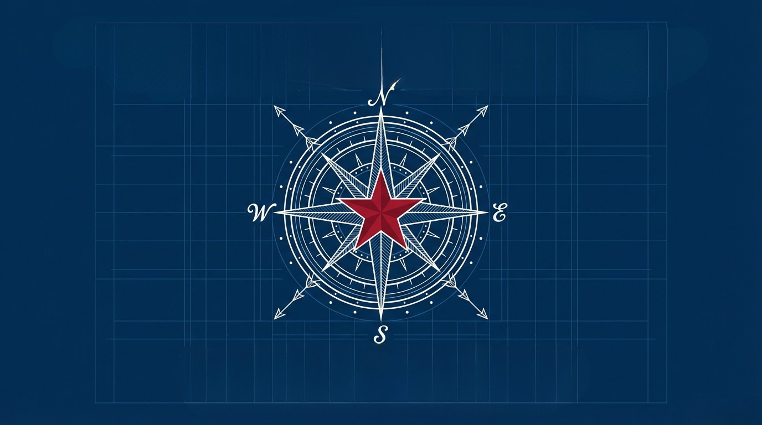
Future Proofing the Texas Way:
Adapt Fast,
Lead Strong,
and
F
Don’t let your
avatar take the reins
Dr. W. Boyd Bush, Jr.

Slide 2

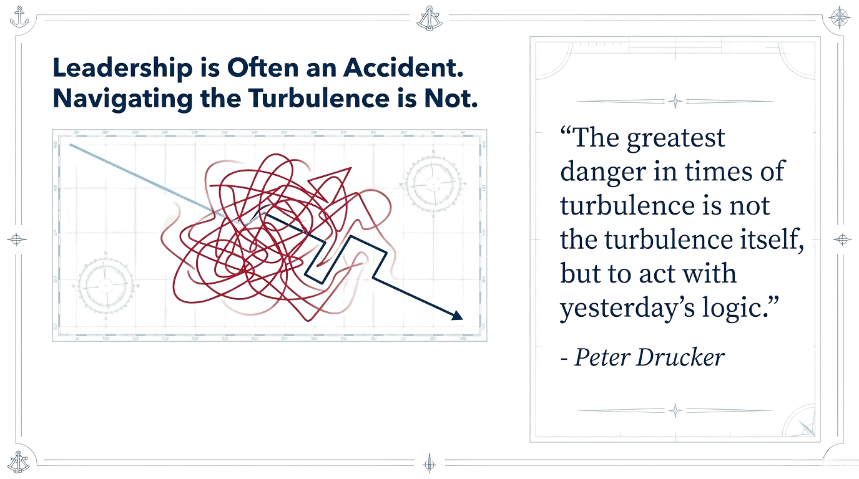

Leadership is Often an Accident.
Navigating the Turbulence is Not.
BODY

Slide 3


Slide 4

In the Modern State Agency,
Leadership is Influence,
Not Authority.

Slide 5

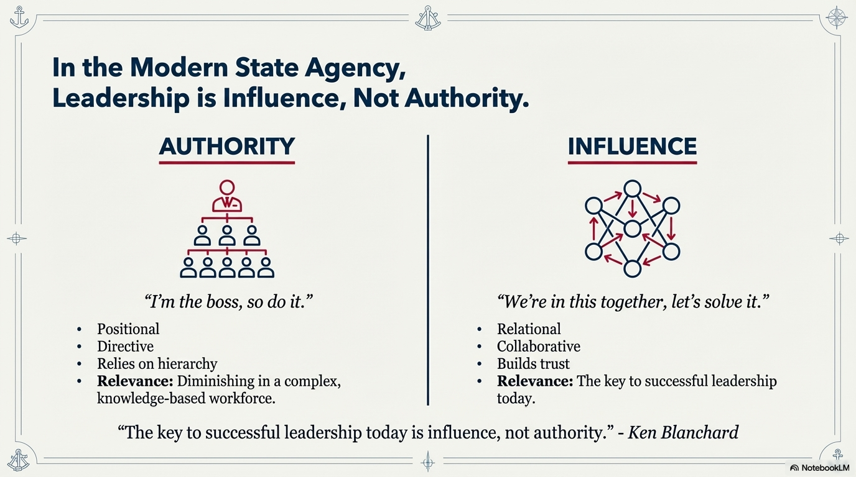

Slide 6


Slide 7

In the Modern State Agency,
Leadership is Influence, Not Authority.
“The key to sucessful leadership today is influence, not authority.” -Ken Blanchard

Slide 8

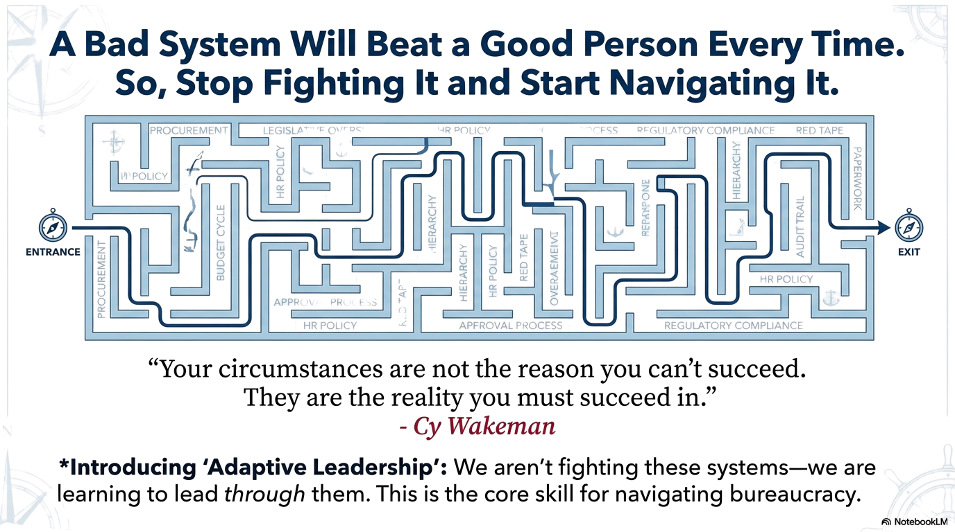

A Bad System Will Beat a Good Person Every Time.
So, Stop Fighting It and Start Navigating It.
“Your circumstances are not the reason you can’t succeed. They are the reality you must succeed in.”
-Cy Wakeman

Slide 9

Adaptive
Leadership
We aren’t fighting these systems.
We are learning to lead through them.
This is the core skill for navigating bureaucracy.

Slide 10

Three Adaptive Truths

Slide 11

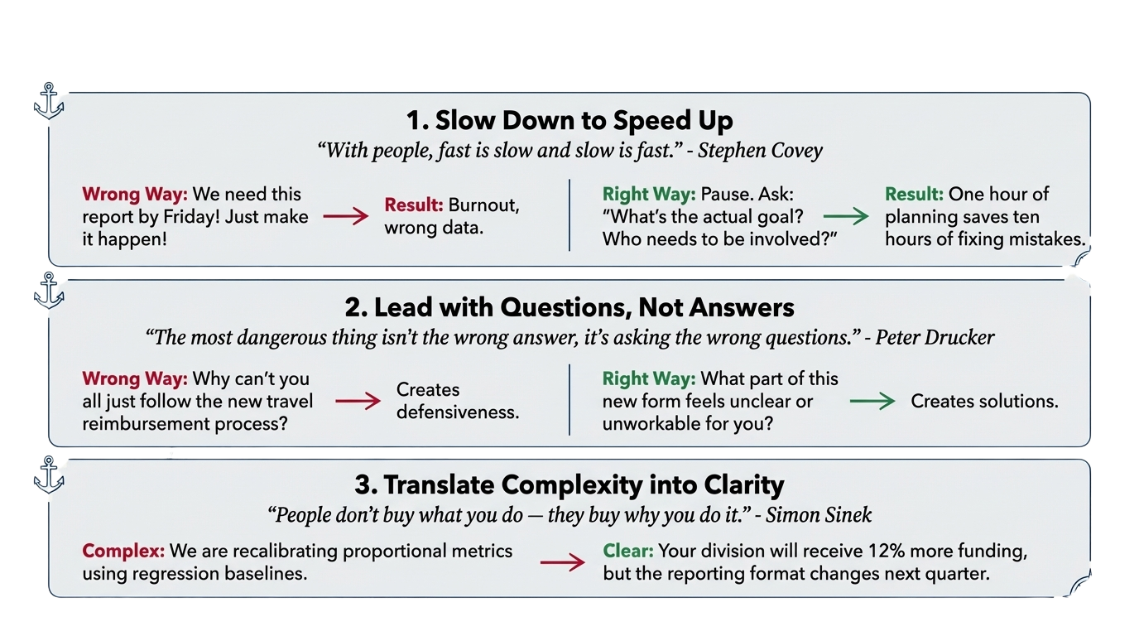
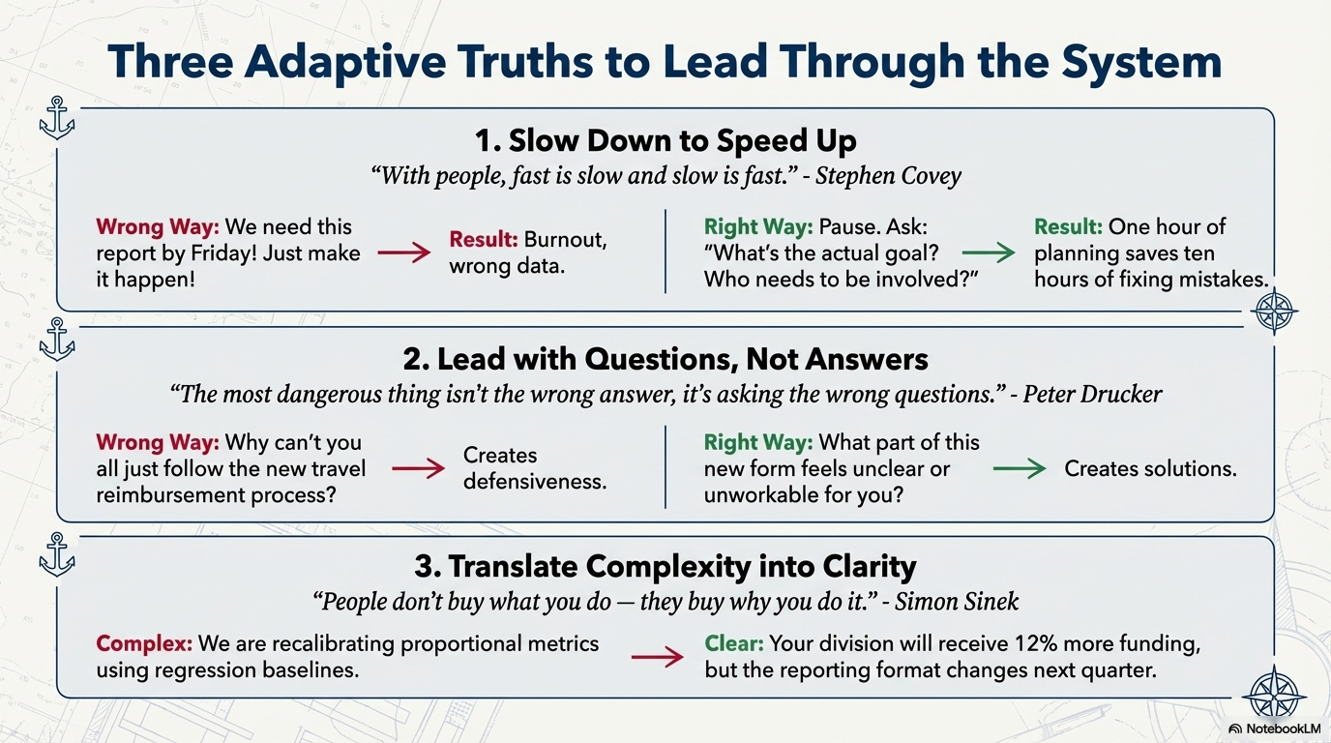
Slow Down to Speed Up
“With people, fast is slow and slow is fast.” - Stephen Covey

Slide 12
Lead With Questions, Not Answers
“The most dangerous thing isn’t the wrong answer,
it’s answering the wrong question.” - Peter Drucker

Slide 13
Translate Complexity into Clarity
“People don’t buy what you do--they buy why you do it.” - Simon Sinek
Complex
Clear

Slide 14

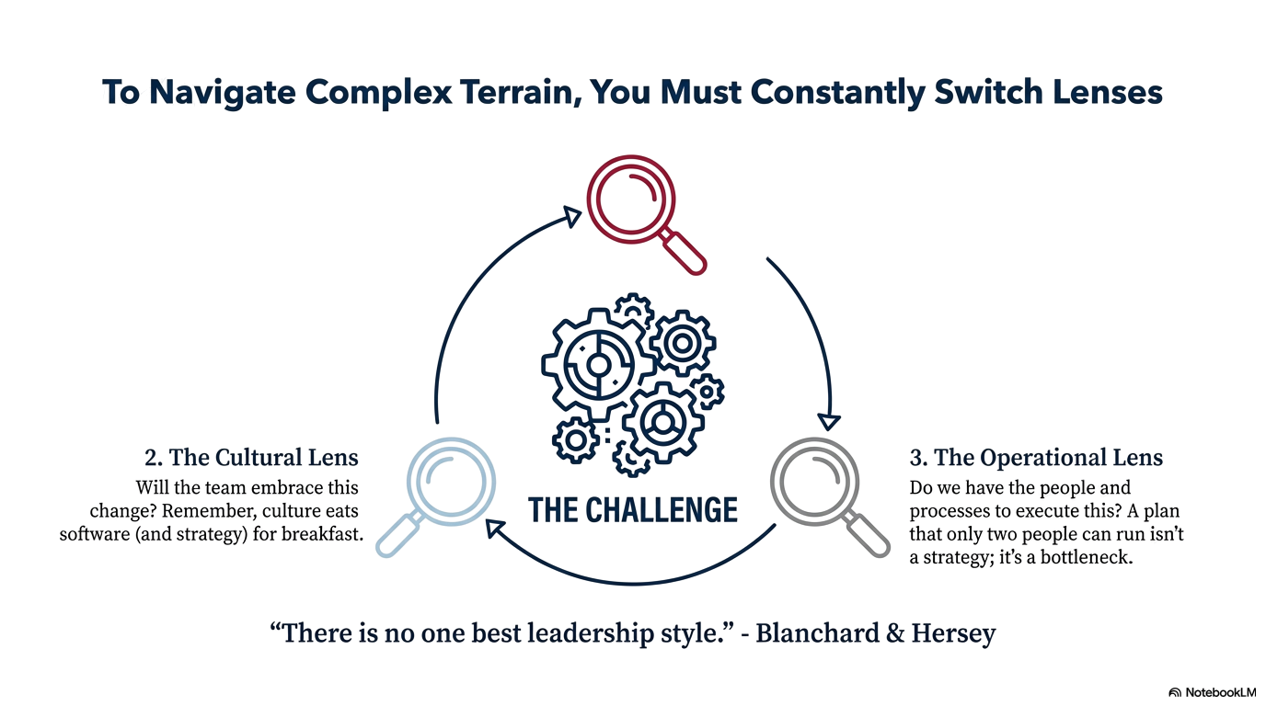
To Navigate Complex Terrain,
You Must Constantly Switch Lenses
The Operational Lens
The Cultural Lens
The Political Lens

Slide 15

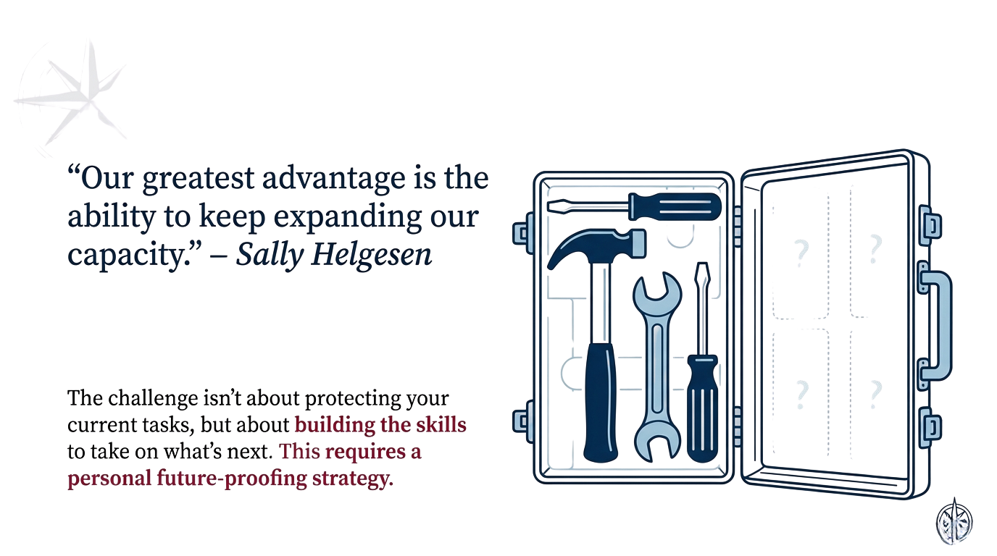
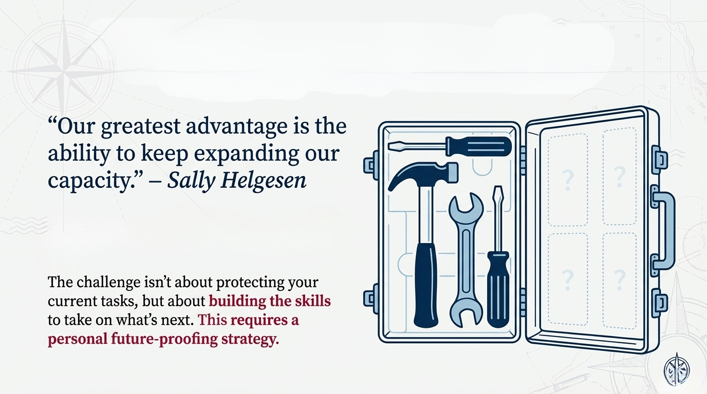
“Our greatest advantage is the ability to
keep expanding our capacity.”
-Sally Helgesen

Slide 16

The Four Pillars
of a Future-Proof
Public Service
Career

Slide 17

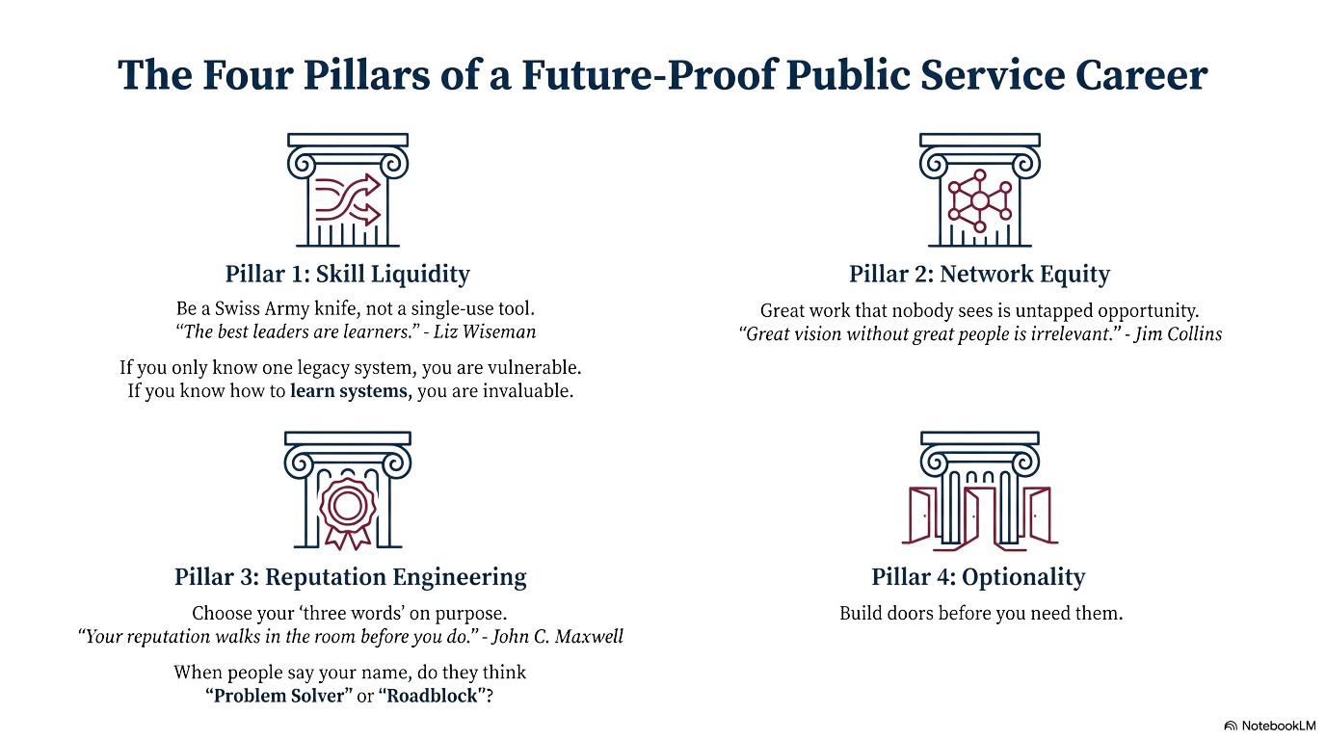
Pillar 1:
Skill Liquidity
Be a Swiss Army knife,
not a single-use tool.
“The best leaders are learners.”
-Liz Wiseman

Slide 18
Pillar 2:
Network Equity
“Great vision without
great people is irrelevant.”
-Jim Collins

Slide 19
Pillar 3:
Reputation Engineering
“Your reputation walks in the room before you do.”
-John C. Maxwell

Slide 20
Pillar 4:
Optionality
Build doors before you need them.

Slide 21

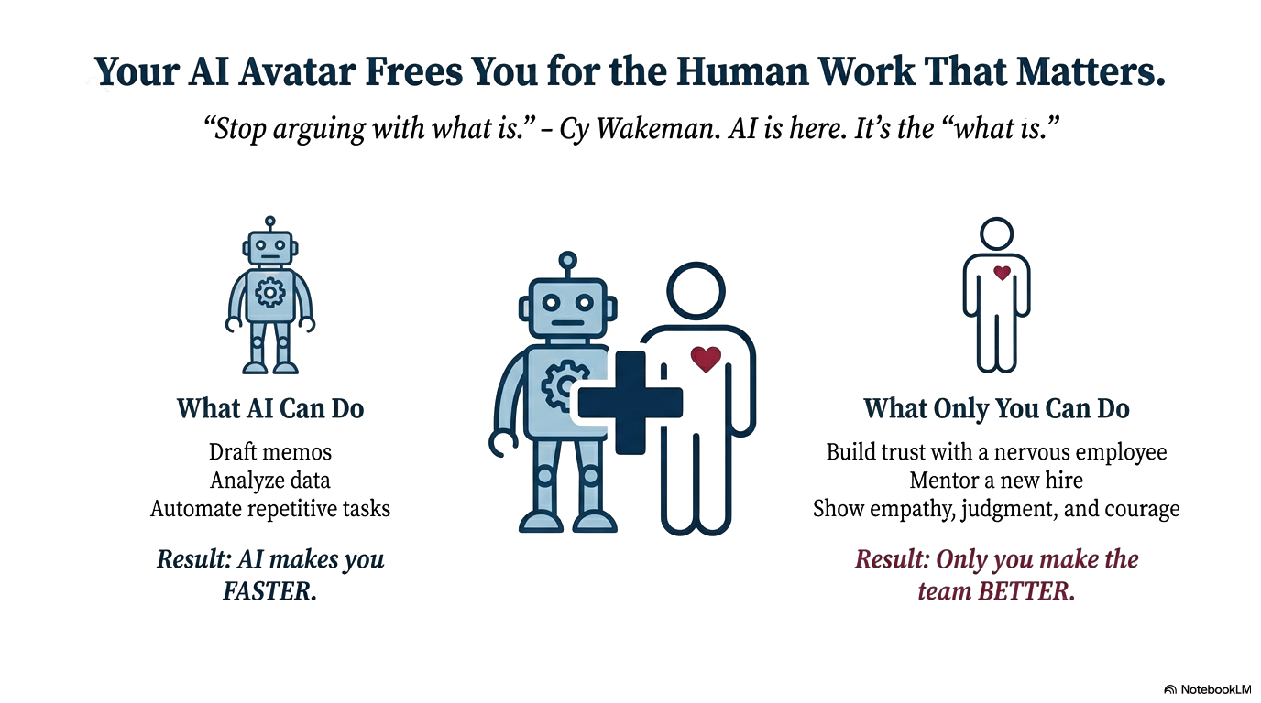
AI: We Come in Peace!

Slide 22

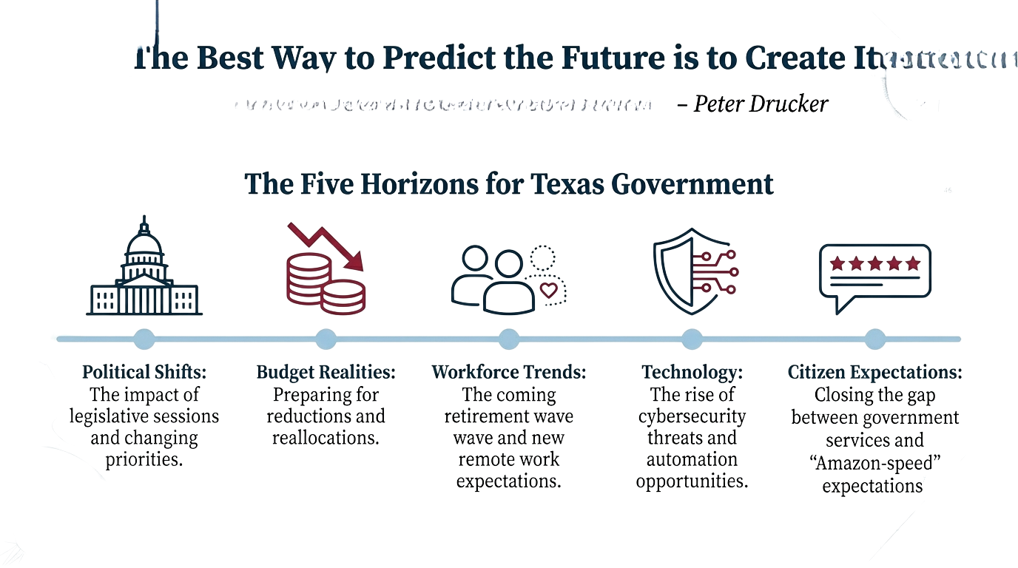
“The Best Way to Predict the Future is to Create it.”
Peter Drucker

Slide 23

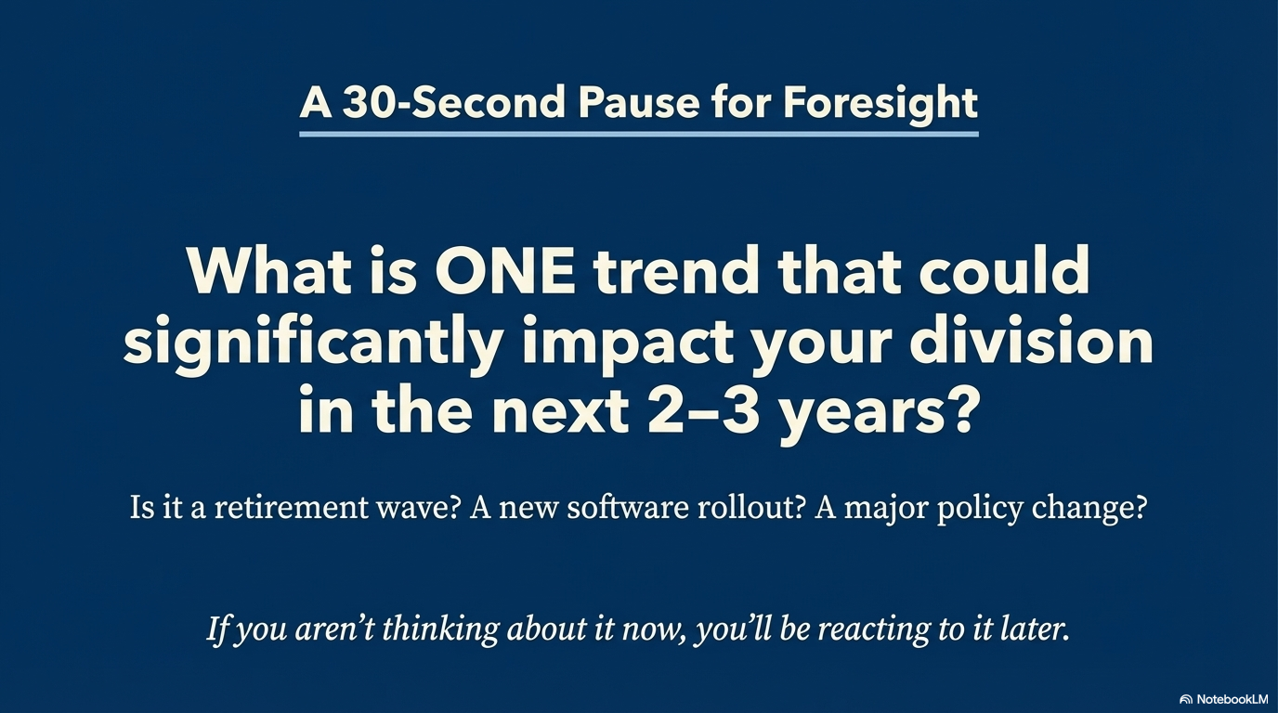

Slide 24

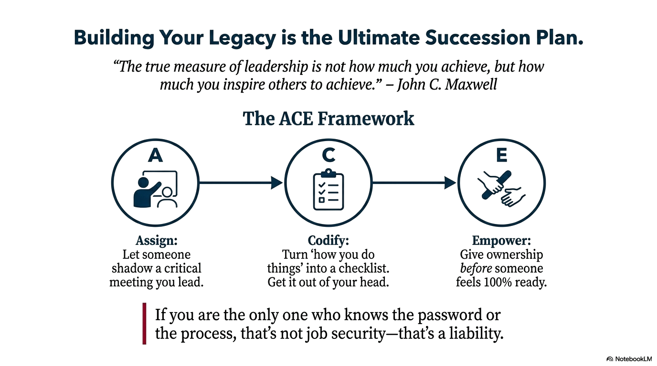
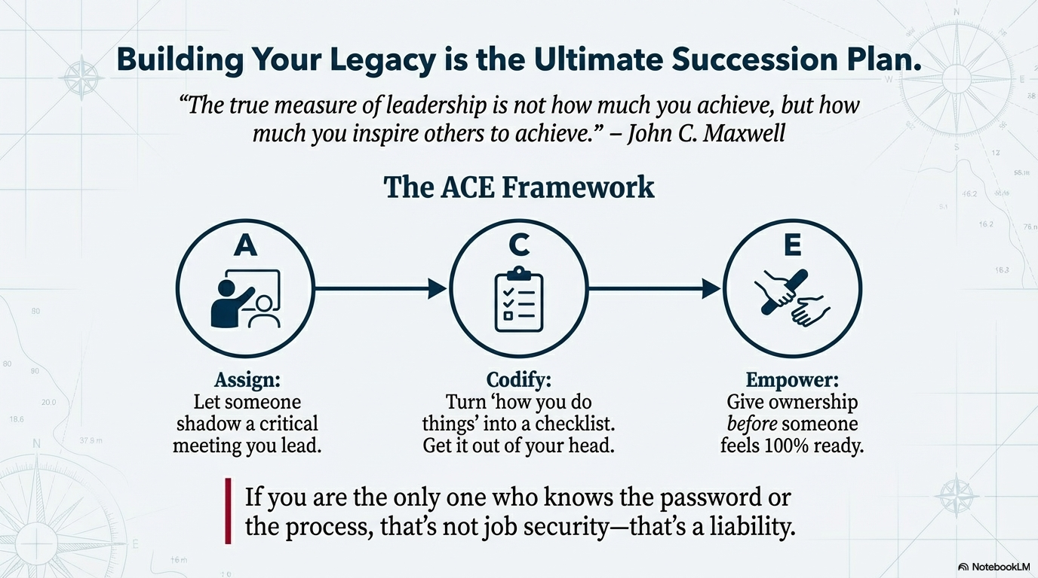

Slide 25

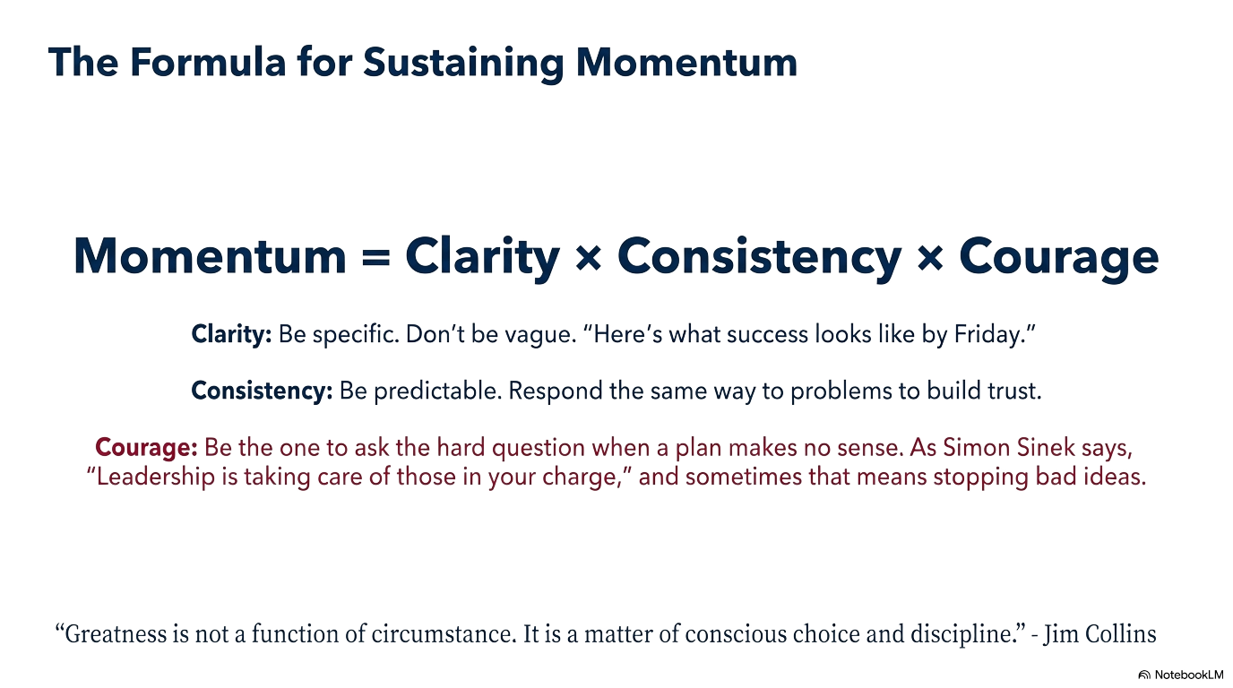
The Formula for Sustaining Momentum
“Greatness is not a function of circumstance.
It is a matter of conscious choice and discipline.”
-Jim Collins

Slide 26

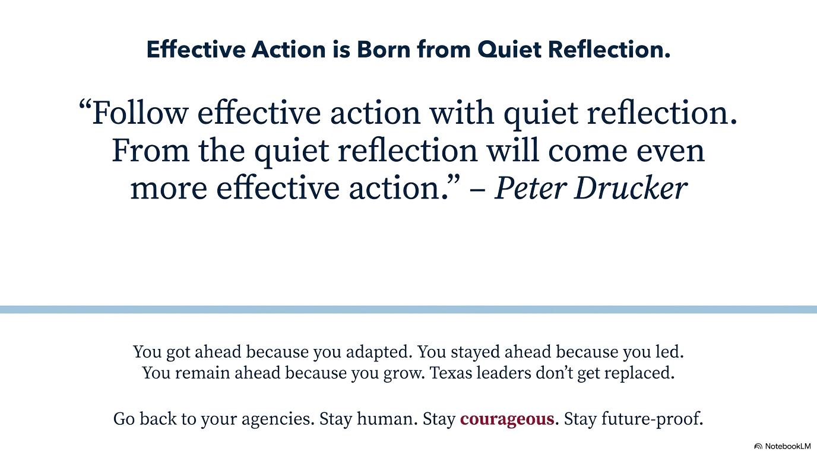
“Follow effective action with quiet reflection.
From the quiet reflection will come
even more effective action.”
- Peter Drucker

