Slide 1
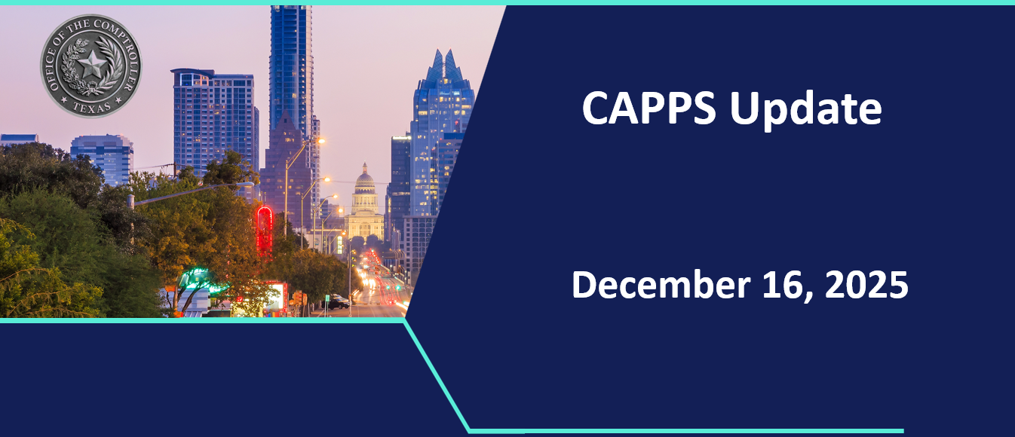
CAPPS Update
December 16, 2025

Slide 2

Project Update
Texas State Agency Business Administrators' Association (TSABAA)
December 16, 2025

Slide 3
TSABAA Member Survey

Slide 4
Primary Concerns
Integration – Will CAPPS STARR work with our current systems?
  Integration with agency’s internal applications (PeopleSoft, pension systems, etc.)
  Integration with CPA’s CAPPS PeopleSoft Financials
  Existing interface preservation
Functionality – Will we lose critical capabilities?
  USAS screen 62 (comprehensive appropriation view)
  SIRS queries, DAFR reports, and other reports
  Real-time vs. overnight data access
  Data upload capabilities

Slide 5
Primary Concerns (continued)
Implementation – We have questions around timeline and resources.
  How long will transition take?
  Staggered vs. simultaneous rollout?
  Agency resource commitment required
  Parallel systems during transition?
Change Management – We need to talk about training and user adoption.
  Adequate training availability
  Resistance from long-term USAS users
  Concerns around complexity
  Learning curve expectations

Slide 6
What Agencies Need
Training - Education & Documentation Requests
  User manuals and desk aids
  Training resources (basic to advanced)
  Change management communication
  "Keep it basic - don't assume we know everything”
Technical Information - System Details and Specifications
  What stays the same vs. what changes
  Field specifications and data maps
  Test/sandbox environment access
  Prototype screens and reports
Demonstrations - Show Us How It Works
  Live demo sessions with Q&A
  Phase 1 feature overview
  Comparison with current systems
  Use case walkthroughs
Communication - Keep Us Informed
  Regular progress updates
  Implementation timeline and milestones
  Technical and functional changes
  Early warning of required agency actions

Slide 7
Addressing Agency Concerns
In your own words…
"Just keep communication open every step of the way and keep it basic.“
"Will there be a comparable substitute for USAS's 62 screen that shows the whole picture?“
"Will we be able to complete our recons as we have done in the past?“
"USAS users that have been in the system since conception simply don't want to convert."
What I am hearing…
Cautious optimism mixed with anxiety
Recognition that upgrade is needed
Fear of losing established workflows
Strong desire for agency input in design
How CPA can address it…
Establish regular communication cadence
Provide early access to training materials
Create agency advisory groups
Develop detailed implementation roadmap
Demonstrate functionality preservation

Slide 8
Project Overview & Objectives

Slide 9



Project Background

What is CAPPS?
The Centralized Accounting and Payroll/Personnel System (CAPPS) is the official name of the statewide Enterprise Resource Planning (ERP) system directed by Texas CPA.

What is CAPPS STARR?
State of Texas Accounting and Reporting Resource (STARR) is a new system to replace the legacy central accounting system run by CPA that services the official state books, vendor file, and payment processor.

Slide 10
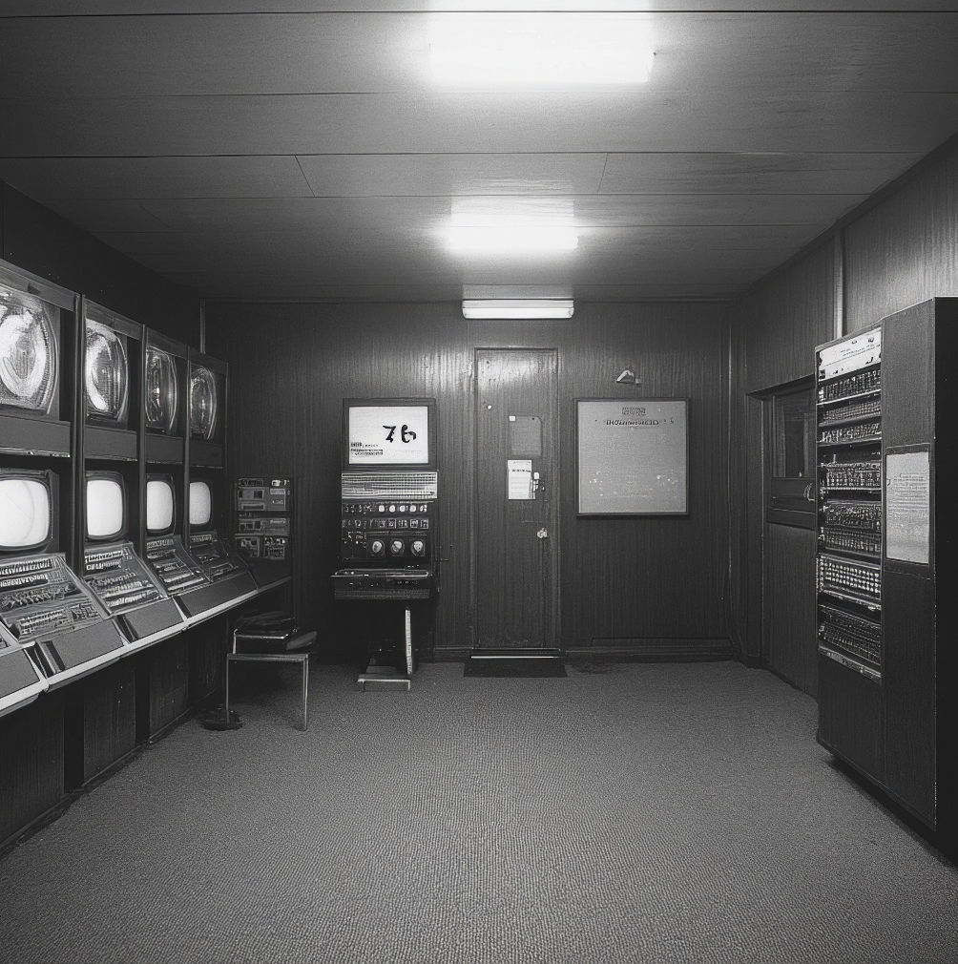
Project Background

Uniform Statewide Accounting System (USAS)
Implemented in 1993 – 3,366 statewide users
42.7 million transactions annually
$378 billion in revenue and $355 billion in expenses
Texas Identification Numbering Systems (TINS)
Implemented in 1989 – 5,299 statewide users
Tracks 14.3 million payments annually
Statewide Property Accounting (SPA)
Built in 1993, 526 statewide users
Tracks 528,604 active assets



Slide 11

Vendor Selection

CPA conducted a robust competitive bid process and selected CGI to implement their Advantage ERP product to replace the functionality of USAS, TINS, and SPA.
CGI only works with state and local governments.
CGI has modernized state accounting applications based on the same technology as USAS (R*STARS)
CGI both develops and implements Advantage where other products rely on a separate integrator for implementation.
CGI has successfully implemented over 500 projects with the CGI Advantage solution – with a 100% success rate.
22 states are currently running on Advantage.






Slide 12
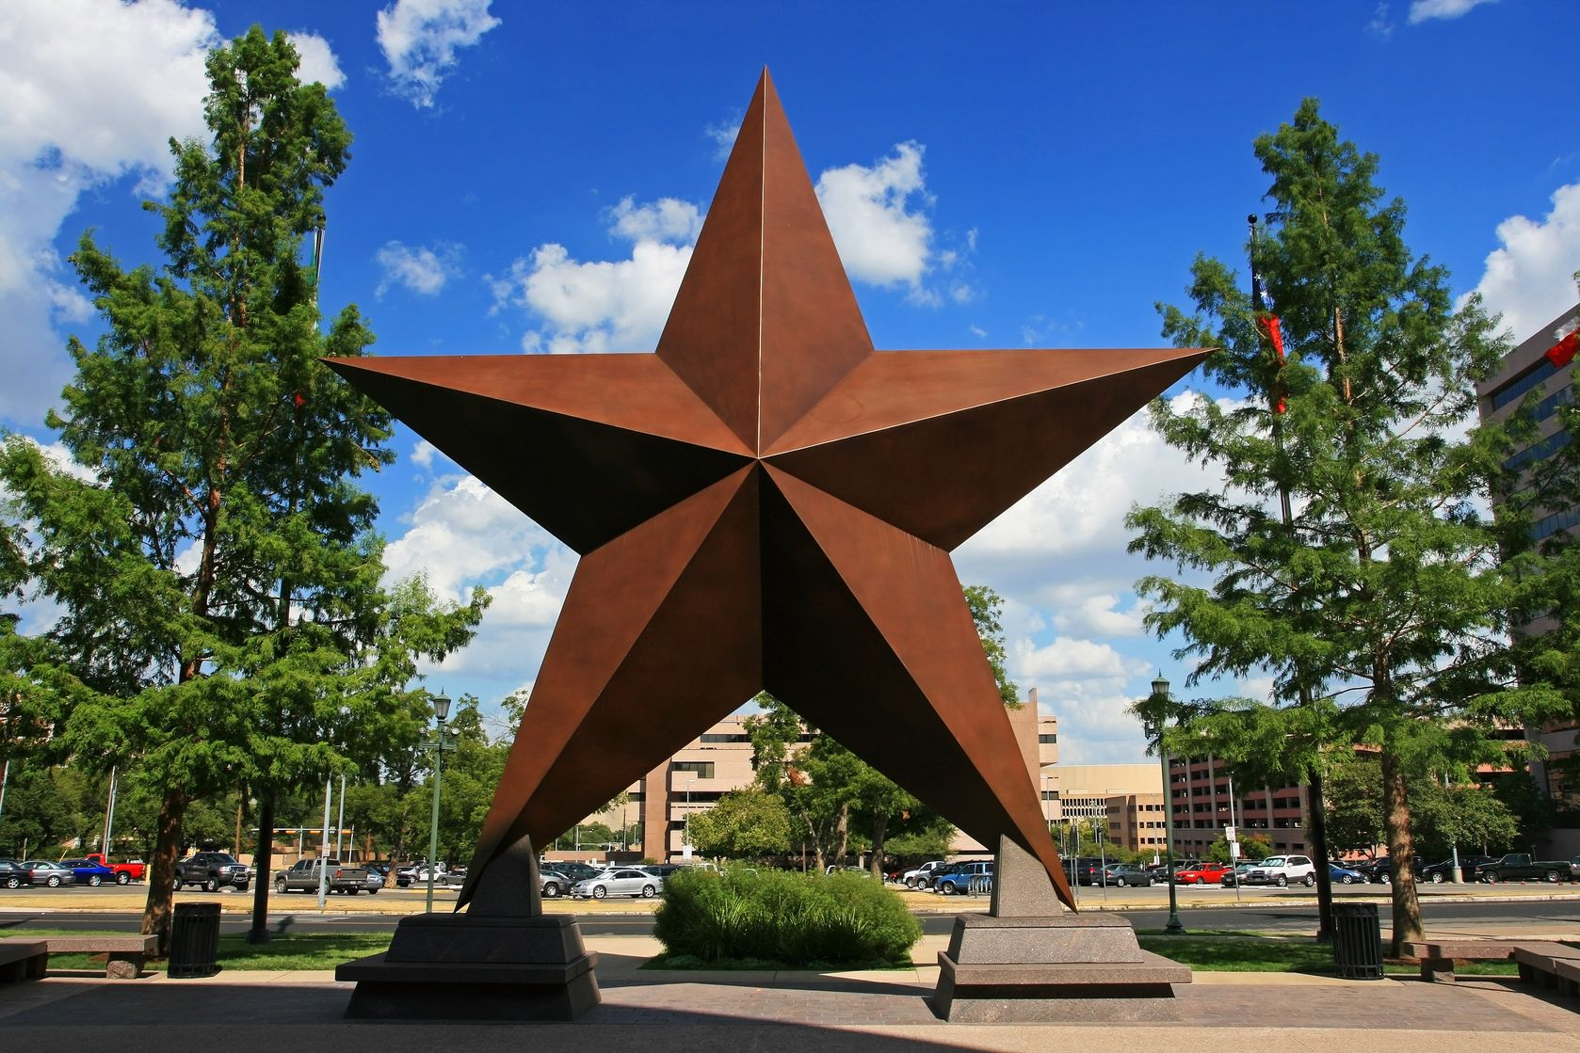
CAPPS STARR Overview
  Advantage is a cloud-based Software as a Service (SaaS) product
  Contains 97% of the functionality out-of-the-box needed to replace USAS, TINS, and SPA
  Remaining 3% of functionality will be incorporated into the product baseline
  Will be accessed through the existing CAPPS portal
  Contains integrated workflow management for approvals
  STARR will continue to accept INRECS as an input and output HX files to limit the initial impact of switching to the new system







Slide 13
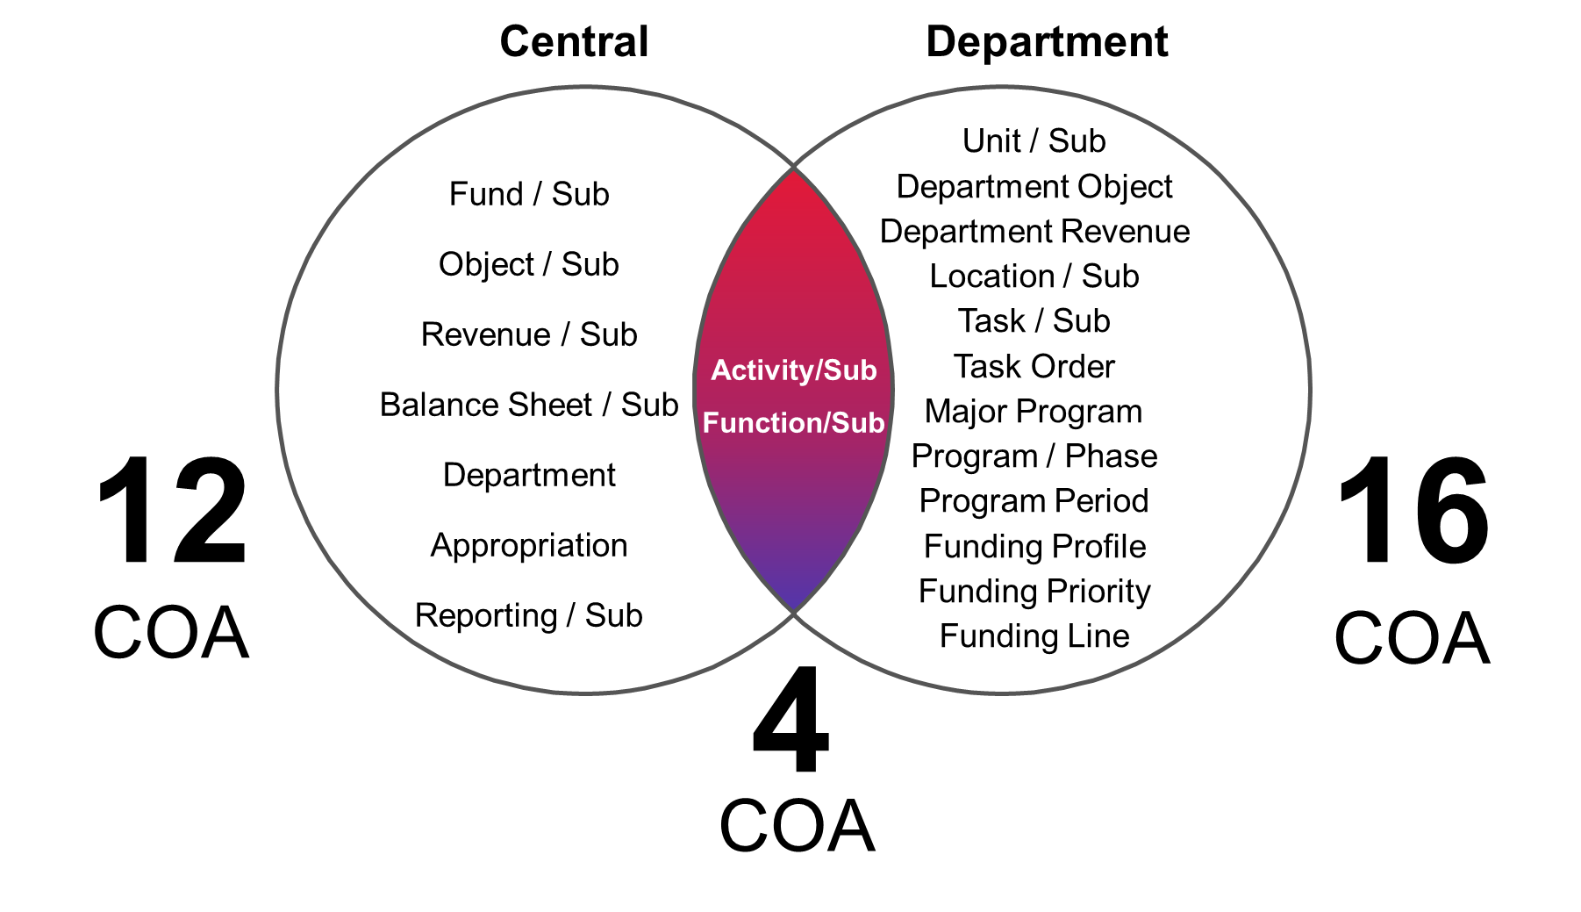
CGI Advantage – Core Financial Functions
General
Accounting
Budget
Control
Accounts Payable and Receivable
Offsets
Cash Management
Financial
Management
Cost
Accounting
Inventory Management
Asset Management
Travel & Expense Management
Grant Lifecycle Management
Robust COA designed for government accounting
Delivered for GAAP and GASB
Dedicated ACFR roll-ups
Configurable budget control and cash control
Flexible and configurable journals and ledgers
Finance go-live on September 1, 2027
Asset go-live on March 1, 2028
Full life-cycle implementation services from kickoff through transition to steady-state
Numerous optional software and services options included in the contract

Slide 14
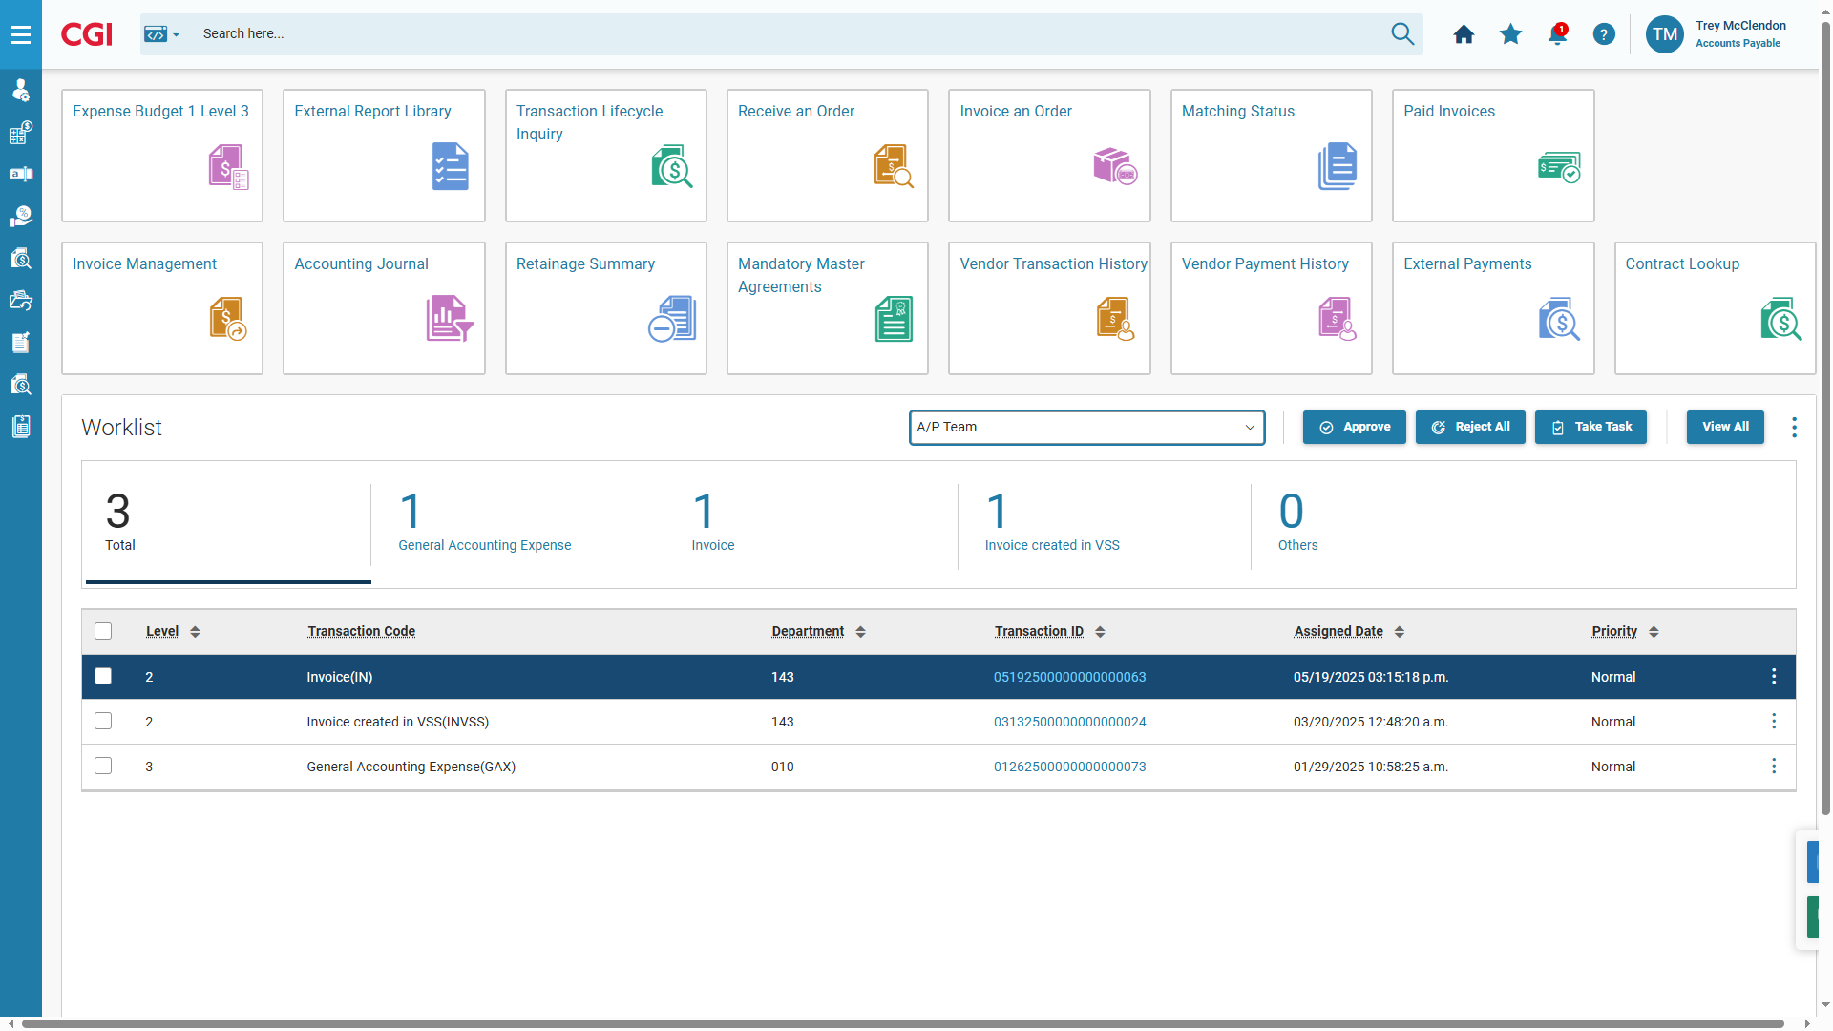
Modern, Intuitive User Experience
Intuitive Homepages
All-in-One View: Key info, tasks, and metrics in one place.
Role-Based & Configurable: Tailors content and layout to each user’s role and preferences
Fast & Intuitive: Designed for quick access to critical workflows and data, helping users easily find what they need

Slide 15
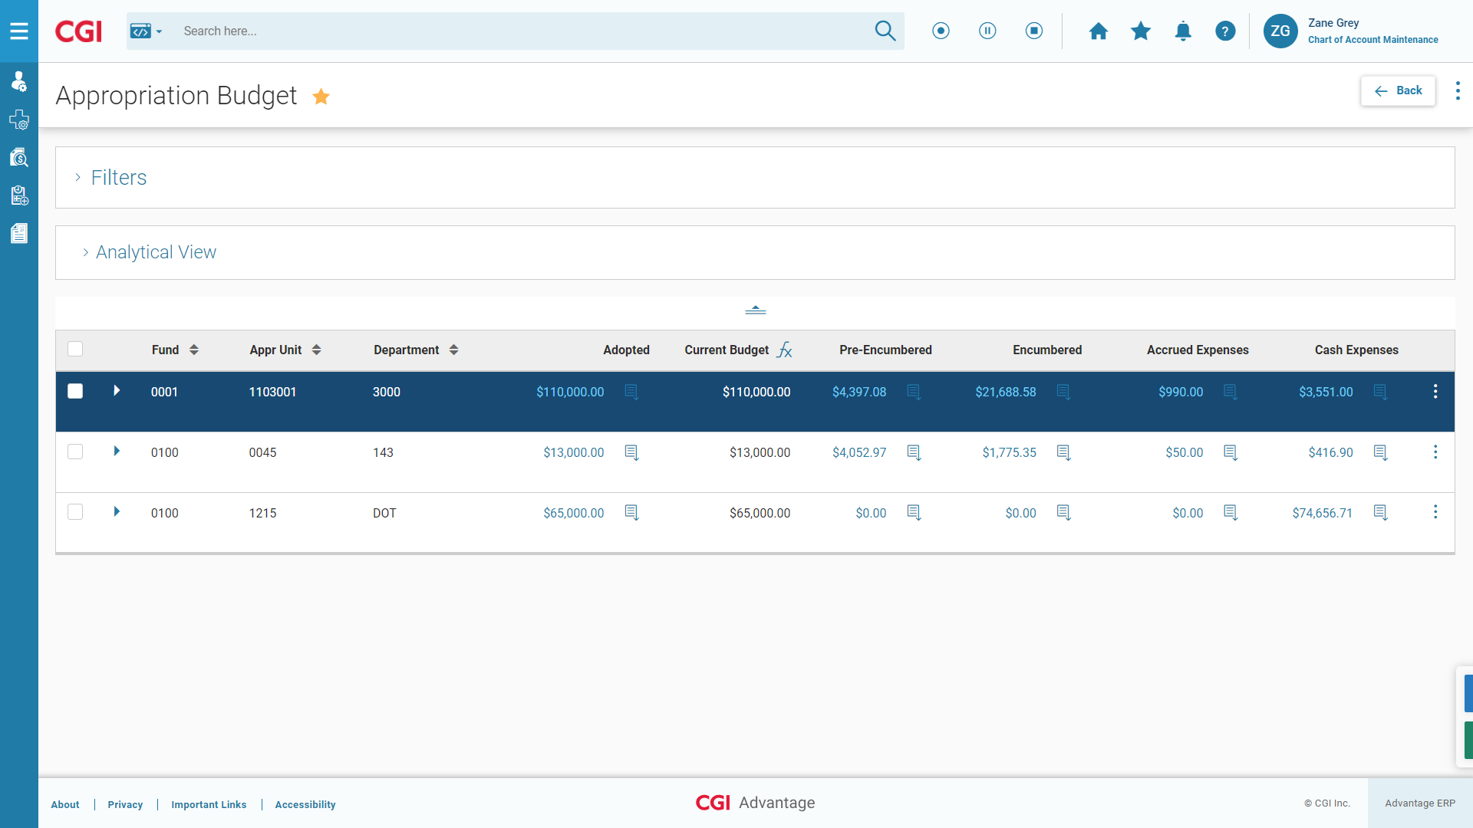
Modern, Intuitive User Experience
Responsive, mobile-first design
Role-based approach with integrated workflow
Real-time data and configurable inquiries

Slide 16
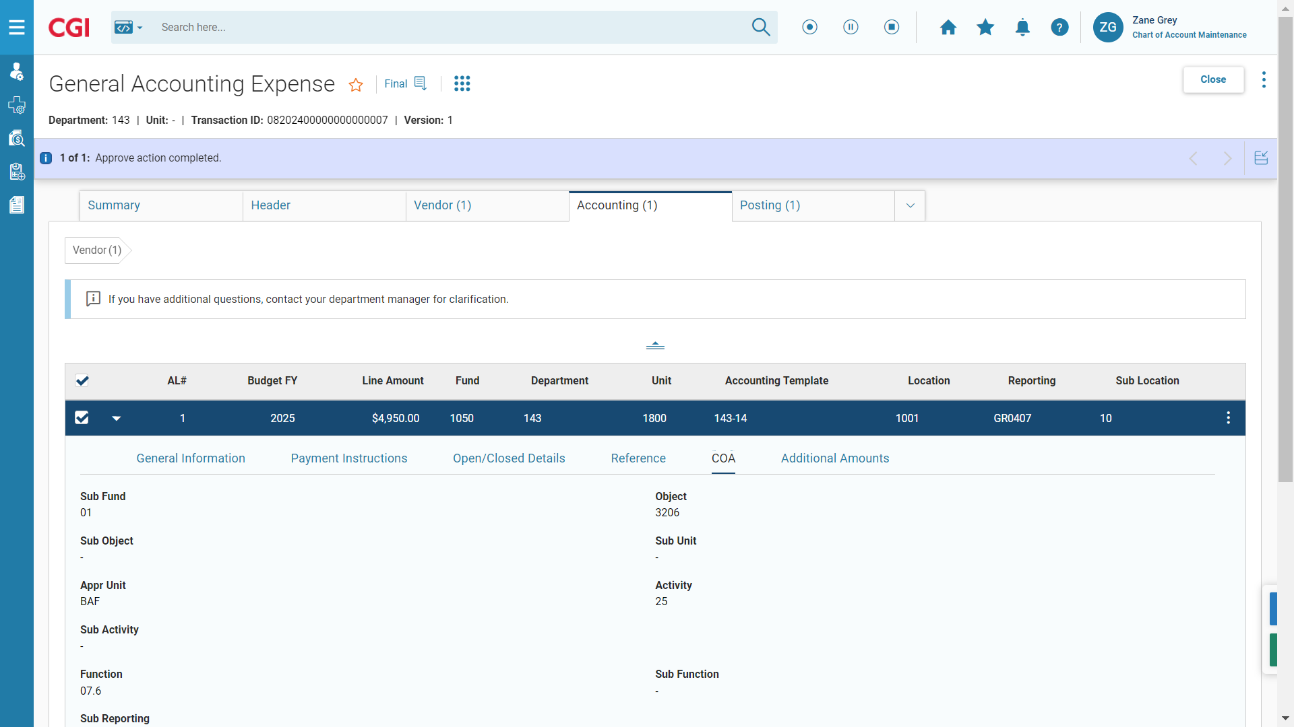
Modern, Intuitive User Experience
Sample General Expenditure Transaction

Slide 17
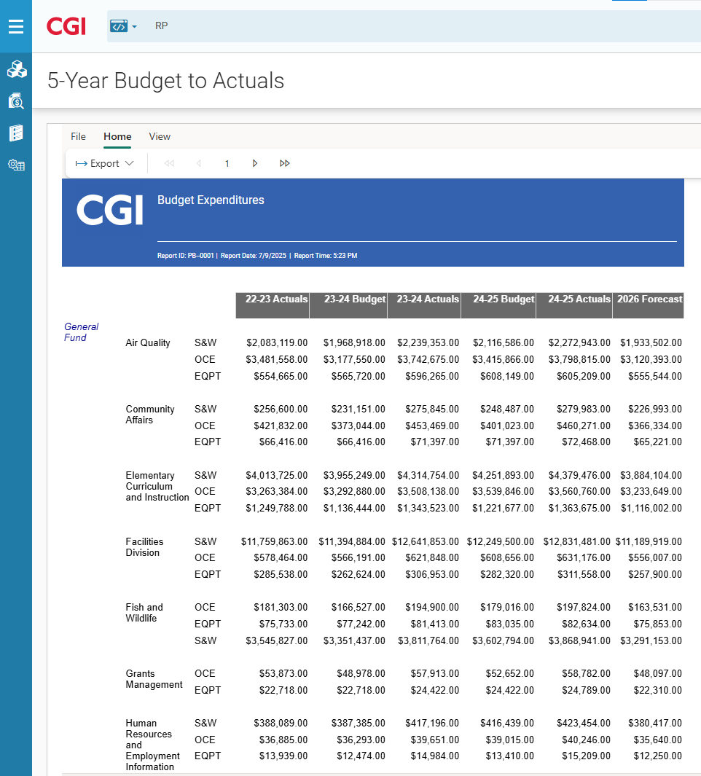
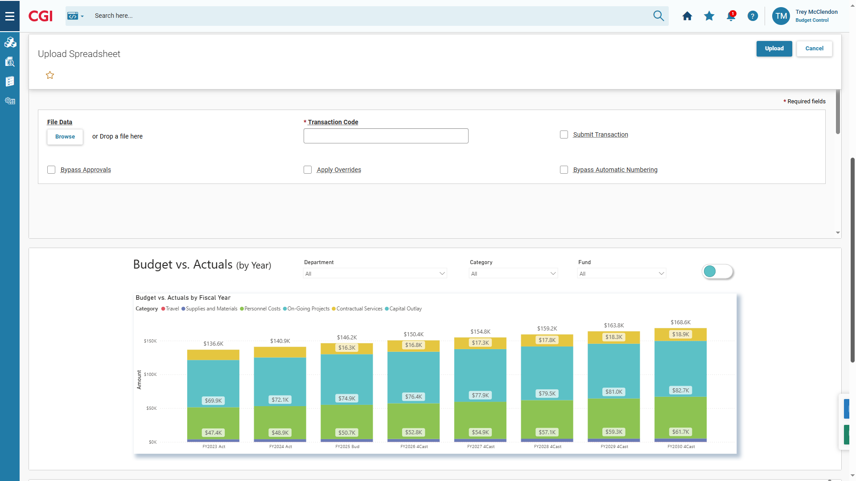
Modern, Intuitive User Experience
Embedded reports and analytics
Real-Time Insights: data at your fingertips
Contextual Analytics: reports embedded where work happens
Interactive & Visual: drill-downs and dashboards for deeper understanding

Slide 18
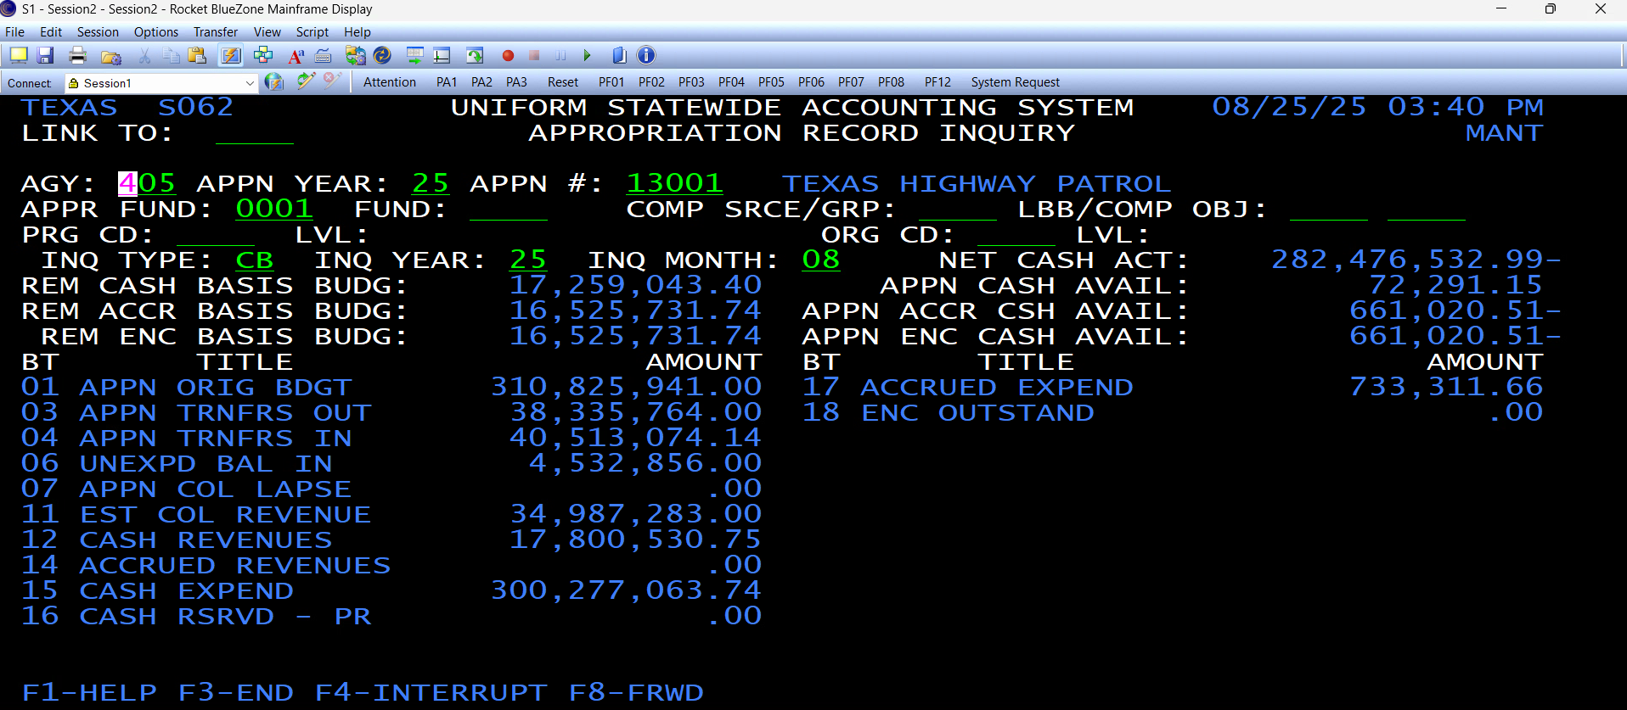
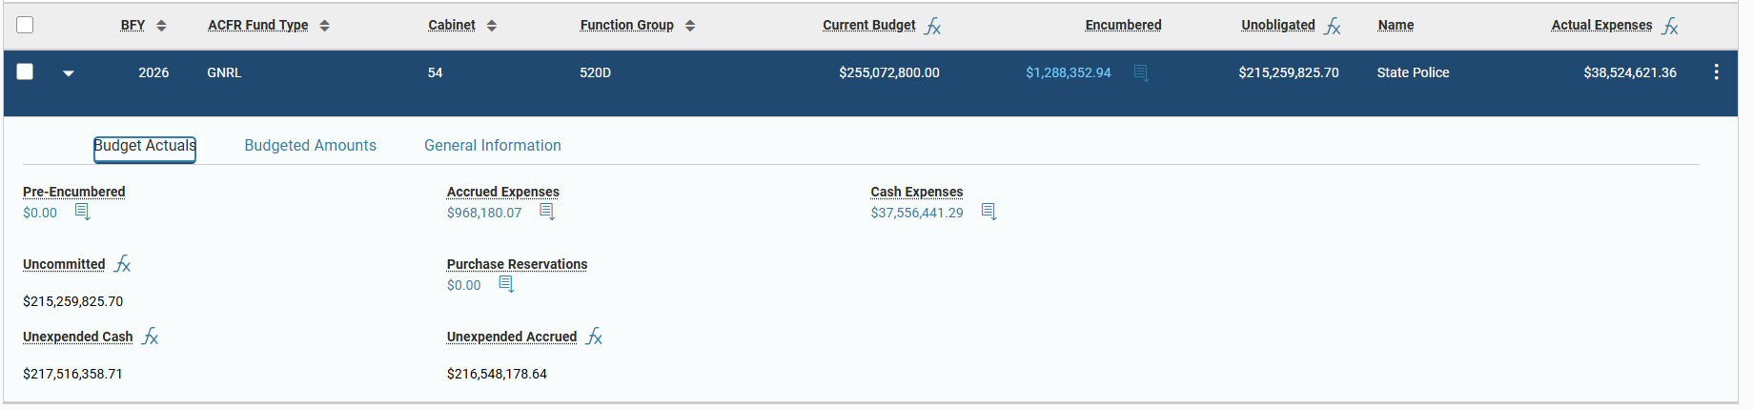
USAS to Advantage Comparison

Slide 19

Technology Overview

USAS, TINS, and SPA Mainframe Systems
  Written in the COBOL and Natural programming languages
  User interface utilizes mainframe green screens
  Utilizes primarily file-based batch processes for integrations with external systems and reporting
  Legacy mainframe systems are difficult to execute, maintain, and update due to the specialized hardware, software, and personnel required

Slide 20

Technology Overview

Benefits of Software as a Service (SaaS)
  Receive quarterly updates with new functionality
  Lower infrastructure cost
  Reduced maintenance requirements
  Scales up and down as needed
  Improved User Interface
  Web-based solution provides increased accessibility
  Decreased implementation time
  Real-time integration with external systems
  Real-time reporting
  Highly Configurable

Slide 21
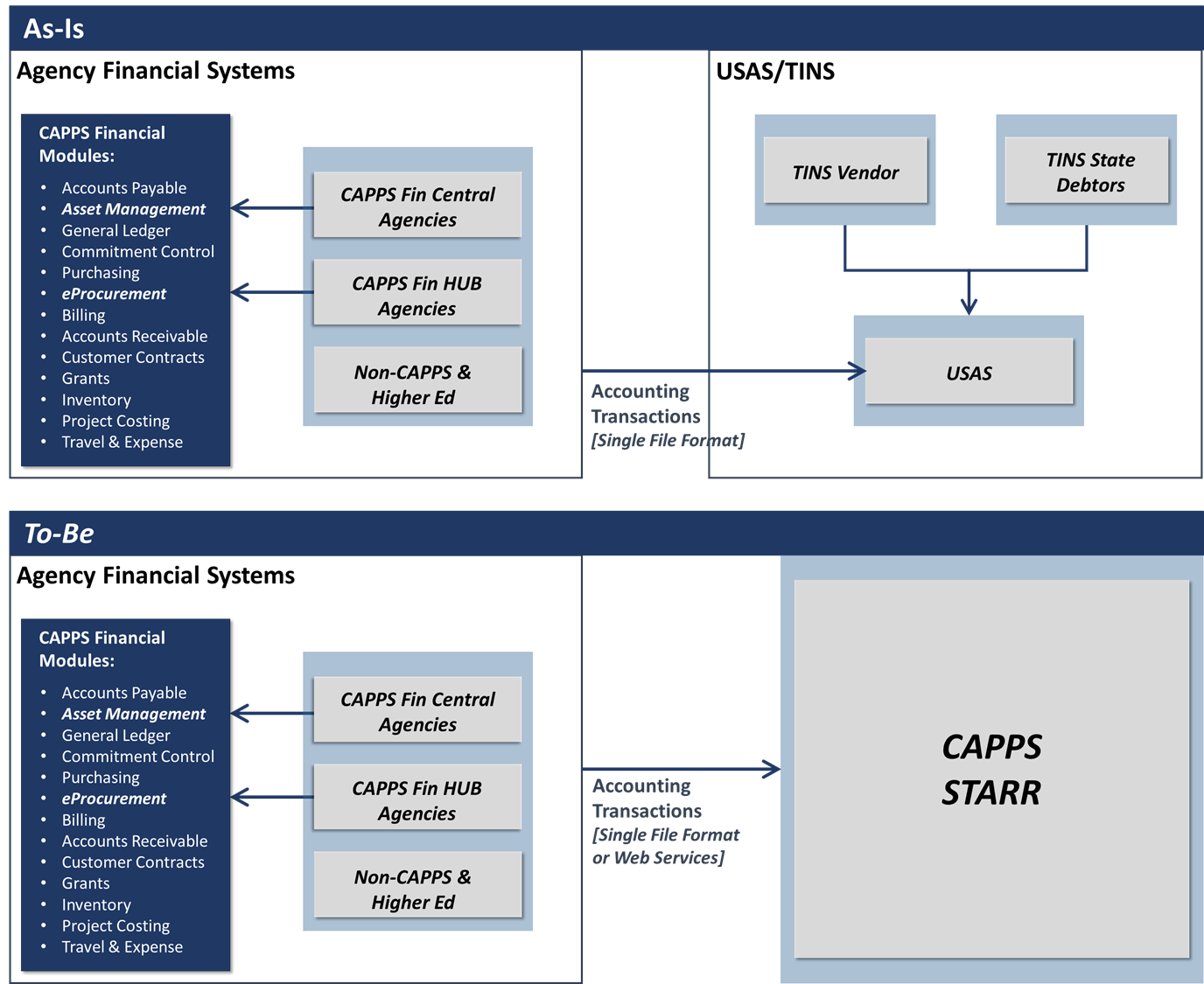
Enhanced Interface Approach

Slide 22
Project Work Plan (High-Level)

Slide 23
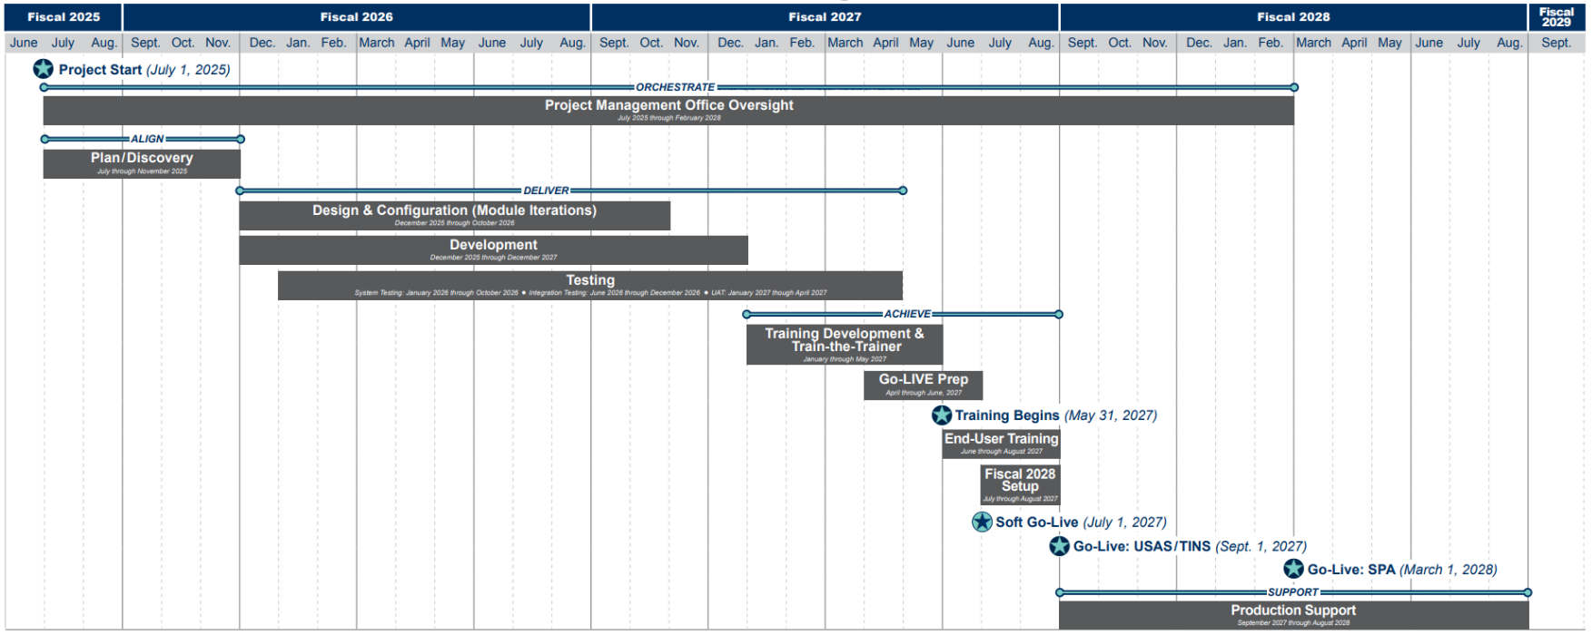
CAPPS STARR High-Level Schedule

Slide 24

Project Communication

Success of the project will depend on the team’s ability to effectively communicate project status, dependencies, requirements, and risks.
Communication Tools (Internal & External)
  Project Website (FMX)
  Teams Site and File Repository
  Email Groups
  Town Halls
  Meeting Minutes (OneNote)
  Project Status Updates
  Sponsor Meetings
  IV&V Reports
  QAT Quarterly Reports


Slide 25
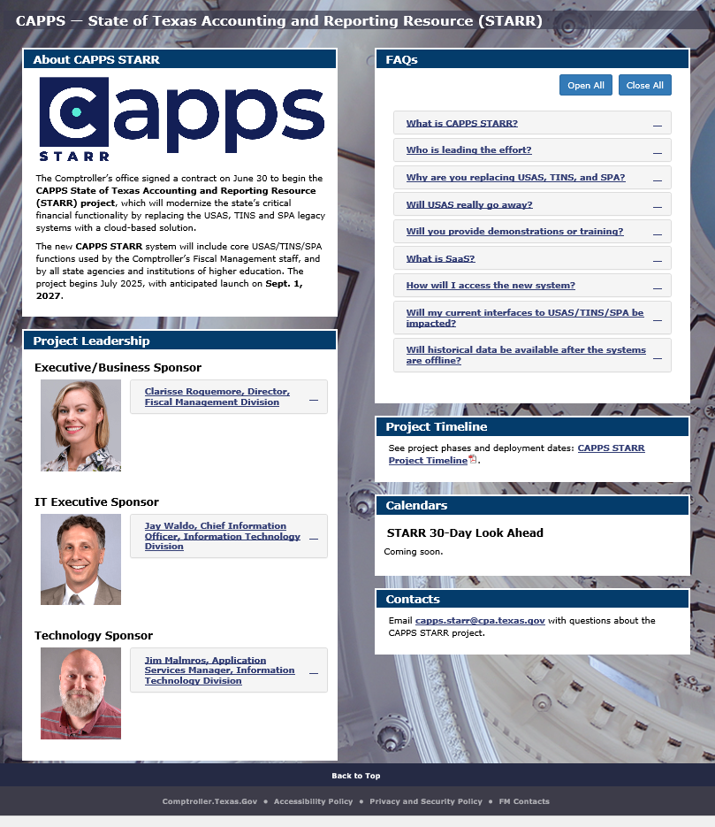
CAPPS STARR Project Website
The CAPPS STARR website serves as an information hub for this joint effort between the Comptroller's Fiscal Management Division and Information Technology Division.
The website will contain important information on the current project timeline as well as FAQs, which are assembled from questions asked by Texas state agencies and institutions of higher education.
Please feel free to send questions/comments to capps.starr@cpa.texas.gov

Slide 26
CAPPS Financials & HR/Payroll Update

Slide 27
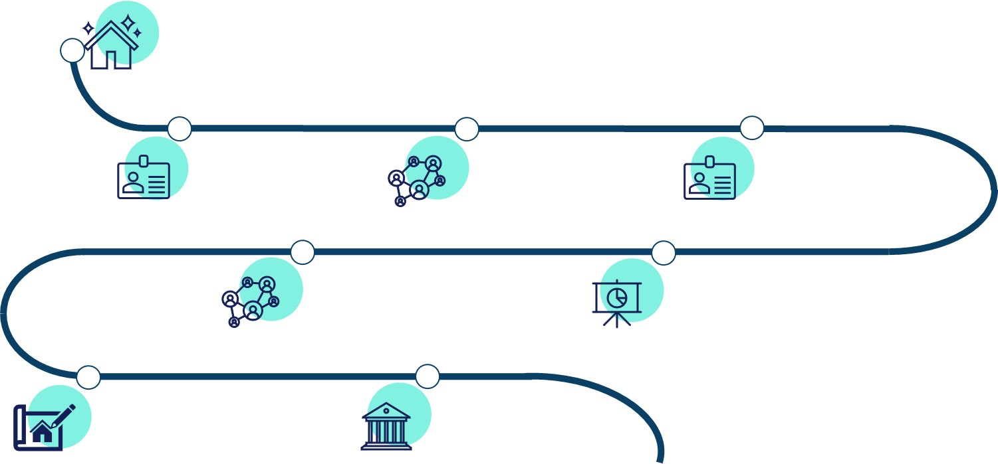
CAPPS Roadmap
Image Upgrade
Configuration and testing are underway for the PeopleSoft image upgrade on June 29, 2026.
CAPPS Recruit – Go Live #1
TAM/CG implementation preparation is underway for Phase 1 on June 29, 2026.
TDCJ HR/Payroll Deployment
TDCJ go-live on CAPPS HR/Payroll on July 13, 2026.
CAPPS Recruit – Go Live #2
TAM/CG implementations Phase 2 go-live on July 20, 2026.
ERS Financials Deployment
ERS go-live on CAPPS Financials on Sept. 1, 2026.
Reporting Strategy: ADDA
Agency Direct Data Connect implementations are in progress.
Home Page Redesign
Refresh look and feel of the CAPPS landing page – Summer 2027
Legacy Fiscal Modernization
CAPPS STARR Financials upgrades and STARR Go-Live – Sept. 1, 2027

Slide 28
Talent Acquisition Management (TAM) and Candidate Gateway (CG)

Slide 29
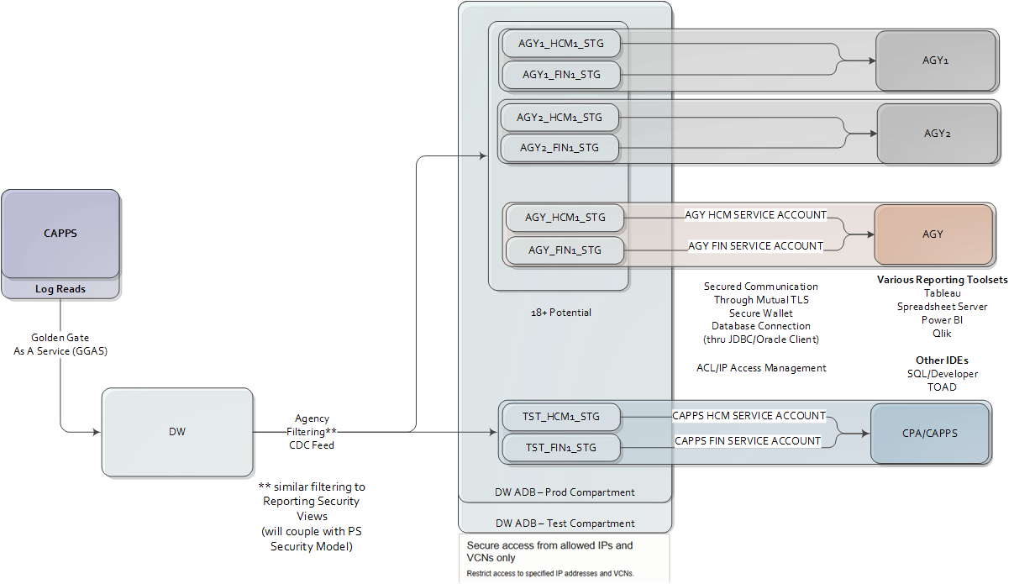
Agency Direct Data Access (ADDA) Architecture Diagram
Notes:
Speaker: Ray

Slide 30
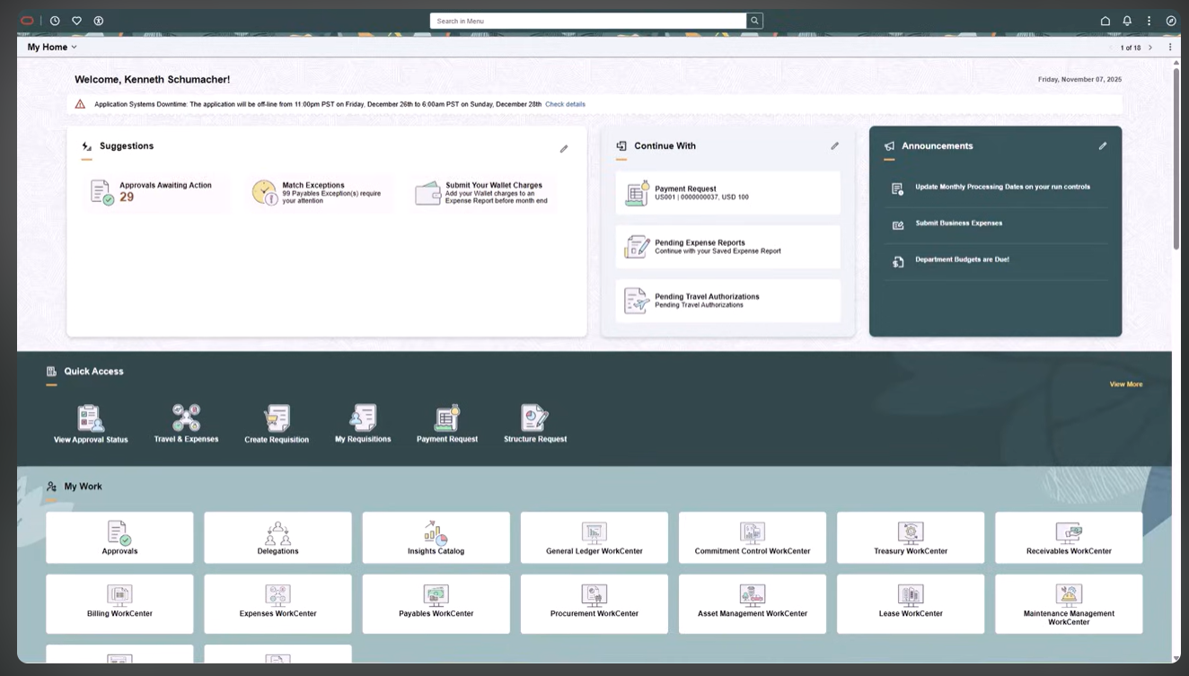

Slide 31
Thank you!

