Slide 1

Bonds and Cash Flow
TSABAA 45th Mid-Winter Conference
December 16, 2025

Slide 2
Bonds and Cash Flow
Kim Edwards
Public Finance Manager
Treasury Operations Division
Texas Comptroller of Public Accounts
Kimberly.Edwards@cpa.texas.gov
  Part I – What is a Bond?
  Types of Debt
  Why issue Debt?
  Debt in the Lone Star State
  Part II – Strings Attached! Federal Securities Law
  IRS Tax Law Requirements
  SEC Disclosure Requirements: What we say to investors
  Part III – Cash Management, Tax and Revenue Anticipation Notes

Slide 3
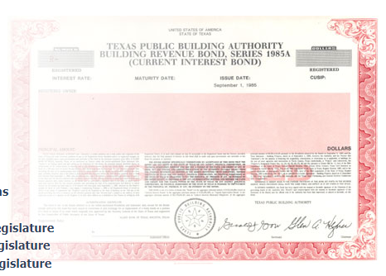
Part 1: What is a Bond?
A Bond is a loan
A Bond is a certificate of indebtedness, between the issuer (borrower) and the bondholder (investor), i.e., a loan; a formal contract to repay borrowed money with interest at fixed intervals.
Used to finance capital projects, equipment, and sometimes working capital, over the useful life of the asset.
The Issuer (borrower) is obligated to repay the Purchaser (lender, investor, bond holder) the principal amount borrowed (par), plus interest.

Slide 4


The “Bond Market”
Sovereign Governments, e.g. the U.S. Government Treasury Bonds
Mortgage Bonds (GNMA, FNMA)
Corporations issue Corporate Bonds as well as Stocks
Political Subdivisions (States, Cities, Counties) issue Municipal Bonds
Tax-exempt municipal bonds are unique to the United States
Stock Market
Global Equity
$62 trillion
U.S. Treasury
$14 trillion
M
Municipal Bonds
$3.8 trillion
Mortgage Bonds
$8.9 trillion
Corp. Bond
$8.5 trillion

Slide 5

Municipal Bonds are “Tax-exempt”
A municipal bond is issued by a US state or local government.
The interest income that the investor receives on a municipal bond is not subject to Federal, State, or Local income taxes (pursuant to Federal Tax Law/IRS Regulations).
Therefore, tax-exempt interest rates are typically lower than comparable taxable interest rates.
Example:
  25% tax bracket - $1,000 taxable interest income = $750 of tax-exempt income.
  10% taxable interest rate => 7.5% tax exempt interest rate, or more realistically 5% => 3.75%.
Tax-exempt bonds offer a lower borrowing cost than taxable bonds or a commercial loan.
What’s the catch? The IRS imposes restrictions and requirements on the proceeds and use of tax-exempt bonds.
Taxable Municipal bonds are sometimes issued.
U.S. Treasury Bonds and Corporate Bonds are not tax-exempt
FREE LUNCH

Slide 6
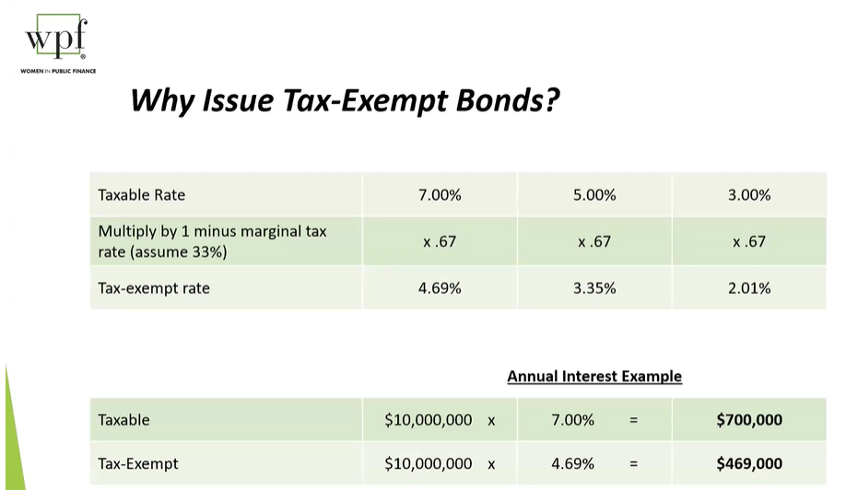
$230,000/yr x 20 years = $4.6 million

Slide 7
Types of Bonds
Security Pledge – what secures the repayment of the loan
General Obligation – “full faith and credit,” unsecured, all available resources pledged to repay.
Revenue – secured,only the revenues “pledged” to repayment can be used to repay the bonds. Project finance
Example:
  GO: property taxes, “Constitution - first monies coming into the Treasury”
  Revenue: water or electric utilities, toll roads, hospitals, universities, airports
GO Bonds typically have the highest credit quality and therefore the lowest interest rate, BUT they require voter approval (Constitution or charter prohibits the incurrence of debt).
Debt Instruments
Long-term, fixed rate bond > 5 years
Short-term, variable rate note - commercial paper notes, fixed or floating interest rate – weekly, daily) < 5 years

Slide 8
General Types of Debt and Financing Tools
Debt Feature | Most Common | Other Options | Even More Options
Security Pledge /Legal Structure | General Obligation (e.g., Property Tax) | Revenue Bonds (e.g. Utility, Toll Road, Airport) | Special Assessment, Sales Tax, Dedicated Revenues, TIF, Conduit Issues, Lease Revenue Bonds, Certificate of Participation*
Tax Status (Typically determined by Use of Proceeds or Specific Tax Law) | Tax Exempt | Taxable | Private Activity Bond (AMT), AMT, Tax Credit (BABs)
Use of Proceeds | General Infrastructure for a Governmental Purpose | Pension Obligation Bonds, OPEB, Working Capital, Private Partner | Bond Anticipation Notes, “Green” Bonds, Securitization
Debt Instrument | Fixed Rate Long Term (Bonds) | Variable Rate Short Term (Notes) | Commercial Paper, Swaps,
Method of Sale | Public: Negotiated Sale, Competitive Sale | Private: Private Placement, Bank Loan | Bond Banks (like SRF for Utilities), Federal Loan Programs
Notes:
This is like ordering your burrito bowl at Chipolte: Mix and Match by choosing one from each row

Slide 9
Typical use of Municipal Bonds
Fund a Capital Project (“New Money”) – to build a school, building, road, water infrastructure
Refinance or “Refunding” to a lower interest rate/different loan terms. Unlike your mortgage, which you can refinance/pay off at anytime, municipal bonds have a “10-year call feature” so you can’t pay them off for 10 years.
Bond Banks issue bonds and lend the proceeds to smaller governments or special programs (mortgages, student loans, infrastructure) to pass along lower borrowing cost and economies of scale.
Working Capital – manage cash flow

Slide 10

State of Texas Bond Programs
State of Texas Debt Issuers
General Purpose
Texas Transportation Commission (TxDOT) – transportation projects
University Systems (UT, A&M, TSUS, Texas Tech, UH, UNT…)
Texas Public Finance Authority
Loan Programs
Texas Water Development Board – loan programs to political subdivisions for water infrastructure
Texas Higher Education Coordinating Board - student loan program
Veteran’s Land Board – land and mortgage loan program for Veterans
Texas Department of Housing and Community Affairs – Single family mortgage loan program and multifamily project finance
Texas State Affordable Housing Corporations– Single family mortgage loan program and multifamily project finance
Working Capital
Comptroller of Public Accounts – TRAN Tax and Revenue Anticipation Notes
Bond Review Board – BRB is an oversight body (Governor, Lt. Governor, Speaker, Comptroller, AG). It does not issue debt, but it approves the issuance of state debt and provides data collection and reporting. Debt Affordability Study, Constitutional debt limit
Notes:
Debt issuance in the state of Texas is decentralized – over 16 state agencies and higher ed institutions issue their own bonds. In smaller or more centralized states, often all debt is issued through the Treasurer's office.

Slide 11

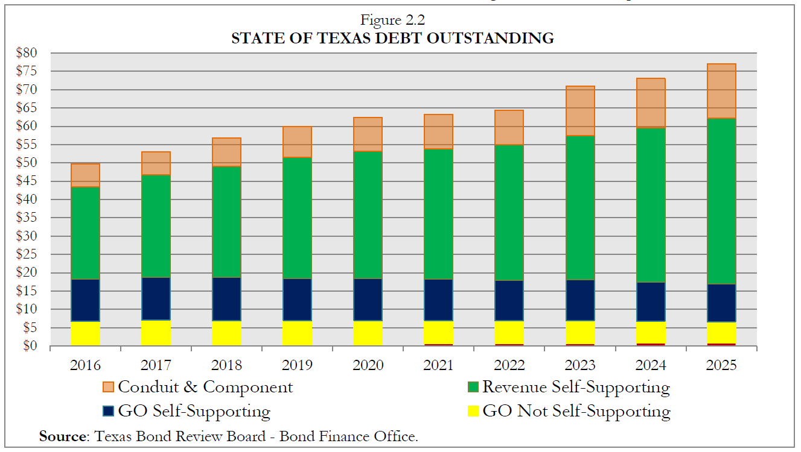
State of Texas Debt in Perspective
Texas has the highest Credit Rating from all three rating agencies.
Rating based on several factors: Economy, Demographics, Financial Condition, Debt/Liabilities (Pensions) and Liquidity
Texas local governments historically have also been highly rated
Agency | Issuer Credit Rating
Moody’s | Aaa - Stable
S&P | AAA - Stable
Fitch | AAA - Stable
KBRA (Kroll) | AAA - Stable
The Texas Bond Review Board collects data and reports on state and local debt in Texas.
https://www.brb.texas.gov/
Notes:
10 other states have AAA rating from all agencies.
Most State of Texas Debt is “Self Supporting” – that is, supported by Program Revenues, not General Revenue. (Slide 10, most debt are loan programs. TPFA is the main issuer of GR supported debt).

Slide 12
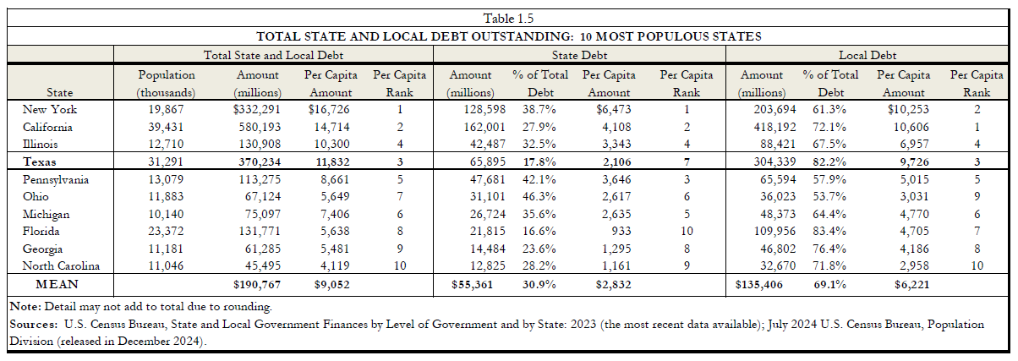
State of Texas Debt in Perspective
In Texas, debt issuance is decentralized, and most is done at the local level.
Source: Texas Bond Review Board
Debt outstanding: Total Amount Outstanding at any point in time
Debt Issued: Amount of Debt issued in a time period, fiscal year
Notes:
32nd in debt outstanding as % of revenue, per capita, personal income, and State GDP

Slide 13
Texas debt issuance 2025 year to date
State of Texas Debt in Perspective
Issuer Type | Number of Issues | New Money | Refunding | Total | % of Total
City | 501 | 16,064,599,659 | 3,049,064,691 | 19,113,664,350 | 21.50%
County | 74 | 2,648,523,612 | 995,209,388 | 3,643,733,000 | 4.10%
Higher Ed | 20 | 1,180,311,022 | 720,863,978 | 1,901,175,000 | 2.10%
Hospital/Healthcare | 6 | 1,468,120,000 | 0 | 1,468,120,000 | 1.70%
Housing | 75 | 1,632,285,516 | 32,485,000 | 1,664,770,516 | 1.90%
IDB & Other | 64 | 7,778,577,070 | 229,015,630 | 8,007,592,700 | 9.00%
Junior Coll Dist | 11 | 553,528,389 | 167,511,611 | 721,040,000 | 0.80%
Road & Tollway Auth | 13 | 276,111,426 | 1,036,008,574 | 1,312,120,000 | 1.50%
School | 324 | 19,718,877,468 | 6,876,981,984 | 26,595,859,452 | 29.90%
State Agency | 25 | 5,077,146,235 | 2,829,982,765 | 7,907,129,000 | 8.90%
University | 12 | 4,532,430,141 | 1,214,449,859 | 5,746,880,000 | 6.50%
Water & Other Dist/Auth | 597 | 9,882,055,037 | 846,761,037 | 10,728,816,074 | 12.10%
Total | 1,722 | $70,812,565,574 | $17,998,334,518 | $88,810,900,092
Source: Texas Municipal Advisory Council

Slide 14



Part II - Strings Attached!
Notes:
Tax-exempt debt issuance comes with “strings attached,” that is compliance with federal tax (IRS) and securities (SEC) law. Since debt issuance is decentralized, and the Comptroller is the State’s chief fiscal officer, CPA is responsible for compliance, and we need your help!

Slide 15
Federal Securities Law
Tax Compliance - IRS/Treasury
Since the IRS is foregoing collecting tax revenue on tax-exempt bonds, they want to limit the amount of tax-exempt debt outstanding.
Use of proceeds - project must be for a “public purpose,” no private business use.
Monitor expenditure of and interest earnings on bond proceeds.
Arbitrage rebate - IRS limits interest earnings as a way to control amount of tax-exempt debt issuance. Arbitrage Example: borrow at 3.75%, invest proceeds at 4.5%. You can keep the difference, as long as proceeds are spent by a certain time frame; otherwise you must “rebate” them back to the IRS.
Limits use of refinancing
Notes:
Compliance at the issuer level. This is the responsibility of each issuer – each agency that issues debt.

Slide 16

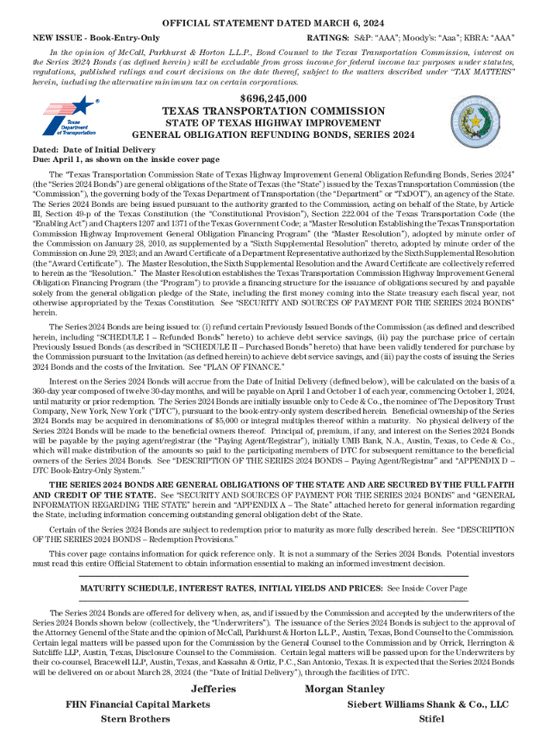
Federal Securities Law
Disclosure - Securities and Exchange Commission (SEC)
Securities laws (1933 and 1934) prohibit misrepresentation or other fraudulent conduct in connection with the purchase or sale of securities.
Requires disclosure of all material information about the issue (debt) and the issuer (borrower) to allow investors to make informed investment decisions.
Governed by SEC Rule 10(b)5, and SEC Rule 15(c)2-12
Implemented through
  Offering document (“Official Statement” - like a stock prospectus)
  Continuing Disclosure (ex. Quarterly Bond Appendix published by CPA)
  Financial Obligation reporting
  Other Statements readily accessible to investors, for example:
        Websites
        Publications, e.g., Fiscal Notes
        Press releases
        Speeches covered by media
        Social media

Slide 17

SEC Rule 10b-5: Anti-fraud provision
SEC Rule 10b-5 makes it illegal to directly or indirectly defraud, make false statements, omit relevant information or operate in a manner that would deceive someone in connection with the purchase or sale of securities.
Misstated facts: if “there is a substantial likelihood that an investor would consider it important to an investment decision.”
Omitted fact: if “there is a substantial likelihood that the disclosure of the omitted fact would have been viewed by the reasonable investor as having significantly altered the ‘total mix’ of information made available.”
Future Events: depends on the relative probability and magnitude of the event.
Recent enforcement under Section 17(a), which establishes a negligence standard - “knew or should have known.” Standard is a “reasonable person under like circumstances.”
Applies to any public statement by officials who may be viewed as having knowledge regarding the financial condition and operation of an issuer that may be reasonably expected to reach investors and therefore be subject to the antifraud requirements.
Notes:
You can’t lie, cheat or steal; you should tell “the truth, the whole truth and nothing but the truth.” Examples:

Slide 18
SEC Rule 15(c) 2-12: Disclosure
In a public offering, the SEC regulates what information you make available to investors to help them make their investment decision.
Upfront, when you sell the bonds - Offering document called a Preliminary Official Statement
Ongoing, at least annually and always “as needed.” (Continuing Disclosure and Voluntary Disclosure)
Note the Type of Offering (slide 8)
Public – selling to the public (competitive or negotiated sale; institutional/individual investors) vs.
Private Placement – bank loan or bonds sold directly to an Institutional Investor (like an ETF or Mutual Fund).
History of 15c2-12
Pre 1994 – Focused on disclosure when you sold the bonds
1994 Amendments – Continuing Disclosure, at least annually, and other times “as needed.”
Listed 14 material events
2019 Amendments – added 2 more to the list: “Financial Obligations”
2020 – Voluntary Disclosure (Covid)
Notes:
SEC Staff Legal Bulletin (Feb. 7, 2020) 10b-5 more voluntary disclosure, then in May 2020 statement from the SEC encourages voluntary disclosure of COVID-19 impacts and seeks to provide some assurances to issuers and borrowers in making a voluntary disclosure during this time of uncertainty

Slide 19

What is Material?
  Principal and interest payment delinquencies;‎
  ‎Non-payment related defaults, if material;‎
  ‎Unscheduled draws on debt service reserves reflecting financial difficulties;‎
  ‎Unscheduled draws on credit enhancements reflecting financial difficulties;‎
  ‎Substitution of credit or liquidity providers, or their failure to perform;‎
  ‎Adverse tax opinions, the issuance by the Internal Revenue Service of proposed or final ‎determinations of taxability, Notices of Proposed Issue (IRS Form 5701-TEB) or other ‎material notices or determinations with respect to the tax status of the security, or other ‎material events affecting the tax status of the security;‎
  ‎Modifications to the rights of security holders, if material;‎
  ‎Bond calls, if material, and tender offers;‎
  ‎Defeasances;‎
  ‎Release, substitution or sale of property securing repayment of the securities, if material;‎
  ‎Rating changes;‎
  ‎Bankruptcy, insolvency, receivership or similar event of the Board;‎
  ‎The consummation of a merger, consolidation, or acquisition involving the Board or the ‎sale of all or substantially all of the assets of the Board, other than in the ordinary course ‎of business, the entry into a definitive agreement to undertake such an action or the ‎termination of a definitive agreement relating to any such actions, other than pursuant to its ‎terms, if material;‎
  ‎Appointment of a successor or additional trustee or the change of name of a trustee, if ‎material
  ‎Incurrence of a financial obligation ‎ of the Board, if material, or agreement to covenants, ‎events of default, remedies, priority rights, or other similar terms of a financial obligation of ‎the Board, any of which affect security holders, if material; and
  ‎Default, event of acceleration, termination event, modification of terms, or other similar ‎events under the terms of a financial obligation of the Board, any of which reflect ‎financial difficulties.‎
Notes:
Lists 16 “material events” ; 10 of them say “if material” The gist of this is that you are supposed to let investors know when things are starting to head south, instead of waiting until after the damage is done.

Slide 20
What is Material?
  Materiality is determined by issuer and their financing team
  Material or uniform standards are NOT defined by the SEC
  Offering documents for new securities must disclose all information material to the offering (key terms of the securities, legal pledge and authority to issue the debt, security pledge to repay the debt, issuer’s ability to repay the securities on a timely basis, legal opinions, most recent financial information (i.e. audited financial statements) and operating data such as demographic information, enrollment, number of utility customers, etc.)
  Depends on the security pledge of the debt. For example, GO debt will describe the tax base, while revenue debt will describe the operating results.
  For State of Texas GO and General Revenue supported debt the materiality threshold for financial obligations is: 10% of GR Budget OR 10% of Outstanding Debt
TEST 1 - LIQUIDITY |  | TEST 2 - BONDS OUTSTANDING
FY26 GR Budget | $77,416,886,540 | 8/31/2024 | $22,456,390,000
10% | $7,741,688,654 | 10% | $2,245,639,000

Slide 21
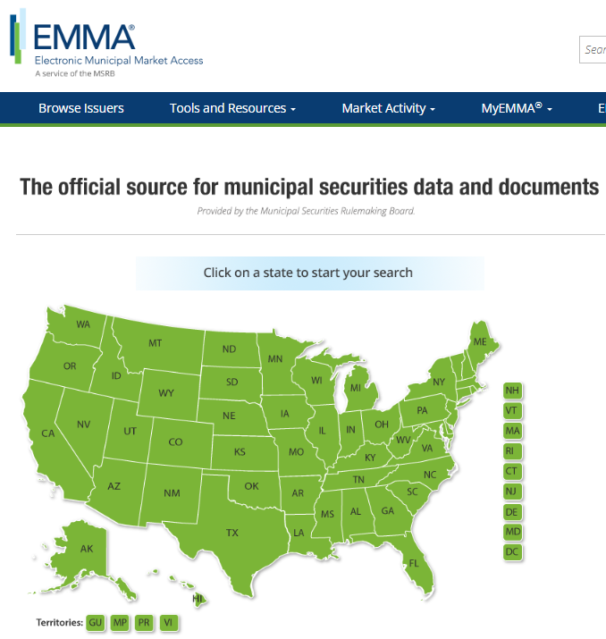
How does the State Comply with 15 (c ) 2-12
The SEC can not directly regulate state and local governments. It regulates the dealers that purchase the debt.
SEC Rule 15c2-12 requires dealers, when underwriting certain types of municipal securities, to ensure that the issuer enters into a written agreement (contract) to provide: Annual financial statements (audit), Annual operating or other information as stated in the undertaking, Notice of certain events within 10 business days of the occurrence of the event. Continuing Disclosure Agreement (CDA)
Issuers and obligated parties are required to file information with the Municipal Securities Rulemaking Board (MSRB) through its Electronic Municipal Market Access (EMMA) portal by a specified date.
To enable underwriters of State agency security offerings to comply with Rule 15c2-12, the Comptroller has agreed through a CDA with the BRB to file with the MSRB:
    annual financial information concerning the State,
    the State’s Annual Comprehensive Financial Report (ACFR), and
    timely notice of certain financial obligation events
    State agency issuers agree to provide all other information and notices required by the rule to the MSRB.
  Municipal Securities Rulemaking Board::EMMA
Notes:
Red Box – this will be on the test!
CPA CDA with BRB is required because debt issued in the state of Texas is decentralized.
At the issuer level, each issuer also has a due diligence call prior to the publication of the Official Statement.
Fun fact: Corporate issuers file quarterly on a system called EDGAR.

Slide 22

The Bond Appendix
BOND APPENDIX SECTIONS
STATE GOVERNMENT
FISCAL MATTERS
STATE REVENUES AND EXPENDITURES
STATE DEBT
ECONOMIC INFORMATION/ TEXAS TRADE
DEMOGRAPHIC INFORMATION
EDUCATION
RETIREMENT SYSTEMS
LITIGATION
INFORMATION SECURITY
CONTINUITY OF OPERATIONS/RECENT EVENTS
Published quarterly in November, February, May and August.
Filed on the MSRB EMMA website and the CPA website.
CPA staff emails over 20 individuals (“editors”) around the first of October, January, April and July to request updated information. Response is generally due within 2 weeks or as available.
Must meet Section 508 accessibility requirements.
The Bond Appendix is referenced in each GR-supported debt offering.
Notes:
The appendix is dissected into 26 different sections. Some sections have multiple editors. Also, some editors have more than one section sent to them.

Slide 23


Continuing Disclosure
The Bond Appendix is published to comply with 15 (c) 2-12 disclosure requirements for both the initial offering and the ongoing, i.e. “at least” annually (we provide quarterly).
The CPA also monitors events and financial transactions to determine if the Bond Appendix needs to be amended between quarterly publications (“voluntary disclosure”). Examples: Hurricane Harvey, Covid-19 Pandemic.
We also try to monitor any “financial obligations” that the state or a state agency might incur that could be deemed material, particularly to General Revenue.
Please contact us if you are aware of anything or have any questions.
Financial.obligations@cpa.Texas.gov

Slide 24
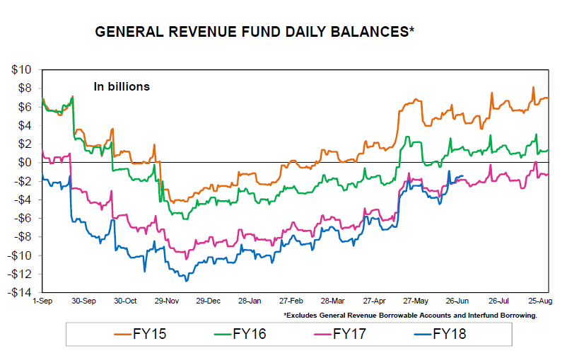
Part III: Working Capital - Cash Flow Forecasting
Historically, the State has had a timing mismatch of expenditures and revenues in each fiscal year, resulting in a cash flow deficit, typically in November or December.
Texas Government Code 404, Subchapter H authorizes the Comptroller to issue short-term obligations to address temporary cash shortfalls.
Tax and Revenue Anticipate Notes (TRAN) are short-term (one year or less) obligations issued to assist the state with its cash flow.
In addition, Texas Constitution, Article 3, Sec 49-g(j) allows “inter-fund” borrowing from the Economic Stabilization Fund.
Prior to 2020, the State routinely issued a TRAN annually, ranging from $4 – $10 billion.

Slide 25
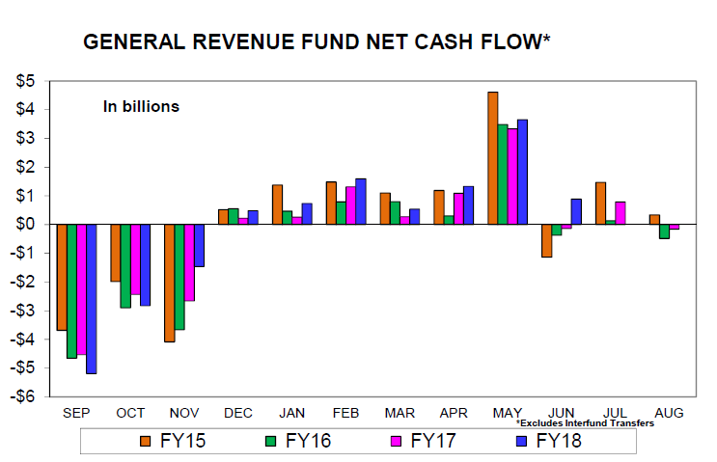
Working Capital - Cash Flow Forecasting
The Cash Flow Analyst in the Public Finance Team monitors the state’s cash flow to:
Identify the need for external (TRAN) or internal (ESF) borrowing to offset cash flow shortfalls
Assist the Texas Treasury Safekeeping Trust Company manage the liquidity of the Treasury pool and maximize investment earnings.
Please contact us if you are aware of any cash inflows or outflows that are large (over $500 million) or have atypical timing or amounts.

Slide 26
Contact Information
Continuing Disclosure
  Kim Edwards
  kimberly.edwards@cpa.texas.gov
  512-475-0594
  Melissa Popkoff
  melissa.popkoff@cpa.texas.gov
  512-463-8366
Cash Flow Forecasting
  Duvan Arsola
  duvan.arsola@cpa.texas.gov
  512-936-4432

