Slide 1

Learning the Art of Legislative Empowerment 2.0
By:
Ray Hymel
TPEA Legislative Consultant
Notes:
We believe arming yourself with knowledge about the Legislative process will help benefit your job and livelihood.

Slide 2
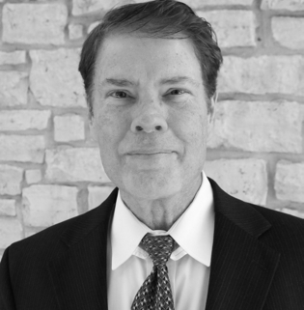
Introductions
Notes:
Give a little intro of yourself and your background. Share your knowledge of working with the state, ERS, legislature, etc.

Slide 3

Learn the Basics
Know
the Legislative Process
Know
the Players
Know
the Rules
Notes:
Start with a question. Ask about their knowledge about the Legislative process.
If you don’t already know the basic rules of the game, learn them, whether from the LBB, Texas Legislative Council website or Google.
Talk about the importance of knowing some of the basic information about the Legislative process and how it can benefit them.

Slide 4
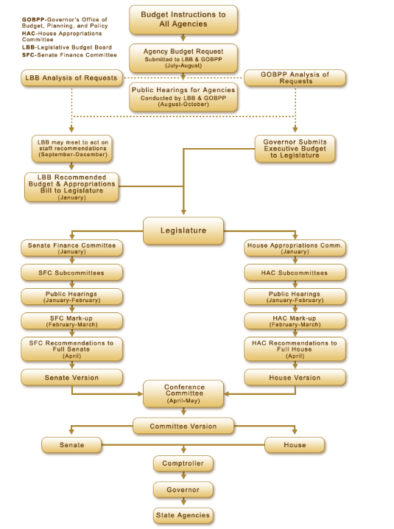
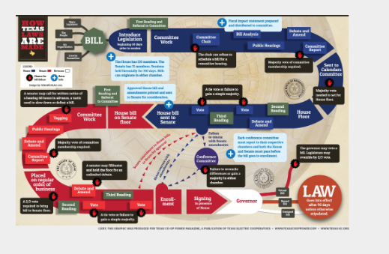
Know the Process
Notes:
Call out some interesting facts about how this works, the number of bills that are introduced every year, the approximate percentage that usually passes, etc.
9000 bills, 1155 passed, all the amendments to bills including pass bills.
Ask how many are involved in preparations of their agency’s LAR.

Slide 5
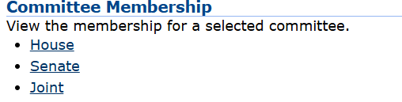
Know The Legislative Players
Learn more about the committees that legislative members serve on
Found on the House and Senate websites
Notes:
Talk about why the committee members are important. How the committees are made and how they interreact.
Mention who the chairs are and why the committee members are important…for your budget.

Slide 6

Resources
Reports
Guidelines
Statistics
Notes:
Ask another question?
Where do you find some of the data within agencies?
What to look for within the reports
How to show the statistics for ex: pay raises.
The State Classification Team produces several reports and guides on various compensation, classification, and workforce issues. Reports include:
Benefits as a Percent of Total Compensation
Classification Compliance Reviews and Audits
Compensation and Classification
Employee Turnover
Full-Time Equivalent (FTE) Employees
Human Resources Management Statutes Inventory
Legislative Workforce Summaries
Comptroller of Public Accounts- Fiscal Notes
LBB- Fiscal Size Up
Policy area reports

Slide 7


State Employee Rights
Notes:
Even if you know the basic rules and process, sometimes things happen. Share the example of the two LAR instructions last year.
Ideas, suggestions and specific proposals for bills may come from several sources.
There are other resources available, but you do need to know your rights as a state employee.

Slide 8
Permissible Political Activities
HHS employees are entitled to participate in the political process to the extent that such participation does not violate applicable laws and agency policy. For example, employees may participate, on their own time and without the use of agency resources, in the following political activities:
Assisting in voter registration drives
Expressing opinions about candidates and issues
Wearing or displaying political badges, buttons, or stickers
Attending, organizing, or managing political rallies and meetings
Joining a political club or party
Signing or circulating nominating petitions
Campaigning for or against referendum questions, such as constitutional amendments or municipal ordinances
Collecting contributions or selling tickets to political fundraising functions
Distributing campaign materials in a partisan election outside of the workplace and subject to the preceding conditions
Notes:
know your rights as a state employee. Here is an example of HHS.

Slide 9
Employee Political Activity
A TDCJ employee is encouraged to exercise the employee’s rights and responsibilities as a citizen in the political process through various activities. These activities may include voting, participating as a voter registrar, contributing personal money to the employee’s preferred candidates or political parties, and actively engaging in campaigning or fundraising and endorsements. However, TDCJ employee political activities shall comply with the provisions within this directive.
Notes:
Here is an example of TDCJ guidelines. Talk about how active TDCJ is…and their successes

Slide 10

Resources outside of Agencies
Special Interest Groups
Think Tanks
Not-for-profits
Associations
Unions
Notes:
Who are the groups?
How do they help you?
Talk about the different groups.
Ask the question of testimonies?
Think Tank example is 2036 Group.

Slide 11
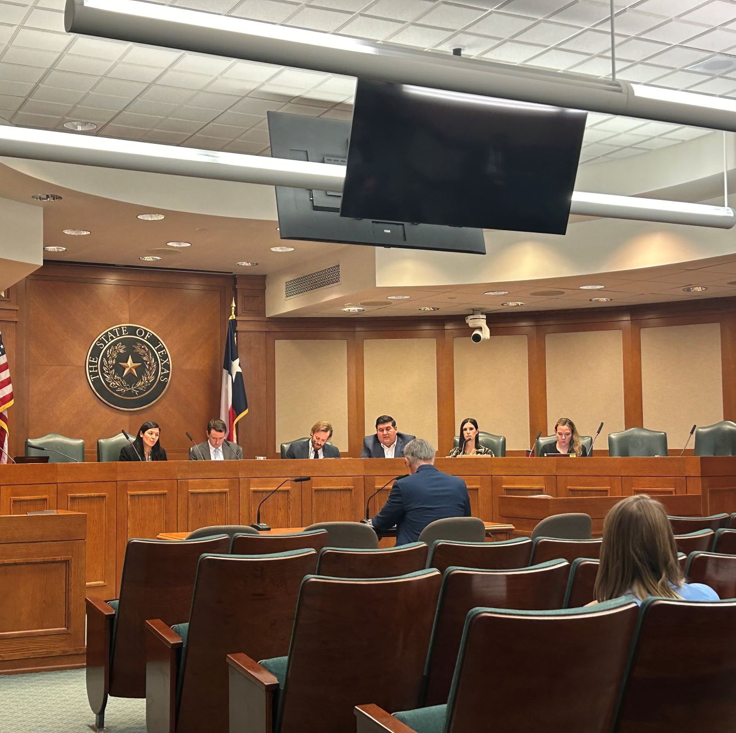
Behind the Scenes
Letter to State Agency Directors- If you don’t ask, we can’t ask.
Judiciary-wide inflation relief and staff retention and recruitment - The OCA is grateful for the increased funding received in the 88th Legislative Session that provided much-needed relief for maintaining and recruiting staff for our agency.
Boards of Reviews
Pre-session workgroups
Notes:
Talk about TPEA’s letter to agency directors, how target pay raises work, comp time for TDCJ, remote work policy, etc.
Expand on the $10K raise request bill that we keep hearing about. How TPEA is realistic using the revenue available to the Legislature.
Come together for everyone for the raises

Slide 12

Using The Cycle To Educate and Empower Yourself and Your Team
Notes:
With that being said, we’re going to end it with a little more information about TPEA and how TPEA can help you and your agency.
Knowledge = Power
TPEA can help provide that knowledge!
Leaders at state agencies have the opportunity to educate employees about the legislative process, and empower them to advocate for what they need.
Being able to speak for yourself/your team in terms of LARs, exceptional item requests, and budget hearings adds weight to your request and demonstrates your knowledge.
Advocacy: Before and during the session, everyone can reach out to their lawmakers to let their thoughts and needs be known.
Reminder to not use state time or equipment (its one of the reasons why TPEA asks for home emails for better communication)

Slide 13


Your friend at the Capitol
Our Mission
At TPEA, our mission is not just a statement but a commitment to actively preserve and enhance the salaries, benefits, and pensions of state employees and retirees.
Our Vision
State employees and retirees are respected and properly compensated for their dedicated service.
Notes:
Evolution of TPEA’s work
Pension
Benefits
Pay/Salary
Remote work
Parental leave

Slide 14

Who We Are
TPEA was established in 1946
Advocate for current and retired state employees
Instrumental in creating the ERS pension fund
Only non-profit, non-union, non-partisan advocacy group
Notes:
Share the history of TPEA and notable successes

Slide 15

More than an Advocate
Advocate
Created by TxDOT employees 80 years ago
Influence & protect
Advocacy Action Center
Tools, resources and legislative updates
Exclusive Member Discounts
Discounts and savings from daycare (10%), tech, travel, entertainment
Learning Hub
Skills and life courses like pre-retirement webinar
Instrumental in creating the ERS pension
Notes:
Talk about the 2 – 5% pay raises and how we got it.

Slide 16






THANK YOU
CONTACT US
888.367.8732
membership@tpea.org
tpea.org
10815 Ranch Rd. 2222, Bldg. 3B-100, Austin, TX 78730

