Slide 1


Simplify State of Texas
Application
12/15/2025
SOTA Streamline Project

Slide 2
Objectives
Align process of applying for State of Texas jobs more closely with private sector job application process
Reduce barriers to applying for state jobs by:
Simplifying application
Reducing process time and increasing ease
Eliminating redundancy of re-entering education and job history
Allowing jobseekers to leverage existing resume or new AI resume builder in WorkinTexas

Slide 3
Purpose
Resume and shorter set of questions will provide basic information needed for initial screening
Agencies can tailor additional screening to their needs or those of the position

Slide 4
New SOTA
The SOTA will have two components:
Resume
Short set of questions:
Contact information
Foster youth, military and felony information
EEO data
Required attestations

Slide 5
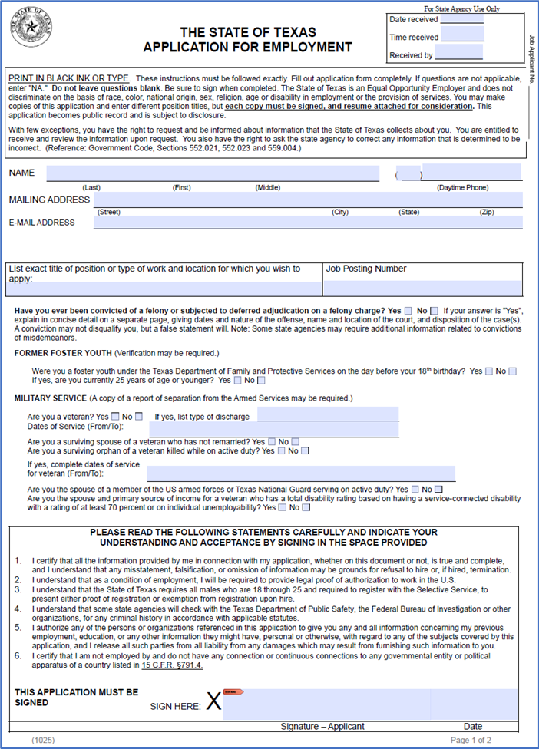
New SOTA
The updated SOTA will:
Require a resume
Collect contact information
Collect former foster youth, military status, and felony information
Collect Equal Employment Opportunity (EEO) data
Require attestations (signature area)
No longer include employment history, education, licenses, and skills (refer to resume)
No longer contain extraneous questions (agencies can tailor screening questions for relevant information)
12/15/2025

Slide 6
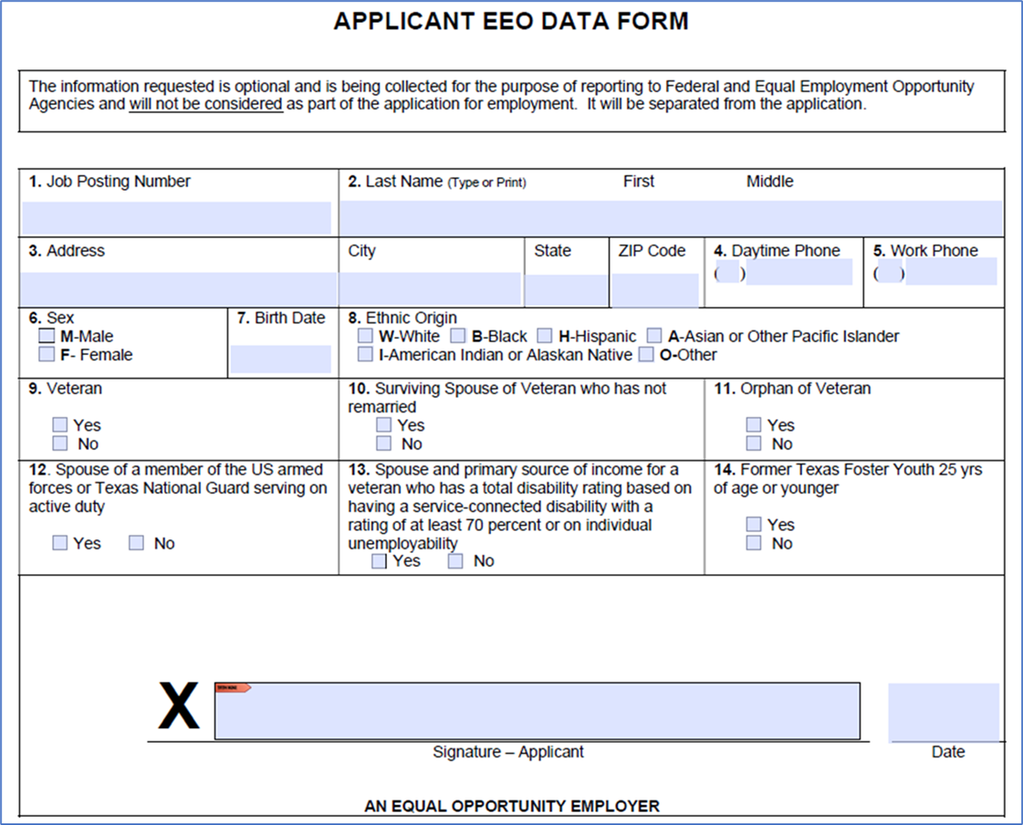
New SOTA
The updated EEO Data Form will remove question 15: How did you first find out about this job? (agencies can ask this in subsequent screening.)
12/15/2025

Slide 7
Target Schedule
Project timeline
Information Sharing and Coordination with Partner Agencies | 6/30/25
Development | 7/11/25
Client UAT testing | 9/29/25
Deployment to production (Executive Order GA-48 attestation deployed 7/31/2025) | 1/26

Slide 8
Contact Information
Please direct any questions to newSOTA@twc.texas.gov.
Michelle D. Kranes, Deputy Director of Workforce Development Compliance and Assistance, TWC
Jerry White, Director of Human Resources, TWC

