Slide 1

Adaptability and Evolvability of Leadership in State Government
TSABAA Mid-Winter Conference, December 2025
Tetyana Melnyk, Director, Revenue Estimating Division

Slide 2
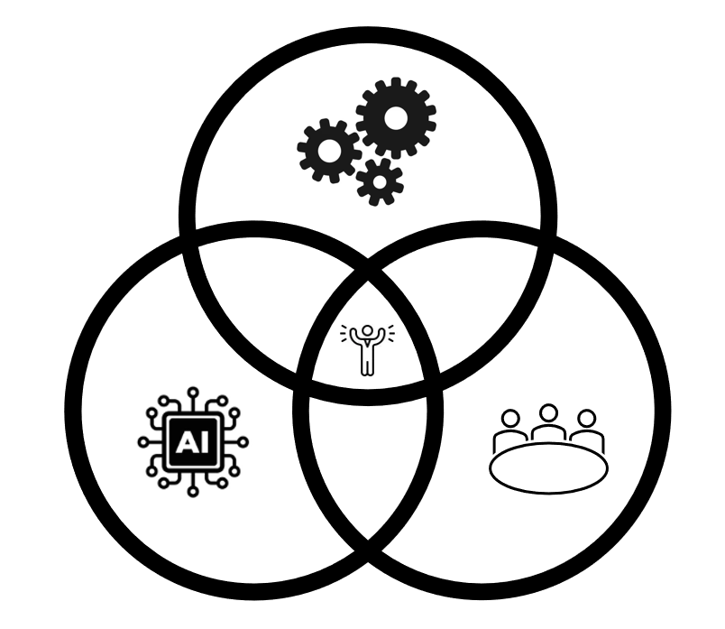
I need to find a captive picture for this

Slide 3
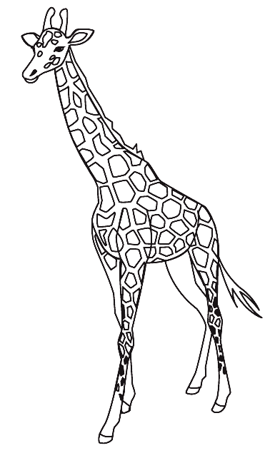
Definitions
Adaptability
  Ability to respond to immediate challenges
  Reactive response to current crises
  Giraffes can take quick action to avoid predators
Evolvability
  Long-term generational change
  Proactive, strategic vision to build a stronger, more resilient organization
  Giraffes’ necks evolved over millions of years to reach higher leaves for feeding

Slide 4
Constant Change
State leaders face changes from:
  Economic environment
  Appropriations levels
  Change of policy
  Informational and technological changes
  Organizational changes
  Processes
  New Boss
  Staffing
  Disasters

Slide 5
Texas Economy
 | Fiscal 2008 | Fiscal 2025 | Percent Change
GDP (billions, current $) | $1,254 | $2,867 | 128.6%
GDP International Ranking | 12 | 8 | n/a
Employment (thousands) | 10,620 | 14,348 | 35.1%
Resident Population (thousands) | 24,250 | 31,645 | 30.5%

Slide 6
Texas State Government
 | Fiscal 2008 | Fiscal 2025 | Percent Change
Appropriated State FTEs | 232,138 | 224,524 | -3.3%
Economic Stabilization Fund Ending Balance | $4.36 billion | $24.84 billion | 470.4%
 | Fiscal 2008-09 | Fiscal 2026-27* | Percent Change
State Budget (All Funds) | $167.79 billion | $338.02 billion | 101.5%
State Revenue (All Funds) | $171.27 billion | $354.92 billion | 107.2%
* Estimated

Slide 7
Comptroller’s Office
 | Fiscal 2008 | Fiscal 2025 | Percent Change
Appropriated CPA FTEs | 2,688 | 2,966 | 10.3%
Number of CPA Divisions | 18 | 26 | 44.4%
Programs Managed by CPA* | 30 | 38 | 26.7%
 | Fiscal 2008-09 | Fiscal 2026-27 | Percent Change
CPA Budget* | $965 million | $6.21 billion | 544.2%
* Includes appropriations to Comptroller of Public Accounts and Comptroller of Public Accounts-Fiscal Programs

Slide 8








Slide 9
Changes in Processes – Fiscal 2008 to 2025
  IT Division, Texas Comptroller’s Office
General Technology
CPA’s technology budget has nearly doubled since fiscal 2008
In fiscal 2008, almost all critical systems and/or data were on the mainframe. In the next couple of years, only core tax system will be on mainframe
Cloud services were not used in 2008. Now, about 25% of CPA’s technology budget goes to cloud services
Computers and Connectivity
Moved toward using laptop computers in 2016 in anticipation of more telework
Expanded WebEx to the whole agency in 2019 to allow for remote and hybrid meetings. Started implementation of Microsoft Teams in January 2020
Security
Information Security Officer position established in 2006, at that time data security received little funding and focus. Now, CPA has comprehensive security and privacy standards, robust training program, and automated security processes
Tax Filing
In fiscal 2008, sales tax could be filed and paid online (75% of tax filings were received via paper); all other taxes and fees were paid via paper forms and checks.. Now, 95% of forms and payments are electronic, and an automated scanning process is used to read paper forms

Slide 10
Changes in Processes – Fiscal 2008 to 2025
  Fiscal Management Division, Texas Comptroller’s Office
Payments and Allocations
Overall payment volume increased from fiscal 2008 to 2025, and the percentage of payments made by direct deposit increased – a result of successful adoption campaigns
Expanded responsibilities regarding fund allocations, and complying with increasingly complex statutory requirements
Significantly more audits completed, with more payment errors identified and corrected
ERP Evolution
In fiscal 2008, managed 6 separate and independently operating legacy mainframe systems (USAS, USPS, HRIS, SPRS, TINS, and SPA). Now manage 7 statewide financial systems, including CAPPS, with nearly all state spending to flow through CAPPS by fiscal 2026 and the ability to retire legacy systems starting in fiscal 2028
Other Technological Infrastructure
Evolved from UNIX server environment on desktop PCs into a sophisticated application service provider model with BI reporting, SIRS data warehouse, ServiceNow ticketing through CAPPS Service Desk, online instructor-led courses and self-paced training modules
IT Governance
In fiscal 2008, had an immature IT Governance infrastructure consisting of one committee challenged by multiple priorities. In fiscal 2025, operate under a mature governance framework including multi-agency Steering Committee for CAPPS, user feedback, and more.

Slide 11
Changes in Processes – Fiscal 2008 to 2025
  Audit Division, Texas Comptroller’s Office
Move Away from Paper
Increase in electronic taxpayer records has allowed for more efficient audits, and for audit/refund errors to be provided to taxpayers via PDF
Eliminated monthly auditor production reports and other miscellaneous office statistics reports
Providing final audit schedules to taxpayers electronically saved postage expense
Technology to Improve Efficiency
Dollar stratified sampling program has led to generation of more efficient samples
Conducting more audits remotely, including using video calls to meet with taxpayers and share screens to walk through records

Slide 12
Adaptability vs. Evolvability
  Adaptability:
  Quick action
  Protection
  Open communication
  Evolvability
  Long-term vision
  Proactive design
  Generational change

Slide 13
Comparing Adaptability and Evolvability in State Government
Feature | Adaptability | Evolvability
Timeframe | Immediate, short-term | Long-term, generational
Action | Reactive, quick response | Proactive, strategic planning
Focus | Solving current problems | Building future resilience
Example | Responding to a disaster | Investing in energy and water for long-term sustainability and support of data centers

Slide 15
Governance & Oversight of AI in Texas Government
In 2023, Greg Abbott signed legislation (House Bill 2060) establishing a statewide Artificial Intelligence Advisory Council. That council’s job is to study and monitor all AI systems developed or used by Texas state agencies
More recently (2025), 11 new laws passed by the legislature expanded oversight by the Texas Department of Information Resources (DIR) by creating an “AI Division” inside DIR and requiring government and certain public-sector employees to complete AI and cybersecurity training
Alongside oversight, Texas is preparing a state-level “code of ethics for AI” to govern fairness, transparency, privacy, human oversight, and accountability when AI is used by state agencies
The state isn’t just letting agencies deploy AI at will — there’s a deliberate infrastructure for governance, transparency, and ethics

Slide 16
New Laws & Rules — What’s Changing in 2025/2026
Texas recently passed major AI regulation: the Texas Responsible Artificial Intelligence Governance Act (TRAIGA), signed June 2025. This law dramatically reshapes how AI used by government — and in many cases private-sector operators serving Texas will have to comply with new rules as of January 1, 2026
Key features:
It prohibits certain high-risk or harmful AI practices — such as AI that intentionally manipulates behavior, infringes on civil or constitutional rights, or uses biometric data to identify individuals — especially when deployed by governmental entities
It imposes a “notice requirement”: if a government agency is using an AI system in a way that interacts with citizens (for decisions or services), it must disclose that fact to people.
It establishes accountability and reporting requirements for state agencies, aims to pre-empt overly broad or discriminatory uses of AI, and formalizes compliance and ethical guardrails

Slide 17
Where Texas Agencies Are Already Using AI
Over one-third of Texas state agencies were reported (in a 2022 survey) to already use some form of AI. Common uses include language translation, speech-to-text in call centers, cybersecurity, fraud detection, and automation of manual tasks like invoice or budget-tracking
For example, the Texas Department of Transportation (TxDOT) recently unveiled a formal TxDOT Artificial Intelligence Strategic Plan to guide how AI will be used over the next few years — for traffic and incident detection, infrastructure maintenance planning, data-driven decision-making, process automation, and making workflow more efficient across the agency.
The state also maintains a collaborative forum, the AI User Group under DIR. This group brings together public-sector stakeholders and vendors to discuss adoption, share best practices, and coordinate responsible AI deployment across agencies.
AI is not hypothetical in Texas government — it’s active, across a variety of services, and increasingly formalized.

Slide 18
What It Means in Practice — Opportunities and Challenges
Opportunities:
Increased efficiency: AI can help agencies handle large data, customer support, translation, record-keeping, and administrative tasks more efficiently
Improved services: With AI, government services (from transportation to licensing to benefit programs) can be more responsive, accurate, and scalable — especially for tasks that are repetitive or data-intensive
Public-safety & infrastructure impact: AI-driven traffic incident detection and analysis can lead to faster emergency response, fewer accidents, less congestion — directly affecting everyday Texans who drive
Better planning & data-driven decisions: AI-powered planning tools help agencies make long-term infrastructure decisions with more data, leading to potentially more effective use of resources and smarter investments
Modernization of state government operations: Broad internal use of AI across many agencies suggests state government is aligning more with 21st-century tech practices — which may improve responsiveness, citizen services, and bureaucratic efficiency
Governance & ethics under oversight: The formal advisory council and ethical-governance framework means AI deployments are (at least in principle) being scrutinized for risk, fairness, accountability — which is critical for trust and long-term sustainability

Slide 19
What It Means in Practice — Opportunities and Challenges (continued)
Challenges and Risks:
Bias, mistakes, opacity: As with any AI deployment, automated systems risk errors, bias, or unfair treatment — which is why the “human oversight,” “transparency,” and “notice” requirements matter. DON’T POST CONFIDENTIAL DATA IN OPEN AI
Public trust & accountability: Even with rules, public agencies have to earn and maintain trust — particularly when AI is used in sensitive areas (health, benefits, justice, licensing, etc.).
Implementation complexity: Rolling out AI across many agencies — each with different legacy systems, data practices, and needs — is hard. Governance structures help, but meaningful oversight and auditing will be required

Slide 20
AI in the Comptroller’s Office
In 2023 new LLM was introduced to pick the delinquent taxpayers that need to be researched. This resulted in decreased staff time and an increase in accuracy, and improved use of the LLM
In 2025 Agency established (1) AI infrastructure, including: governance process, Acceptable Use Policy, software request process, committee for AI review, tracking tool and resource center; and (2) a Microsoft Copilot Gen AI pilot
In 2026 the agency will continue to work on maturing governance processes; establish DIR AI reporting and Governance; MS Copilot Chat for ALL CPA Users and full for the specific businesses. Work is underway for the Fiscal Notes Generator AI for the Revenue Estimating. Analysis for creating AI Summaries for CPA Website Searches, customer services, workflows, etc.

Slide 21
What is Still Unclear or Evolving
Not all agencies are using AI — as of 2024, not all state agencies reported using generative AI (chatbots, code generation, etc.)
Adoption and maturity vary a lot: some initiatives are full-scale or production-ready (like parts of TxDOT), while others are still pilot or research-stage (e.g. planning or data-mining tools)
Because many agencies are decentralized and each handles its own tech stack, there isn’t a uniform standard across Texas — which can mean uneven AI adoption or different levels of risk/oversight
Public transparency about which exact systems are in use (especially for AI-powered decision-making tools) remains limited — making it hard for citizens to fully audit or evaluate risks (bias, privacy, errors)

Slide 23
Adapting to Change &
Responding effectively to Change
  Adaptability:
  Adapting to Change
  -Understand the Difference between change and transition
  -Identify how the changes in organization affect your feelings and thoughts
  -Note the stages of transition (ending, neutral zone, new beginning)
  Responding effectively to change using 3 types of flexibility
  Cognitive
  Emotional
  Dispositional

Slide 24
Stages of Transition - Ending
Mark a conclusion. You let go of a clear past, honoring and grieving the ending but accepting it and taking with you what you can.
Listen. Learn all you can about the nature of the change without first judging it
Make an inventory. Take stock of who is losing what
Define. Color in the precise details of what is over and what is not
Acknowledge. Admit to yourself and others that change has occurred
Inquire. Actively seek information from all relevant sources about the change
Share. Let other know the facts and feelings that you have about the change
Signify. Mark the ending in a meaningful way
Identify. Take note of what has ben list and what has been gained

Slide 25
Stages of Transition – Neutral Zone
Accept the conclusion of living with a clear ending but having no clear beginning. You allow clarity to develop, using creativity, renewal and innovation to point toward a new beginning
Accept. Realize that uncertainty is integral stage between an ending and a new beginning. Don’t expect to know everything or to be perfect
Plan. Set short-term goals to move through uncertainty and advance toward a new beginning. Take stock of what you need to accomplish those goals and identify opportunities that will help you to move forward
Balance. Keep your feet. Look forward to the ending and acknowledge what you had. Look forward to the beginning and the possibilities it could create
Anchor. Connect to your values. When you feel uncertain and confused, feelings characteristics of the neutral zone. Your personal values can remind you of how your got where you and can provide direction

Slide 26
Stages of Transition – New Beginning
Utilize the clarity that has developed in the neutral zone and accept the challenge of working in a changed environment. You are aware that a change has occurred, you realize that some things were lost, some things were gained, and your work with your eyes wide open in this new environment.
Envision. Plant a picture of the new beginning. Imagine what it looks and feels like. Symbolize the new beginning in words, images and thoughts
Share. Give everyone a part of the new beginning ; find a place for all relevant parties to the change
Plan. Create strategies for tackling new problems and meeting new challenges
Confirm. Reemphasize the reason for the change and recognize that reason as why you are beginning anew
Celebrate. Find ways to mark your successes

Slide 27
Change is not easy…
Success of managing organizational transition depends on 1) your ability to manage your own personal uncertainty and resistance to change and 2) responding effectively to changing events and adaptive and systematic challenges with no clear solutions

Slide 28
Why to Adapt
Frequency. Leaders must constantly deal with change
Personalization. Leaders must understand change personally before helping others through it.
Role Modelling. People look to and rely on their leaders in times of change.
Success. Adaptability is important for leader effectiveness and success- especially during time of change.

Slide 29
Three Elements of Adaptability
Cognitive Flexibility is the ability to use different thinking strategies and mental frameworks
Emotional flexibility is the ability to vary your approach to dealing with your own emotions and those of others
Dispositional Flexibility (or Personality-Based Flexibility) is the ability to remain optimistic and at the same time realistic

Slide 30
Cognitive Flexibility indicates nimble and divergent thinking and ability to:
Scan the environment. Leaders be able to identify changes as they occur
Develop Understanding, or “sense making”. Leaders need to diagnose and interpret the meaning of changes for themselves and their agencies
Create Strategies. Leaders develop several possible strategies, recognizing they cannot predict exactly how a situation will play out

Slide 31
Cognitive Flexibility
Ways to practice:
Become childlike in curiosity. Ask a lot of questions
Accept Difference. Different is not right or wrong
Have a plan for the problems. Adjust your procedures and approach to deal with resistance and crisis
Understand the resistance. Be informed about underlying concerns and issues
Keep your eyes open. Scan environment
Commit to learning. Experiment, test, and try

Slide 32
Emotional Flexibility comfortable with the process of transition and ability to:
Understand and manage your own emotions. Leaders be able to demonstrate an awareness of their own emotions
Connect with and address the emotions of others. Leaders need to understand what employees and peers are feeling
Engage Emotionally to help others to get on board. Leaders need genuinely provide emotional support
Maintain a balance between emotion and action. Leaders are comfortable connecting with and rather than but

Slide 33
Emotional Flexibility
Ways to practice:
Create support systems. Look for mentors, friends, coaches, trusted peers. Encourage employees to do the same
Commit to feedback. Provide prompt feedback, both positive and negative, to employees
Act decisively. When faced with a touch decision such as laying of workers, be clear and make decision and act decisively
Stretch your direct reports. Coach and delegate
Avoid bulldozing change. Effectively manage other’s resistance by taking time to explain and answers questions
Find ways to motivate. Consistently interact with staff
Confront problem employees. Not addressing issue will hurt moral, foster resentment
Collaborate. Involve others from the beginning
Face reality. Adapt to changing environment with realism, openness and optimism

Slide 34
Dispositional Flexibility operate from the place of optimism grounded in realism and openness and able to:
Be genuinely and realistically optimistic about change and communicate that optimism to others. Leaders are confident that they and the team can be effective in new environment.
Balance expressions of uncertainty with a positive attitude. Leaders allow other to understand the questions and issue behind their concerns and doubts.
Support others through process of change. Leaders are highly visible and energetic.
Know your tendencies related to change. Leaders are comfortable experiencing new things, trying new approaches and working through ambiguity.

Slide 35
Dispositional Flexibility
Ways to practice:
Be genuine. Be honest and authentic and straightforward with others.
Accept change as positive. Find ways to see benefits for organization and yourself
Adapt your plans. Accept that you don’t know everything and be prepared to shift
Cast a wide net. Involve key people in the design and implementation of change
Rehearse. Give yourself time to practice new skills and new behaviors
Coach and mentor employee. It allows to set expectations and guide employees through change
Pay attention to life beyond work. Shifting between work, family and other interests and obligations is a form of adaptability
Seek feedback. Find way to receive feedback (both positive and negative) from a variety of sources

Slide 36
EvolvAbility
Your EvolvAbility is the cultivation of skills that help you adapt, change, and grow in times of uncertainty and disruption—and it is one of the strongest predictors of your success, happiness, and well-being.

Slide 37
The EVOLVE Framework
A practical, proven model for navigating uncertainty and thriving through change
E – Emotional Aptitude. Read, recognize, and respond to emotions to build trust, improve decision-making, strengthen relationships, and grow resilience.
V – Values. Define the principles that guide your priorities, decisions, and behaviors to ensure your choices align with what truly matters
O – Optimization. Optimize your time, energy, and attention to protect your well-being, improve focus, and sustain high performance without burning out
L – Leadership Inspire trust, foster collaboration, and positively influence those around you
V – Versatility Strengthen your ability to shift perspectives, reframe problems, and adapt your thinking to lead through complexity—not get lost in it
E – Empowerment Own your mindset, energy, and actions—regardless of the circumstances—so you can stop reacting to change and start driving it

Slide 38
Resources
Financial data
  Texas Comptroller of Public Accounts
  Legislative Budget Board
Non-Financial
  Ideas into Action Guidebooks by Center for Creative Leadership
  EvolvAbility: Growing Forward When Life Goes Sideways by Anne Grady

Slide 39
Tetyana Melnyk, CGFM, CTCM
Director, Revenue Estimating Division
Texas Comptroller of Public Accounts
tetyana.melnyk@cpa.texas.gov
512-463-5202

