Slide 1


Capitol 101
The Legislature & Why it Matters to You
Advocacy & the Capitol | 45 minutes then 15 minutes of Q&A
Presented by Bianca Rawlings
Director of Membership & Development, TPEA
Thank You
For Hosting Us:

Slide 2

About TPEA
The Texas Public Employees Association is the membership organization and unified voice for Texas state employees and retirees.
We represent state employees and retirees at the Capitol and provide benefits, resources, and a collective voice on legislative matters that affect public employees and retirees across Texas.
WHAT WE ADVOCATE FOR
Your salary · Your benefits · Your retirement · You!
80
YEARS
as the collective voice for all state of Texas employees and retirees at the Capitol

Slide 3
What You'll Learn
1
How the Texas Legislature is structured — House, Senate, and the leadership roles that matter to you
2
The legislative calendar: sessions, interim periods, and when your voice is most powerful
3
How a bill becomes law — and how it can be stopped
4
Key legislation that has directly affected state employees and retirees in Texas
5
What TPEA has accomplished through advocacy — and what's still at stake
6
Two or more concrete ways YOU can personally advocate as a TPEA member or stakeholder

Slide 4
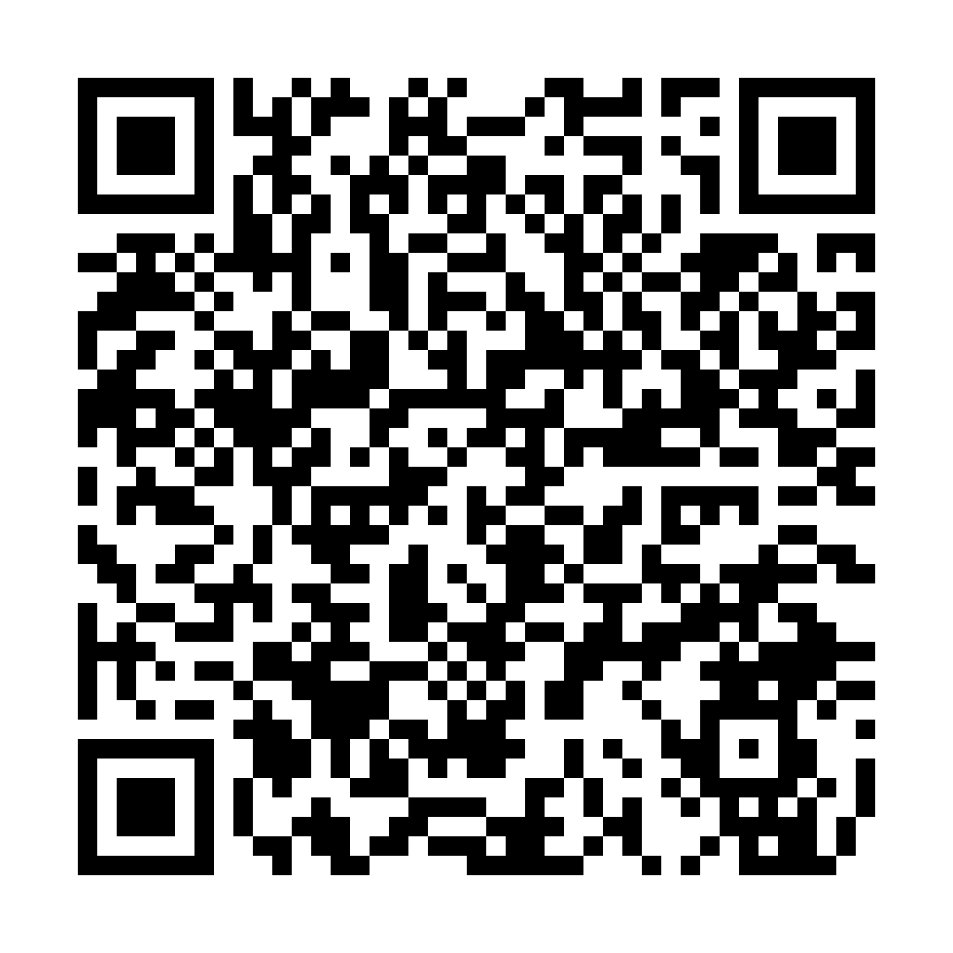
The Texas Legislature
Texas House of Representatives
Texas Senate
150 representatives
31 senators
One per district across Texas
Staggered 4-year terms
2-year terms
Lt. Governor
Elected every even year
Presiding officer, sets agenda, appoints committees
Speaker of the House
Committee chairs
Presiding officer, sets agenda, appoints committees
Appointed by Lt. Governor
Control which bills get hearings
Committee chairs
Two-thirds rule
Historically required to bring bills to floor
Appointed by Speaker of the House
Control which bills get hearings
Texas House of Representatives
AND Texas Senate
Session begins
Interim committees
January of odd-numbered years
Study issues between sessions

Slide 5
The Legislative Calendar
Interim
Regular Session
Special Sessions
Post-Session
Even-numbered years
Jan–June, odd years (140 days)
Called by Governor anytime
July–December, odd years
Legislature meets. Bills introduced, heard, voted on, and either passed or not.
Your advocacy is MOST impactful here.
Limited agenda, 30 days each.
Can address issues left from regular session.
Laws take effect (usually Sept 1).
Agencies implement.
Planning for next session begins.
Committees study issues and make recommendations to be considered in the next session.
Bills pre-filed.

Slide 6
How a Bill Becomes Law in Texas
1
2
3
4
5
6
Filed
Committee
Hearing
Floor Vote
Other
Chamber
Conference
(if needed)
Governor
Signs
Member introduces bill;
assigned to committee
Public testimony;
committee vote.
Originating chamber
debates & votes
Same process
repeated
Differences
reconciled
Becomes law
or is vetoed
⚠ Where bills die most often:
Committee — most bills never get a hearing. And even those that do get a hearing, often do not have the necessary votes to pass and never make it to a vote – TPEA works to get the support needed at each stage of a bill.
House Committee on Calendars — bills can be set but never scheduled for floor votes.
This is why building relationships with representatives that serve on committees impacting state employees
and retirees matters so much to TPEA.

Slide 7
Why This Matters to You
The legislature directly controls:
Your Salary
Your Benefits
The General Appropriations Act sets state spending and employee pay. Pay raises require legislative action. TPEA advocates for both across the board pay raises and agency specific.
Health insurance premiums, ERS contribution rates, and benefit plan structures are set by statute. ERS insurance and retirement fund contributions are set every 2 years in the General Appropriations Act.
Your Retirement
Your Workplace
ERS funding, 13 check, COLA increases, and retirement eligibility rules all require legislative approval.
Staffing levels, agency budgets, and operating conditions are determined by the Appropriations process.

Slide 8
TPEA Advocacy — Making a Difference
TPEA has advocated successfully on behalf of state employees and retirees for decades.
Examples of our work:
State Employee Pay Increases
Health Insurance Protections
TPEA has consistently advocated for across-the-board and targeted salary increases in every legislative session.
Fought to secure hundreds of millions of dollars to prevent premium increases that would reduce effective compensation for state workers.
ERS Funding
Workplace Rights
Advocated for adequate funding of employee retirement systems to maintain benefit levels.
Supported policies protecting state employee rights, working conditions, and due process.

Slide 9
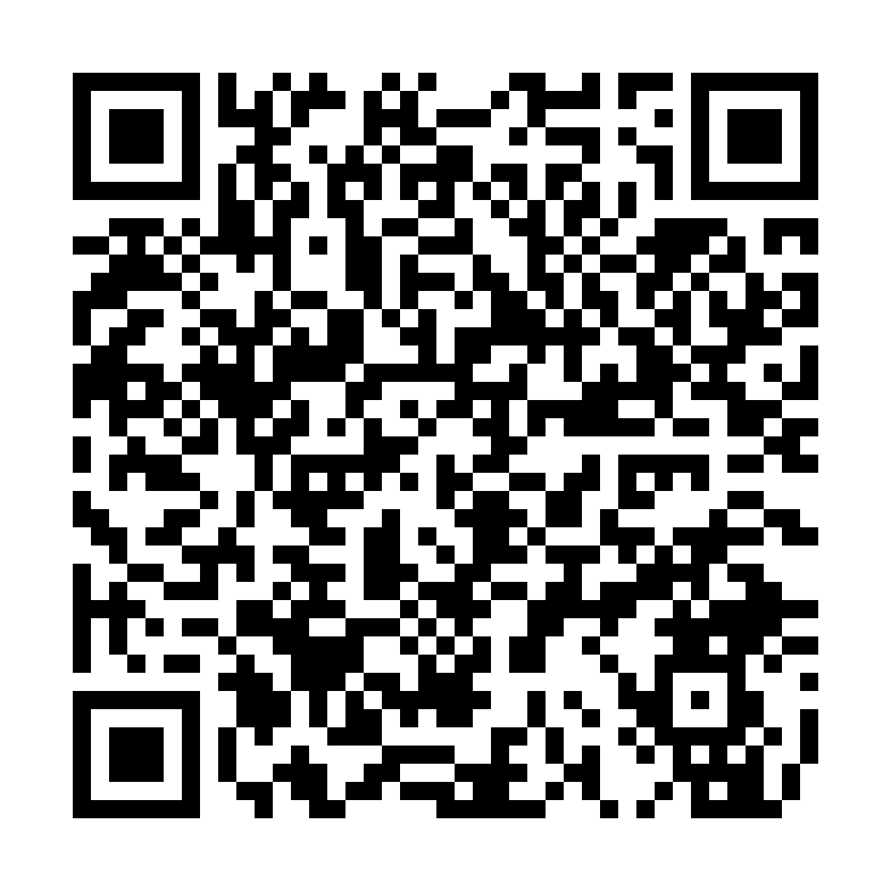
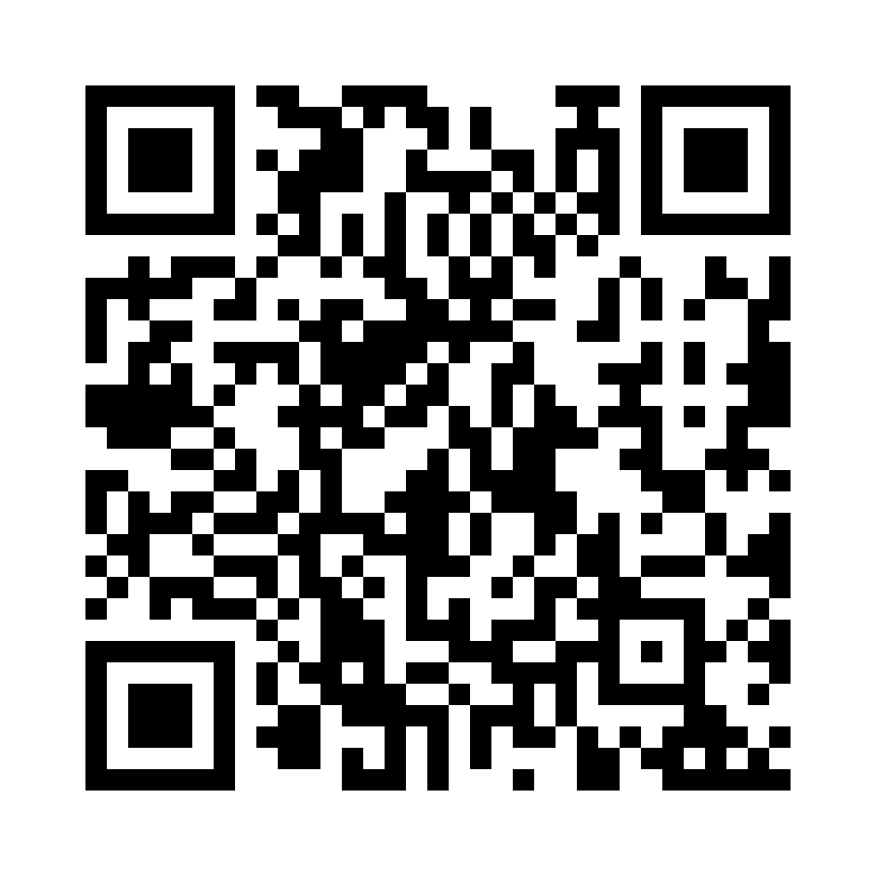
Your Role as an Advocate
✉
Contact your legislators
Email, call, or visit your State Representative and Senator.
Constituent voices matter — and are especially loud when they are amplified in community.
🗣
Testify at committee hearings
Public testimony is open to anyone. TPEA can help you prepare. Even written testimony counts.
📢
Get involved with TPEA
There's strength in numbers.
Become a member to add your voice and support our work.
🤝
Talk to colleagues
Be a TPEA ambassador. Help coworkers understand why legislative advocacy matters to every state employee.

Slide 10
Let's Recap
Call out your answers — then we'll confirm together.
Q1 What does the Texas Legislature directly control for you?
ANSWER Your salary, benefits, retirement, and workplace conditions
Q2 When is your voice the most impactful?
ANSWER During the regular session (Jan–June, odd years), when bills are heard and voted on
Q3 Why does TPEA build relationships with legislators?
ANSWER Most bills die in committee — relationships help get state-employee/retiree priorities heard and scheduled
Q4 What's one way you can personally advocate?
ANSWER Contact legislators, testify, get involved with TPEA, or talk to colleagues

Slide 11
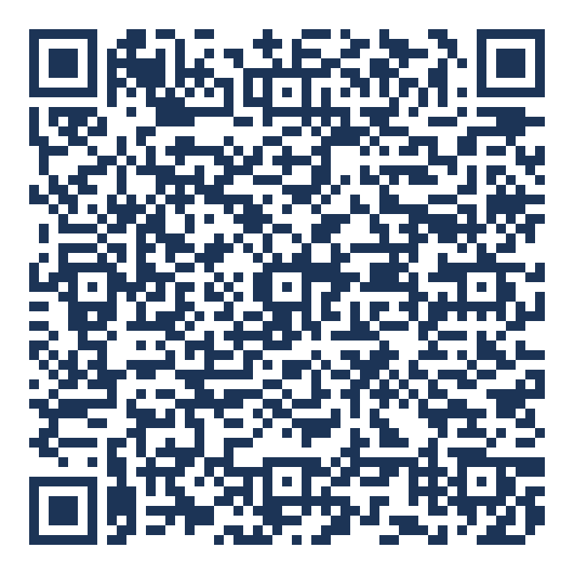
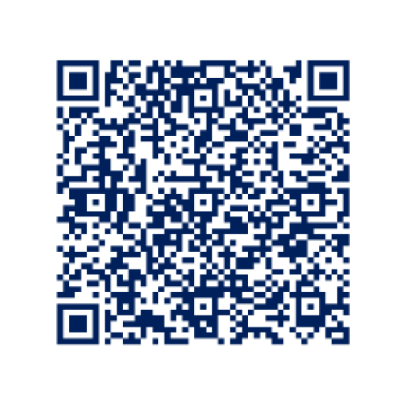
Bring This Training to Your Team
TPEA presents Advocacy 101 to agencies and organizations across Texas.
Scan to book a session for your group — or to get our free legislative updates.
Book a Training
Free Legislative Updates
Email Bianca Rawlings
brawlings@tpea.org
Scan to join our
free e-newsletter

Slide 12
BRINGING IT HOME
Great work — you now understand how advocacy works in Texas.
Questions or thoughts?
Thank you for your time.
Bianca Rawlings · Director of Membership & Development · brawlings@tpea.org

