Slide 1



Lead From Here
CHOOSING LEADERSHIP WHEREVER YOU ARE
2026 TSABAA SUMMER CONFERENCE
Bre Bailey
Leadership Development Unit
Texas Department of Public Safety

Slide 2
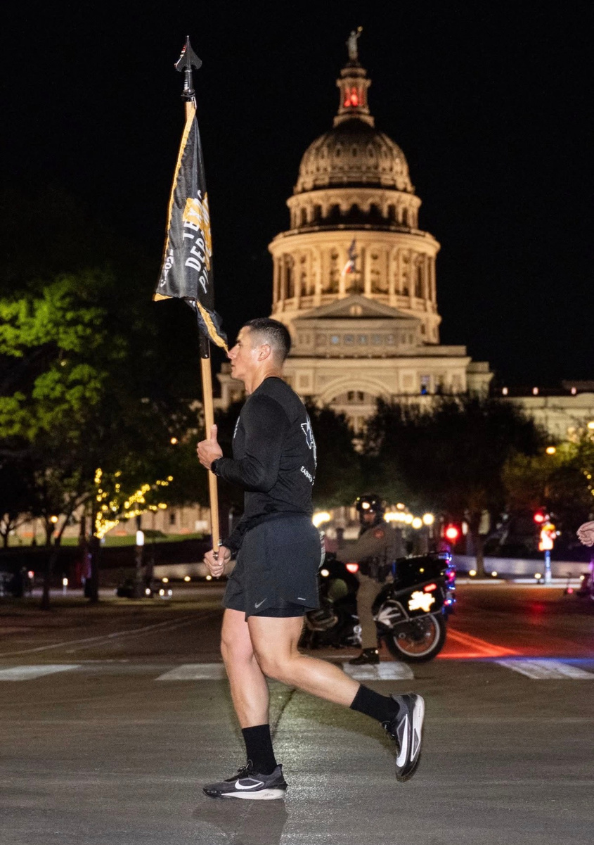
Today's Goal
By the time we're done, you'll walk out with:
  A definition of leadership that doesn't depend on a title
  Your own values, named and owned
  The start of your leadership philosophy
  An honest look at how different generations experience the same workplace
  A plan of action
Notes:
11

Slide 3
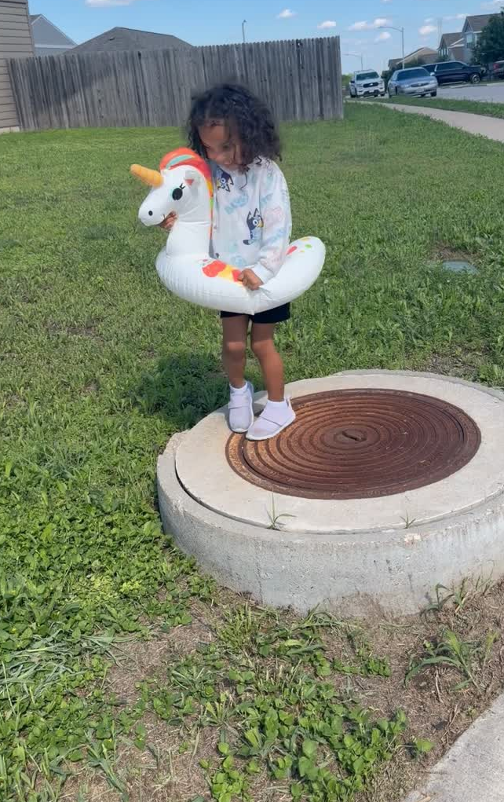
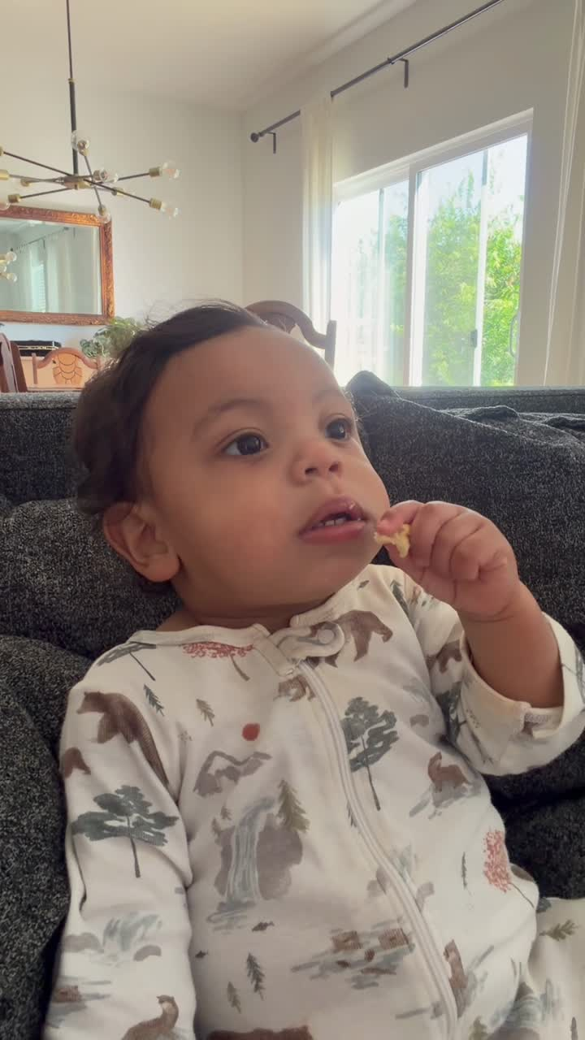
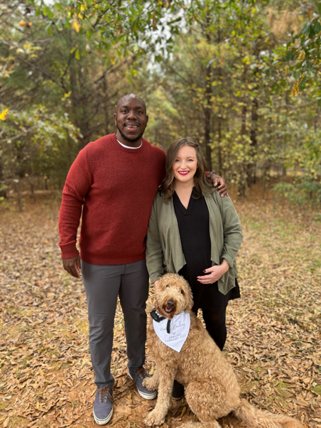
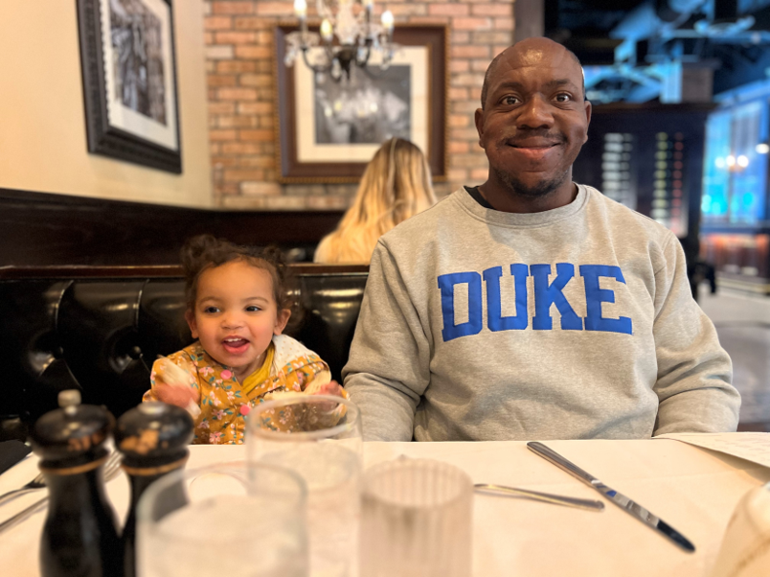

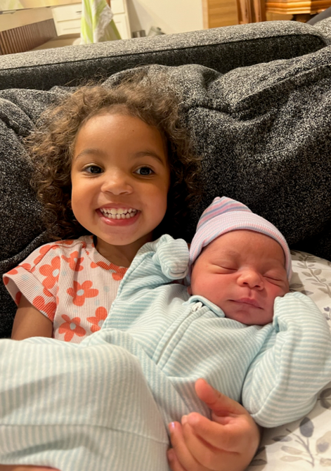
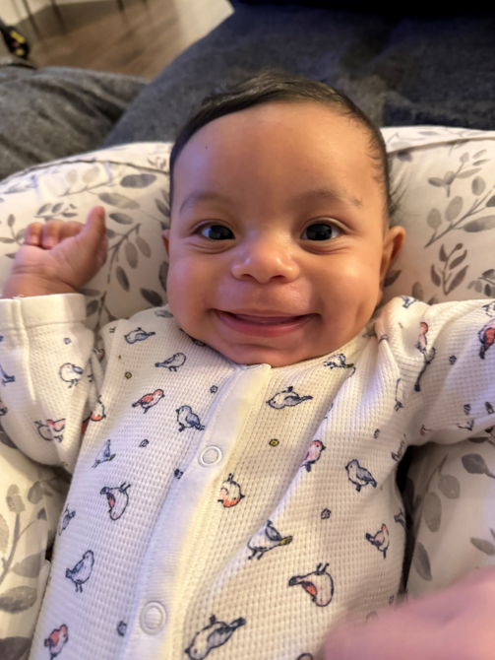



Slide 4




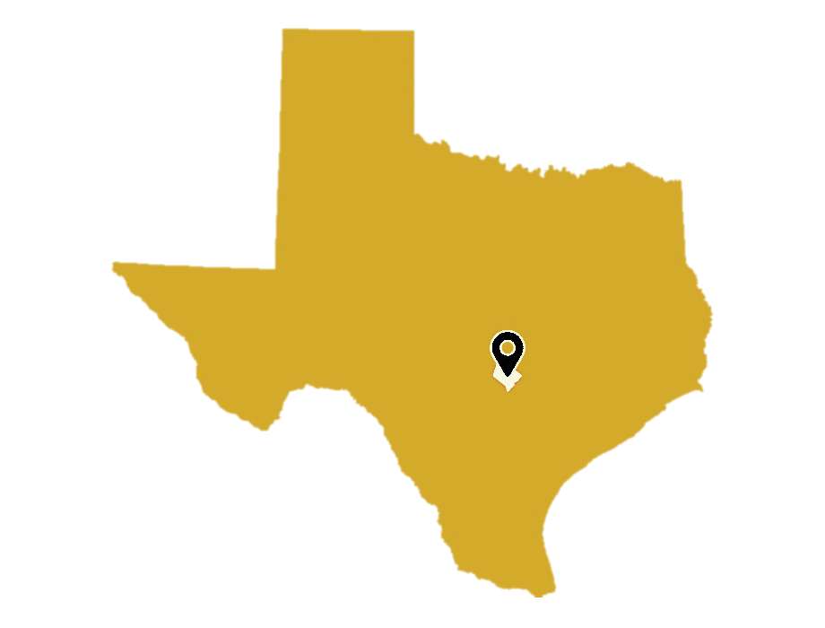
© Property of the Texas Department of Public Safety - Leadership Development Unit
Leadership Development Unit
13,000
  MODEL
  RESOURCE
  EMPOWER
  CONNECT
  LEAD
Alii Semper
“Always For Others”

Slide 5
© Property of the Texas Department of Public Safety - Leadership Development Unit
Defining “Leadership”
WHAT IS IT?
Notes:
What think of when hear…leadership?
Seen demonstrated? Good/Bad/Healthy/Unhealthy
What is it?
4

Slide 6
© Property of the Texas Department of Public Safety - Leadership Development Unit
Texas DPS Definition:
The ability to motivate and inspire others; to develop and mentor others; to gain the respect, confidence, and loyalty of others; to articulate a vision, to give guidance and to direct others in accomplishing goals.
Source: Texas DPS, HR-110

Slide 7

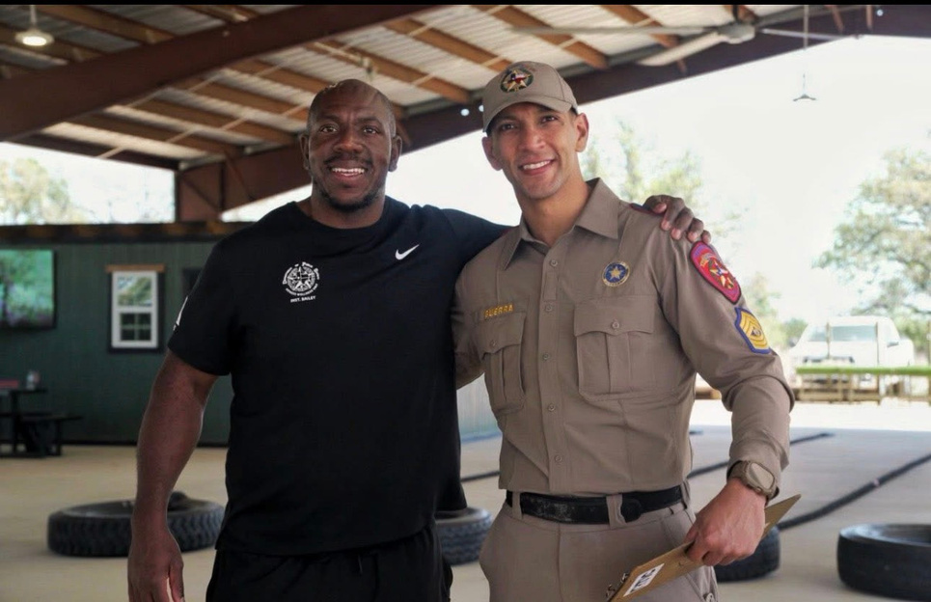
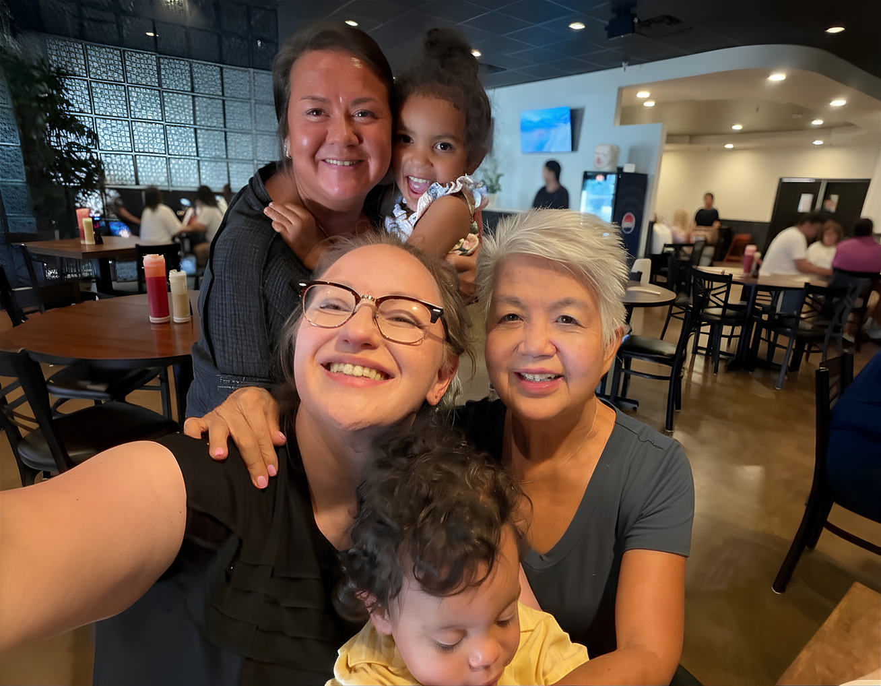
Think of someone who led you well
  A coworker who always made time to help.
  A teacher who made everyone feel welcome.
  Someone who believed in you before you believed in yourself.
  Someone who made you feel important.

Slide 8
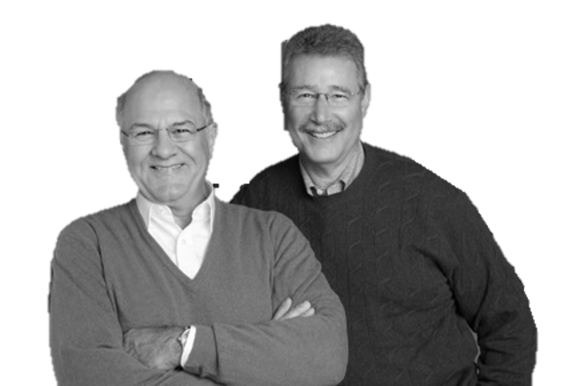
“Leadership is a relationship between those who aspire to lead and those who choose to follow.”
— James Kouzes & Barry Posner, The Leadership Challenge

Slide 9
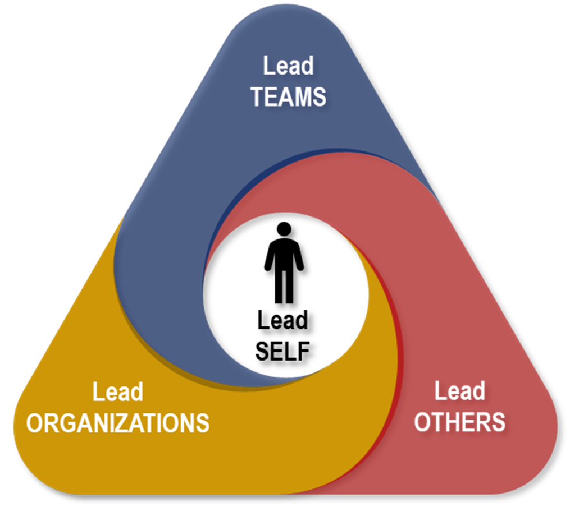
© Property of the Texas Department of Public Safety - Leadership Development Unit
Lead Self
Lead Others
Lead Teams
4 Leadership Practices
Lead Organizations
Leadership is an ongoing and dynamic reality.

Slide 10
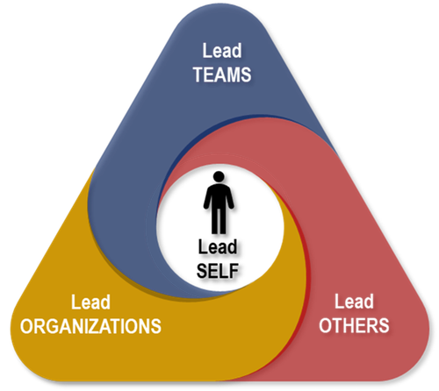
© Property of the Texas Department of Public Safety - Leadership Development Unit
WHY:
We believe…
- Everything rises and falls on leadership.
- Everyone can lead in their context.
- Everyone wins when a leader gets better.
- There are no shortages of opportunities to lead.
- Leadership is a lifelong journey.

Slide 11
“I’m Not a Leader. I Don’t Have the Title.”
  Leadership is a choice, not just a title.
  Everyone leads somewhere.
  Influence starts with how we show up.
  Small actions shape culture.
  Leadership grows through practice.

Slide 12
“Leadership isn't the private reserve of a few charismatic men and women. It's a process ordinary people use when they're bringing forth the best from themselves and others.”
— James Kouzes & Barry Posner, The Truth About Leadership

Slide 13
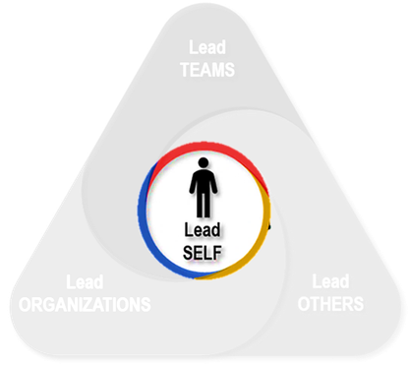
© Property of the Texas Department of Public Safety - Leadership Development Unit
Leading Self…First!
  Before we lead people… We have to lead ourselves.
  Self-leadership isn’t perfection. It’s intentionality
  It’s choosing how you respond.
  It’s choosing curiosity instead of assumptions.
  It’s choosing credibility.

Slide 14
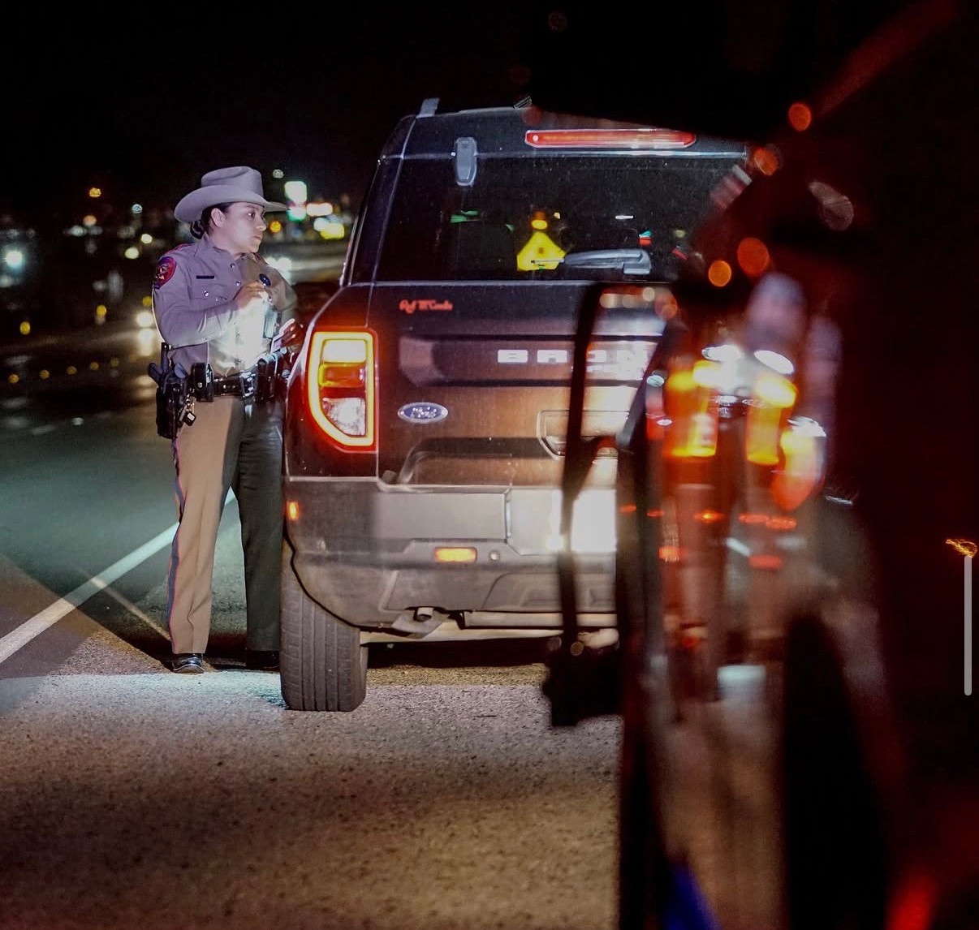
© Property of the Texas Department of Public Safety - Leadership Development Unit
Values
  Values are the beliefs that quietly drive your decisions — especially under pressure, when no one's watching, or when it's inconvenient to act on them.
  They're not words on a wall. They're what you actually protect, even when it costs you something.
  Knowing yours is the foundation for leading anyone else.

Slide 15
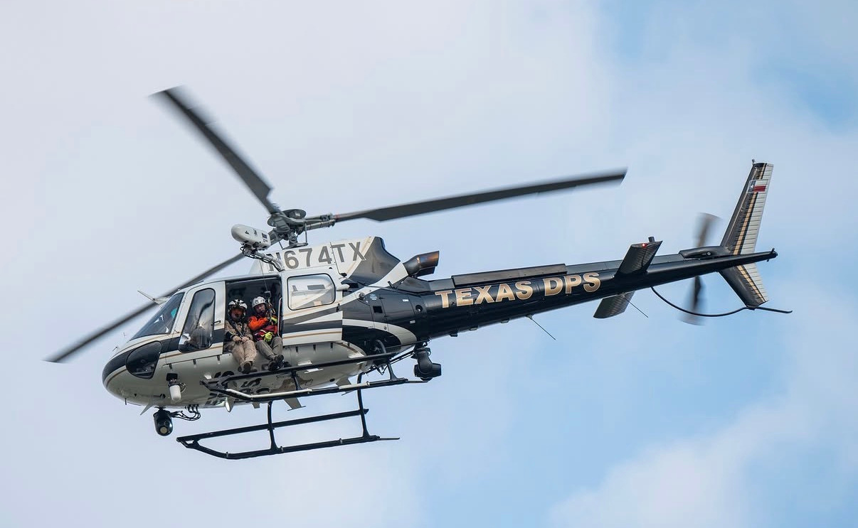
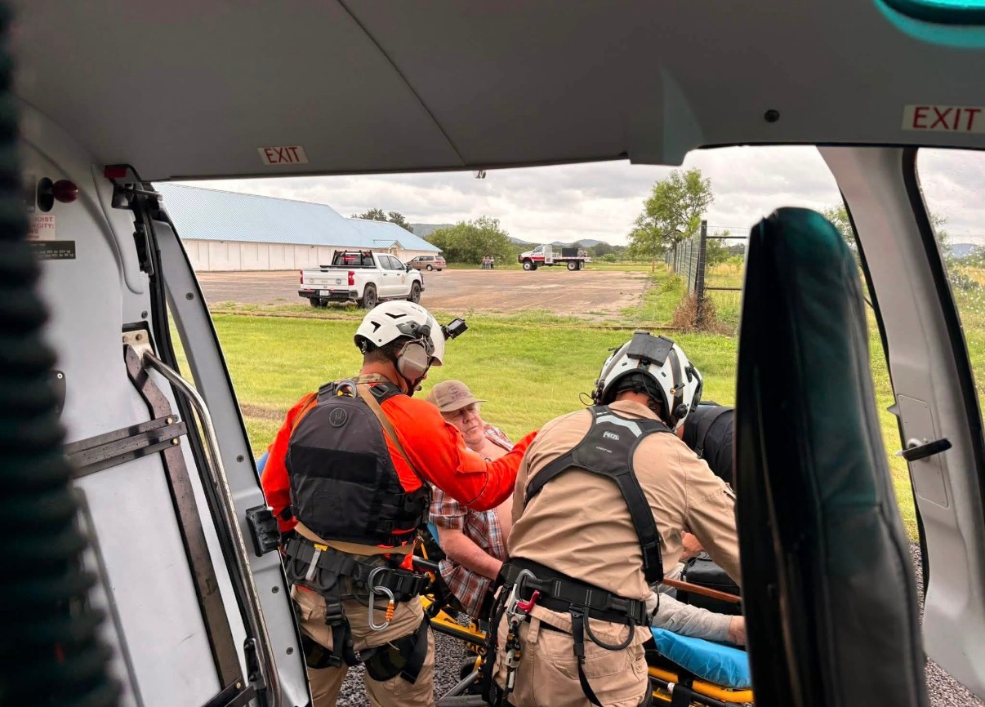
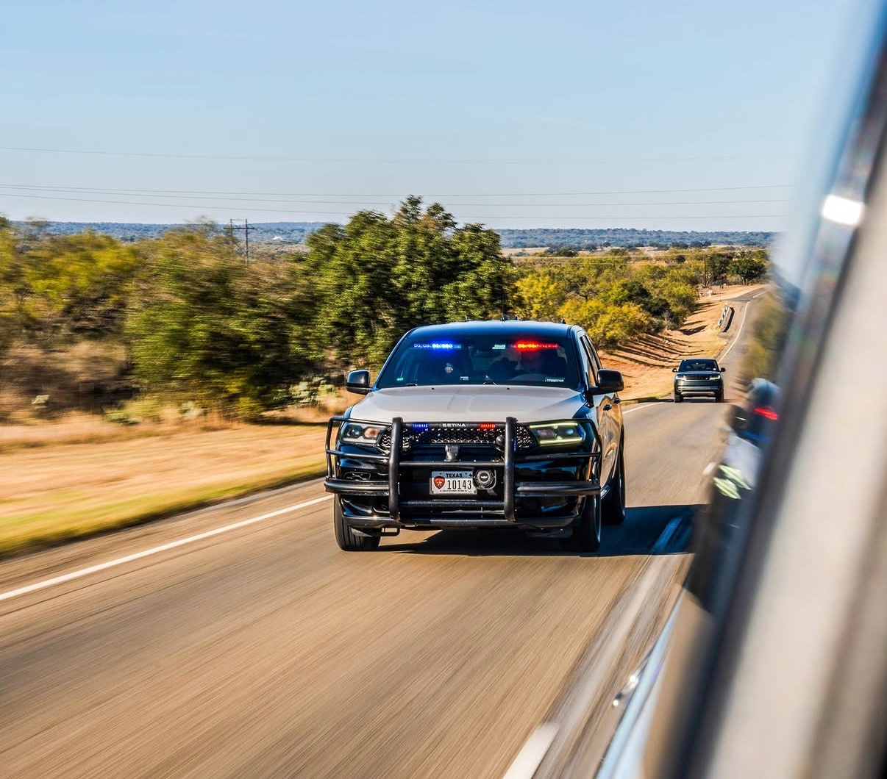
© Property of the Texas Department of Public Safety - Leadership Development Unit
Values Exercise
  Identify your top three values.
    If one of yours is not listed, then feel free to write it in.
  Define each of your values.
Top 3 Values:
1.
2.
3.
Kindness - Doing the right thing with empathy, especially when it's difficult.
Communication - Building understanding by listening deeply, speaking with intention, and adapting to others.
Curiosity - Approaching others with humility, believing there's always more to learn.

Slide 16
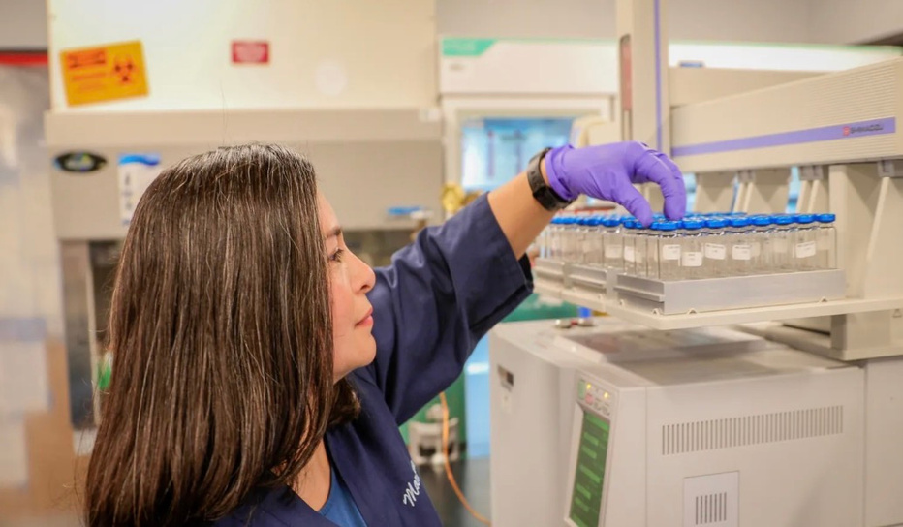
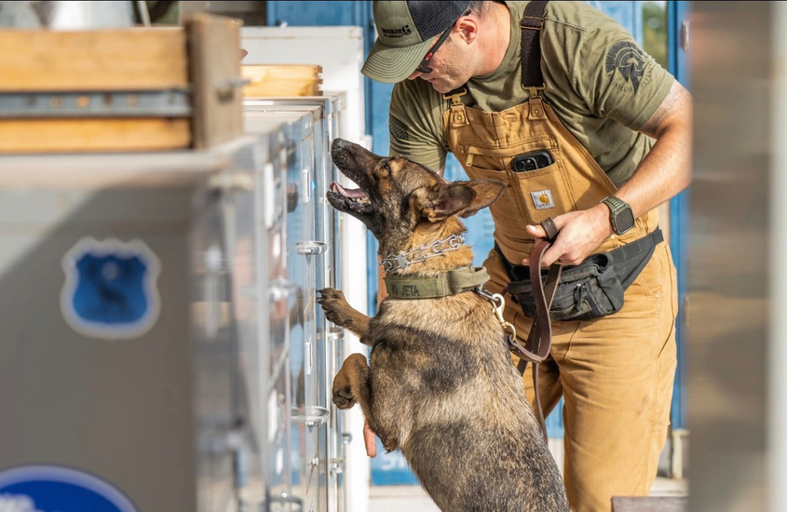
© Property of the Texas Department of Public Safety - Leadership Development Unit
From Values to Commitment
  Your values are the non-negotiables.
  What you believe about leading people is what you build from them.
  And a commitment is what you actually do about it.
  Take each of your values and translate each into one observable behavior
    “I am”
    “I will”
    “I choose”
    “I believe”

Slide 17
© Property of the Texas Department of Public Safety - Leadership Development Unit
CHRIS HUTCHINSON, DIRECTOR PROGRAM DEVELOPMENT, HARRISON COLLEGE
  I believe in being a conduit of greatness for those I care about, personally and professionally.
  I believe my most significant accomplishment is to make others around me great — and my most significant action is yet to come.
  I believe it's okay to be frustrated, as long as you love more.
  I believe laughter is, in fact, the best medicine.
Your turn: I believe ___________.

Slide 18
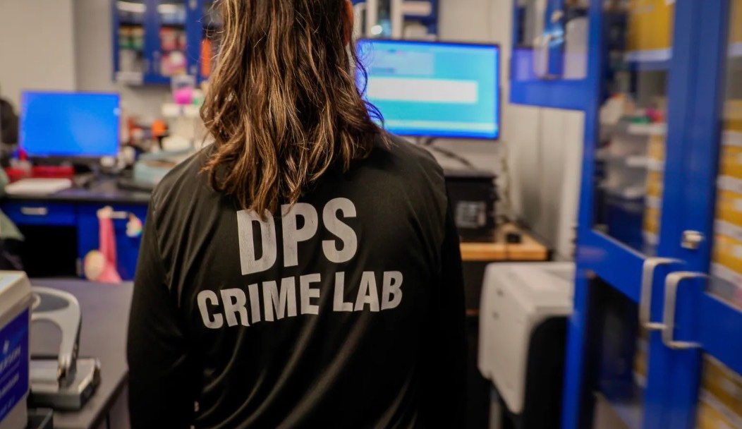
Break
We'll see you back in a few minutes.

Slide 19
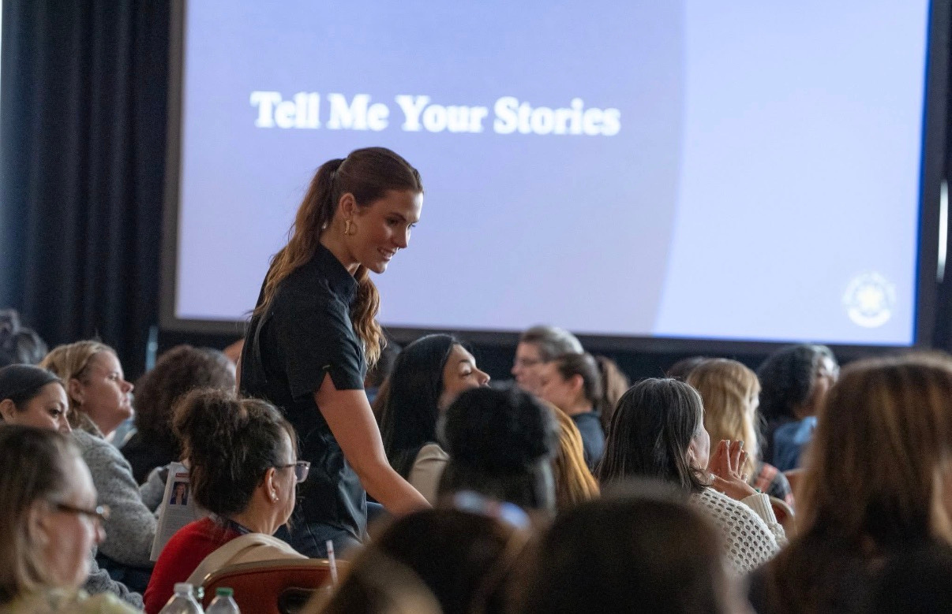
Welcome Back
Let's pick up where we left off.

Slide 20
© Property of the Texas Department of Public Safety - Leadership Development Unit
Where We’ve Been
  Fear of failure kept people quiet instead of curious.
    The "fail fast" / growth mindset movement and Agile methodology built failure into the process itself, rather than treating it as something to avoid.
  Low psychological safety meant good ideas went unsaid.
    Google's Project Aristotle (2015) found psychological safety was the single biggest predictor of team performance — not talent, not tenure.
  Competition got rewarded over cooperation.
    The rise of coaching-style leadership and cross-functional team structures replaced siloed, competitive department structures.
Notes:
11

Slide 21
© Property of the Texas Department of Public Safety - Leadership Development Unit
Where We’ve Been
  Hierarchy told us only titles were allowed to lead.
    The military's "mission command" doctrine and the "leadership at every level" model.
  Leadership was treated as an innate trait, not a trainable skill.
    Employees trust "my employer" more than any other institution measured — 78%, the highest score in the study (Edelman Trust Barometer, 2026).
  Burnout was worn as a badge of honor.
    The World Health Organization formally classified burnout as an occupational phenomenon in 2019 — wellbeing moved from an HR afterthought to a real leadership responsibility.
Notes:
11

Slide 22
© Property of the Texas Department of Public Safety - Leadership Development Unit
Where We Are
  Engagement is at its lowest point in years — and it's hitting leaders hardest.
    Global engagement fell to 20% in 2025, the lowest since 2020. Manager engagement dropped even faster — from 31% to 22% — and leaders report measurably more stress and loneliness than the people they lead (Gallup, 2026).
  Trust has become the new currency.
    Employees trust “my employer” more than any other institution measured — 78%, the highest score in the study (Edelman Trust Barometer, 2026).
  Belonging just lost its top spot — to something leaders can actually control.
    Belonging led engagement for nine straight years. In 2025 it fell to last place, replaced by how well leaders handle change (Perceptyx, 2026).
Notes:
11

Slide 23
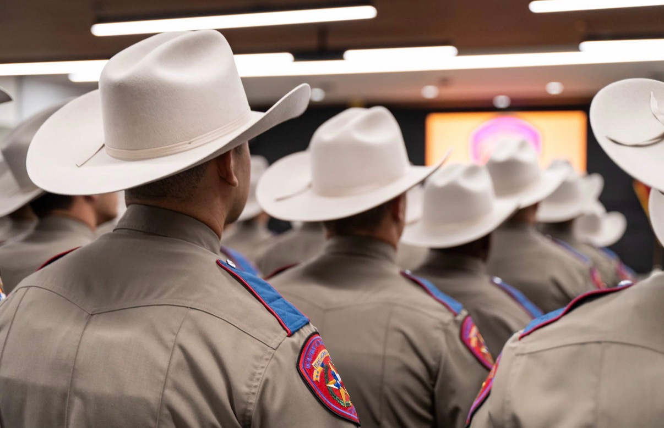
© Property of the Texas Department of Public Safety - Leadership Development Unit
Where We Are
  Leading is shifting from directing to developing.
    The coaching industry grew 87% in two years as command-and-control management became obsolete (ICF, 2025; Deloitte, 2025).
  For the first time in history, five generations are working side by side.
    Gen X (34.8%) and Millennials (38.6%) now make up nearly three-quarters of the workforce, while Boomers have dropped to 18.6% (Stand Together / World Economic Forum, 2025–2026).
Notes:
11

Slide 24
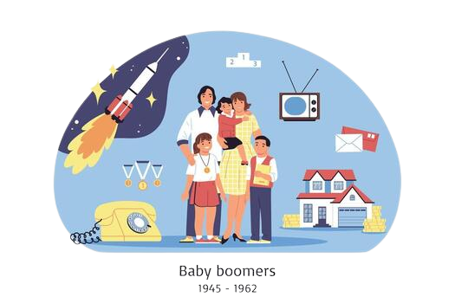
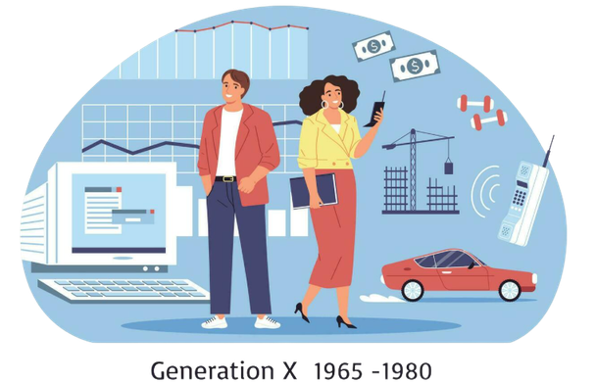
© Property of the Texas Department of Public Safety - Leadership Development Unit
Connect Across Generations
Baby Boomers
1946–1964
Population: ~71M
Shaped by:
  Loyalty
  Face-to-face relationships
  Advancement through commitment
Strengths:
  Institutional knowledge
  Dedication
  Mentorship
Connect by:
  Ask for their context and history.
  Make time to meet face-to-face
Gen X
1965–1980
Population: ~65M
Shaped by:
  Independence
  Skepticism of structure
  Self-reliance
Strengths:
  Adaptability
  Resourcefulness
  Steady under pressure
Connect by:
  Give ownership.
  Skip the micromanaging.

Slide 25

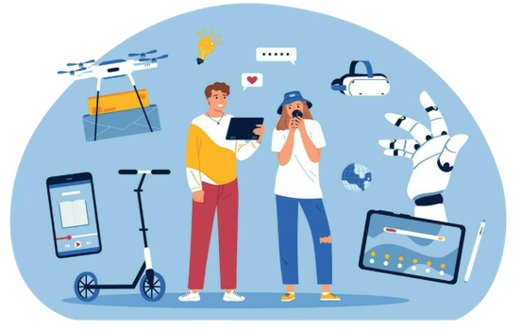
© Property of the Texas Department of Public Safety - Leadership Development Unit
Connect Across Generations
Millennials
1981–1996
Population: ~72M
Shaped by:
  Rapid tech change
  Access to information
Strengths:
  Collaboration
  Achievement-Oriented
  Civic- and Open-Minded
Connect by:
  Explain the why.
  Offer a real growth path.
Gen Z
1997–2012
Population: ~68M
Shaped by:
  Digital-native childhood
  Social awareness
  Uncertain entry into adulthood
Strengths:
  Adaptability
  Digital fluency
  Global Minded
Connect by:
  Communicate often.
  Be transparent about process.

Slide 26
© Property of the Texas Department of Public Safety - Leadership Development Unit
Where We’re Going
  From Hero Leaders → Leadership Networks
    No one person has to have all the answers — the best teams share the load of leading.
  From Values on the Wall → Values in Action
    A poster doesn't build trust. What you do when no one's watching does.
  From Leading Change → Building Capacity to Change
    Change isn't a single event anymore — it's the environment. The goal is resilience, not recovery.
Notes:
11

Slide 27
© Property of the Texas Department of Public Safety - Leadership Development Unit
Where We’re Going
  From Psychological Safety → Psychological Ownership
    Safety says "you won't be punished." Ownership says "this is yours." Both matter — but ownership is what people show up for.
  From Fixed Expertise → Continuous Learning
    What got you here won't be enough to get you there. The learning never stops — for any of us.
  From Efficiency → Humanity
    Technology will keep making us faster. It won't make us kinder, wiser, or more connected. That's still on us.
Notes:
11

Slide 28

© Property of the Texas Department of Public Safety - Leadership Development Unit
How This Works
  I'll read a statement. Vote with your arms, right from your seat.
    Hand raised high = strongly agree.
    Halfway up = agree.
    Down = disagree.
    Arms crossed = strongly disagree.
  No wrong answers — just what's true for you.

Slide 29
“I do my best work when feedback comes in the moment, not just at a scheduled review.”
Notes:
11

Slide 30
“I'd rather have a leader I trust than a job that pays more.”
Notes:
11

Slide 31
“I need to understand the ‘why’ behind a decision before I can really commit to it.”
Notes:
11

Slide 32
“I'd rather have a stable, predictable job than an exciting but uncertain one.”
Notes:
11

Slide 33
“A face-to-face conversation gets better results than a written message, for anything that actually matters.”
Notes:
11

Slide 34
“A leader's title should determine how much say they get in a decision.”
Notes:
11

Slide 35
© Property of the Texas Department of Public Safety - Leadership Development Unit
What We Learned
  Feedback timing is personal — but everyone wants to feel like they're improving.
  Trust outweighs a paycheck more often than we'd guess.
  We commit harder when we understand the why.
  Comfort with uncertainty isn't a generational trait — it's a personal one.
  How people connect best isn't one-size-fits-all.
  Influence isn't handed out along with a title.
Notes:
Closing line (say this live, not on the slide): “This is what's already shifting — from where we've been to where we're going. And it shows up in the person sitting next to you.”
Deliver this after walking through the six bullets. It ties the activity back to the Been/Are/Going arc and hands off into the Three Challenges section.

Slide 36

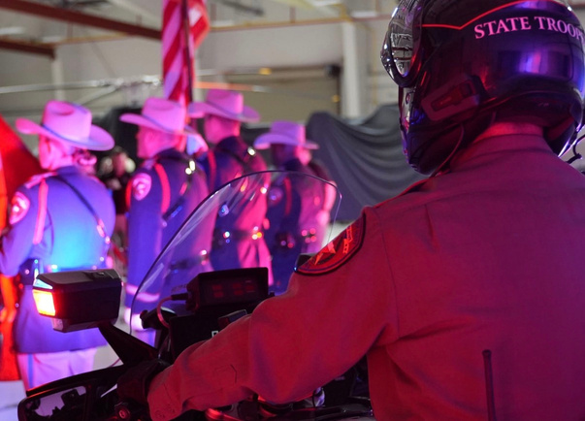
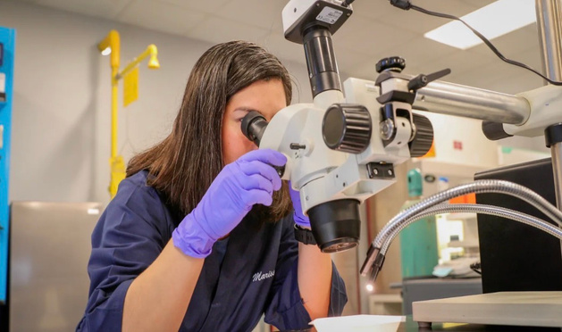
© Property of the Texas Department of Public Safety - Leadership Development Unit
Three Challenges from Here
Notes:
The best leaders create environments where people feel seen, supported, and capable — these are human skills, not management skills.
Care enough to understand people.
Connect before you correct.
Build trust through consistency.
40

Slide 37
© Property of the Texas Department of Public Safety - Leadership Development Unit
Challenge 1: Become a Lifelong Student
  Choose curiosity over certainty
    Ask more questions, seek different perspectives, and remain open to changing your mind.
  Make learning a daily habit
    Growth happens through consistent, intentional learning - not occasional inspiration.
  Learn from people with different experiences
    View every conversation as an opportunity to gain a new perspective.
  Apply one new idea every week
    Turn what you learn into action before the excitement fades.
Notes:
11

Slide 38
© Property of the Texas Department of Public Safety - Leadership Development Unit
Your Next Classroom is Already in Your Pocket
Knowledge has never been more accessible.
  Books & Libraries: Borrow books, ebooks, and audiobooks for free through your local library.
  Podcasts & Video: Turn your commute, workouts, or household chores into learning opportunities.
  Online Learning: Explore affordable courses through platforms like LinkedIn Learning, Coursera, edX, or Udemy.
  AI as a Learning Partner: Turn prompts into activities to put what you learn into practice.
Notes:
11

Slide 39
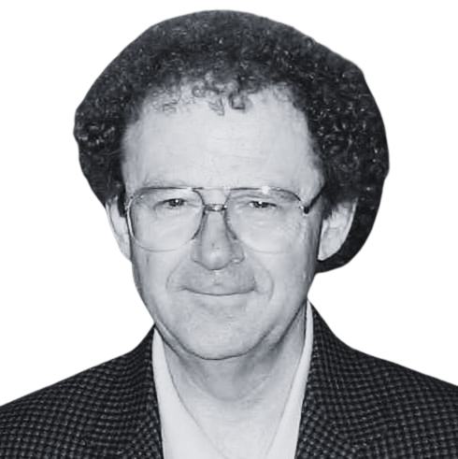
“The capacity to learn is a gift; the ability to learn is a skill; the willingness to learn is a choice.”
— Brian Herbert

Slide 40
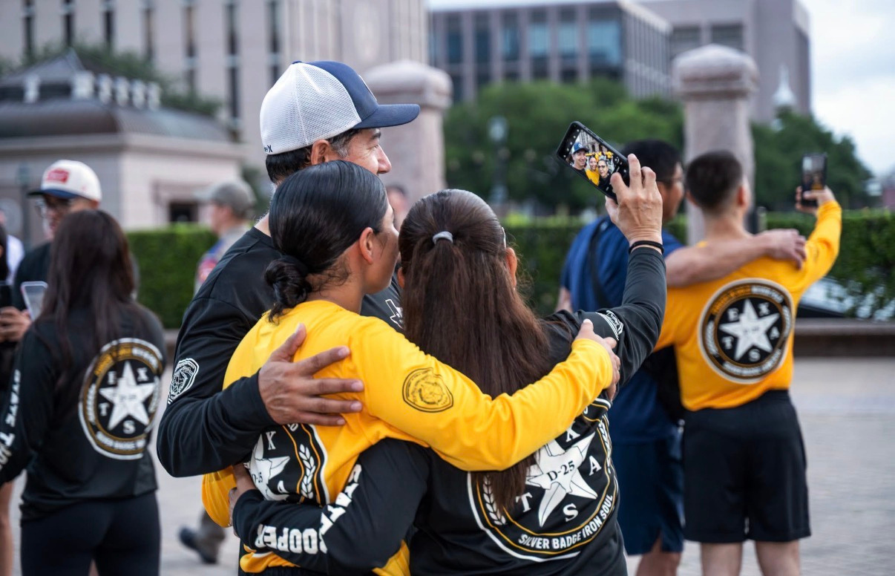
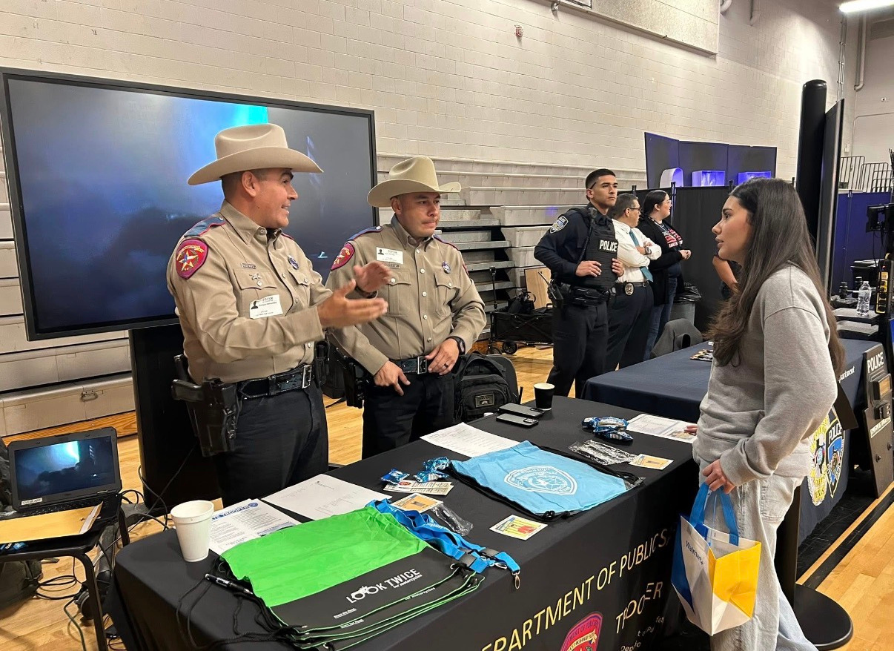
© Property of the Texas Department of Public Safety - Leadership Development Unit
Challenge 2: Listen to Connect
Before you can lead others, get honest about your own listening habits.
Reflect:
  Did I listen to understand, or did I listen to reply?
  What assumption did I walk into that conversation with?
  Whose voice did I not hear today that I should have?
Notes:
11

Slide 41
© Property of the Texas Department of Public Safety - Leadership Development Unit
Listen to Connect
  Listen to the story behind the statement.
    Every comment has context. What experiences, values, concerns, or motivations are shaping what someone is saying?
  Listen for what energizes people.
    Pay attention to what sparks excitement, curiosity, or confidence - these moments often reveal strengths and potential.
  Listen for what you don’t expect.
    Challenge assumptions about someone’s passions, motivations, or experiences.
  Listen for what people need from you.
    Not every conversation needs an answer. Sometimes people need support, encouragement, or simply to know they’ve been heard.
Notes:
11

Slide 42
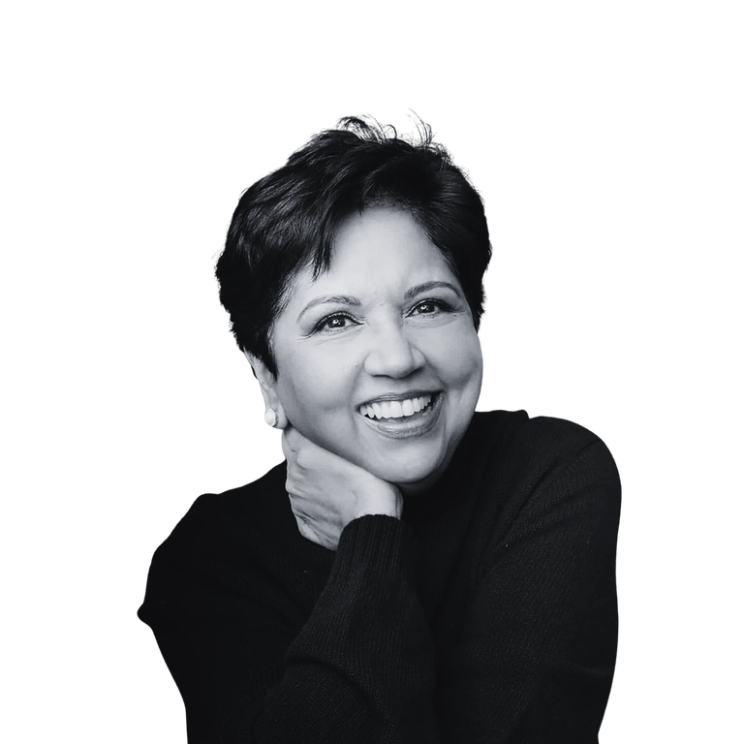
“The most important part of persuasion is listening.”
— Indra Nooyi, former Chairman & CEO, PepsiCo

Slide 43
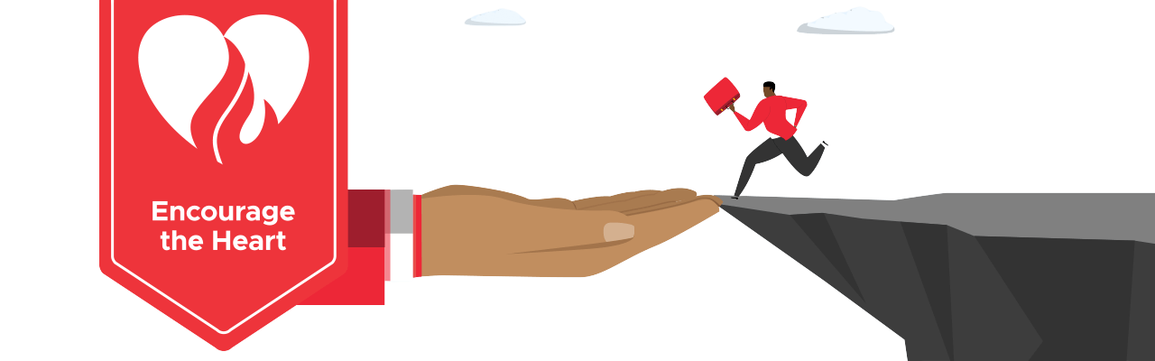
© Property of the Texas Department of Public Safety - Leadership Development Unit
Challenge 3: Encourage the Heart
  Kouzes & Posner's Five Practices of Exemplary Leadership.
  Recognition doesn't have to come from a manager to count.
    Peer-to-peer appreciation makes people 21x more likely to be personally invested in their organization's success (O.C. Tanner, 2026).
  Encouragement isn't one-size-fits-all
    People have real preferences for how they want to be appreciated — not just a kudos post or public shoutout (Chapman & White, 2019).
Photo Source: https://www.leadershipchallenge.com/blog/encourage-the-heart-to-build-community-and-achieve-results
Notes:
11

Slide 44
© Property of the Texas Department of Public Safety - Leadership Development Unit
Ways to Motivate Through Encouragement
Adapted from Kouzes & Posner's Encouraging the Heart framework
  Being asked for your expertise - someone comes to you because they trust your judgment, not because they have to.
  Being trusted with something bigger - a stretch assignment, more ownership, less oversight.
  Being included before a decision, not informed after - your voice shaped the outcome, not just heard it.
  Being asked to teach or mentor someone else - a sign your growth itself is visible and valued.
Notes:
11

Slide 45
© Property of the Texas Department of Public Safety - Leadership Development Unit
Ways to Motivate Through Encouragement
Adapted from Kouzes & Posner's Encouraging the Heart framework
  Getting credit when it counts — your name stays attached to the work as it moves up the chain.
  Having your workload protected — someone shields your time without you having to ask.
  A team celebration - public, shared, and about the group’s win, not just yours.
  A thank you treat - something small, but it says someone was thinking about you specifically.
Notes:
11

Slide 46
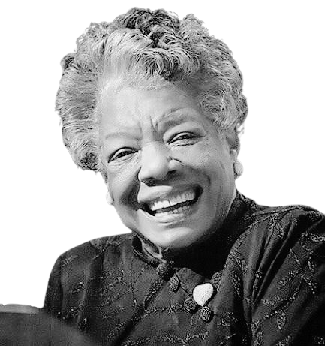
“A leader sees greatness in other people. He nor she can be much of a leader if all she sees is herself.”
— Dr. Maya Angelou

Slide 47
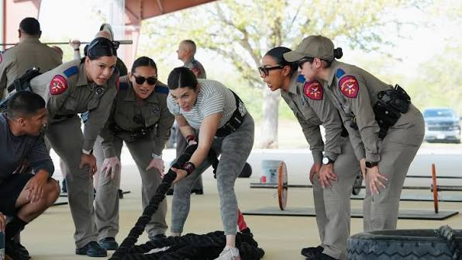
© Property of the Texas Department of Public Safety - Leadership Development Unit
THREE CHALLENGES
Recap
Become a lifelong student.
Listen to connect.
Encourage the Heart.
Small actions. Lasting influence.
Notes:
11

Slide 48

“Leadership is about making others better as a result of your presence and making sure that impact lasts in your absence.”
— Sheryl Sandberg, Lean In

Slide 49

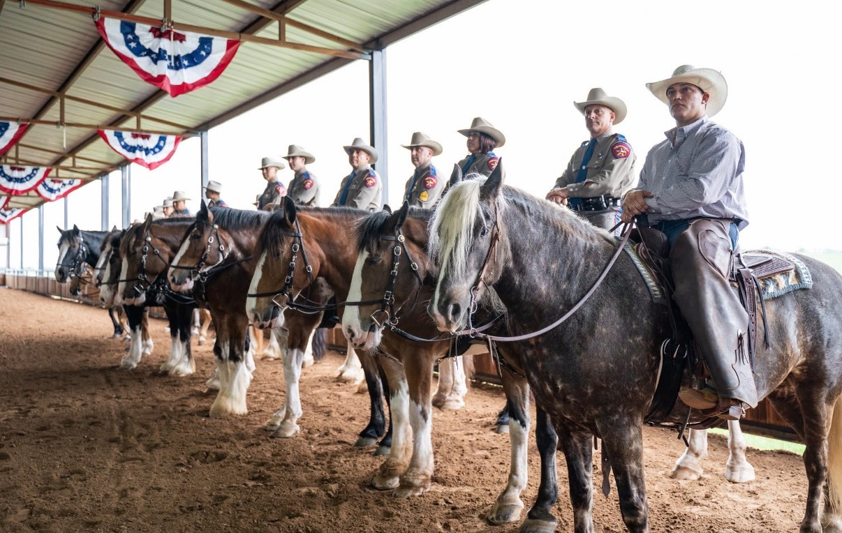
Thank You
THANK YOU FOR LEADING OTHERS.

Slide 50
© Property of the Texas Department of Public Safety - Leadership Development Unit
References:
  Brown, B. (2018). Dare to lead: Brave work. Tough conversations. Whole hearts. Random House.
  Chapman, G., & White, P. (2019). The 5 languages of appreciation in the workplace: Empowering organizations by encouraging people (2nd ed.). Northfield Publishing.
  Deloitte. (2025). 2025 global human capital trends: Turning tensions into triumphs. Deloitte Insights.
  Dweck, C. S. (2006). Mindset: The new psychology of success. Random House.
  Edelman. (2026). 2026 Edelman Trust Barometer global report. https://www.edelman.com/trust/2026/trust-barometer
  Edmondson, A. C. (1999). Psychological safety and learning behavior in work teams. Administrative Science Quarterly, 44(2), 350–383. https://doi.org/10.2307/2666999
  Gallup. (2026). State of the global workplace: 2026 report. https://www.gallup.com/workplace/349484/state-of-the-global-workplace.aspx
  Google re:Work. (n.d.). Guide: Understand team effectiveness. https://rework.withgoogle.com/intl/en/guides/understand-team-effectiveness
  International Coaching Federation. (2025). 2025 ICF global coaching study. https://coachingfederation.org/resources/research/global-coaching-study/
  Kouzes, J. M., & Posner, B. Z. (2010). The truth about leadership: The no-fads, heart-of-the-matter facts you need to know. Jossey-Bass.
  Kouzes, J. M., & Posner, B. Z. (2017). The leadership challenge: How to make extraordinary things happen in organizations (6th ed.). Wiley.
  Kouzes, J. M., & Posner, B. Z. (n.d.). The Leadership Practices Inventory (LPI). The Leadership Challenge, A Wiley Brand. https://www.leadershipchallenge.com
  O.C. Tanner Institute. (2026). The state of employee recognition 2026 report. O.C. Tanner. https://www.octanner.com/press/oc-tanner-releases-the-state-of-employee-recognition-2026-report-revealing-how-recognition-builds-high-performing-teams
  Perceptyx. (2026). Employee experience trends: What the data says about 2026. https://blog.perceptyx.com/employee-experience-trends-what-the-data-says-about-2026
  Sandberg, S. (2013). Lean in: Women, work, and the will to lead. Knopf.
  Stand Together. (2025, December 12). Five generations now work together — here's what that means. https://standtogether.org/stories/future-of-work/why-generational-differences-in-the-workplace-are-an-opportunity
  World Health Organization. (2019, May 28). Burn-out an “occupational phenomenon”: International Classification of Diseases. https://www.who.int/news/item/28-05-2019-burn-out-an-occupational-phenomenon-international-classification-of-diseases
Notes:
11

Slide 51
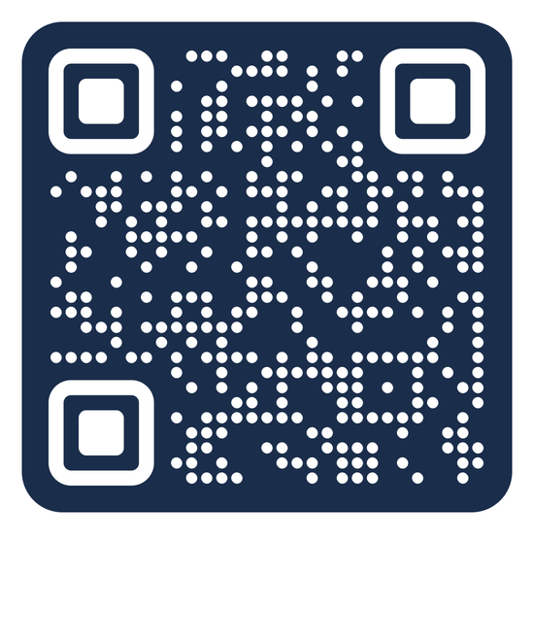
Bre Bailey
737-465-3708
BreAnna.Bailey@dps.texas.gov
Leadership@dps.texas.gov
SCAN ME

