Slide 1
Sleight of Speech
Secrets for Effective Communication
Rudy Reynoso

Slide 2


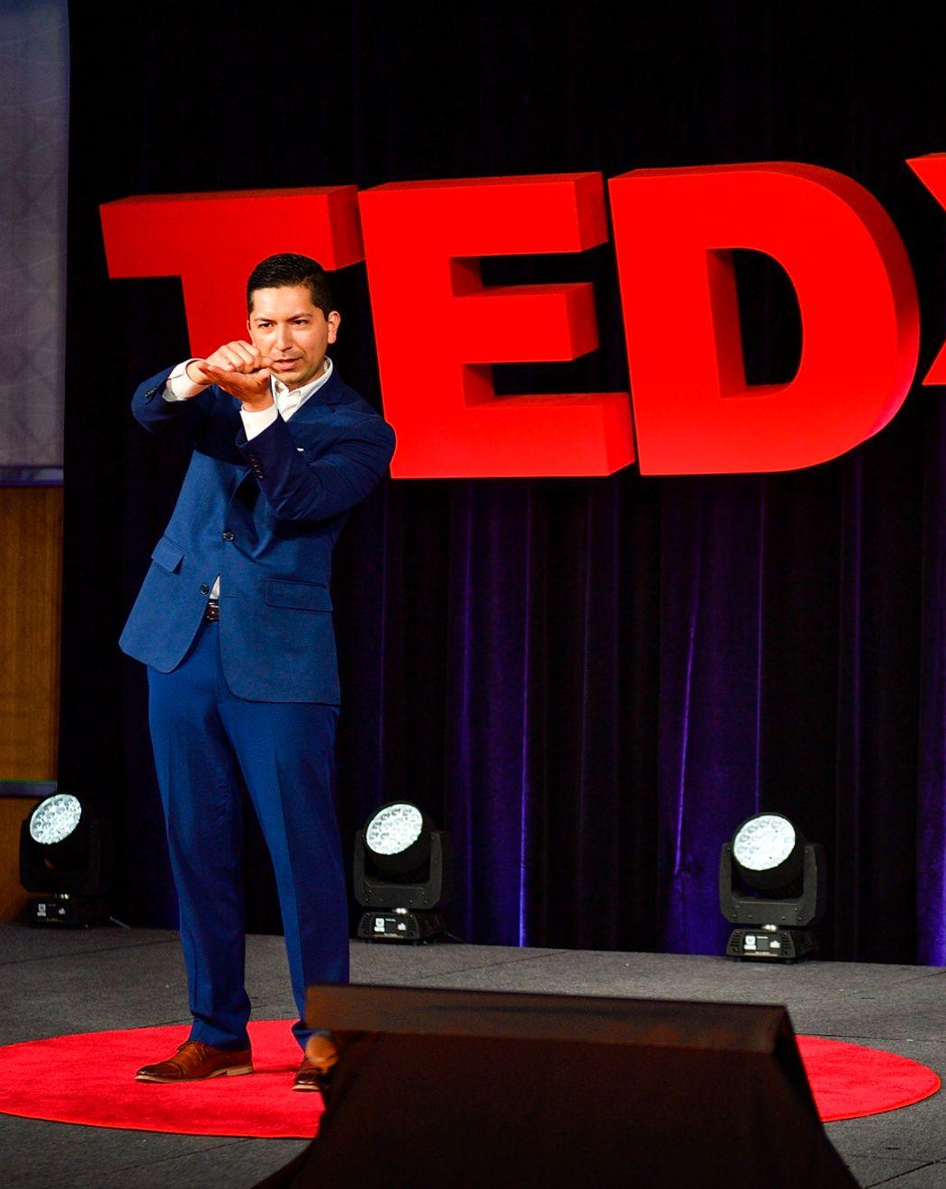


Rudy Reynoso

Slide 3


Slide 4
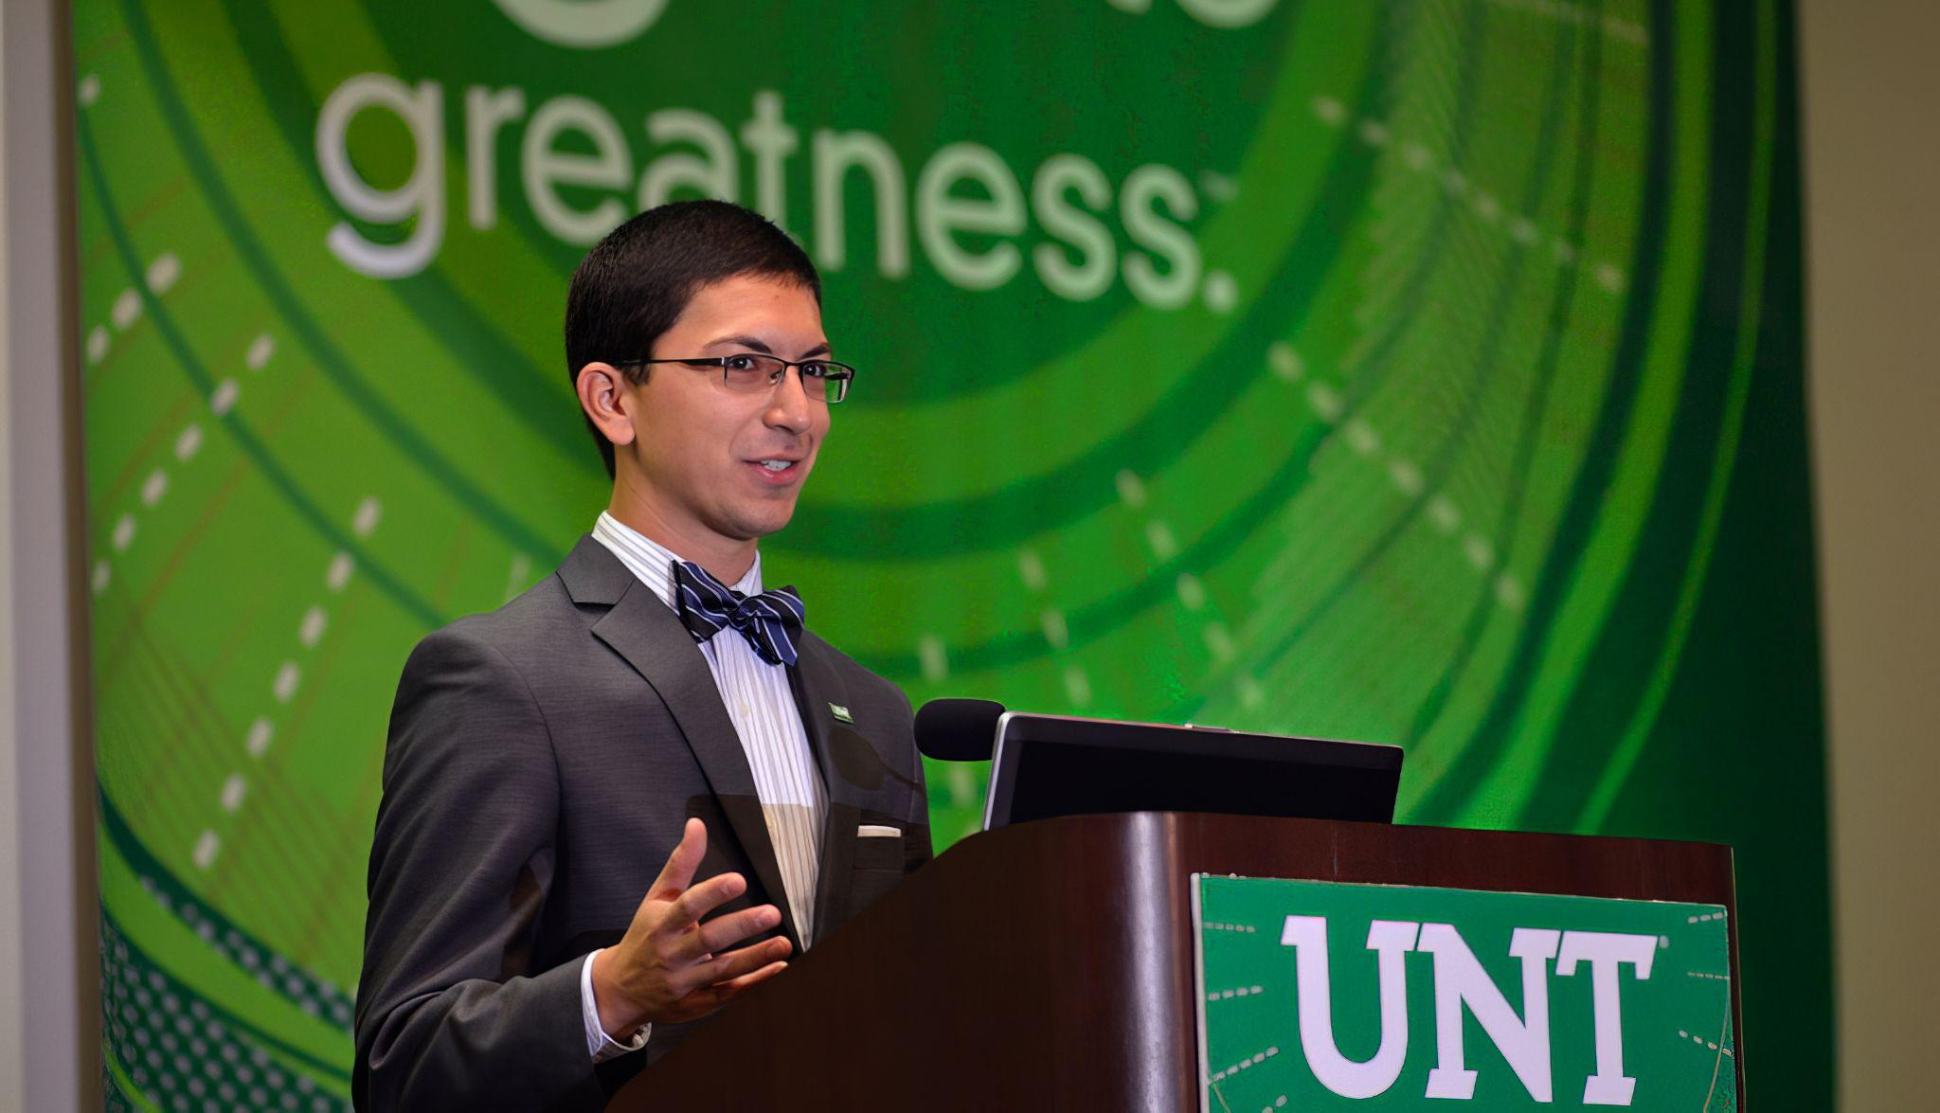

Slide 5
3 Truths
This is learnable
YOU can learn it
You’ll learn something new TODAY

Slide 6


Visual
Vocal

Slide 7
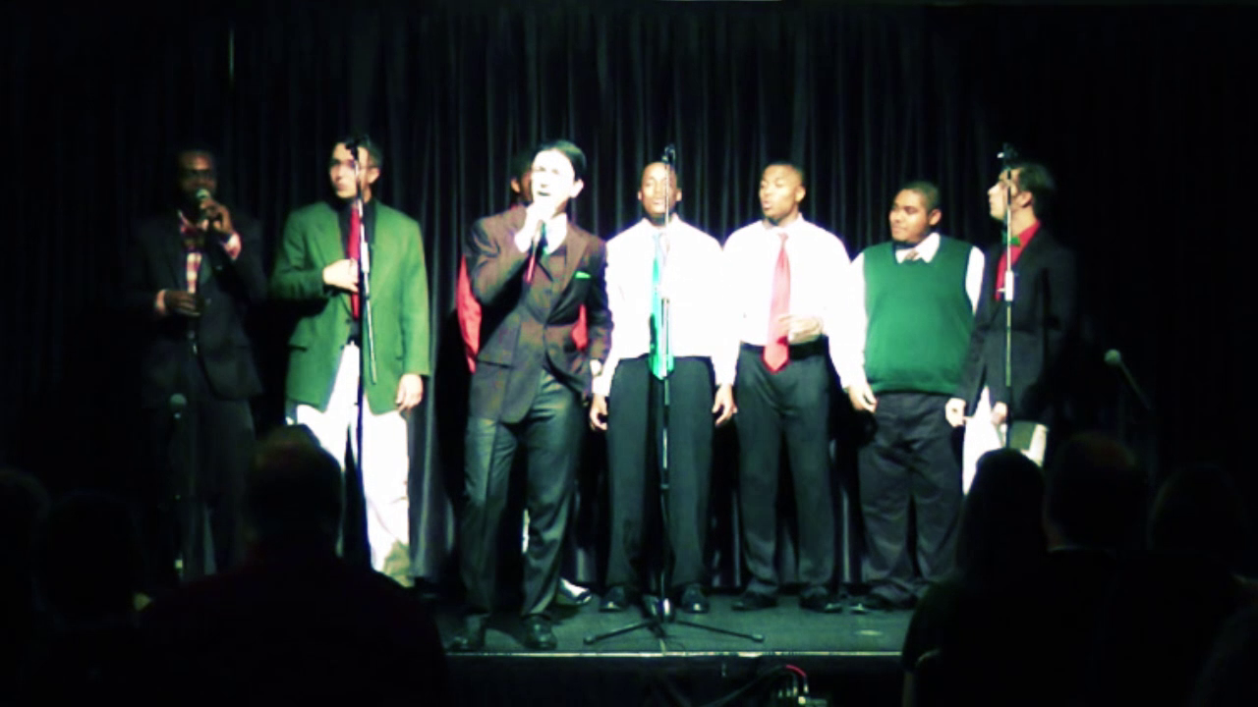
Secret Technique #1
Vocal Warm Ups & Breath

Slide 8

Secret Technique #2
Your Voice is a Piano

Slide 9
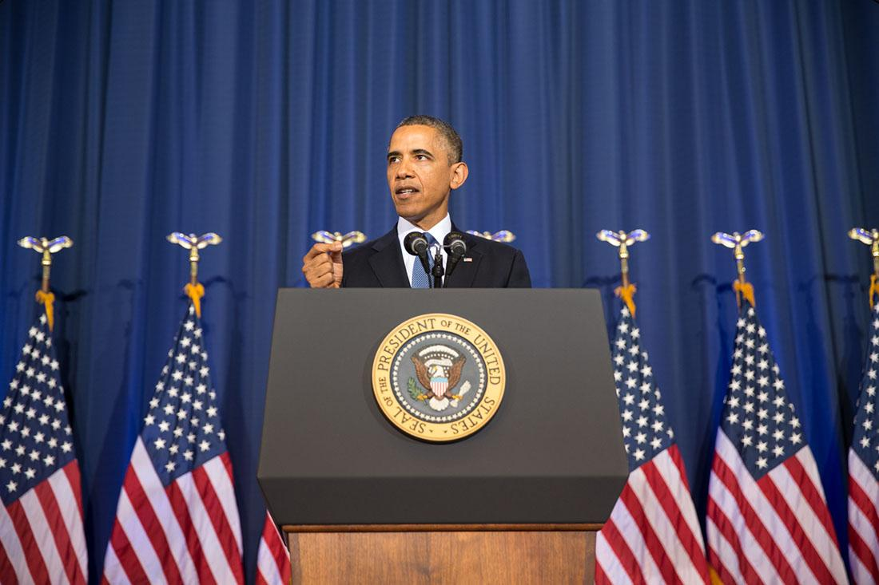

Slide 10


Slide 11


Slide 12

Secret Technique #3
The Vocal Mirror

Slide 13


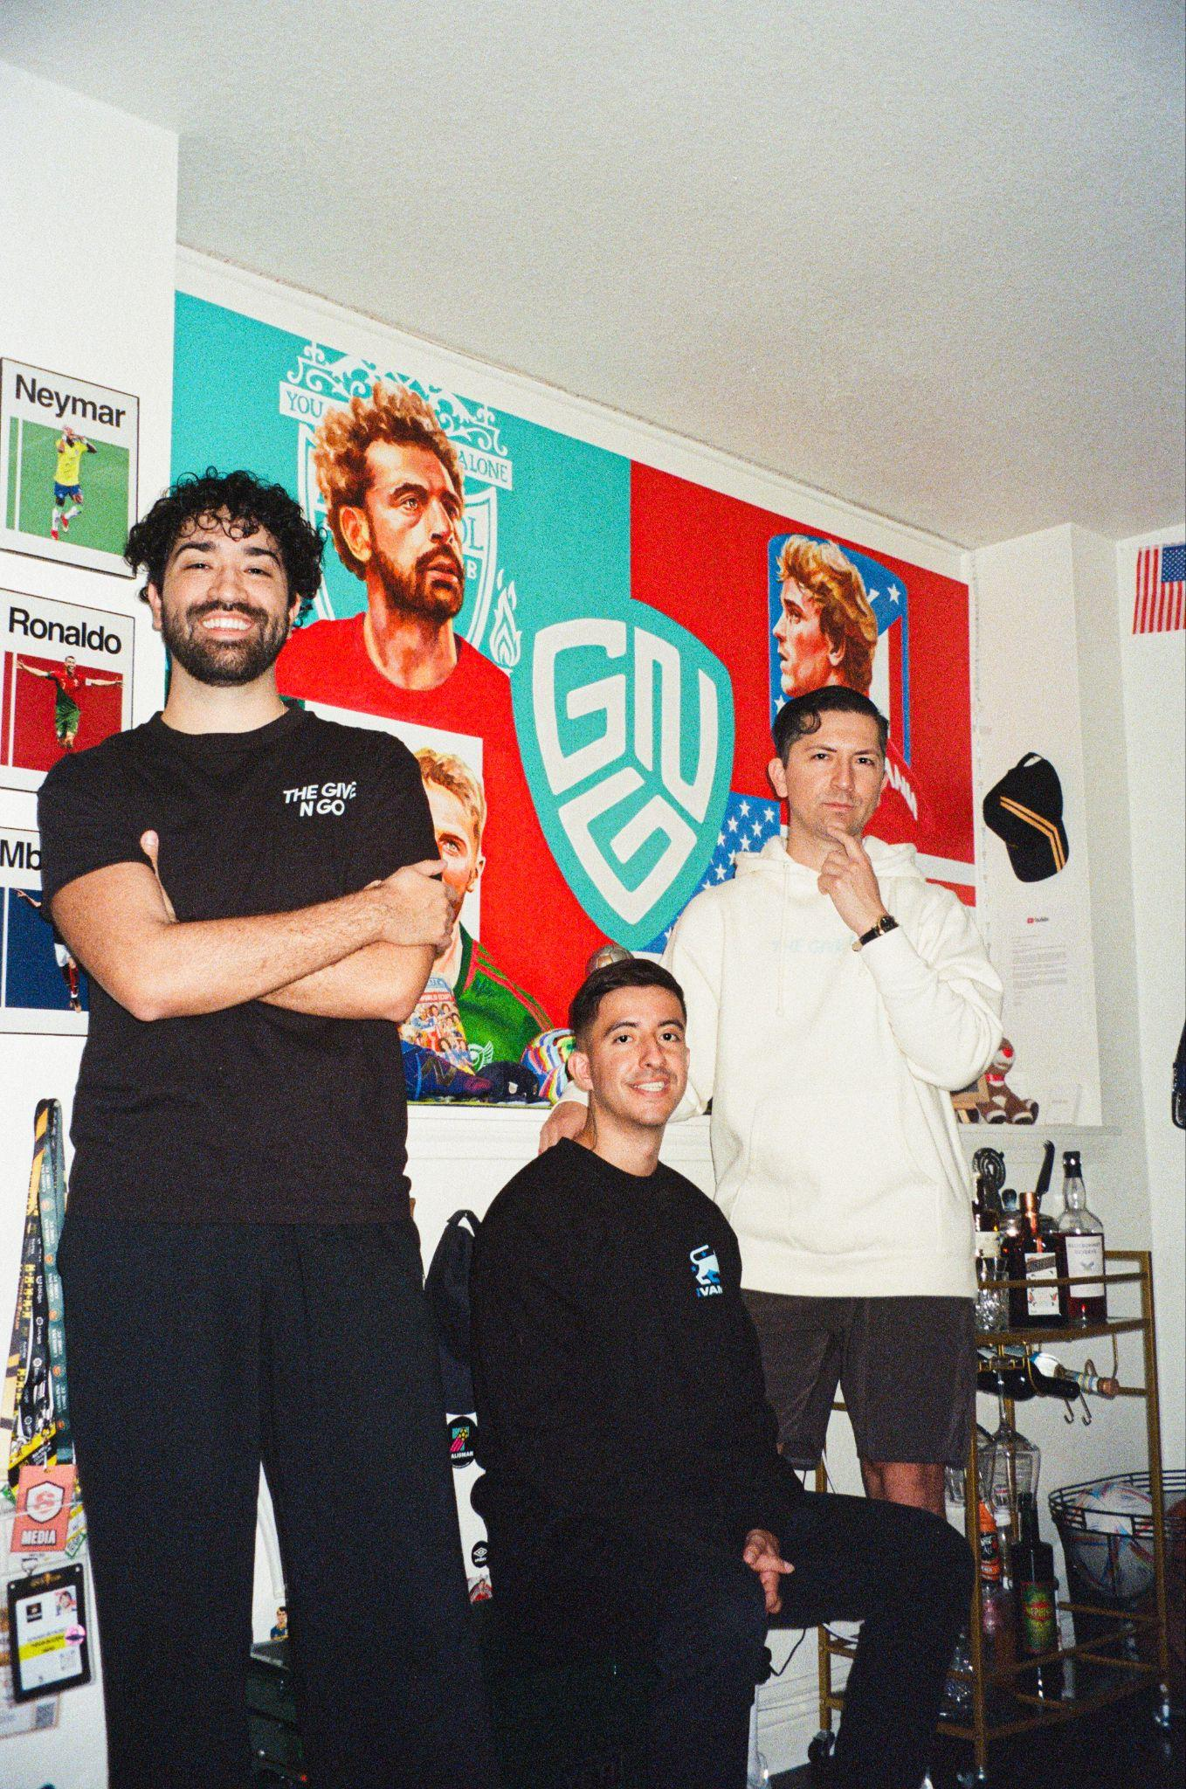
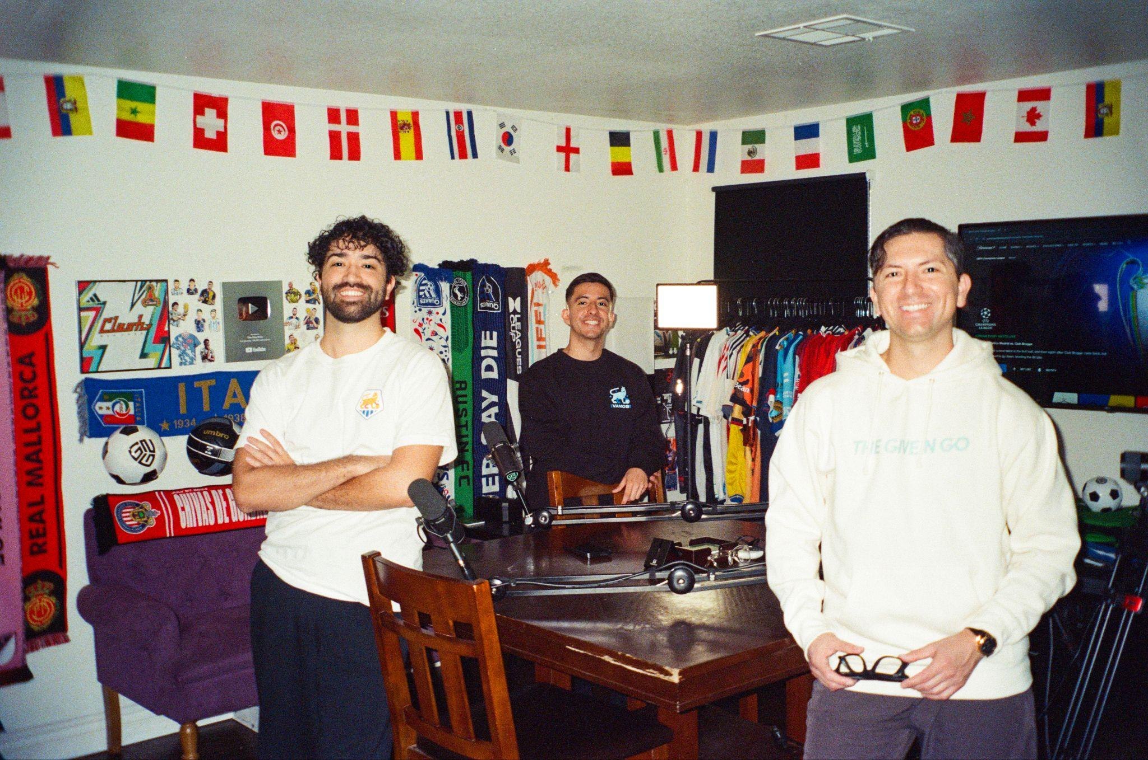
The Give N Go

Slide 14
The Most Powerful
Secret Technique

Slide 15
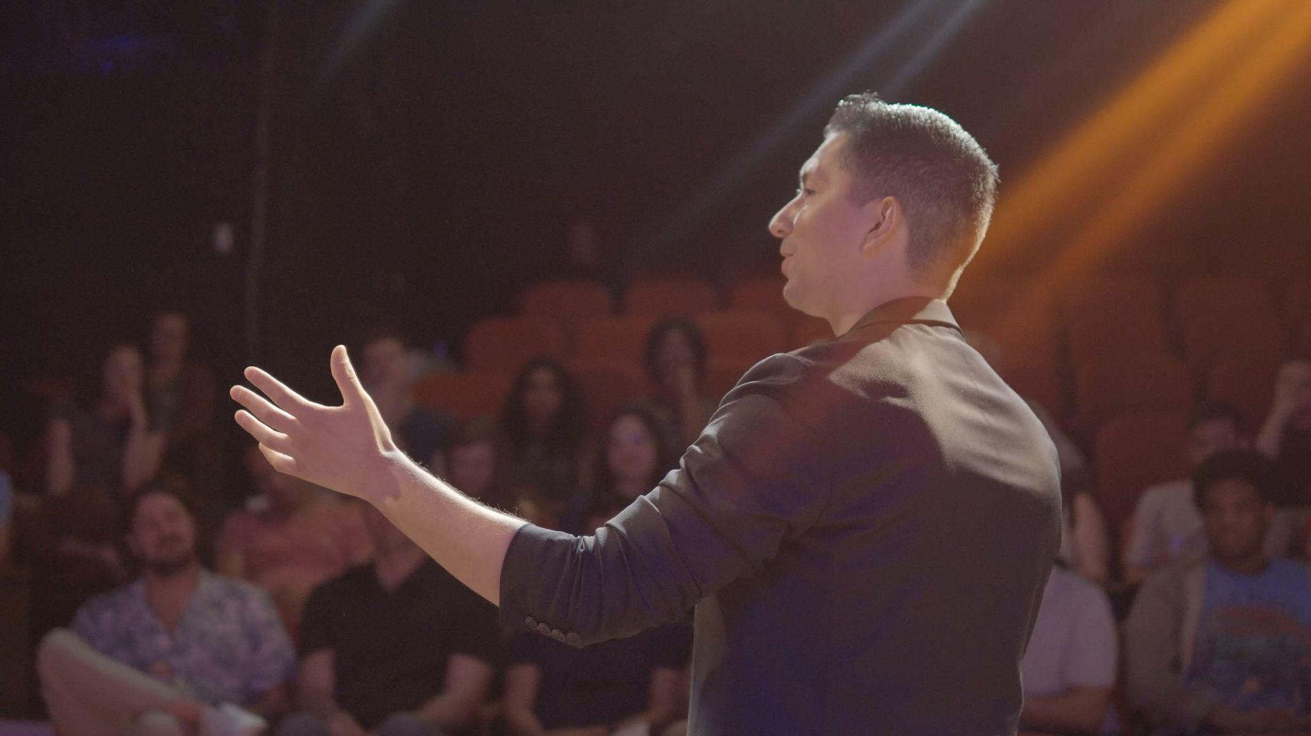
Secret Technique #4
The Power of the Pause

Slide 16

The Sleight of Speech Book
Google Reviews and Free Chapters

Slide 17

Secret Technique #5
The Name Game

Slide 18

1% and one small thing

Slide 19
Missions
Start a sentence quickly, then slow it down at the end.
PAUSE halfway through a sentence with your hand held in the air, lower it, and finish the sentence.
Meet someone new and repeat their name three times to lock it in.
(BONUS) Mirror someone in your next conversation by using the last word they said as a question.

Slide 20
Sleight of Speech
www.SleightofSpeech.com
Rudy Reynoso

