Slide 1

Texas Service Awards
A Rewarding Program to Honor Your Employees
Presented by
Texas State Preservation Board

Slide 2
HUMAN RESOURCES AND ACCOUNTING
HAVE ENOUGH TO DO

Slide 3
Meet Texas Service Awards
A fully managed employee recognition program designed specifically for Texas State agencies.
👤
Live Human Support
🎁
Employee Choice
🚚
Shipping & Fulfillment
📊
Reports & Invoicing
From employee communication to award delivery, we manage the entire recognition process—so your team doesn’t have to.

Slide 4
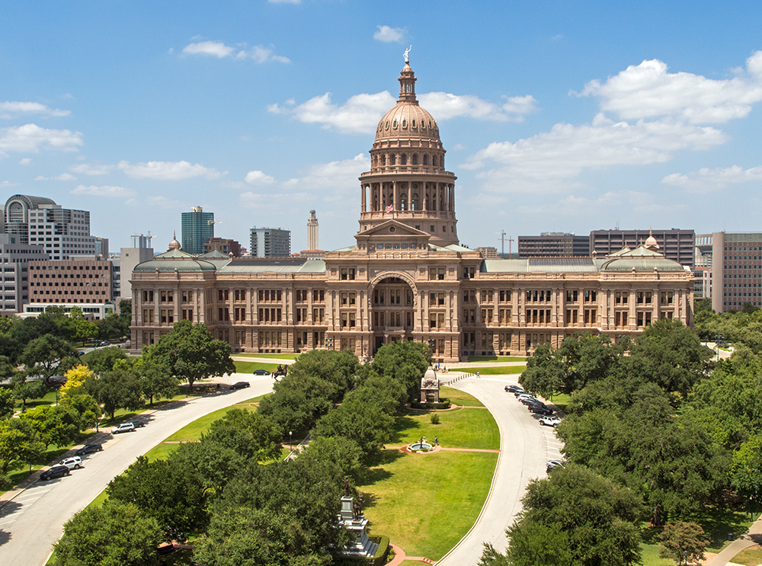
20+
Years
Serving Texas State agencies with trusted employee recognition for more than two decades.
20+ YEARS
22 AGENCIES & COUNTING
THOUSANDS OF AWARDED EMPLOYEES

Slide 5
Trusted Across Texas
From agencies with fewer than 10 employees to agencies with more than 10,000. Texas Service Awards is designed to scale with your agency.
🚧 Texas Department of Transportation
💼 Texas Workforce Commission
🚂Texas Railroad Commission
👩‍⚖️Texas Department of Licensing and Regulation
Serving agencies of every size across Texas!

Slide 6
Designed Around Your Agency’s Procurement Process
Annual Purchase Order
For the upcoming FY2027:
Simplifies annual budgeting
Reduces administrative burden
Provides uninterrupted program support
Interagency Contract
Available for agencies that prefer contract-based purchasing
Flexible to meet agency procurement requirements
Monthly or Quarterly Purchase Orders
Can be processed as needed throughout the fiscal year
Ideal for agencies with changing recognition needs
We recommend establishing a Purchase Order at the beginning of the fiscal year to simplify planning, budgeting, and program administration throughout the year.

Slide 7
Built Around Your Budget
Every agency is different. We build every recognition program around your agency’s unique needs, budget, and award tiers.
$25
5 Years
250+ Award Choices
$30
10 Years
500+ Award Choices
$40
15 Years
650+ Award Choices
✓ Flexible Award Values
✓ Adjustable at Any Time
$50
20 Years
750+ Award Choices
$60
25 Years
800+ Award Choices
$80
30+ Years
900+ Award Choices
Any agency may use appropriated money to purchase an award for tenure which cost no more than $100 for an individual employee. (Texas Government Code Section 2113.201).

Slide 8
Planning Your Program Budget
An example of how agencies can estimate annual program costs.
Step 1 – Estimate Award Costs
Step 2- Estimate Shipping
Milestone | Employees | *Budgeted Award Value*
5 Years | 10 | $25
10 Years | 8 | $30
15 Years | 5 | $40
20 Years | 4 | $50
25 Years | 2 | $60
30 Years | 1 | $80
Award Budget: |  | $1,090
Award Total | Shipping
$0.00 - $35.00 | $10.00
$35.01 - $45.00 | $12.00
$45.01 - $55.00 | $14.00
$55.01 - $65.00 | $15.00
$65.01 - $75.00 | $17.00
$75.01 - $80.00 | $19.00
*This is your planning estimate based on the award tiers your agency chooses.*
Actual shipping is based on the item selected by the employee—not their years of service.

Slide 9
Program Cost Example
Award Tier | Qty | Award Cost | Shipping
5 Years ($25) | 10 | $250 | $100
10 Years ($30) | 8 | $240 | $80
15 Years ($40) | 5 | $200 | $60
20 Years ($50) | 4 | $200 | $56
25 Years ($60) | 2 | $120 | $30
30 Years ($80) | 1 | $80 | $19
Award Total |  | $1,090
Shipping Total |  |  | $345
Total Event Cost |  | $1,435
Shipping varies based on the awards selected by employees!

Slide 10
MANAGING EXPECTATIONS
No complicated software
No system integrations
No lengthy data imports

Slide 11
WE ONLY NEED FOUR THINGS!
😁
First Name
😊
Last Name
💼
Work Email
⭐
Years of Service
This is all we need to launch your program.

Slide 12
SEND US A LIST, WE’LL HANDLE THE REST
Employee Communication
Award Selection
Customer Support (REAL PEOPLE)
Fulfillment
Shipping
Audit Reports
Invoicing

Slide 13
Here’s What Happens Next
TX AWARDS BUILD PROGRAM
AGENCY PROVIDES LIST
Align to your award tiers and policies
Configure milestone tracking
Customize communication
First name
Last name
Work email
Years of service
REPORTS & INVOICING
ONGOING MANAGEMENT
Awards shipped directly to employees (Pickup option available)
Tracking and delivery confirmation
Audit-ready report and invoices available anytime
Employee notifications and award selection
Full program administration handled for you
Personalized customer support from REAL PEOPLE

Slide 14
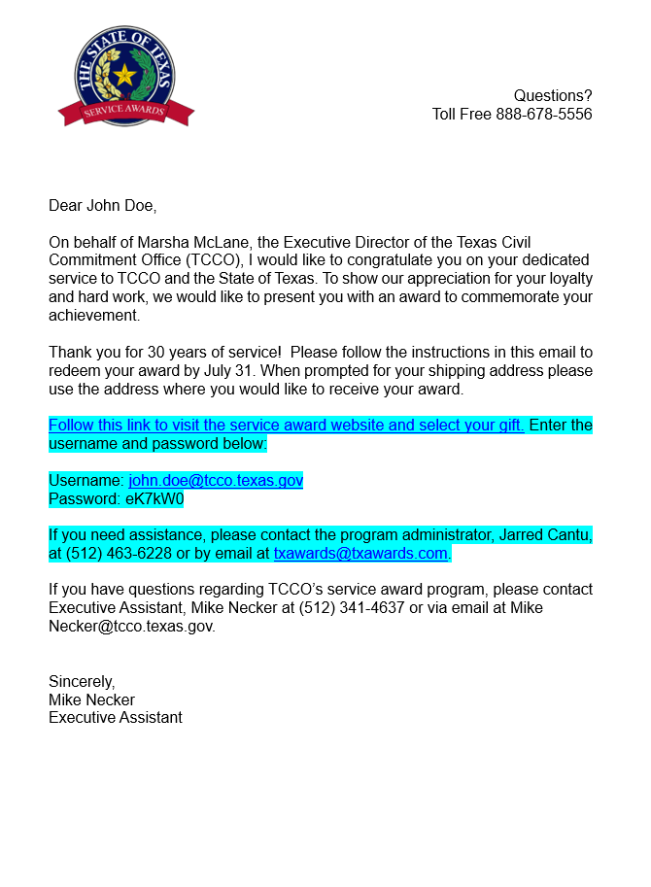
Customized Communication
Every employee receives a personalized invitation designed to reflect your agency's identity.
Personalized Congratulations
A customized recognition letter developed by the agency celebrating the employee’s milestone
Direct Award Selection
A secure link takes the employee to the award site
A reminder email is sent shortly before the event closes.
Every communication is designed to create a professional and meaningful recognition experience.

Slide 15
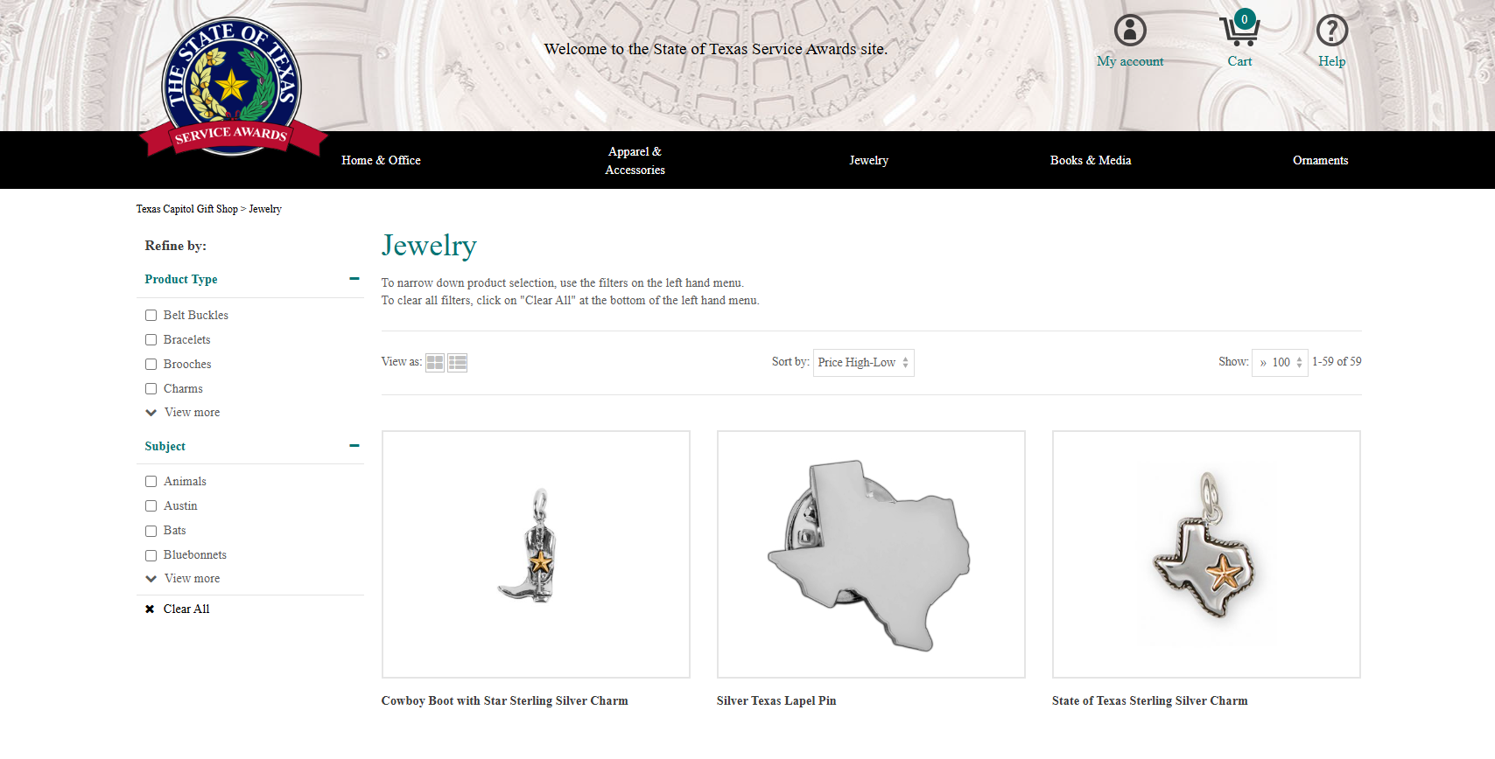
Your Employees Deserve a Choice
Every employee selects the award that’s most meaningful to them.
📧
Invitation
🛍️
Browse
🎁
Choose
📦
Delivered
🎉
Celebrate
✓ One employee
✓ One award
✓ Chosen by awardee

Slide 16
Hundreds of Award Options!
Curated merchandise is updated monthly with hundreds of items to choose from!
Hundreds of award options across multiple categories.
Online selections vary based on your agency's award tiers.

Slide 17
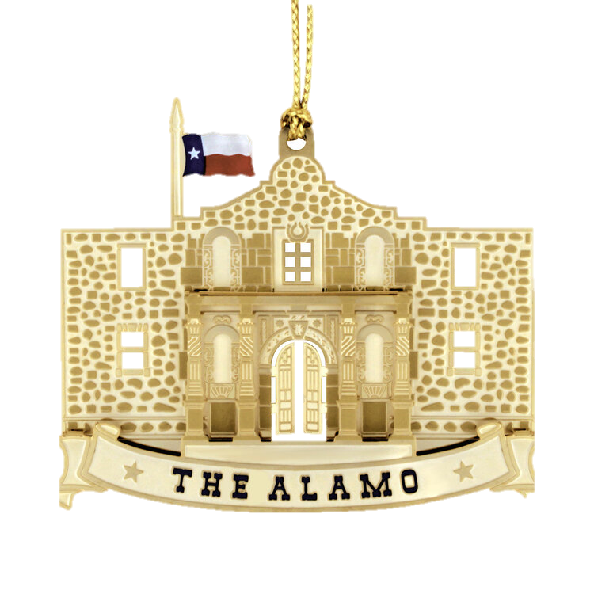
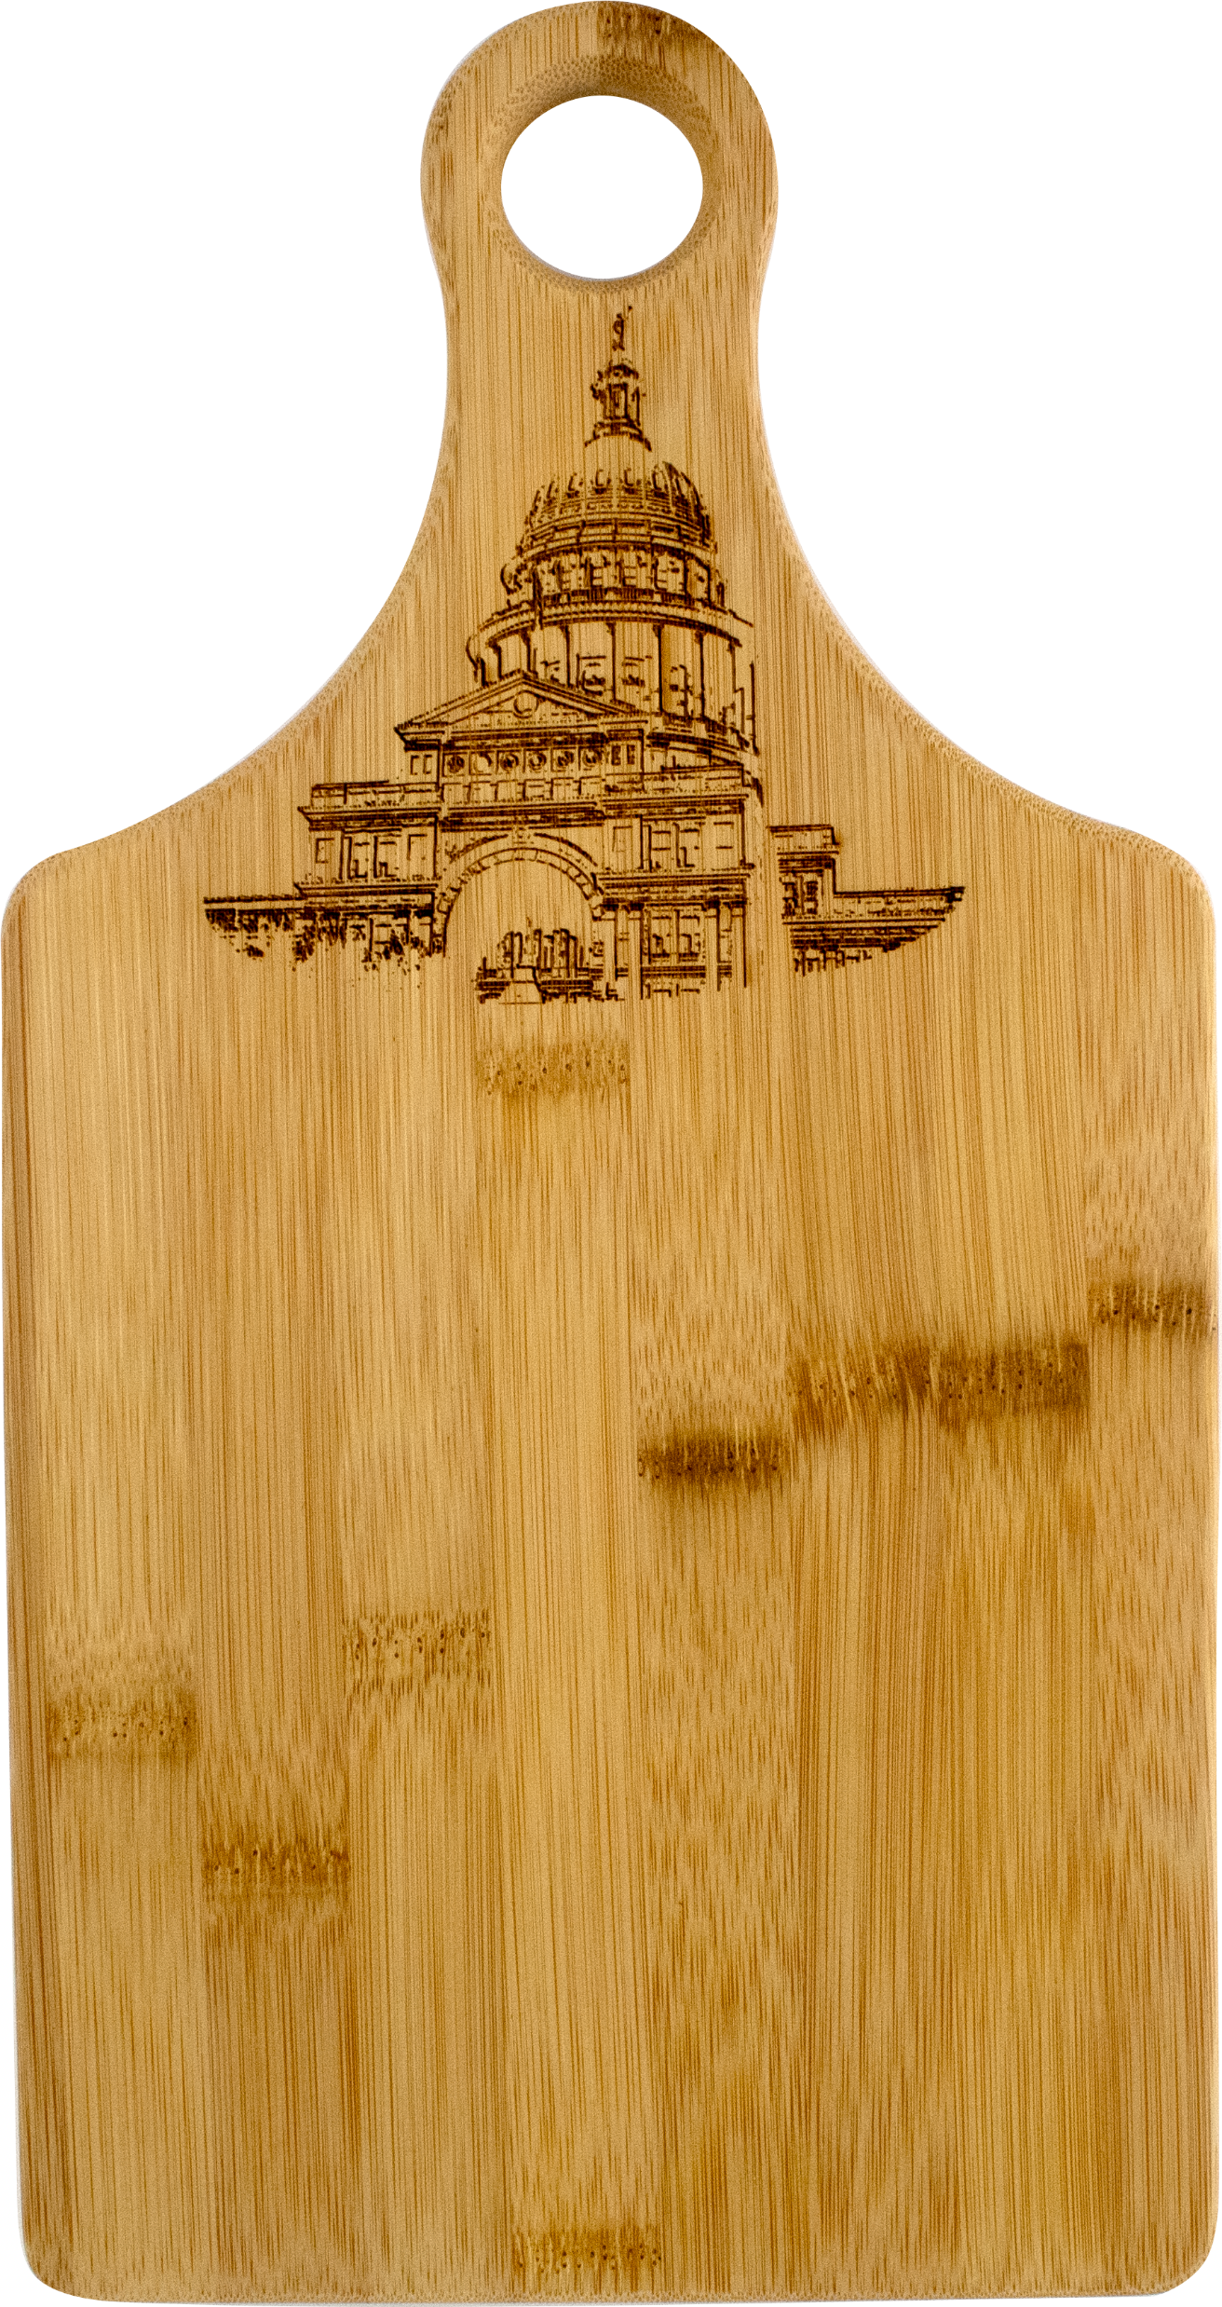
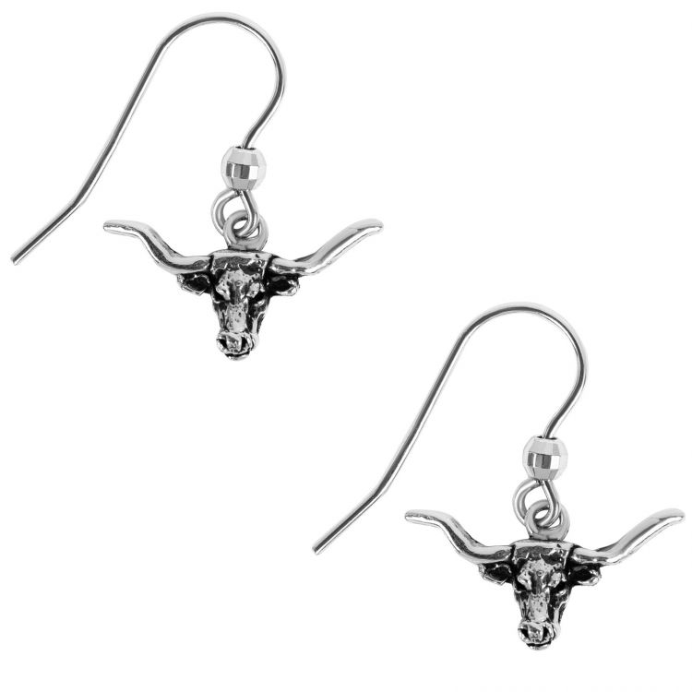
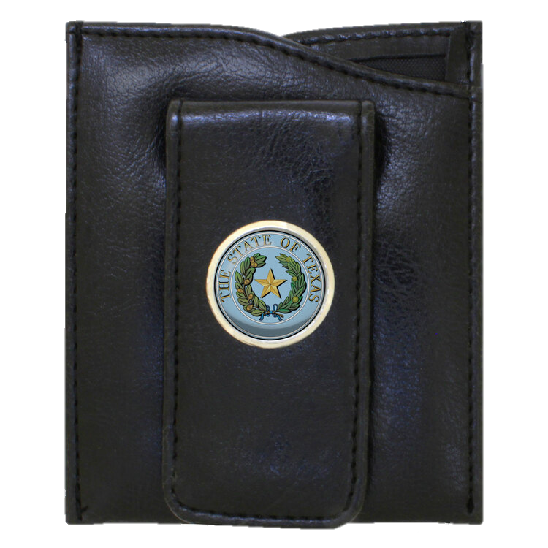
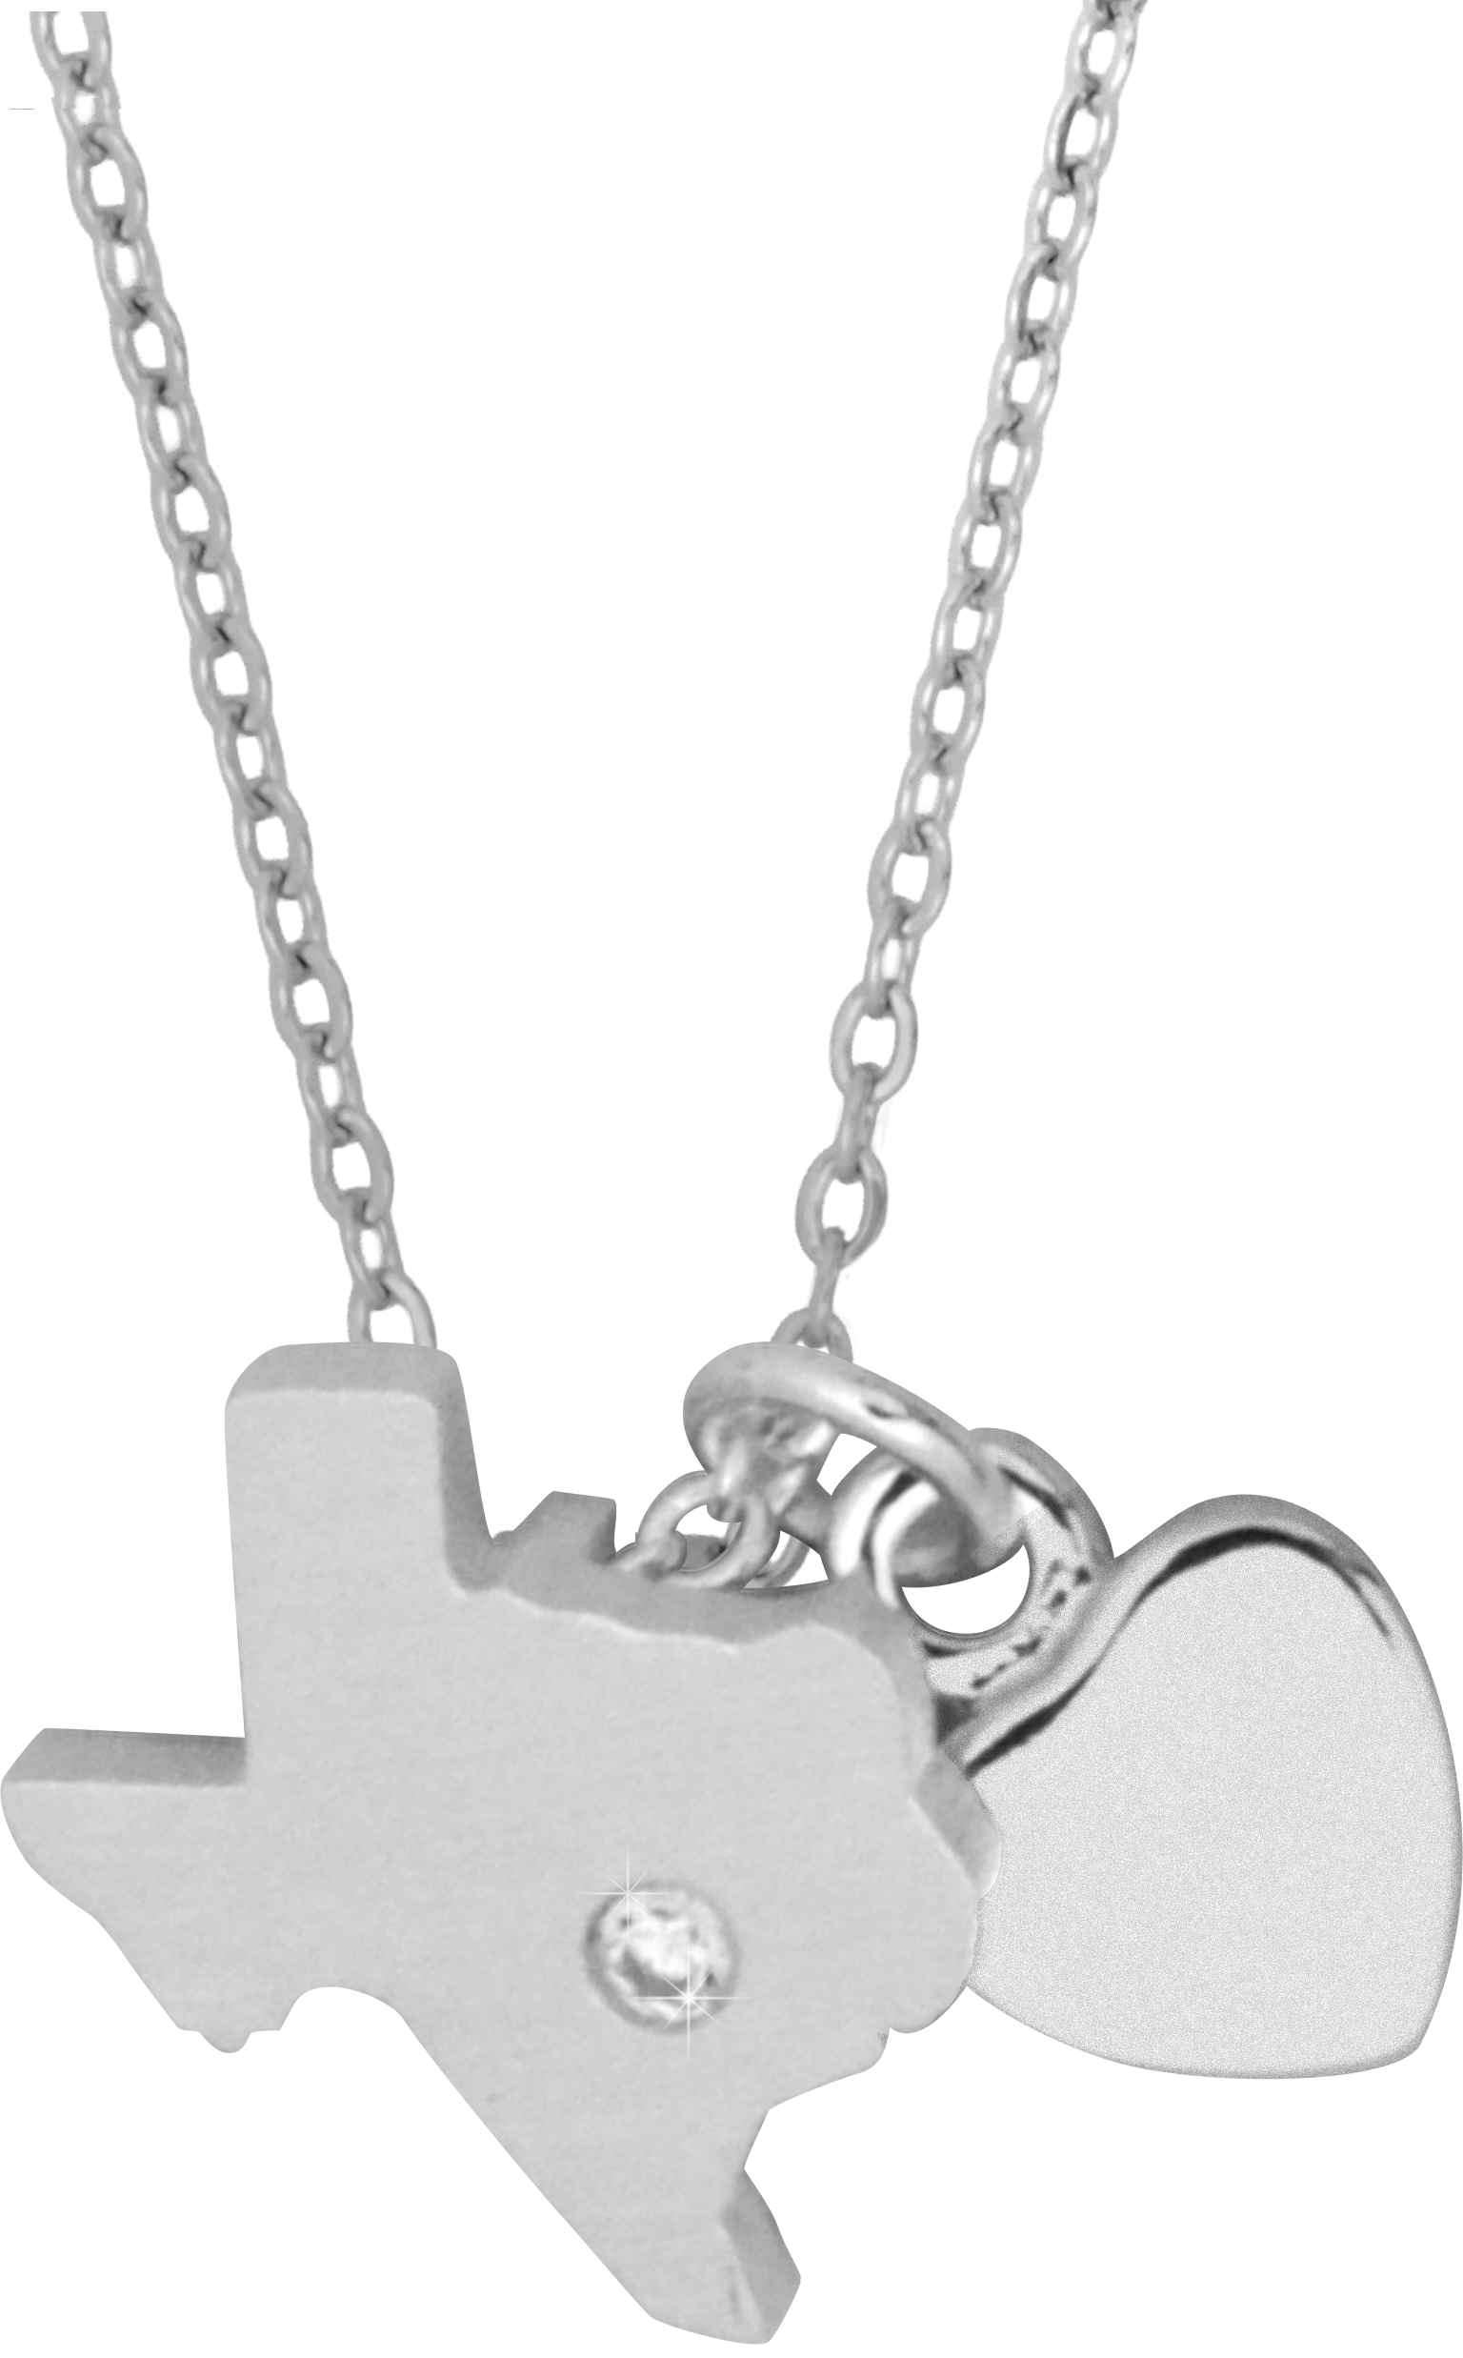
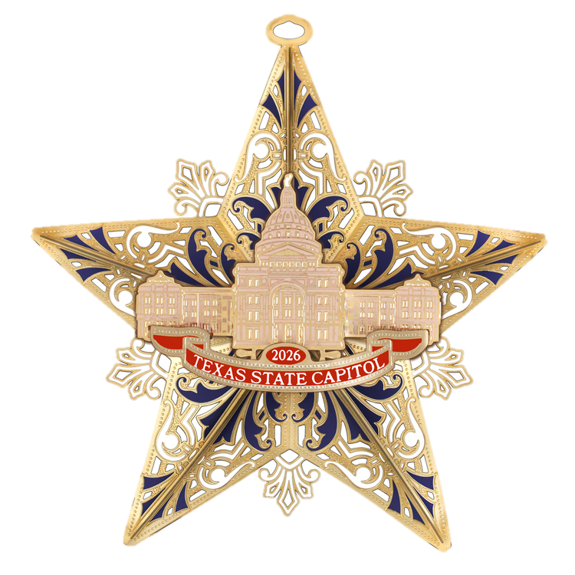
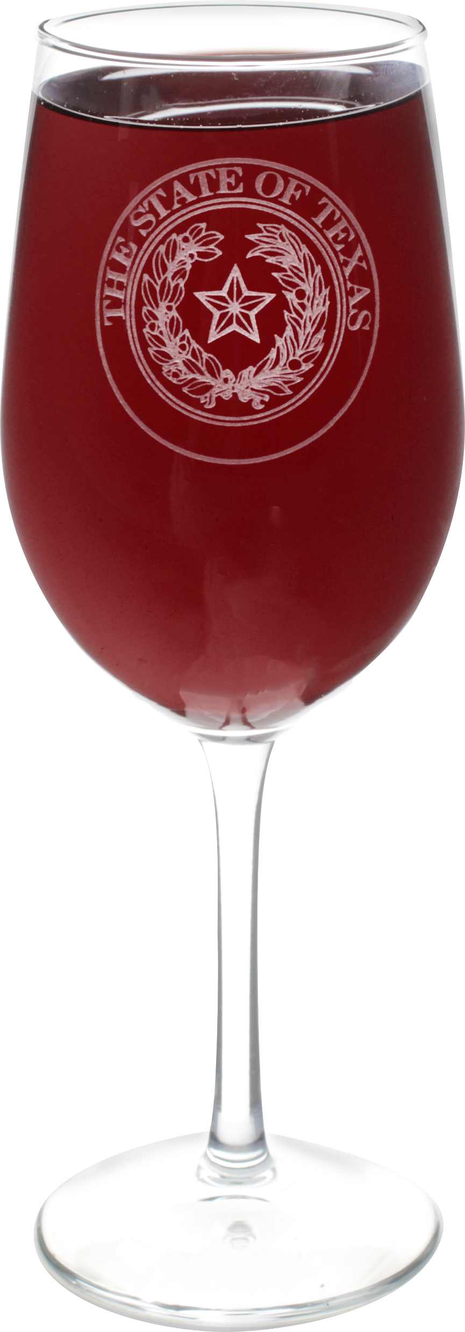
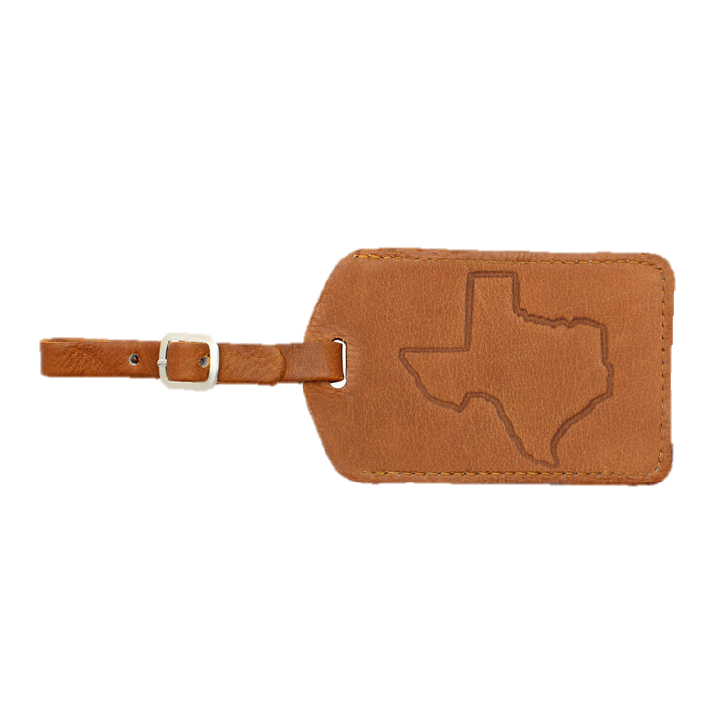

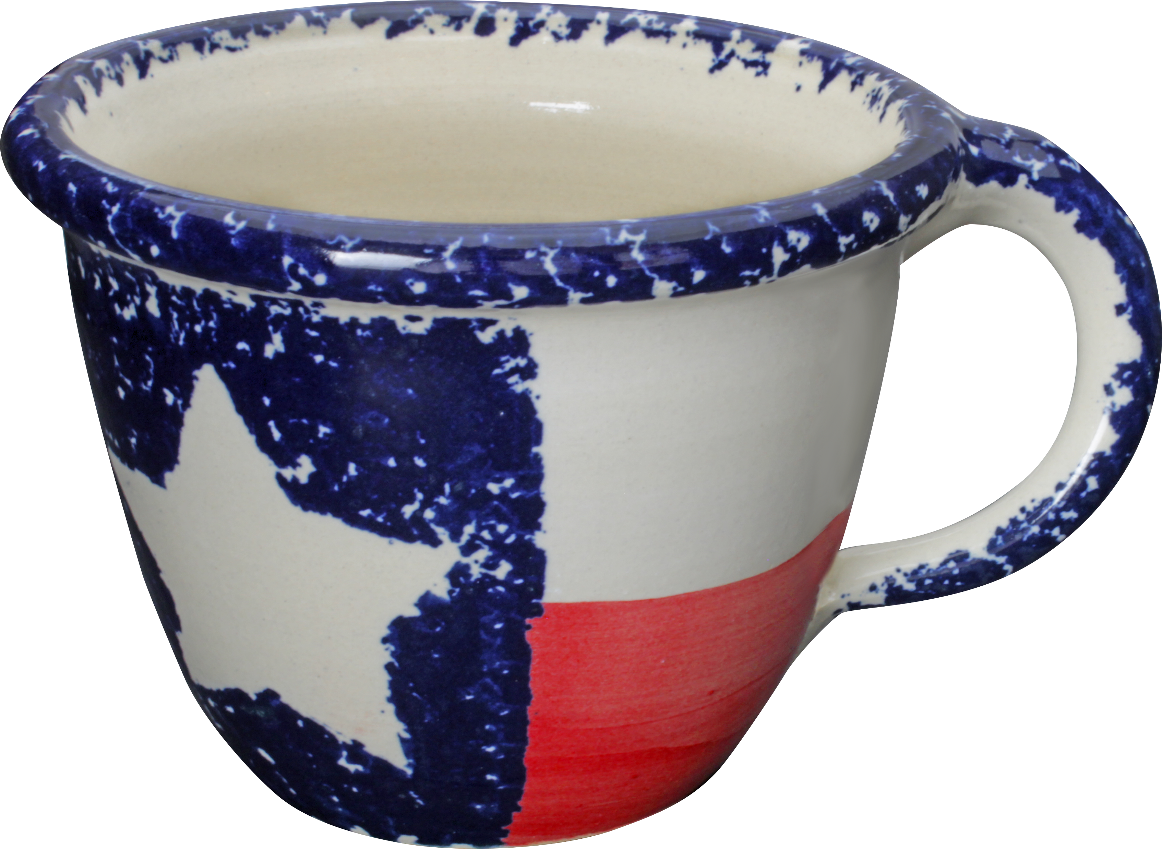
5 Year Awards

Slide 18
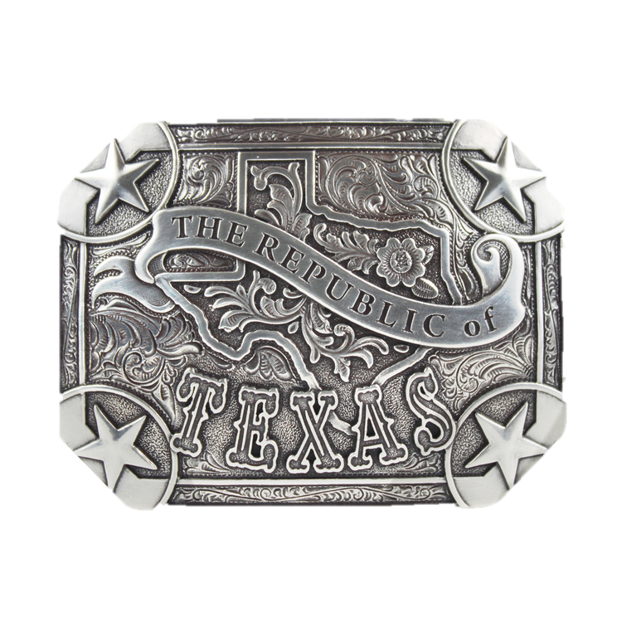



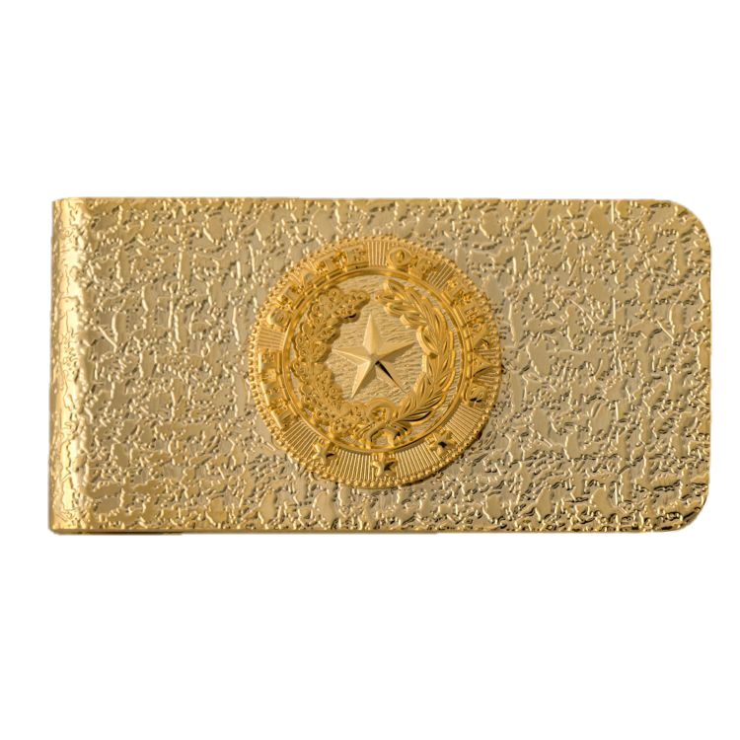

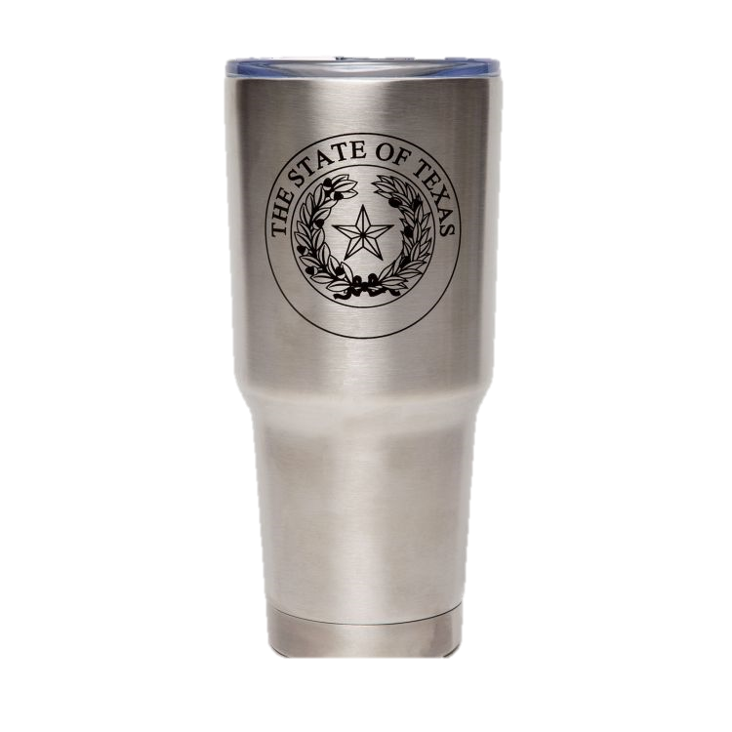
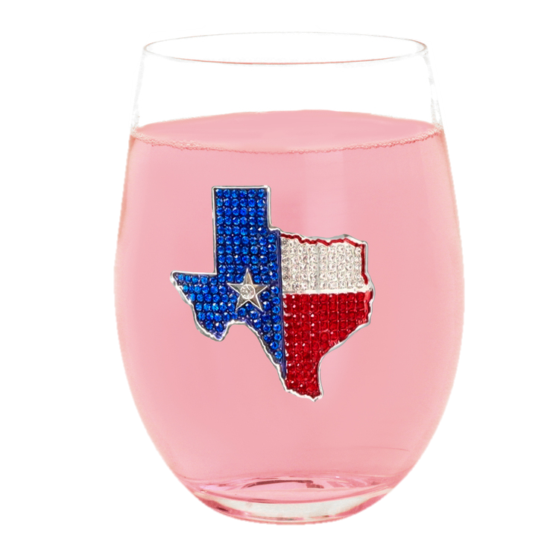
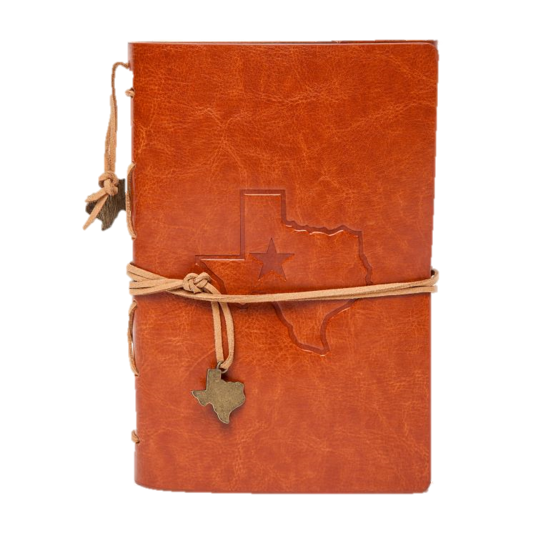
10 Year Awards

Slide 19
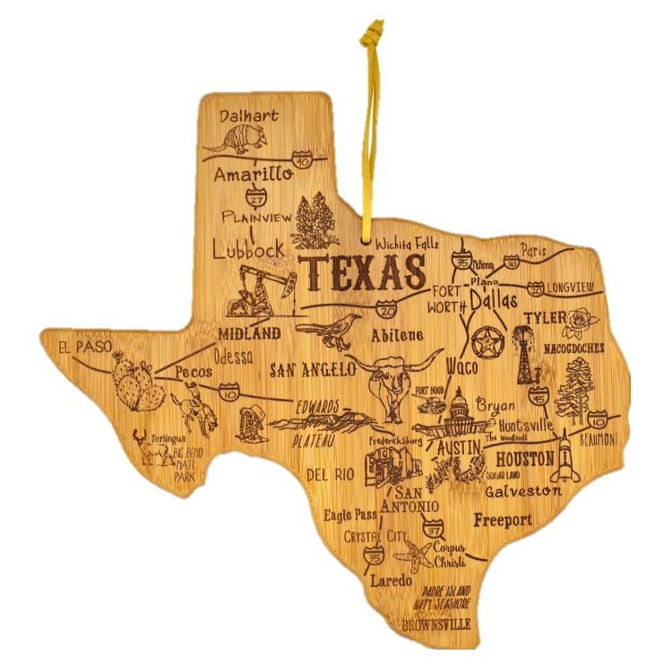
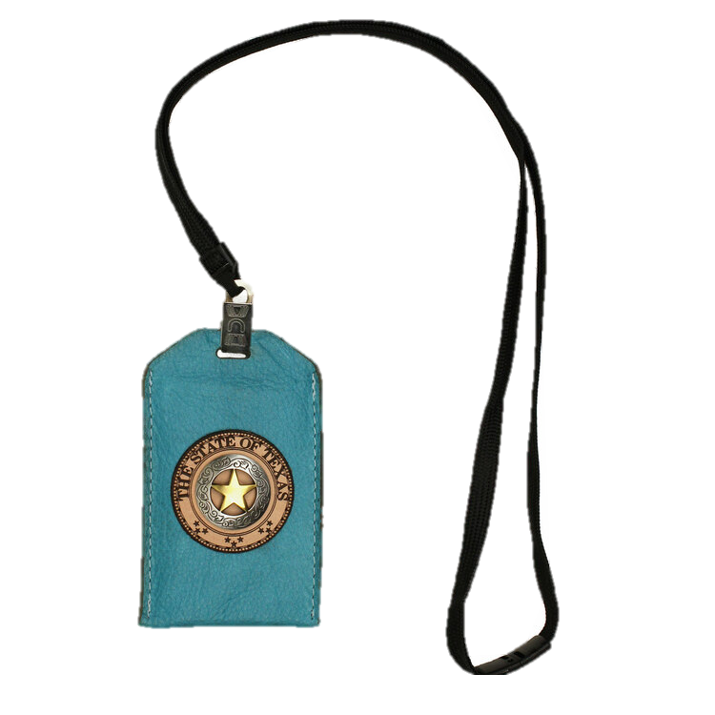

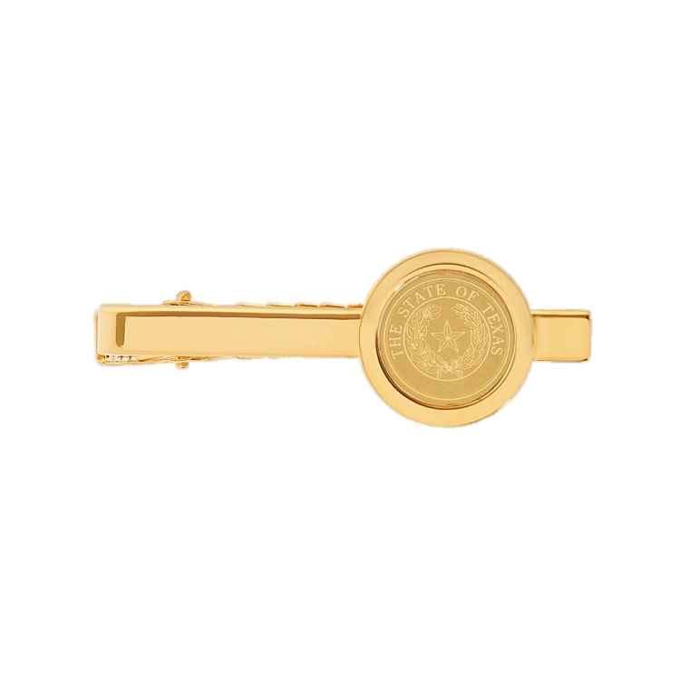
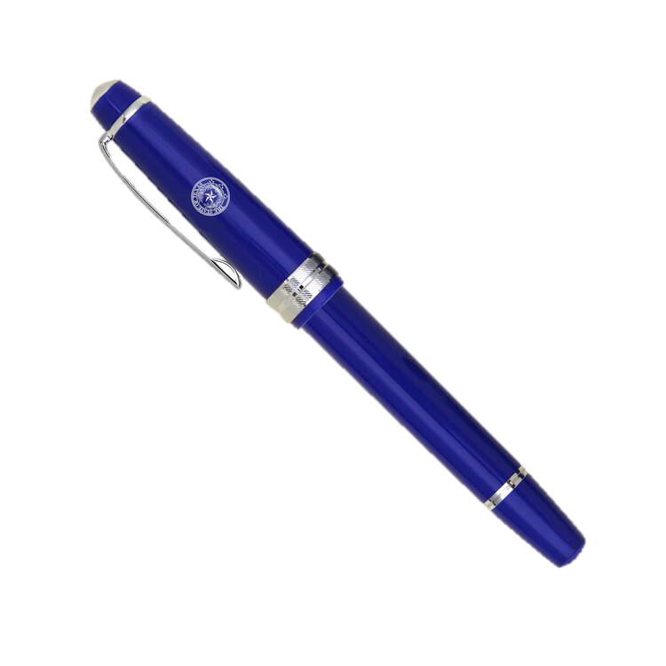
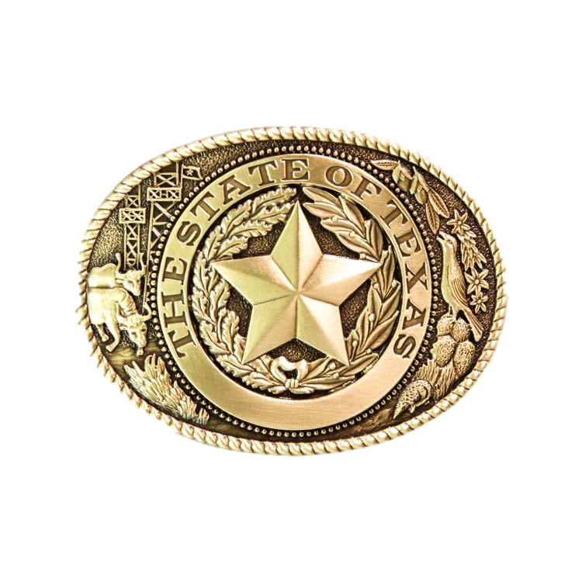
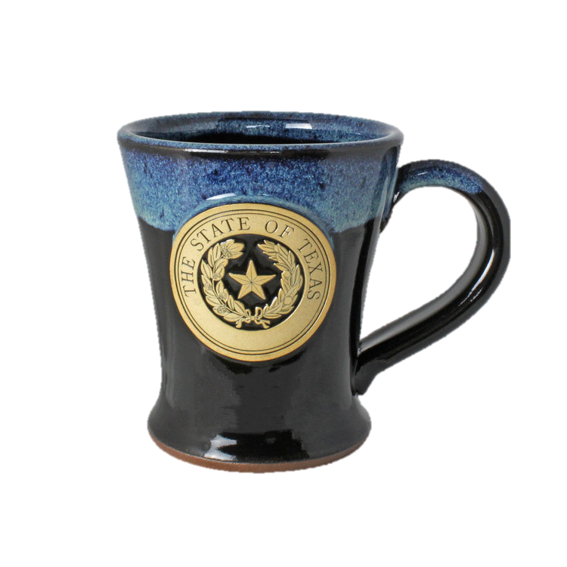
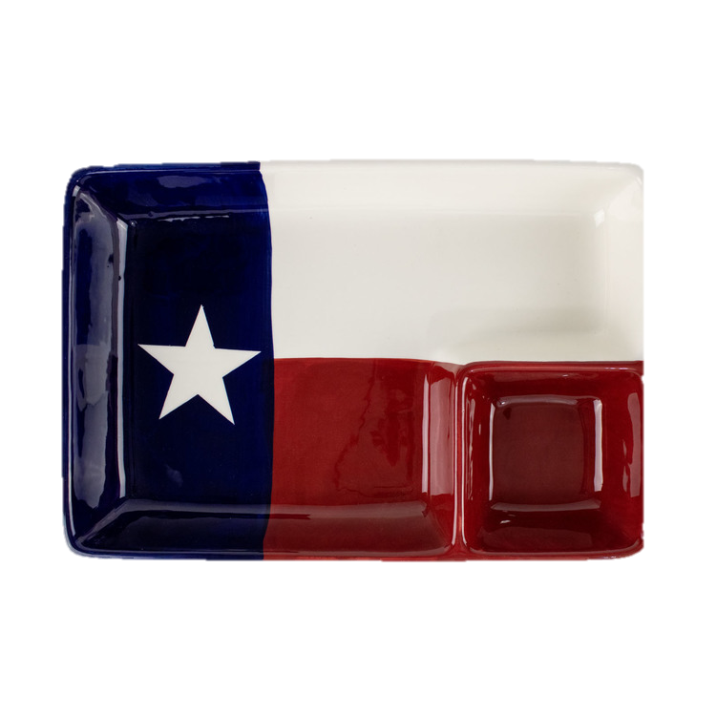
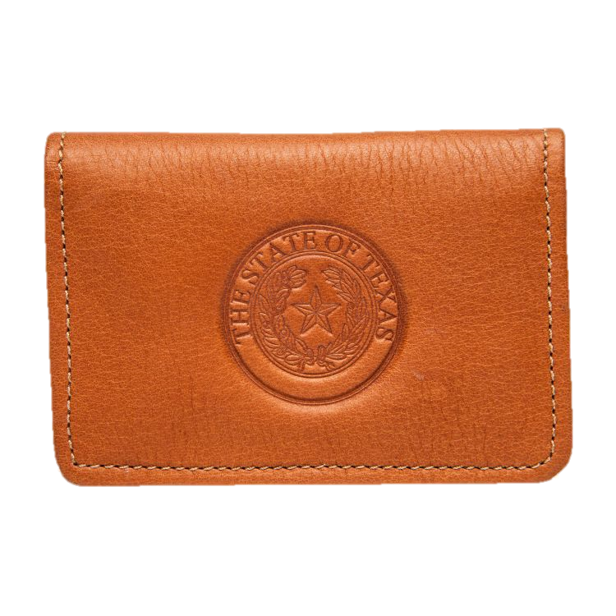
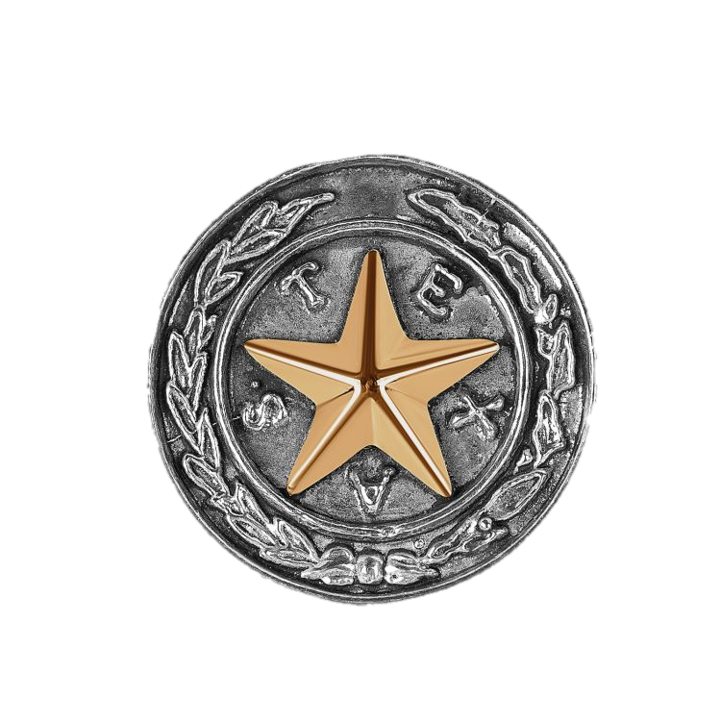
15 Year Awards

Slide 20
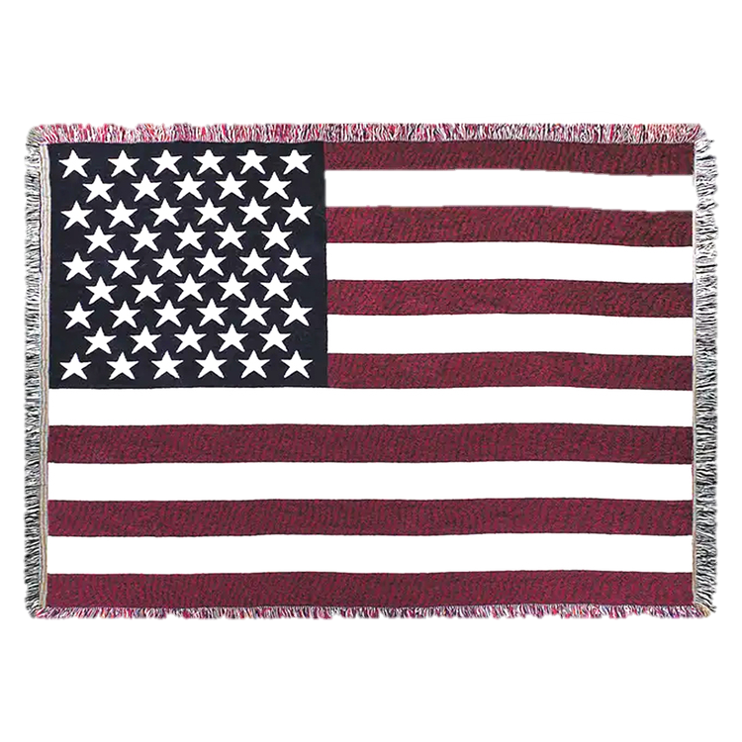
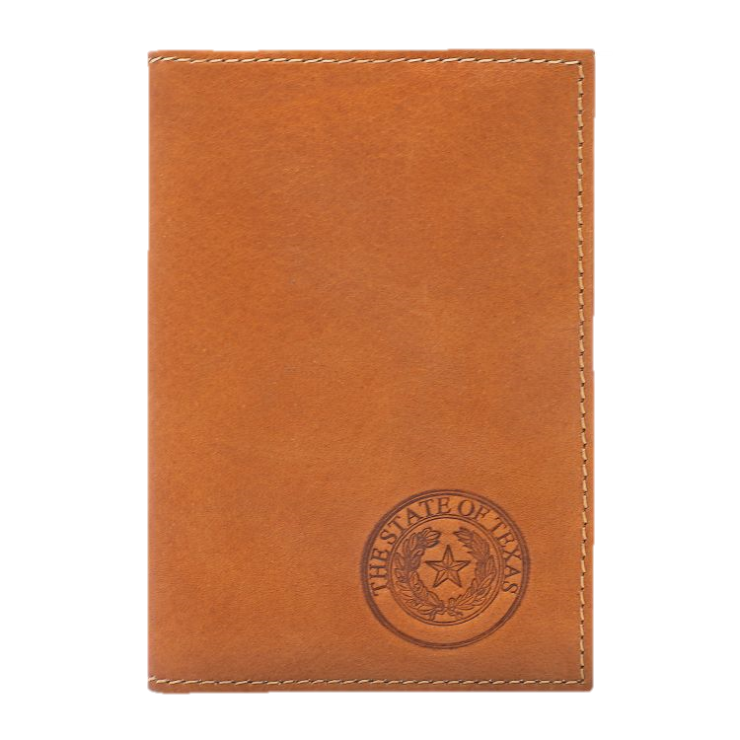
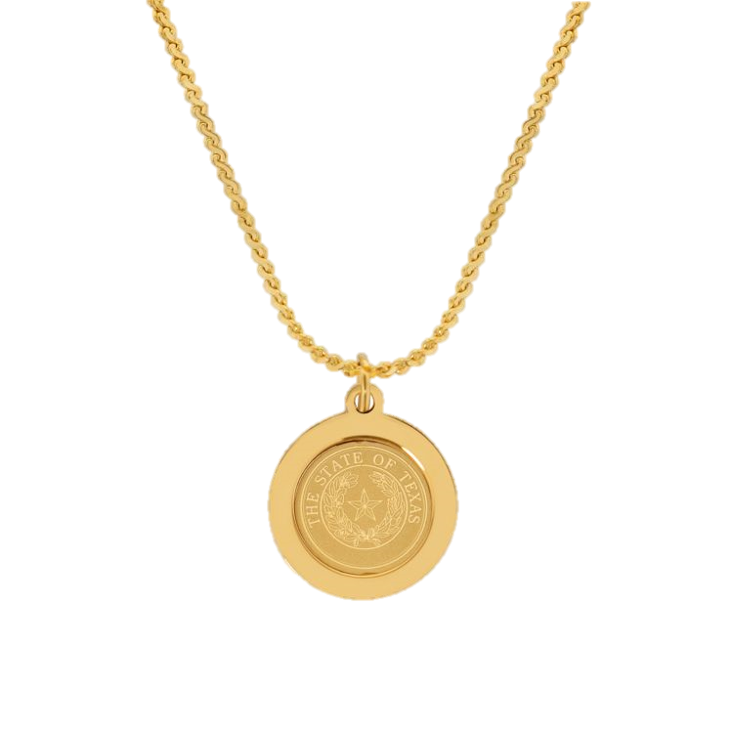
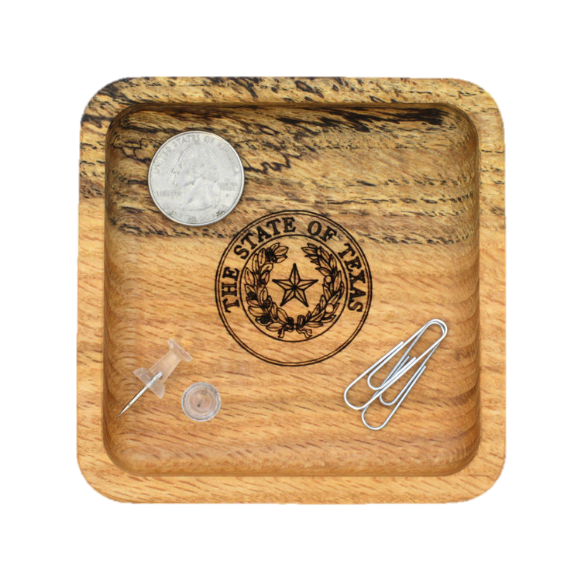
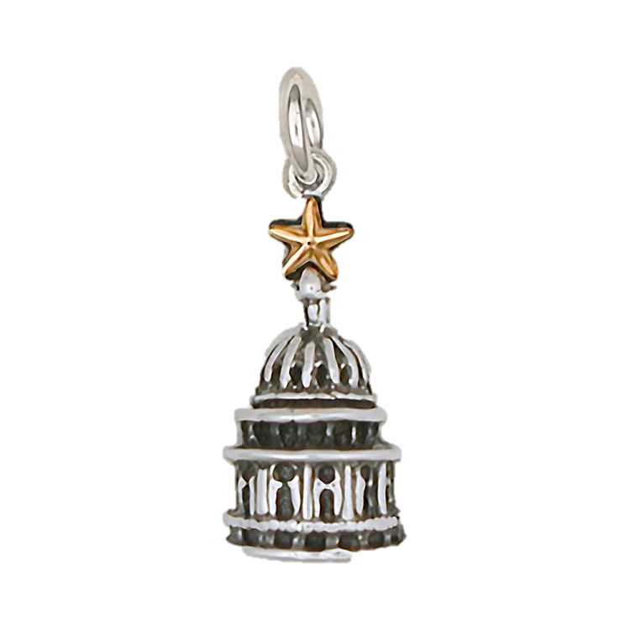
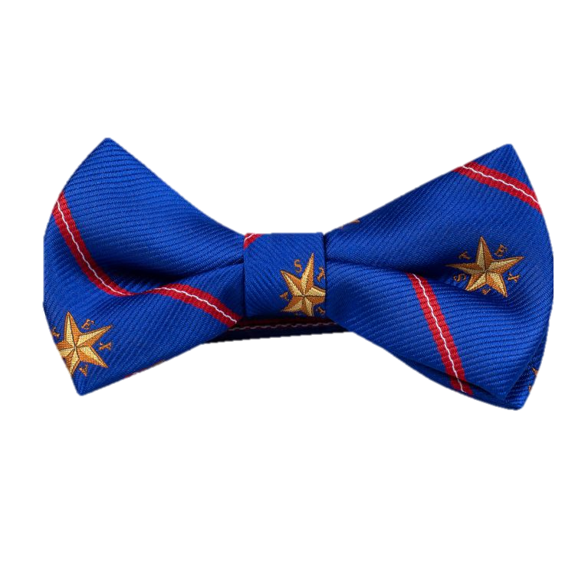

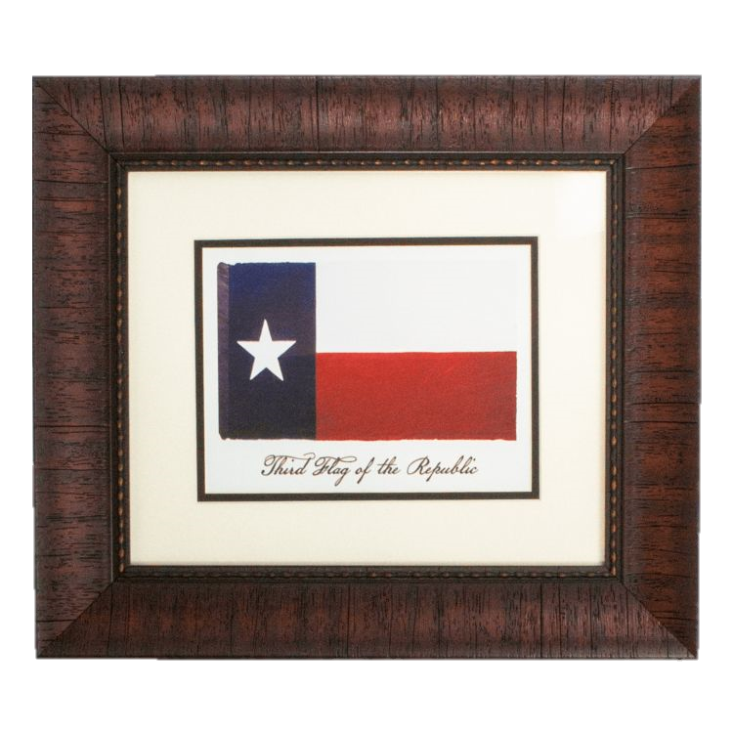
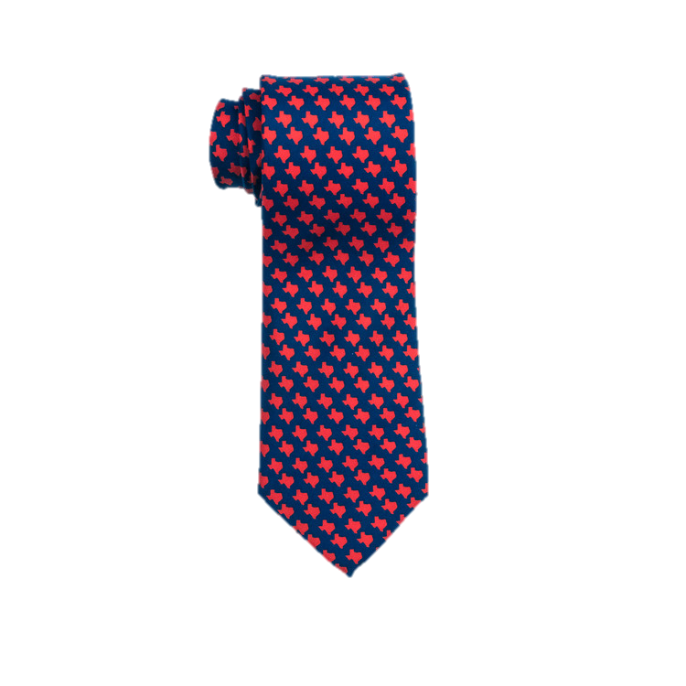

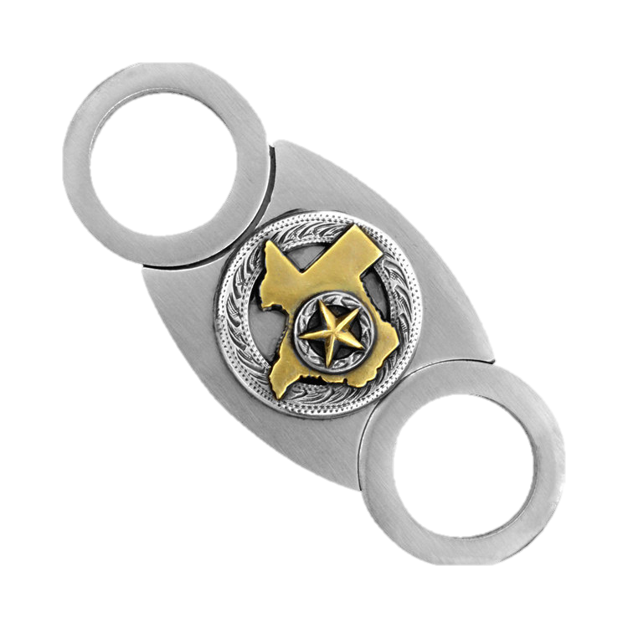
20 Year Awards

Slide 21

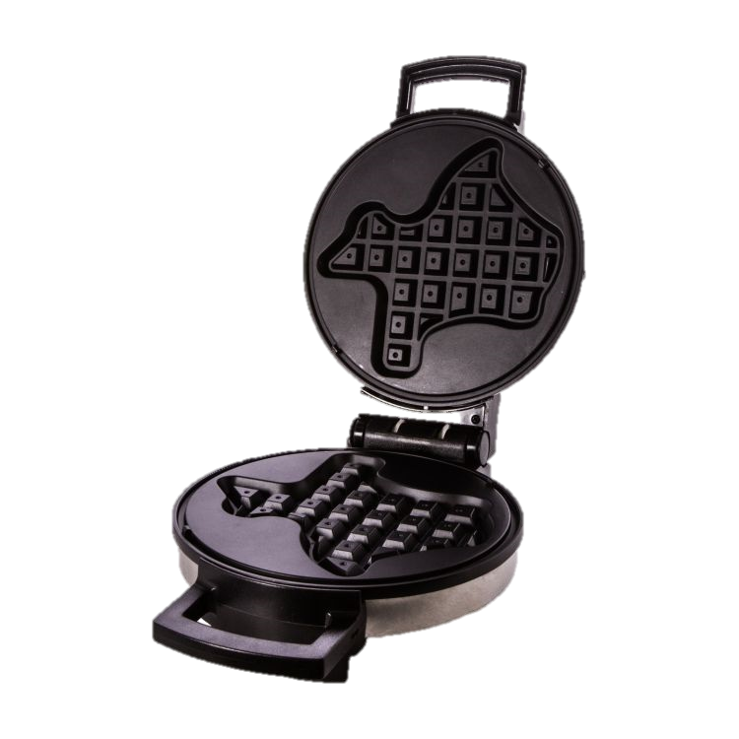

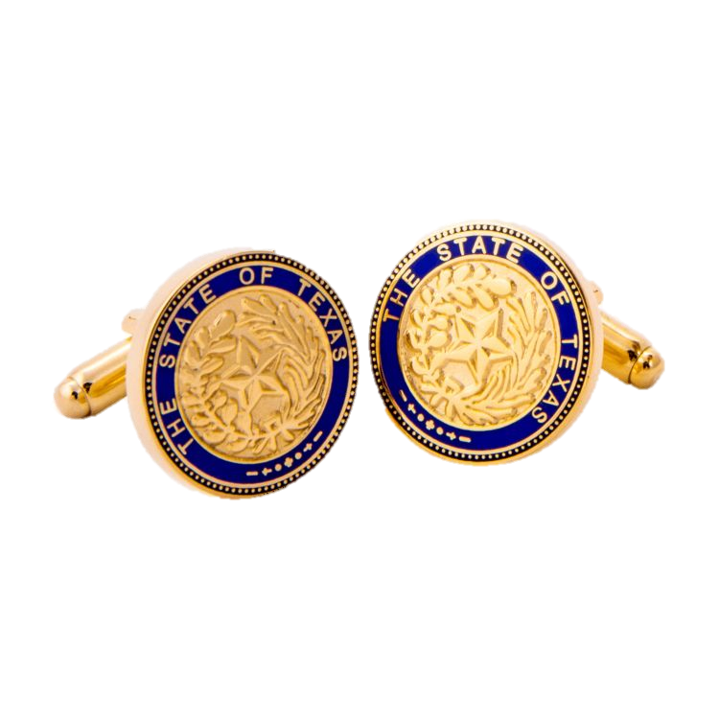




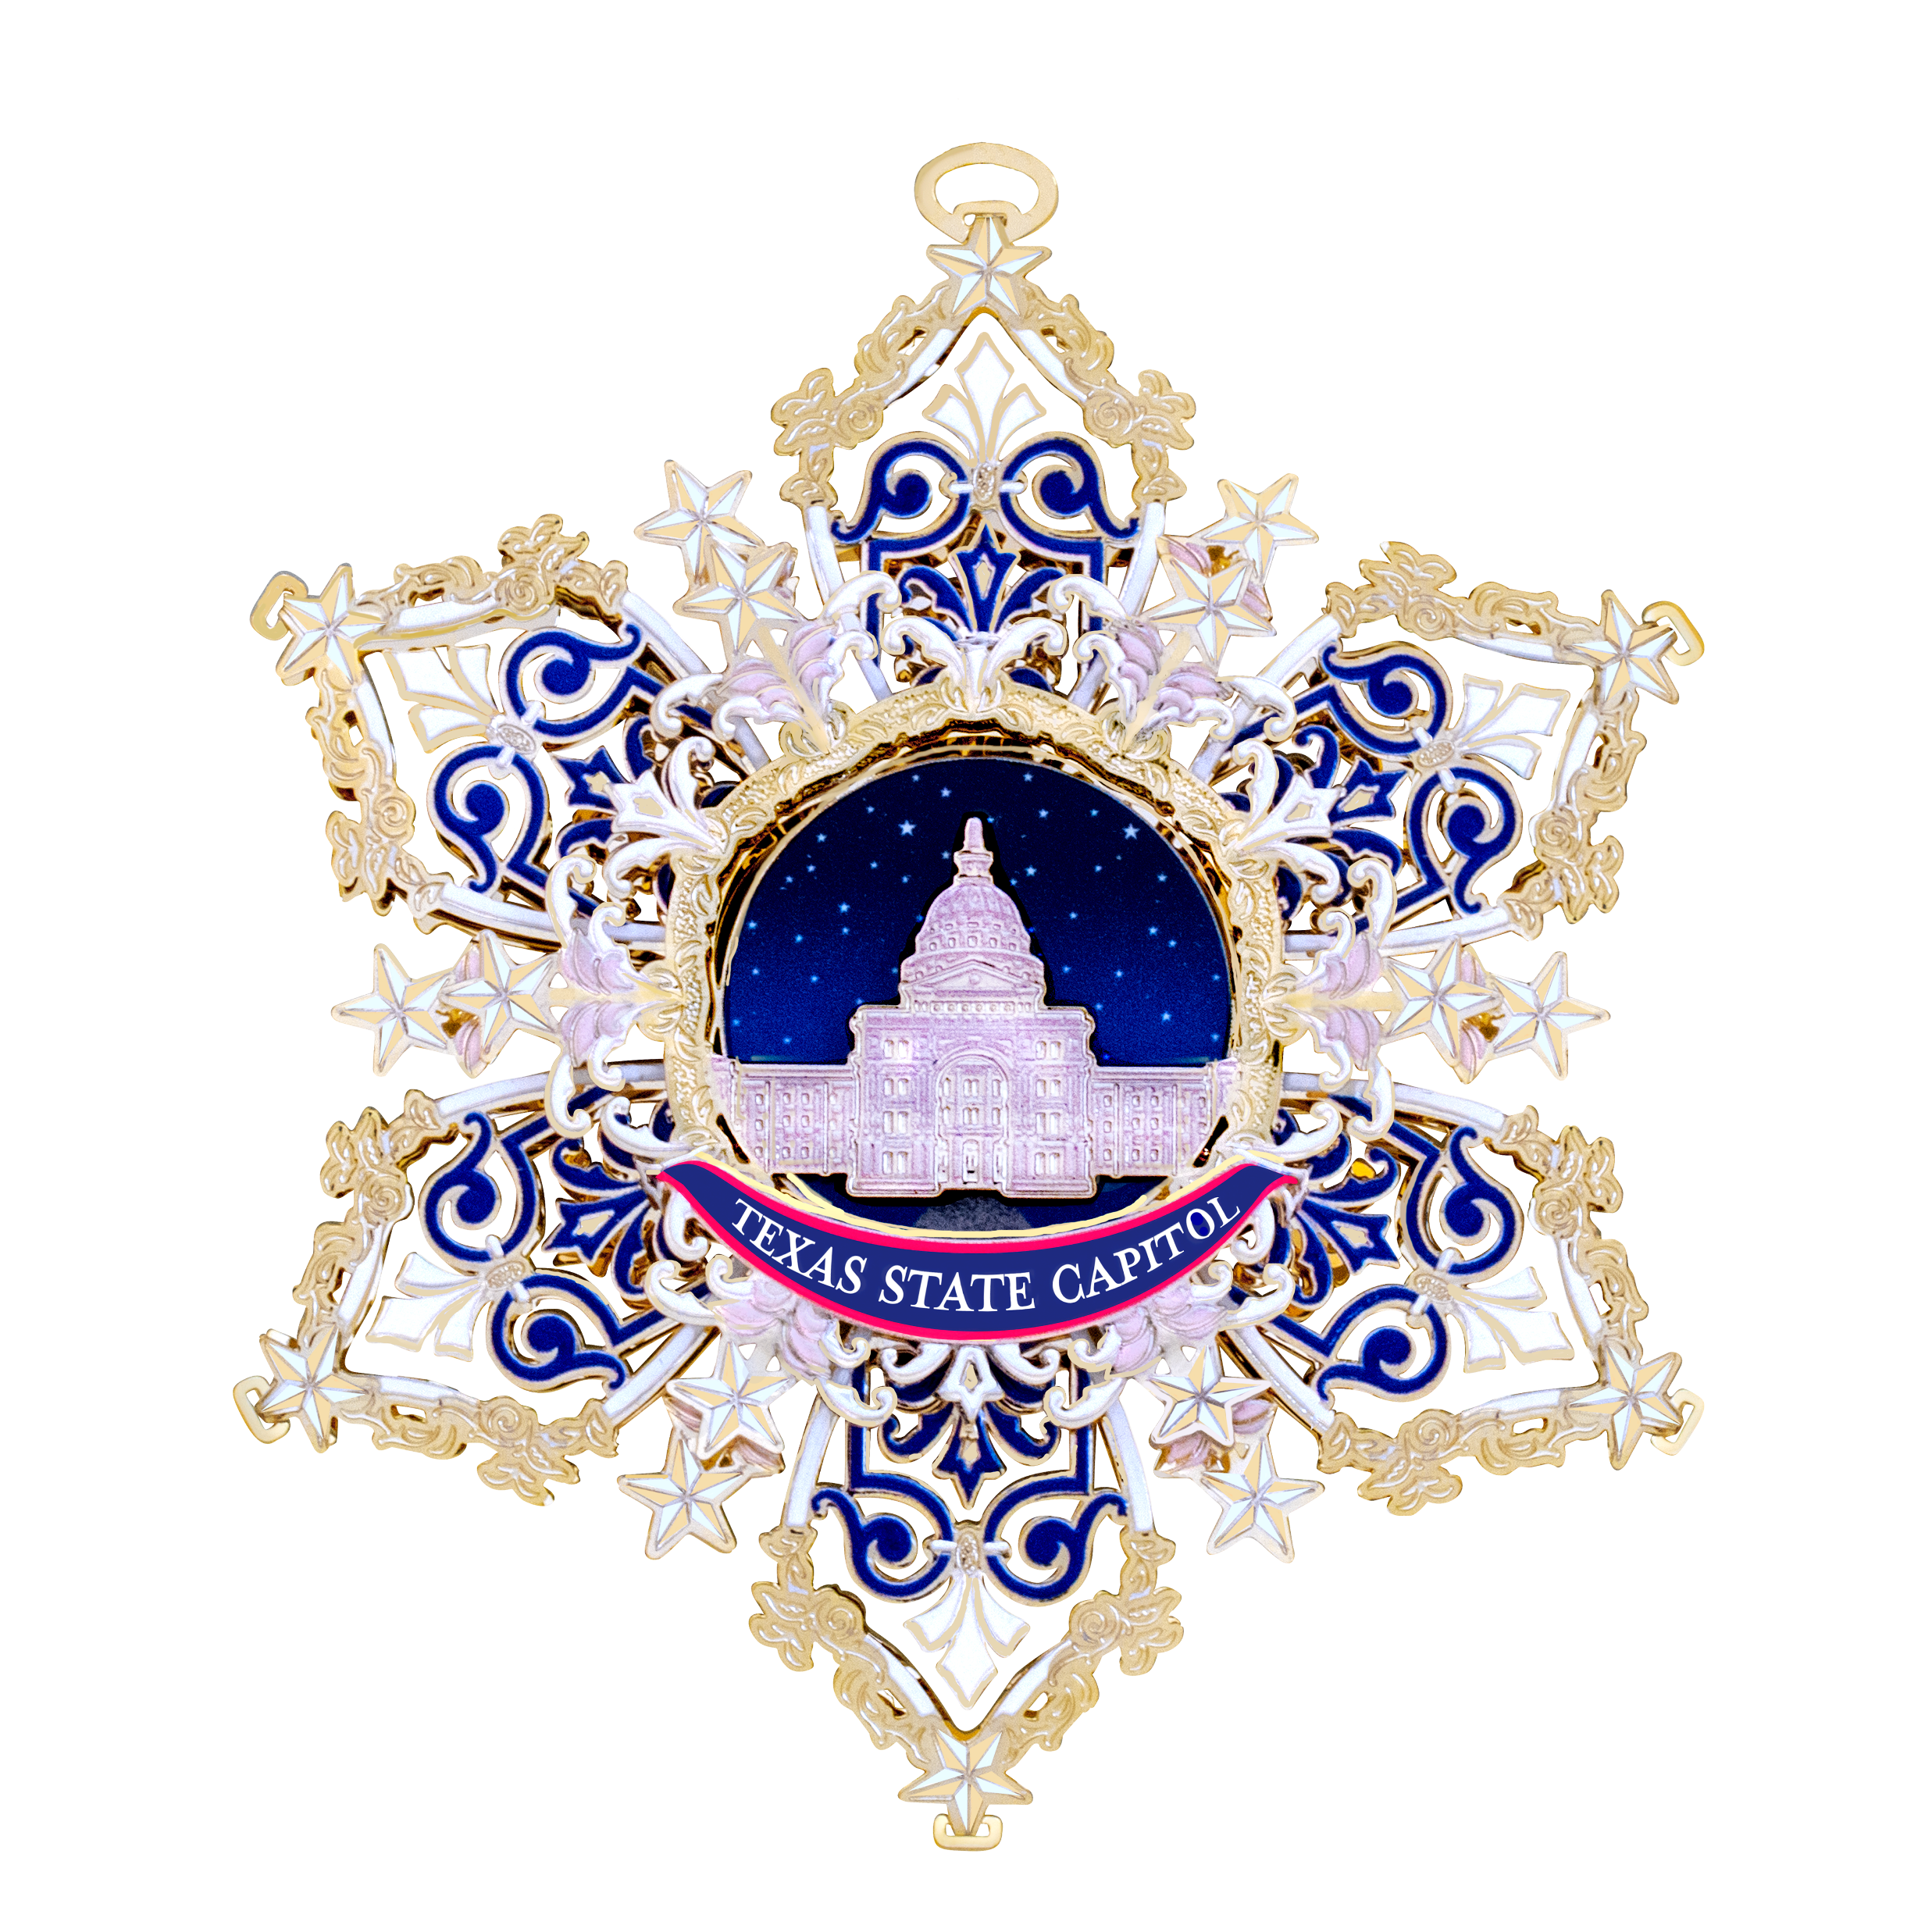
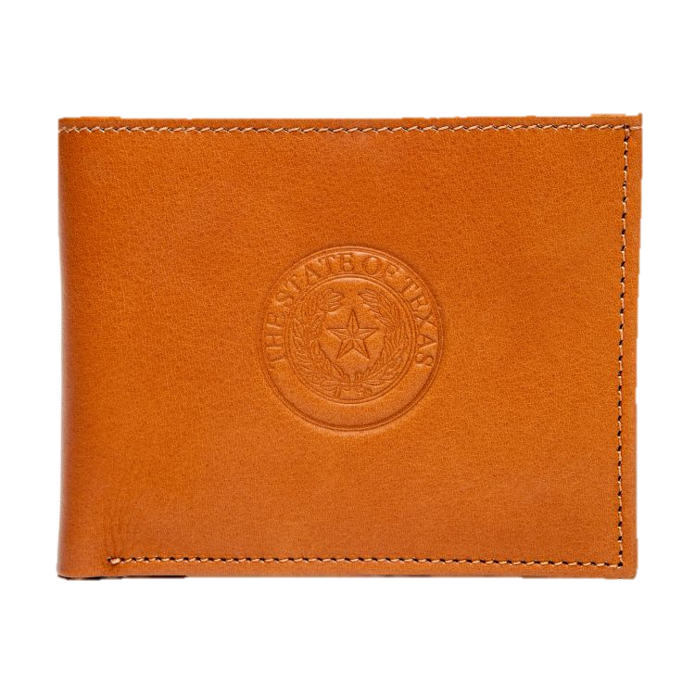

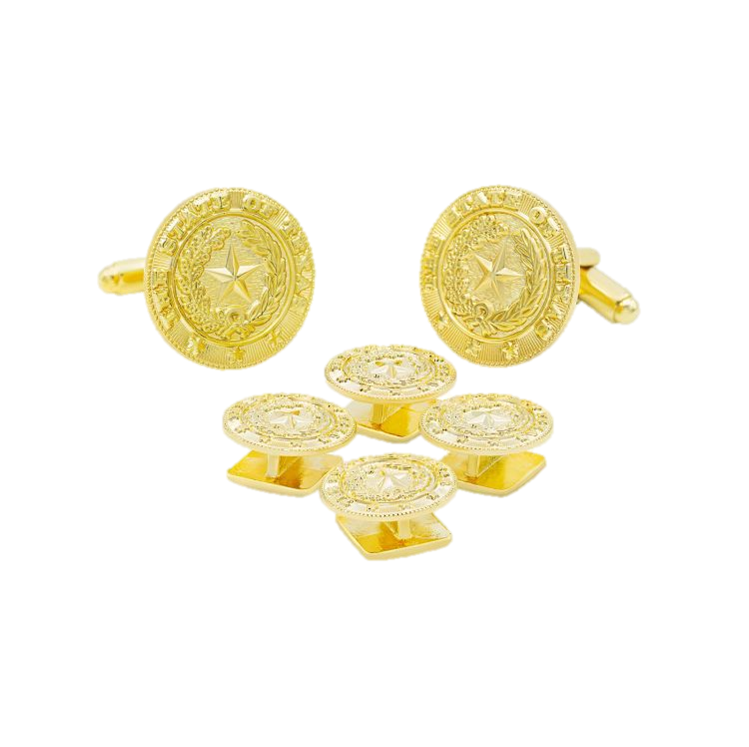
25 Year Awards

Slide 22
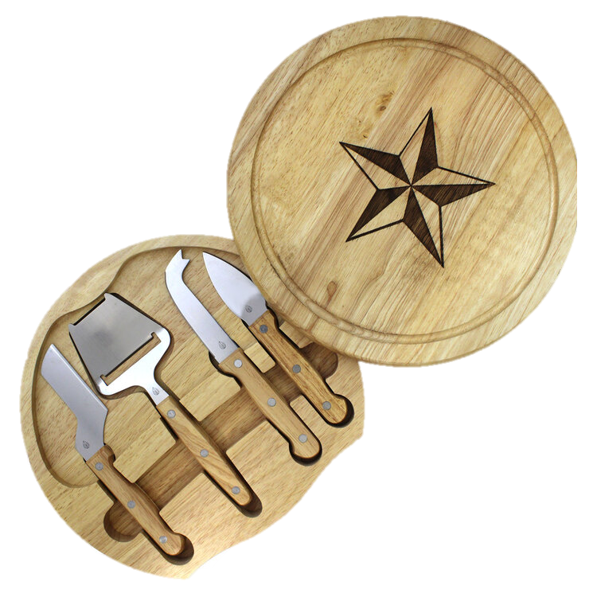
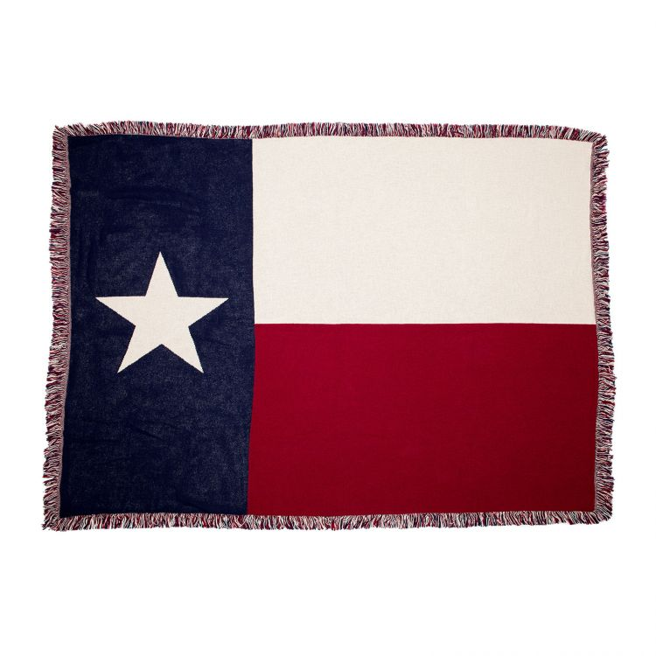
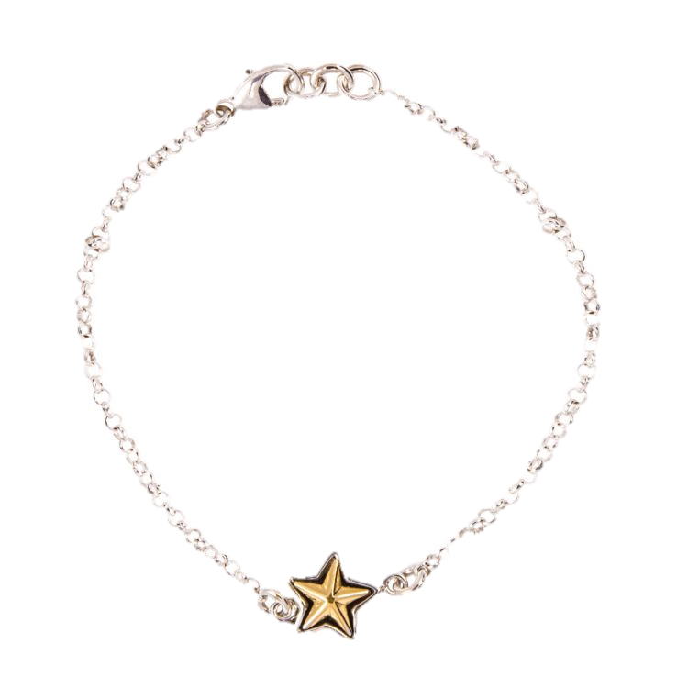
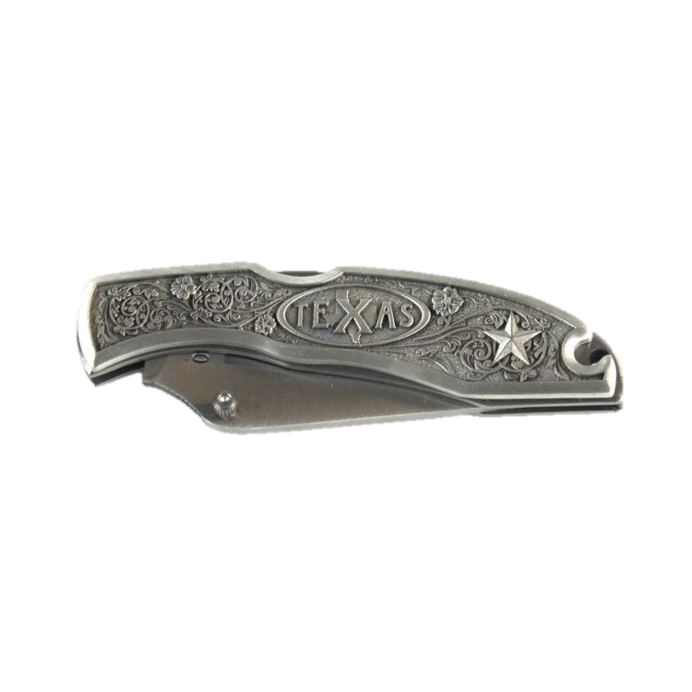
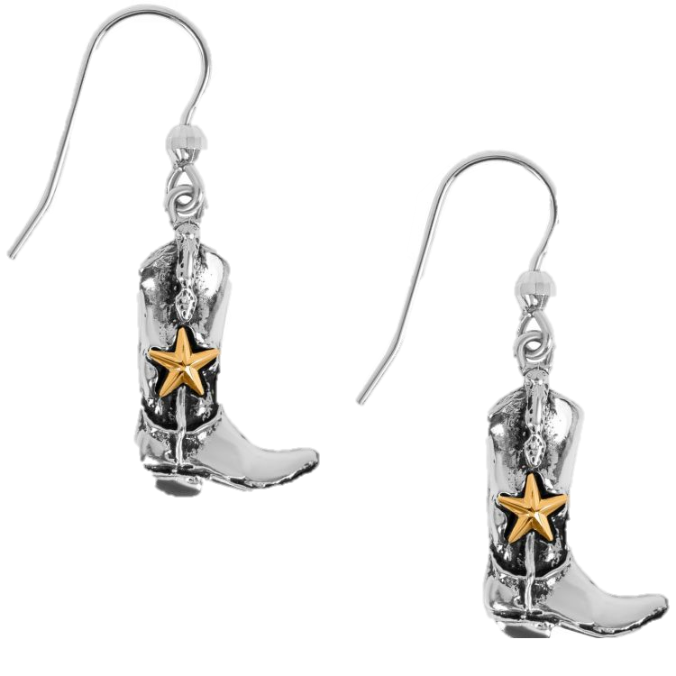
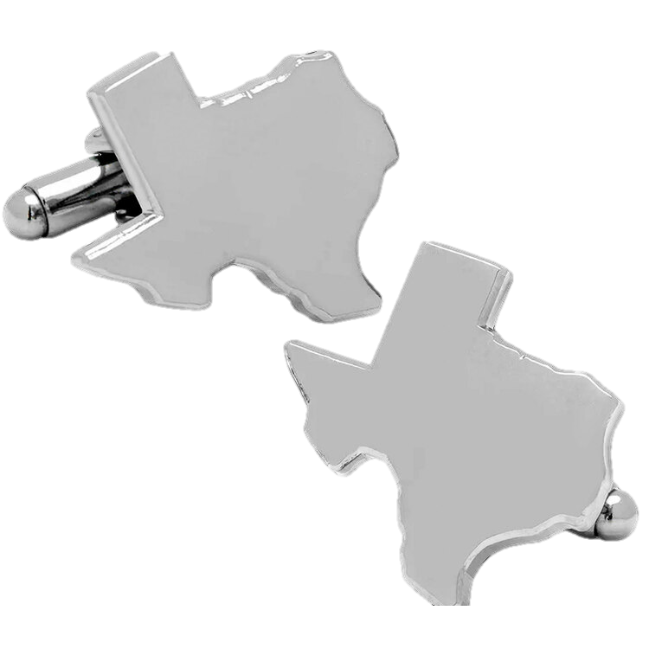
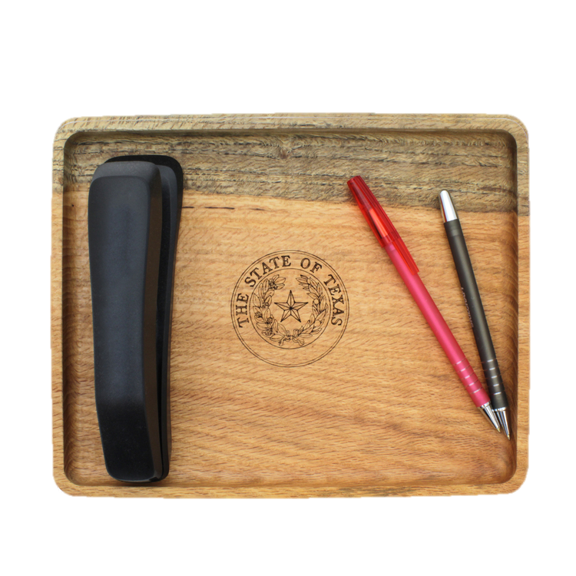
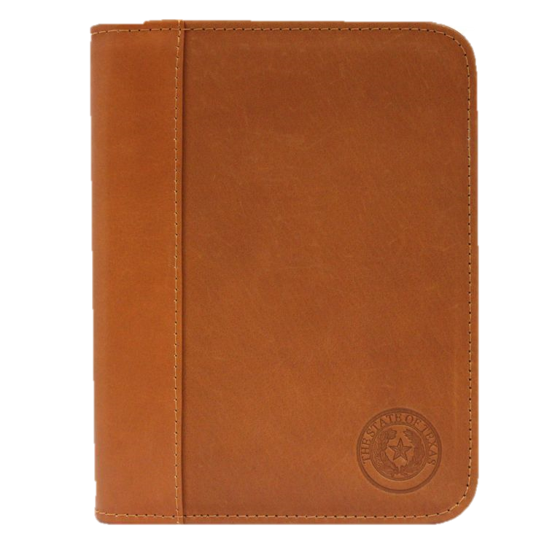
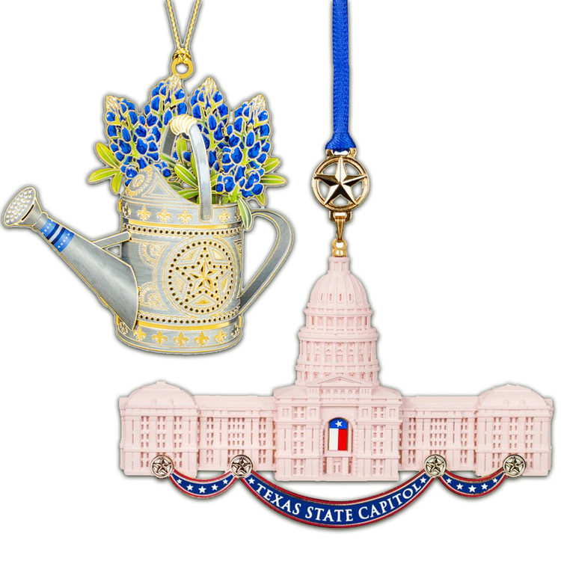
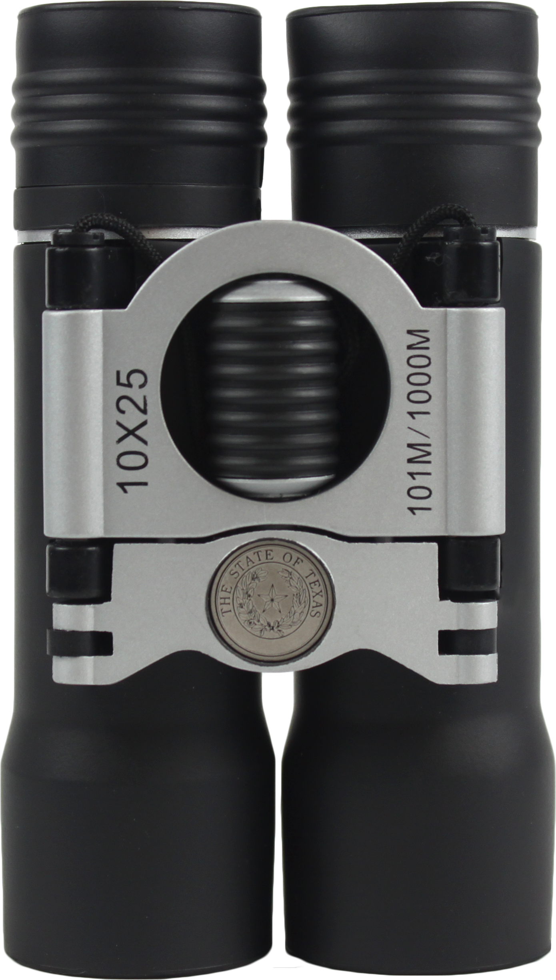
30+ Year Awards

Slide 23
Customized Branded Awards
Create a recognition program that reflects your agency's identity at every service milestone.
🎨 Agency Branding
Develop awards that incorporate your agency’s identity and branding
🏅 Available Across Award Tiers
Customized branded award can be developed for each service award tier
🤝 Collaborative Design
Our team works with your agency to develop branded award options that align with your recognition goals
Whether you're interested in a single branded award or a complete collection across all service milestones, we'll work with you to explore a customized recognition program.

Slide 24






CUSTOM AWARD EXAMPLES

Slide 25

Celebrating a Career of Service
Customized retirement recognition designed to honor a lifetime of dedication.
🎨 Agency Branding
🖌️ Personalized Design
🏆 Lasting Keepsake
Retirement isn’t just a milestone; it’s the celebration of a career dedicated to serving Texas.

Slide 26

Every award purchased helps preserve Texas history and educational projects at the State Capitol and Bullock State History Museum
Texas Capitol
Governor's Mansion
Bullock Museum
Texas State Cemetery

Slide 27

Thank You
Recognizing Texas Employees. Preserving Texas History!
Jarred Cantu
Texas Service Award Facilitator
State Preservation Board
512.463.6228
https://www.txawards.com/

Slide 28

🎁Prize Giveaway!
How to Enter
Leave your business card with me or at the Texas Service Awards booth
Don’t have a business card? No problem! Simply leave name, agency, email address, and phone number at our booth
The winner will be announced following the final presentation of the conference
MUST BE PRESENT TO WIN!

