Slide 1


HUMAN ARCHITECTURE LAB
What Silence in the Room
Is Really Telling You
Why talented people hold back — and what leaders can do about it.
Daniel Cianci | Founder, Human Architecture Lab

Slide 2


Slide 3

WHY DOES IT HAPPEN?

Slide 4



THEY DON’T CARE

Slide 5


Slide 6
When fear takes over in leaders, it often becomes control

Slide 7
When fear takes over in team members, it often becomes silence

Slide 8
WHAT IS SILENCE PROTECTING?

Slide 9


Slide 10


Slide 11
HOW CAN WE CHANGE THE ROOM?

Slide 12
Psychological safety is what people believe will happen after they take a risk.

Slide 13


Slide 14
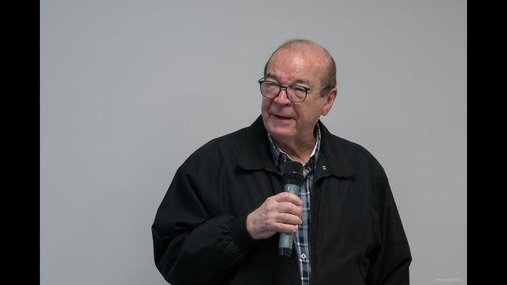

Slide 15
Leadership is communicating someone else’s worth so clearly that they are inspired to see it in themselves
~ Stephen R. Covey

Slide 16
Ask, Assess, Applaud

Slide 17
Your team’s best ideas may not be missing.
They may be waiting for a safer room.

Slide 18

HUMAN ARCHITECTURE LAB
What Silence in the Room
Is Really Telling You
Why talented people hold back — and what leaders can do about it.
Daniel Cianci | Founder, Human Architecture Lab

